Slide 1
Election Debrief: Jamal Aljahmi's Win
Detailed precinct performance and overall comparison

Slide 2
Precinct-wise Performance of Jamal Aljahmi
This slide summarizes Jamal's votes and percentages by precinct.
nan: 538 votes (0.4995357474%)
nan: 456 votes (0.4342857143%)
nan: 558 votes (0.3755047106%)
nan: 274 votes (0.3784530387%)
nan: 268 votes (0.3316831683%)
nan: 525 votes (0.4441624365%)
nan: 663 votes (0.4443699732%)
nan: 422 votes (0.4451476793%)
nan: 402 votes (0.4072948328%)
nan: 370 votes (0.4282407407%)
nan: 391 votes (0.4774114774%)
nan: 448 votes (0.4270734032%)
nan: 24 votes (0.05309734513%)
nan: 600 votes (0.5093378608%)
nan: 502 votes (0.4411247803%)
nan: 489 votes (0.3490364026%)
nan: 789 votes (0.4959145192%)
nan: 485 votes (0.5187165775%)
nan: 486 votes (0.6932952924%)
nan: 641 votes (0.7082872928%)
nan: 219 votes (0.2734082397%)
nan: 252 votes (0.2411483254%)
nan: 45 votes (0.0444225074%)
nan: 228 votes (0.1365269461%)
nan: 250 votes (0.1529051988%)
nan: 164 votes (0.1120218579%)
nan: 102 votes (0.1100323625%)
nan: 88 votes (0.1010332951%)
nan: 105 votes (0.118510158%)
nan: 250 votes (0.1609787508%)
nan: 232 votes (0.1646557842%)
nan: 162 votes (0.1108829569%)
nan: 148 votes (0.1022805805%)
nan: 106 votes (0.09481216458%)
nan: 81 votes (0.07155477032%)
nan: 175 votes (0.1102015113%)
nan: 137 votes (0.08995403808%)
nan: 192 votes (0.1532322426%)
nan: 150 votes (0.09433962264%)
nan: 114 votes (0.09507923269%)
nan: 163 votes (0.1125690608%)
nan: 92 votes (0.0564071122%)
nan: 130 votes (0.07733491969%)
nan: 179 votes (0.1145966709%)
nan: 97 votes (0.08144416457%)
nan: 92 votes (0.09181636727%)
nan: 171 votes (0.1105365223%)
nan: 151 votes (0.1098981077%)

Slide 3
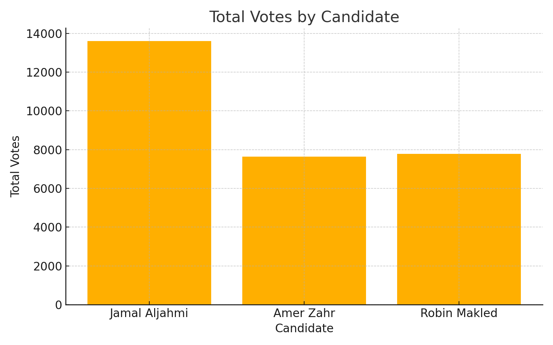
Voting Category Breakdown for Jamal Aljahmi
Comparison of Jamal's performance across Early Voting, Election Day, and Absentee voting.

