Slide 1
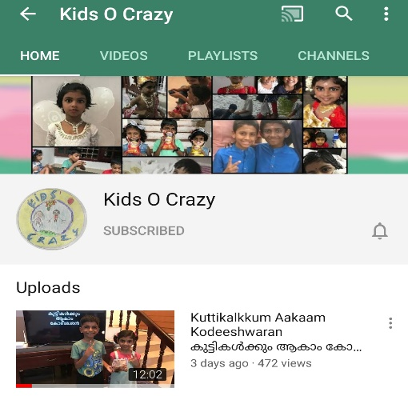
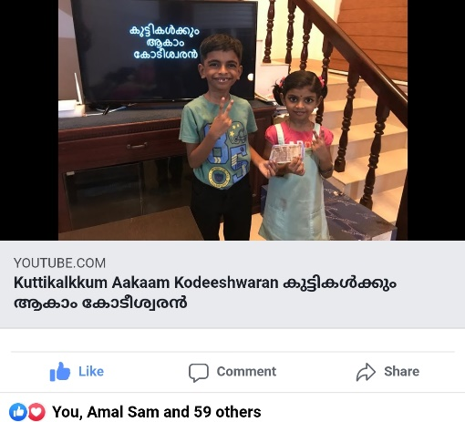
കുട്ടികൾക്കും ആകാം കോടീശ്വരൻ
Click to see the video
Click to go to the channel

Slide 2



Episode - X
12 | 110
11 | 100
10 | 90
9 | 80
8 | 70
7 | 60
6 | 50
5 | 40
4 | 30
3 | 20
2 | 10
1 | 5
Topic - XXXX
Age Group – 4 to 10
12 Questions, 4 Lifelines

Slide 3












Edit here to add question
A:
B:
C:
D:

Slide 4
12 | 110
11 | 100
10 | 90
9 | 80
8 | 70
7 | 60
6 | 50
5 | 40
4 | 30
3 | 20
2 | 10
1 | 5

Slide 5
Edit here to add question
A:
B:
C:
D:

Slide 6
12 | 110
11 | 100
10 | 90
9 | 80
8 | 70
7 | 60
6 | 50
5 | 40
4 | 30
3 | 20
2 | 10
1 | 5

Slide 7
Edit here to add question
A:
B:
C:
D:

Slide 8
12 | 110
11 | 100
10 | 90
9 | 80
8 | 70
7 | 60
6 | 50
5 | 40
4 | 30
3 | 20
2 | 10
1 | 5

Slide 9
Edit here to add question
A:
B:
C:
D:

Slide 10
12 | 110
11 | 100
10 | 90
9 | 80
8 | 70
7 | 60
6 | 50
5 | 40
4 | 30
3 | 20
2 | 10
1 | 5

Slide 11
Edit here to add question
A:
B:
C:
D:

Slide 12
12 | 110
11 | 100
10 | 90
9 | 80
8 | 70
7 | 60
6 | 50
5 | 40
4 | 30
3 | 20
2 | 10
1 | 5

Slide 13
Edit here to add question
A:
B:
C:
D:

Slide 14
12 | 110
11 | 100
10 | 90
9 | 80
8 | 70
7 | 60
6 | 50
5 | 40
4 | 30
3 | 20
2 | 10
1 | 5

Slide 15
Edit here to add question
A:
B:
C:
D:

Slide 16
12 | 110
11 | 100
10 | 90
9 | 80
8 | 70
7 | 60
6 | 50
5 | 40
4 | 30
3 | 20
2 | 10
1 | 5

Slide 17
Edit here to add question
A:
B:
C:
D:

Slide 18
12 | 110
11 | 100
10 | 90
9 | 80
8 | 70
7 | 60
6 | 50
5 | 40
4 | 30
3 | 20
2 | 10
1 | 5

Slide 19
Edit here to add question
A:
B:
C:
D:

Slide 20
12 | 110
11 | 100
10 | 90
9 | 80
8 | 70
7 | 60
6 | 50
5 | 40
4 | 30
3 | 20
2 | 10
1 | 5

Slide 21
Edit here to add question
A:
B:
C:
D:

Slide 22
12 | 110
11 | 100
10 | 90
9 | 80
8 | 70
7 | 60
6 | 50
5 | 40
4 | 30
3 | 20
2 | 10
1 | 5

Slide 23
Edit here to add question
A:
B:
C:
D:

Slide 24
12 | 110
11 | 100
10 | 90
9 | 80
8 | 70
7 | 60
6 | 50
5 | 40
4 | 30
3 | 20
2 | 10
1 | 5

Slide 25
Edit here to add question
A:
B:
C:
D:

Slide 26
12 | 110
11 | 100
10 | 90
9 | 80
8 | 70
7 | 60
6 | 50
5 | 40
4 | 30
3 | 20
2 | 10
1 | 5

Slide 27
Answers
12
11
10
9
8
7
6
5
4
3
2
1

