Slide 1
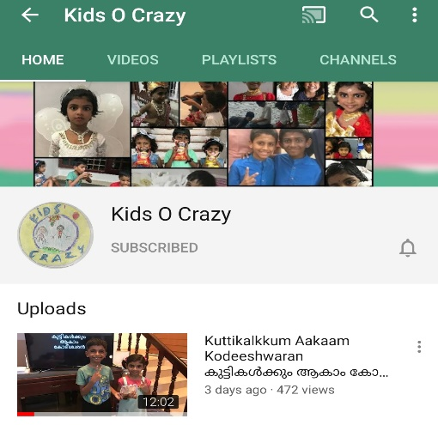
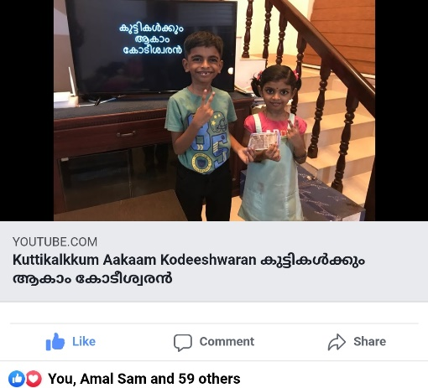
കുട്ടികൾക്കും ആകാം കോടീശ്വരൻ
Click to see the video
Click to go to the channel

Slide 2

Episode - 1
12 | 110
11 | 100
10 | 90
9 | 80
8 | 70
7 | 60
6 | 50
5 | 40
4 | 30
3 | 20
2 | 10
1 | 5
Topic – Our Country
Age Group – 7 to 14
12 Questions, 3 Lifelines

Slide 3












Which is our Country?
A: India
B: Chalakudy
C: Kerala
D: Dubai

Slide 4
12 | 110
11 | 100
10 | 90
9 | 80
8 | 70
7 | 60
6 | 50
5 | 40
4 | 30
3 | 20
2 | 10
1 | 5

Slide 5
Which is of our national flower?
A: Jasmine
B: Lilly
C: Sunflower
D: Lotus

Slide 6
12 | 110
11 | 100
10 | 90
9 | 80
8 | 70
7 | 60
6 | 50
5 | 40
4 | 30
3 | 20
2 | 10
1 | 5

Slide 7
What is our National Animal?
A: Girraffe
B: Lion
C: Tiger
D: Elephant

Slide 8
12 | 110
11 | 100
10 | 90
9 | 80
8 | 70
7 | 60
6 | 50
5 | 40
4 | 30
3 | 20
2 | 10
1 | 5

Slide 9
Which is of our state?
A: Thiruvananthapuram
B: Kerala
C: Delhi
D: Mumbai

Slide 10
12 | 110
11 | 100
10 | 90
9 | 80
8 | 70
7 | 60
6 | 50
5 | 40
4 | 30
3 | 20
2 | 10
1 | 5

Slide 11
How many colours in our national flag?
A: 2
B: 5
C: 4
D: 3

Slide 12
12 | 110
11 | 100
10 | 90
9 | 80
8 | 70
7 | 60
6 | 50
5 | 40
4 | 30
3 | 20
2 | 10
1 | 5

Slide 13
Prime Minister of India?
A: Mahatma Gandhi
B: Narendra Modi
C: Amit Shah
D: Jawahar Lal Nehru

Slide 14
12 | 110
11 | 100
10 | 90
9 | 80
8 | 70
7 | 60
6 | 50
5 | 40
4 | 30
3 | 20
2 | 10
1 | 5

Slide 15
What is colour of Indian Passport?
A: White
B: Blue
C: Red
D: Yellow

Slide 16
12 | 110
11 | 100
10 | 90
9 | 80
8 | 70
7 | 60
6 | 50
5 | 40
4 | 30
3 | 20
2 | 10
1 | 5

Slide 17
What is Capital of India?
A: Mumbai
B: Chennai
C: Calcutta
D: Delhi

Slide 18
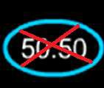
12 | 110
11 | 100
10 | 90
9 | 80
8 | 70
7 | 60
6 | 50
5 | 40
4 | 30
3 | 20
2 | 10
1 | 5

Slide 19
When did India got Independence?
A: 2000
B: 1947
C: 1900
D: 1995

Slide 20
12 | 110
11 | 100
10 | 90
9 | 80
8 | 70
7 | 60
6 | 50
5 | 40
4 | 30
3 | 20
2 | 10
1 | 5

Slide 21
Independence day is celebrated on?
A: 1st May
B: 26th January
C: 2nd October
D: 15th August

Slide 22
12 | 110
11 | 100
10 | 90
9 | 80
8 | 70
7 | 60
6 | 50
5 | 40
4 | 30
3 | 20
2 | 10
1 | 5

Slide 23
Who is Father of our Nation?
A: Jawahar Lal Nehru
B: Mahatma Gandhi
C: Sardar Patel
D: Subash Chandra Bose

Slide 24
12 | 110
11 | 100
10 | 90
9 | 80
8 | 70
7 | 60
6 | 50
5 | 40
4 | 30
3 | 20
2 | 10
1 | 5

Slide 25
What is the name of INDIAN currency ?
A:
Dollar
B:
Rupee
C:
Euro
D:
Dinar

Slide 26
12 | 110
11 | 100
10 | 90
9 | 80
8 | 70
7 | 60
6 | 50
5 | 40
4 | 30
3 | 20
2 | 10
1 | 5

Slide 27
Answers
12 | B
11 | B
10 | D
9 | B
8 | D
7 | B
6 | B
5 | C
4 | B
3 | C
2 | D
1 | A

