Slide 1
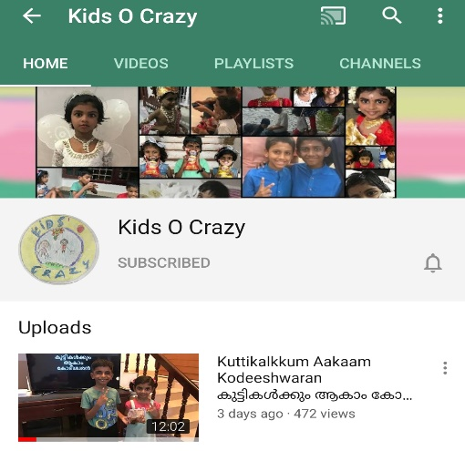
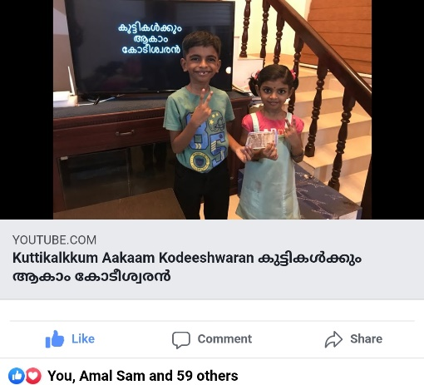
കുട്ടികൾക്കും ആകാം കോടീശ്വരൻ
Click to see the video
Click to go to the channel

Slide 2

Episode - 2
12 | 110
11 | 100
10 | 90
9 | 80
8 | 70
7 | 60
6 | 50
5 | 40
4 | 30
3 | 20
2 | 10
1 | 5
Topic – Our Country
Age Group – 4 to 10
12 Questions, 3 Lifelines

Slide 3












Which is not an Ocean?
A: Antarctic
B: Arabian Sea
C: Arctic
D: Pacific

Slide 4
12 | 110
11 | 100
10 | 90
9 | 80
8 | 70
7 | 60
6 | 50
5 | 40
4 | 30
3 | 20
2 | 10
1 | 5

Slide 5
Which of the following country have dollar as currency?
A:
China
B:
USA
C:
UAE
D:
India

Slide 6
12 | 110
11 | 100
10 | 90
9 | 80
8 | 70
7 | 60
6 | 50
5 | 40
4 | 30
3 | 20
2 | 10
1 | 5

Slide 7
London is the capital of which country?
A: UK
B: UAE
C: India
D: Oman

Slide 8
12 | 110
11 | 100
10 | 90
9 | 80
8 | 70
7 | 60
6 | 50
5 | 40
4 | 30
3 | 20
2 | 10
1 | 5

Slide 9
How many continents in the world?
A: 2
B: 7
C: 14
D: 30

Slide 10
12 | 110
11 | 100
10 | 90
9 | 80
8 | 70
7 | 60
6 | 50
5 | 40
4 | 30
3 | 20
2 | 10
1 | 5

Slide 11
Largest country in the world?
A: India
B: Russia
C: USA
D: China

Slide 12
12 | 110
11 | 100
10 | 90
9 | 80
8 | 70
7 | 60
6 | 50
5 | 40
4 | 30
3 | 20
2 | 10
1 | 5

Slide 13
Which country have ISD code +91?
A: South Africa
B: Zimbabwe
C: India
D: Australia

Slide 14
12 | 110
11 | 100
10 | 90
9 | 80
8 | 70
7 | 60
6 | 50
5 | 40
4 | 30
3 | 20
2 | 10
1 | 5

Slide 15
How many Oceans in the world?
A: 2
B: 10
C: 4
D: 8

Slide 16
12 | 110
11 | 100
10 | 90
9 | 80
8 | 70
7 | 60
6 | 50
5 | 40
4 | 30
3 | 20
2 | 10
1 | 5

Slide 17
Which water body is not near to India ?
A: Caspian Sea
B: Arabian Sea
C: Indian ocean
D: Bay of Bengal

Slide 18
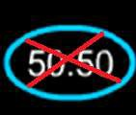
12 | 110
11 | 100
10 | 90
9 | 80
8 | 70
7 | 60
6 | 50
5 | 40
4 | 30
3 | 20
2 | 10
1 | 5

Slide 19
Highest populated country in the world?
A: Russia
B: China
C: Brazil
D: USA

Slide 20
12 | 110
11 | 100
10 | 90
9 | 80
8 | 70
7 | 60
6 | 50
5 | 40
4 | 30
3 | 20
2 | 10
1 | 5

Slide 21
Which of the country will have earliest New Year every year?
A: India
B: USA
C: Japan
D: UK

Slide 22
12 | 110
11 | 100
10 | 90
9 | 80
8 | 70
7 | 60
6 | 50
5 | 40
4 | 30
3 | 20
2 | 10
1 | 5

Slide 23
Which country is a neighbor of India
A: Dubai
B: UK
C: USA
D: Pakistan

Slide 24
12 | 110
11 | 100
10 | 90
9 | 80
8 | 70
7 | 60
6 | 50
5 | 40
4 | 30
3 | 20
2 | 10
1 | 5

Slide 25
What is – land surrounded by water on all side called as?
A: Archipelago
B: Island
C: Strait
D: Peak

Slide 26
12 | 110
11 | 100
10 | 90
9 | 80
8 | 70
7 | 60
6 | 50
5 | 40
4 | 30
3 | 20
2 | 10
1 | 5

Slide 27
Answers
12 | B
11 | D
10 | C
9 | B
8 | A
7 | C
6 | C
5 | B
4 | B
3 | A
2 | B
1 | B

