Slide 1
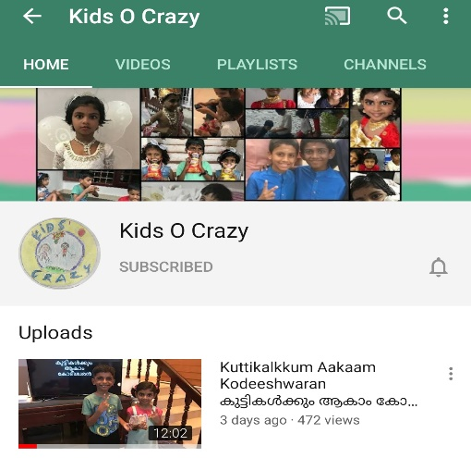
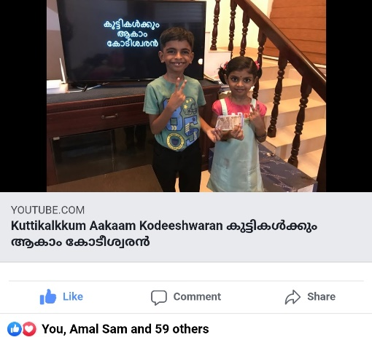
കുട്ടികൾക്കും ആകാം കോടീശ്വരൻ
Click to see the video
Click to go to the channel

Slide 2

Episode - 3
12 | 110
11 | 100
10 | 90
9 | 80
8 | 70
7 | 60
6 | 50
5 | 40
4 | 30
3 | 20
2 | 10
1 | 5
Topic – Solar System
Age Group – 7 to 14
12 Questions, 3 Lifelines

Slide 3












How many planets in Solar System?
A: 7
B: 9
C: 4
D: 11

Slide 4
12 | 110
11 | 100
10 | 90
9 | 80
8 | 70
7 | 60
6 | 50
5 | 40
4 | 30
3 | 20
2 | 10
1 | 5

Slide 5
Moon is a natural _______ of Earth?
A: Satellite
B: Planet
C: Comet
D: Star

Slide 6
12 | 110
11 | 100
10 | 90
9 | 80
8 | 70
7 | 60
6 | 50
5 | 40
4 | 30
3 | 20
2 | 10
1 | 5

Slide 7
Which is the largest plant in solar system
A: Neptune
B: Saturn
C: Jupiter
D: Mars

Slide 8
12 | 110
11 | 100
10 | 90
9 | 80
8 | 70
7 | 60
6 | 50
5 | 40
4 | 30
3 | 20
2 | 10
1 | 5

Slide 9
Which is the nearest planet to earth?
A: Jupiter
B: Mercury
C: Mars
D: Saturn

Slide 10
12 | 110
11 | 100
10 | 90
9 | 80
8 | 70
7 | 60
6 | 50
5 | 40
4 | 30
3 | 20
2 | 10
1 | 5

Slide 11
Which is the closest star to earth?
A: Saturn
B: Sun
C: Titan
D: Proxima Centuri

Slide 12
12 | 110
11 | 100
10 | 90
9 | 80
8 | 70
7 | 60
6 | 50
5 | 40
4 | 30
3 | 20
2 | 10
1 | 5

Slide 13
Which is the organization in India to study about space?
A: BARC
B: ISRO
C: TIFR
D: NTPC

Slide 14
12 | 110
11 | 100
10 | 90
9 | 80
8 | 70
7 | 60
6 | 50
5 | 40
4 | 30
3 | 20
2 | 10
1 | 5

Slide 15
Which of the following is a comet?
A: Jupiter
B: Haley’s
C: Moon
D: Mercury

Slide 16
12 | 110
11 | 100
10 | 90
9 | 80
8 | 70
7 | 60
6 | 50
5 | 40
4 | 30
3 | 20
2 | 10
1 | 5

Slide 17
What is India’s mission to Moon called as ?
A: Apollo
B: Path finder
C: Chandrayan
D: Pariveshan

Slide 18

12 | 110
11 | 100
10 | 90
9 | 80
8 | 70
7 | 60
6 | 50
5 | 40
4 | 30
3 | 20
2 | 10
1 | 5

Slide 19
What is believed to be origin of universe ?
A:
Super Nova
B:
White Dwarf
C:
Black hole
D:
Big Bang

Slide 20
12 | 110
11 | 100
10 | 90
9 | 80
8 | 70
7 | 60
6 | 50
5 | 40
4 | 30
3 | 20
2 | 10
1 | 5

Slide 21
Which is our Galaxy?
A: SkyLab
B: Atlantis
C: Milkyway
D: Naveda

Slide 22
12 | 110
11 | 100
10 | 90
9 | 80
8 | 70
7 | 60
6 | 50
5 | 40
4 | 30
3 | 20
2 | 10
1 | 5

Slide 23
Who was the first Indian to go into space?
A: Bachendri Pal
B: Kalpana Chawla
C: Rakesh Sharma
D: Sunitha Williams

Slide 24
12 | 110
11 | 100
10 | 90
9 | 80
8 | 70
7 | 60
6 | 50
5 | 40
4 | 30
3 | 20
2 | 10
1 | 5

Slide 25
What is ‘Hubble’ famous for in space research & technology?
A: As Space Lab
B: As Rocket
C: As Satellite
D: As Telescope

Slide 26
12 | 110
11 | 100
10 | 90
9 | 80
8 | 70
7 | 60
6 | 50
5 | 40
4 | 30
3 | 20
2 | 10
1 | 5

Slide 27
Answers
12 | D
11 | C
10 | C
9 | D
8 | C
7 | B
6 | B
5 | B
4 | C
3 | C
2 | A
1 | B

