Slide 1

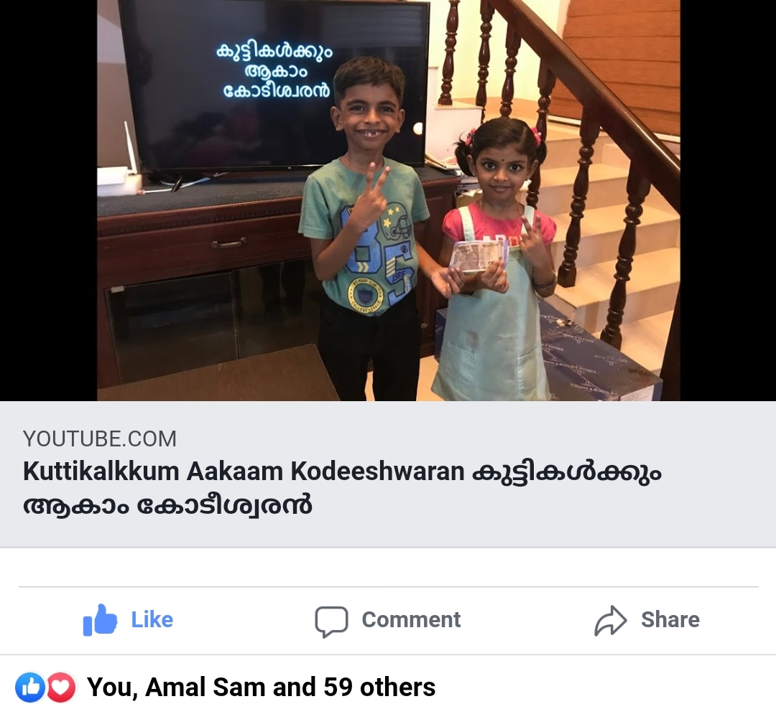
കുട്ടികൾക്കും ആകാം കോടീശ്വരൻ
Click to see the video
Click to go to the channel

Slide 2

Episode - 4
12 | 110
11 | 100
10 | 90
9 | 80
8 | 70
7 | 60
6 | 50
5 | 40
4 | 30
3 | 20
2 | 10
1 | 5
Topic – Space & Technology
Age Group – 7 to 14
12 Questions, 3 Lifelines

Slide 3












Which of the following is space research organization?
A: United Nations
B: NASA
C: NATO
D: WHO

Slide 4
12 | 110
11 | 100
10 | 90
9 | 80
8 | 70
7 | 60
6 | 50
5 | 40
4 | 30
3 | 20
2 | 10
1 | 5

Slide 5
Who was the first person to land on Moon?
A: Edwin Aldrin
B: Niel Armstrong
C: Yuri Gagarin
D: Stephen Fleming

Slide 6
12 | 110
11 | 100
10 | 90
9 | 80
8 | 70
7 | 60
6 | 50
5 | 40
4 | 30
3 | 20
2 | 10
1 | 5

Slide 7
What is India’s mission to Moon called as ?
A: Apollo
B: Path finder
C: Chandrayan
D: Pariveshan

Slide 8
12 | 110
11 | 100
10 | 90
9 | 80
8 | 70
7 | 60
6 | 50
5 | 40
4 | 30
3 | 20
2 | 10
1 | 5

Slide 9
Which planet have a ring around it?
A: Earth
B: Mars
C: Pluto
D: Saturn

Slide 10
12 | 110
11 | 100
10 | 90
9 | 80
8 | 70
7 | 60
6 | 50
5 | 40
4 | 30
3 | 20
2 | 10
1 | 5

Slide 11
Sun is composed of which gases?
A: Hydrogen & Helium
B: Hydrogen & Oxygen
C: Oxygen & Nitrogen
D: Helium & Nitrogen

Slide 12
12 | 110
11 | 100
10 | 90
9 | 80
8 | 70
7 | 60
6 | 50
5 | 40
4 | 30
3 | 20
2 | 10
1 | 5

Slide 13
What does ‘Light Year’ measure?
A: Age for star
B: Distance to star
C: Light intensity of a star
D: Speed of star

Slide 14
12 | 110
11 | 100
10 | 90
9 | 80
8 | 70
7 | 60
6 | 50
5 | 40
4 | 30
3 | 20
2 | 10
1 | 5

Slide 15
What did ‘Rakesh Sharma’ say about India from space on phone to then PM Indira Gandhi?
A:
Chota sa India
B:
Fantastic
C:
Sare Jahan Se Acha
D:
Super small

Slide 16
12 | 110
11 | 100
10 | 90
9 | 80
8 | 70
7 | 60
6 | 50
5 | 40
4 | 30
3 | 20
2 | 10
1 | 5

Slide 17
Which is the largest natural satellite in solar system?
A: Moon
B: Titan
C: Andromeda
D: Venus

Slide 18

12 | 110
11 | 100
10 | 90
9 | 80
8 | 70
7 | 60
6 | 50
5 | 40
4 | 30
3 | 20
2 | 10
1 | 5

Slide 19
Which part of sun is seen as Diamond ring visible during total Solar Eclipse ?
A: Photosphere
B: Atmosphere
C: Core
D: Corona

Slide 20
12 | 110
11 | 100
10 | 90
9 | 80
8 | 70
7 | 60
6 | 50
5 | 40
4 | 30
3 | 20
2 | 10
1 | 5

Slide 21
Which program is a joint project between five space agencies: NASA (United States), Roscosmos (Russia), JAXA (Japan), ESA (Europe), and CSA (Canada).?
A: International Space Station (ISS)
B: Apollo Mission
C: Hubble Telescope
D: Discovery Mission

Slide 22
12 | 110
11 | 100
10 | 90
9 | 80
8 | 70
7 | 60
6 | 50
5 | 40
4 | 30
3 | 20
2 | 10
1 | 5

Slide 23
Which of the following experiment study about ‘Big Bang Theory’?
A: Buddha smiling
B: Atlantis
C: Pathfinder
D: Large Hadron Collider

Slide 24
12 | 110
11 | 100
10 | 90
9 | 80
8 | 70
7 | 60
6 | 50
5 | 40
4 | 30
3 | 20
2 | 10
1 | 5

Slide 25
What is the place where Apollo-11 landed during Moon Mission called as?
A: Bermuda Traingle
B: Islets of Langerhans
C: Sea of Tranquility
D: Dakshin Gangotri

Slide 26
12 | 110
11 | 100
10 | 90
9 | 80
8 | 70
7 | 60
6 | 50
5 | 40
4 | 30
3 | 20
2 | 10
1 | 5

Slide 27
Answers
12 | C
11 | D
10 | A
9 | D
8 | B
7 | C
6 | B
5 | A
4 | D
3 | C
2 | B
1 | B

