Slide 1
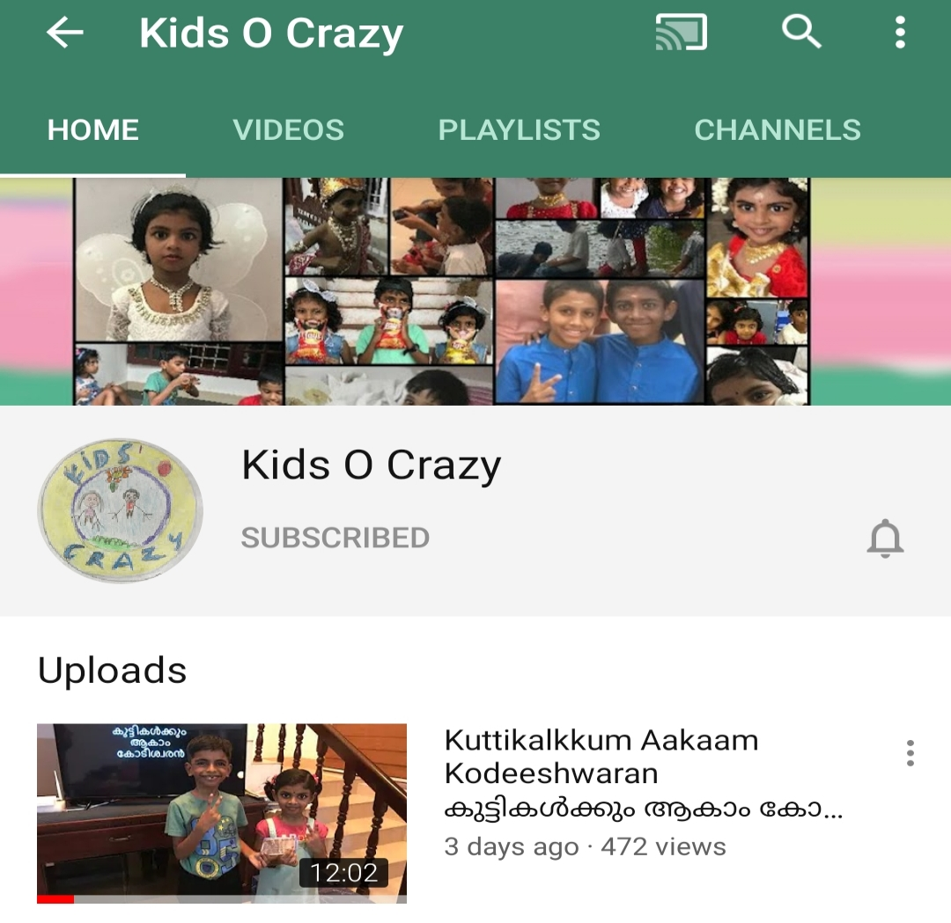
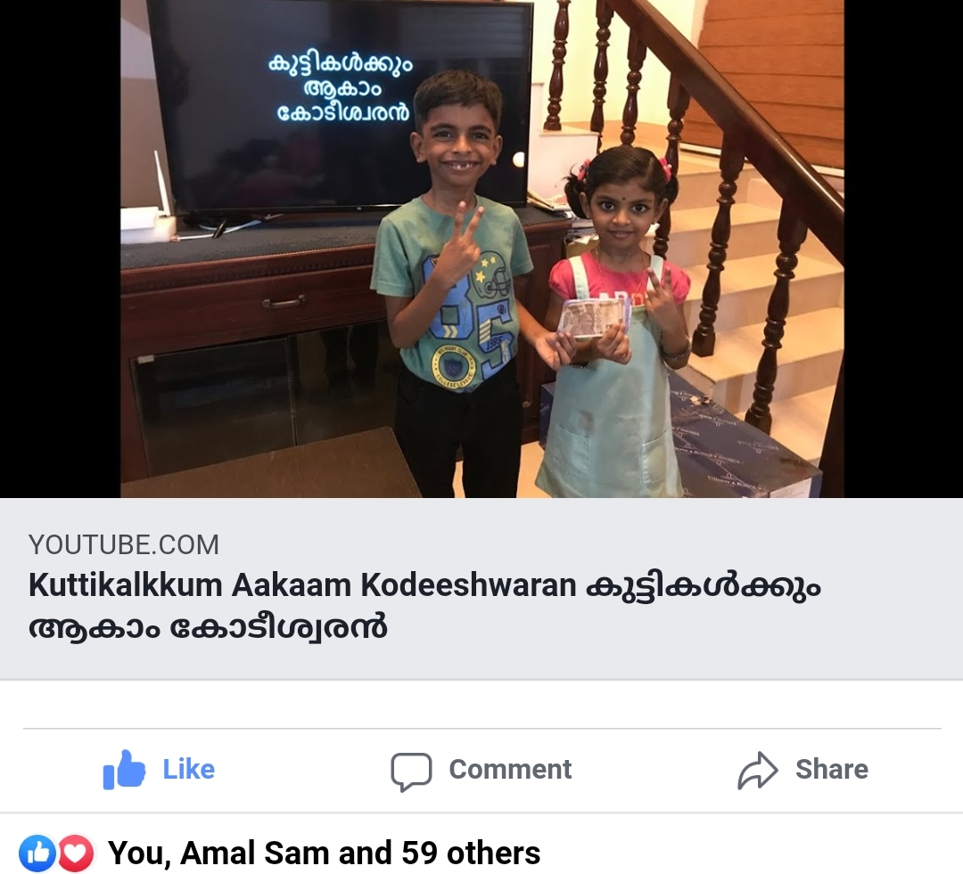
കുട്ടികൾക്കും ആകാം കോടീശ്വരൻ
Click to see the video
Click to go to the channel

Slide 2

Episode - 5
12 | 110
11 | 100
10 | 90
9 | 80
8 | 70
7 | 60
6 | 50
5 | 40
4 | 30
3 | 20
2 | 10
1 | 5
Topic – Science
Age Group – 7 to 14
12 Questions, 3 Lifelines

Slide 3












Corona is a ____________?
A: Bacteria
B: Amoeba
C: Virus
D: Worm

Slide 4
12 | 110
11 | 100
10 | 90
9 | 80
8 | 70
7 | 60
6 | 50
5 | 40
4 | 30
3 | 20
2 | 10
1 | 5

Slide 5
Who invented modern day computer. He is also known as “Father of Computer”?
A: Charles Babbage
B: Abraham Lincoln
C: Thomas Alva Edison
D: Isaac Newton

Slide 6
12 | 110
11 | 100
10 | 90
9 | 80
8 | 70
7 | 60
6 | 50
5 | 40
4 | 30
3 | 20
2 | 10
1 | 5

Slide 7
Why does apple falls down from an apple tree?
A: Density of apple
B: Gravity of Earth
C: Pressure of atmosphere
D: Speed of apple

Slide 8
12 | 110
11 | 100
10 | 90
9 | 80
8 | 70
7 | 60
6 | 50
5 | 40
4 | 30
3 | 20
2 | 10
1 | 5

Slide 9
What is the study of Plants called as?
A: Chemistry
B: Physics
C: Botany
D: Zoology

Slide 10
12 | 110
11 | 100
10 | 90
9 | 80
8 | 70
7 | 60
6 | 50
5 | 40
4 | 30
3 | 20
2 | 10
1 | 5

Slide 11
From which country have more than 1000 deaths, highest after China due to Covid19 ?
A: Singapore
B: Japan
C: South Korea
D: Italy

Slide 12
12 | 110
11 | 100
10 | 90
9 | 80
8 | 70
7 | 60
6 | 50
5 | 40
4 | 30
3 | 20
2 | 10
1 | 5

Slide 13
What make a bulb to glow when we turn on a switch?
A: Electric Current
B: Sound
C: Temperature increase
D: Chemical reaction

Slide 14
12 | 110
11 | 100
10 | 90
9 | 80
8 | 70
7 | 60
6 | 50
5 | 40
4 | 30
3 | 20
2 | 10
1 | 5

Slide 15
Why does a person fall from a moving bus ? Demonstrate coin experiment
A: Gravity
B: Inertia
C: Viscosity
D: Friction

Slide 16
12 | 110
11 | 100
10 | 90
9 | 80
8 | 70
7 | 60
6 | 50
5 | 40
4 | 30
3 | 20
2 | 10
1 | 5

Slide 17
You can walk on a road. But You will slip if you walk on a wet floor. You cannot walk on an ICE floor. Why?
A:
Pressure
B:
Temperature
C:
Electric Current
D:
Friction

Slide 18
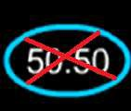
12 | 110
11 | 100
10 | 90
9 | 80
8 | 70
7 | 60
6 | 50
5 | 40
4 | 30
3 | 20
2 | 10
1 | 5

Slide 19
How does a remote controller work?
A: Using Sound waves
B: Using Infra Red Rays
C: Using Water
D: Using Light rays

Slide 20
12 | 110
11 | 100
10 | 90
9 | 80
8 | 70
7 | 60
6 | 50
5 | 40
4 | 30
3 | 20
2 | 10
1 | 5

Slide 21
Which Italian Football club player is affected with Covid 19?
A: Real Madrid
B: AC Roma
C: Juventus
D: AC Milan

Slide 22
12 | 110
11 | 100
10 | 90
9 | 80
8 | 70
7 | 60
6 | 50
5 | 40
4 | 30
3 | 20
2 | 10
1 | 5

Slide 23
Which F1 team withdrawn from Australian Grand Prix after Covid19 ?
A: Redbull
B: McLaren
C: KingFisher
D: Ferrari

Slide 24
12 | 110
11 | 100
10 | 90
9 | 80
8 | 70
7 | 60
6 | 50
5 | 40
4 | 30
3 | 20
2 | 10
1 | 5

Slide 25
Which award is named after the inventor of Dynamite?
A: Einstein Prize
B: Laureus Awards
C: Hertz Medal
D: Nobel Prize

Slide 26
12 | 110
11 | 100
10 | 90
9 | 80
8 | 70
7 | 60
6 | 50
5 | 40
4 | 30
3 | 20
2 | 10
1 | 5

Slide 27
Answers
12 | D
11 | B
10 | C
9 | B
8 | D
7 | B
6 | A
5 | D
4 | C
3 | B
2 | A
1 | C

