Slide 1
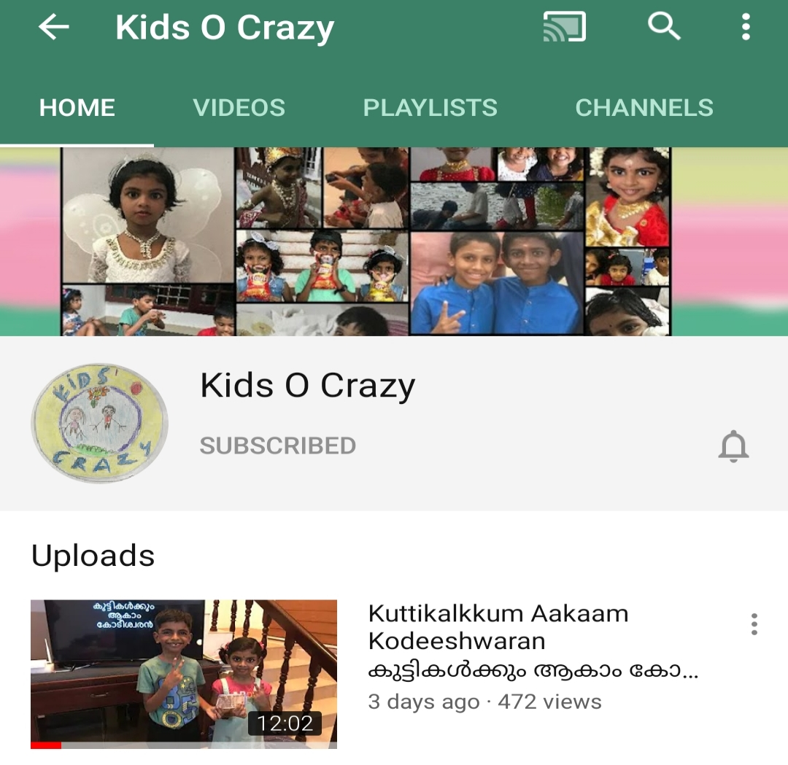
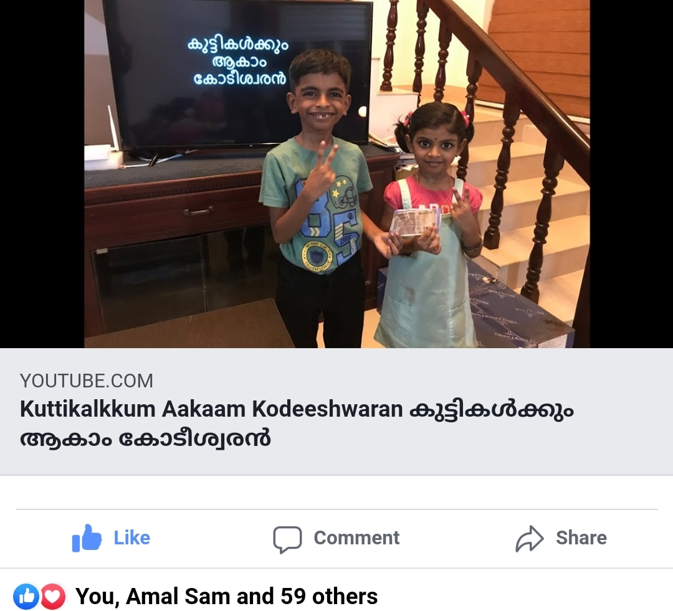
കുട്ടികൾക്കും ആകാം കോടീശ്വരൻ
Click to see the video
Click to go to the channel

Slide 2


Episode - 6
12 | 110
11 | 100
10 | 90
9 | 80
8 | 70
7 | 60
6 | 50
5 | 40
4 | 30
3 | 20
2 | 10
1 | 5
Topic – Sports*
Age Group – 7 to 14
12 Questions, 4 Lifelines
*3 questions from Today’s news paper

Slide 3











Who is captain of Indian Cricket Team?
A: Virat Kohli
B: Rohit Sharma
C: Ravindra Jadeja
D: Sanju Samson

Slide 4
12 | 110
11 | 100
10 | 90
9 | 80
8 | 70
7 | 60
6 | 50
5 | 40
4 | 30
3 | 20
2 | 10
1 | 5

Slide 5
2020 Olympics will be held at?
A: Qatar
B: New Delhi, India
C: Tokyo, Japan
D: London

Slide 6
12 | 110
11 | 100
10 | 90
9 | 80
8 | 70
7 | 60
6 | 50
5 | 40
4 | 30
3 | 20
2 | 10
1 | 5

Slide 7
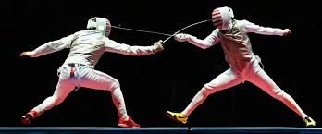
What do we call this game?
A: Golf
B: Kalari
C: Teakwondo
D: Fencing

Slide 8
12 | 110
11 | 100
10 | 90
9 | 80
8 | 70
7 | 60
6 | 50
5 | 40
4 | 30
3 | 20
2 | 10
1 | 5

Slide 9
Who is Mary Kom?
A: Chinese Athlete
B: Indian Boxer
C: English Footballer
D: US Boxer

Slide 10
12 | 110
11 | 100
10 | 90
9 | 80
8 | 70
7 | 60
6 | 50
5 | 40
4 | 30
3 | 20
2 | 10
1 | 5

Slide 11
What is FIFA?
A: International Football Federation
B: International Chess Federation
C: International F1 Association
D: International Cricket Association

Slide 12
12 | 110
11 | 100
10 | 90
9 | 80
8 | 70
7 | 60
6 | 50
5 | 40
4 | 30
3 | 20
2 | 10
1 | 5

Slide 13
Who was the captain of first Indian team which won Cricket World Cup?
A: Ravi Shasthri
B: Sunil Gavaskar
C: Sachin Tendulkar
D: Kapil Dev

Slide 14
12 | 110
11 | 100
10 | 90
9 | 80
8 | 70
7 | 60
6 | 50
5 | 40
4 | 30
3 | 20
2 | 10
1 | 5

Slide 15
Which of the following woman badminton player from India had won an Olympic Medal ?
A: Sania Mirza
B: Saina Nehwal
C: Hima Das
D: PV Sindhu

Slide 16
12 | 110
11 | 100
10 | 90
9 | 80
8 | 70
7 | 60
6 | 50
5 | 40
4 | 30
3 | 20
2 | 10
1 | 5

Slide 17
Who are the current Football World Cup Champions?
A:
Germany
B:
England
C:
France
D:
Brazil

Slide 18
12 | 110
11 | 100
10 | 90
9 | 80
8 | 70
7 | 60
6 | 50
5 | 40
4 | 30
3 | 20
2 | 10
1 | 5

Slide 19
Michael Schumacher is associated with which sports?
A: Football
B: F1 Racing
C: Rugby
D: Golf

Slide 20
12 | 110
11 | 100
10 | 90
9 | 80
8 | 70
7 | 60
6 | 50
5 | 40
4 | 30
3 | 20
2 | 10
1 | 5

Slide 21
Which national politician was released from house arrest yesterday?
A: Farukh Abdullah
B: Rajiv Gandhi
C: Mehbooba Mufti
D: Mulayam Singh

Slide 22
12 | 110
11 | 100
10 | 90
9 | 80
8 | 70
7 | 60
6 | 50
5 | 40
4 | 30
3 | 20
2 | 10
1 | 5

Slide 23
Indian Super League (ISL) final 2020 is between which two teams?
A: Delhi FC & Bangalore FC
B: Kerala Blasters & Goa FC
C: Mumbai City FC & ATK FC
D: ATK & Chennain FC

Slide 24
12 | 110
11 | 100
10 | 90
9 | 80
8 | 70
7 | 60
6 | 50
5 | 40
4 | 30
3 | 20
2 | 10
1 | 5

Slide 25
From which city in China Covid19 started?
A: Beijing
B: Shanghai
C: Wuhan
D: Gangshou

Slide 26
12 | 110
11 | 100
10 | 90
9 | 80
8 | 70
7 | 60
6 | 50
5 | 40
4 | 30
3 | 20
2 | 10
1 | 5

Slide 27
Answers
12 | C
11 | D
10 | A
9 | B
8 | C
7 | D
6 | D
5 | A
4 | B
3 | D
2 | C
1 | A

