Slide 1

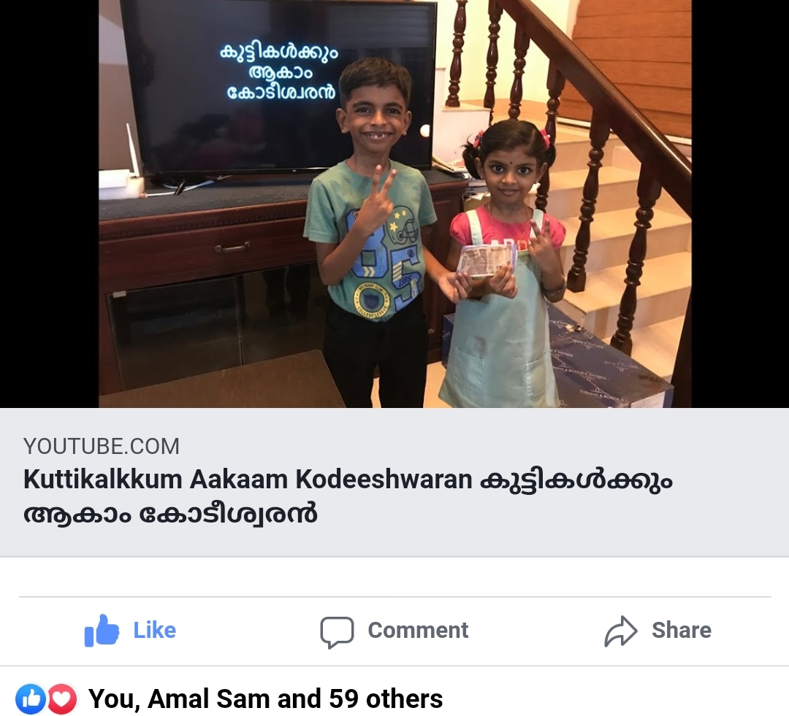
കുട്ടികൾക്കും ആകാം കോടീശ്വരൻ
Click to see the video
Click to go to the channel

Slide 2


Episode - 7
12 | 110
11 | 100
10 | 90
9 | 80
8 | 70
7 | 60
6 | 50
5 | 40
4 | 30
3 | 20
2 | 10
1 | 5
Topic – Food*
Age Group – 7 to 14
12 Questions, 4 Lifelines
*3 questions from Today’s news paper

Slide 3











Which Vitamin is found in Carrot in abundance?
A: Vitamin K
B: Vitamin D
C: Vitamin E
D: Vitamin A

Slide 4
12 | 110
11 | 100
10 | 90
9 | 80
8 | 70
7 | 60
6 | 50
5 | 40
4 | 30
3 | 20
2 | 10
1 | 5

Slide 5
What is ‘K’ in KFC?
A: Karimeen
B: Kerala
C: Kentucky
D: Kashmiri

Slide 6
12 | 110
11 | 100
10 | 90
9 | 80
8 | 70
7 | 60
6 | 50
5 | 40
4 | 30
3 | 20
2 | 10
1 | 5

Slide 7
Which food is made from rice flour in the form of a cake and shape of a cylinder by steaming?
A: Appam
B: Porotta
C: Puttu
D: Pathiri

Slide 8
12 | 110
11 | 100
10 | 90
9 | 80
8 | 70
7 | 60
6 | 50
5 | 40
4 | 30
3 | 20
2 | 10
1 | 5

Slide 9
Which vitamin is the only one that you will not find in an egg??
A: Vitamin C
B: Vitamin A
C: Vitamin K
D: Vitamin B

Slide 10
12 | 110
11 | 100
10 | 90
9 | 80
8 | 70
7 | 60
6 | 50
5 | 40
4 | 30
3 | 20
2 | 10
1 | 5

Slide 11
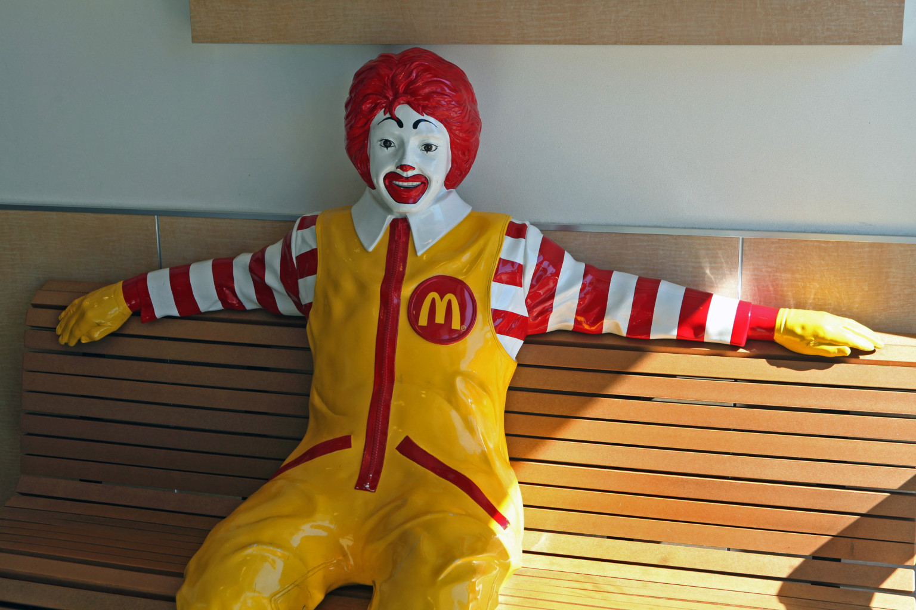
Where do we find this?
A: Dominos Pizza
B: Pizza Hut
C: American Burger
D: McDonalds

Slide 12
12 | 110
11 | 100
10 | 90
9 | 80
8 | 70
7 | 60
6 | 50
5 | 40
4 | 30
3 | 20
2 | 10
1 | 5

Slide 13
To which South Asian forum did India contributed 1 Cr Dollar to fight against Covid-19?
A: SAARC
B: SAF
C: UN
D: G-8

Slide 14
12 | 110
11 | 100
10 | 90
9 | 80
8 | 70
7 | 60
6 | 50
5 | 40
4 | 30
3 | 20
2 | 10
1 | 5

Slide 15
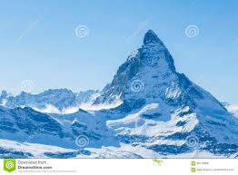

Which chocolate have this mountain on its packet?
A:
Kitkat
B:
Toblerone
C:
M&M
D:
Munch

Slide 16
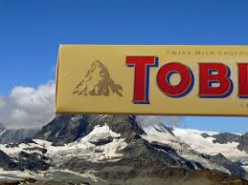
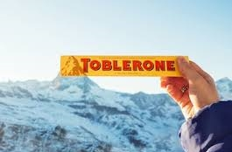
12 | 110
11 | 100
10 | 90
9 | 80
8 | 70
7 | 60
6 | 50
5 | 40
4 | 30
3 | 20
2 | 10
1 | 5
The Matterhorn in the Swiss Alps

Slide 17
Which Italian food have a round flattened wheat base topped with cheese, tomatoes, baked at high temperature?
A: Pizza
B: Porotta
C: Tandoori Roti
D: Chappathi

Slide 18
12 | 110
11 | 100
10 | 90
9 | 80
8 | 70
7 | 60
6 | 50
5 | 40
4 | 30
3 | 20
2 | 10
1 | 5

Slide 19
Which is the fruit found in Kerala, Tamil Nadu, Sri Lanka, named in English after Portuguese word ‘Jaca’?
A: Kappa
B: Manga
C: Chakka
D: Pazham

Slide 20
12 | 110
11 | 100
10 | 90
9 | 80
8 | 70
7 | 60
6 | 50
5 | 40
4 | 30
3 | 20
2 | 10
1 | 5

Slide 21
Which state under chief minister ship of ‘Kamal Nath’ is going to face confidence vote in next few days?
A: Rajasthan
B: Madhya Pradesh
C: Uttar Pradesh
D: West Bengal

Slide 22
12 | 110
11 | 100
10 | 90
9 | 80
8 | 70
7 | 60
6 | 50
5 | 40
4 | 30
3 | 20
2 | 10
1 | 5

Slide 23
Who is the famous Chef featured in Master Chef pgm?
A: Brent Owens
B: Gordon Ramsay
C: Vikas Khanna
D: Sanjay Kapoor

Slide 24
12 | 110
11 | 100
10 | 90
9 | 80
8 | 70
7 | 60
6 | 50
5 | 40
4 | 30
3 | 20
2 | 10
1 | 5

Slide 25
Which famous personality predicted about Epidemic as highest threat for the world and a Virus war (biological weapon use) in his 2015 talk?
A: Bill Gates
B: Rahul Gandhi
C: Donald Trump
D: Narendra Modi

Slide 26

12 | 110
11 | 100
10 | 90
9 | 80
8 | 70
7 | 60
6 | 50
5 | 40
4 | 30
3 | 20
2 | 10
1 | 5

Slide 27
Answers
12 | A
11 | B
10 | B
9 | C
8 | A
7 | B
6 | A
5 | D
4 | A
3 | C
2 | C
1 | A

