Slide 1

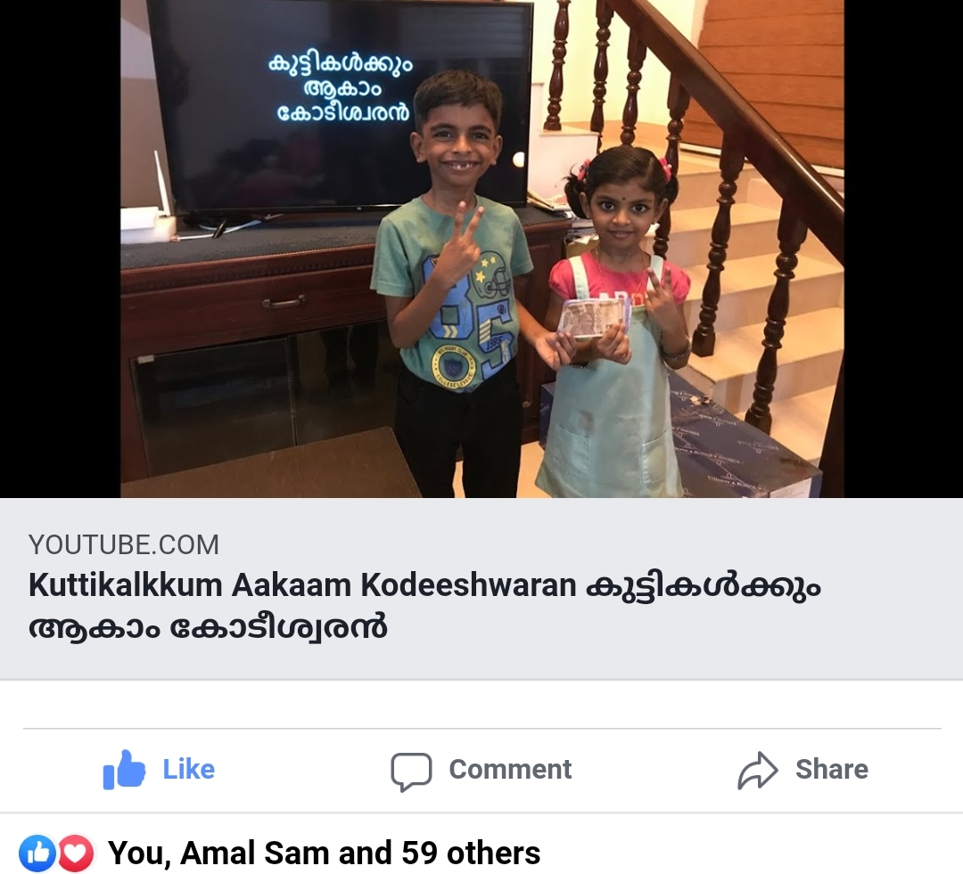
കുട്ടികൾക്കും ആകാം കോടീശ്വരൻ
Click to see the video
Click to go to the channel

Slide 2


Episode - 8
12 | 110
11 | 100
10 | 90
9 | 80
8 | 70
7 | 60
6 | 50
5 | 40
4 | 30
3 | 20
2 | 10
1 | 5
Topic – Automobiles
Age Group – 7 to 14
12 Questions, 4 Lifelines

Slide 3











Which company manufacture the model “City” which is present in the market for more than 20 years?
A: Toyota
B: Honda
C: Ford
D: Suzuki

Slide 4
12 | 110
11 | 100
10 | 90
9 | 80
8 | 70
7 | 60
6 | 50
5 | 40
4 | 30
3 | 20
2 | 10
1 | 5

Slide 5
Which Japanese automobiles company joined Maruthi to build cars in India?
A:
Suzuki
B:
Mitsubishi
C:
Sony
D:
Honda

Slide 6
12 | 110
11 | 100
10 | 90
9 | 80
8 | 70
7 | 60
6 | 50
5 | 40
4 | 30
3 | 20
2 | 10
1 | 5

Slide 7
Which Indian company own Jaguar & LandRover Brands?
A: Reliance
B: Mahindra Motors
C: Tata Motors
D: Toyota

Slide 8
12 | 110
11 | 100
10 | 90
9 | 80
8 | 70
7 | 60
6 | 50
5 | 40
4 | 30
3 | 20
2 | 10
1 | 5

Slide 9
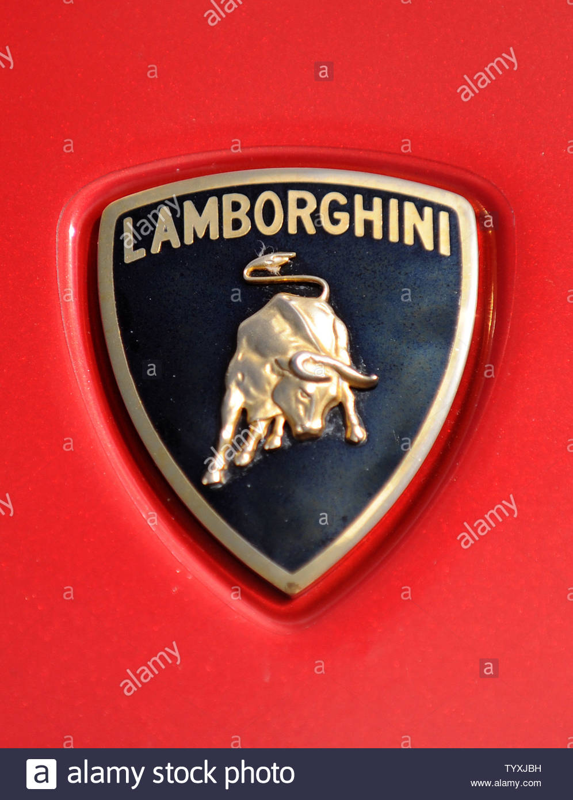
Identify the car company?
A: Ferrari
B: Peugeot
C: Mustang
D: Lamborghini

Slide 10
12 | 110
11 | 100
10 | 90
9 | 80
8 | 70
7 | 60
6 | 50
5 | 40
4 | 30
3 | 20
2 | 10
1 | 5

Slide 11
Mahindra ‘Marazzo’ design is inspired from which animal?
A: Tiger
B: Shark
C: Dolphin
D: Bull

Slide 12
12 | 110
11 | 100
10 | 90
9 | 80
8 | 70
7 | 60
6 | 50
5 | 40
4 | 30
3 | 20
2 | 10
1 | 5

Slide 13
Which automobile company of India had the models – Padmini, 118 NE?
A: Hindustan Motors
B: Premier Automobiles
C: Mahindra
D: Maruthi

Slide 14
12 | 110
11 | 100
10 | 90
9 | 80
8 | 70
7 | 60
6 | 50
5 | 40
4 | 30
3 | 20
2 | 10
1 | 5

Slide 15
Which company manufactured worlds first motor car – 1908 Model T ?
A: Ford
B: BMW
C: Daimler
D: FIAT

Slide 16
12 | 110
11 | 100
10 | 90
9 | 80
8 | 70
7 | 60
6 | 50
5 | 40
4 | 30
3 | 20
2 | 10
1 | 5

Slide 17
Which brand have the following model families: Touring, Softail, Dyna, Sportster, Vrod and Street?
A: Kawasaki
B: Yamaha
C: Ninja
D: Harley- Davidson

Slide 18
12 | 110
11 | 100
10 | 90
9 | 80
8 | 70
7 | 60
6 | 50
5 | 40
4 | 30
3 | 20
2 | 10
1 | 5

Slide 19
Which brand of car does James Bond use majorly in “007” movies ?
A: Rolls Royce
B: BMW
C: Mercedes Benz
D: Aston Martin

Slide 20
12 | 110
11 | 100
10 | 90
9 | 80
8 | 70
7 | 60
6 | 50
5 | 40
4 | 30
3 | 20
2 | 10
1 | 5

Slide 21
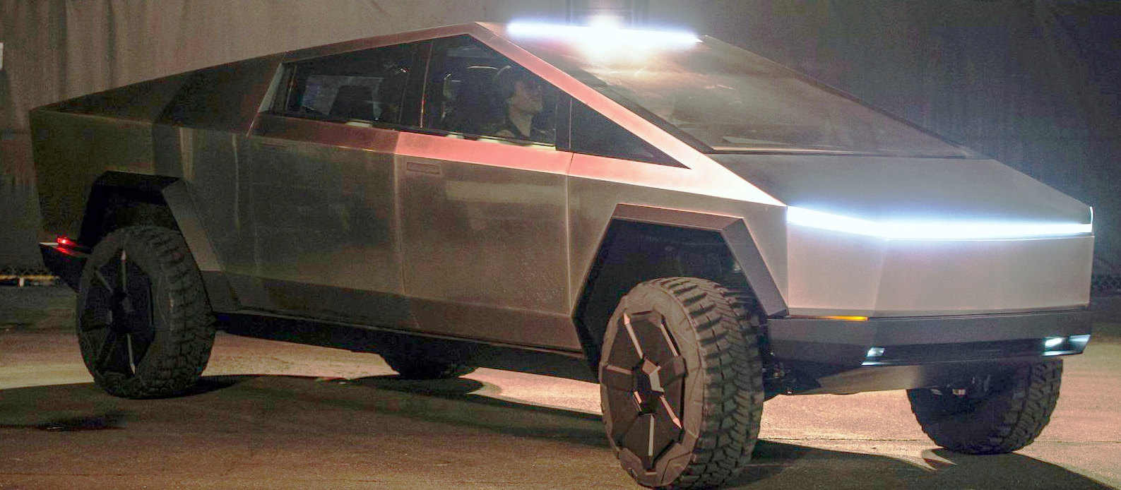
What is the name of this Tesla model car launched in 2019?
A: Model S
B: Cyber Truck
C: Traingle
D: The Rock

Slide 22
12 | 110
11 | 100
10 | 90
9 | 80
8 | 70
7 | 60
6 | 50
5 | 40
4 | 30
3 | 20
2 | 10
1 | 5

Slide 23
Which company invented modern day seat belt (3-point) and give a patent for other manufacturers for the safety of passengers?
A: BMW
B: Toyota
C: Ford
D: Volvo

Slide 24
12 | 110
11 | 100
10 | 90
9 | 80
8 | 70
7 | 60
6 | 50
5 | 40
4 | 30
3 | 20
2 | 10
1 | 5

Slide 25
Which car is used by Indian Army; model codenamed as MG413W ‘King’ from 1991. The company stopped its production in 2019 after Army demand went down?
A: Safari
B: Esteem
C: Gypsy
D: Thar

Slide 26

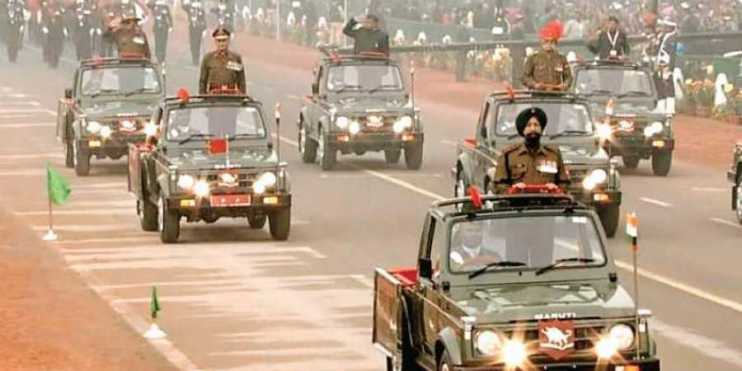
12 | 110
11 | 100
10 | 90
9 | 80
8 | 70
7 | 60
6 | 50
5 | 40
4 | 30
3 | 20
2 | 10
1 | 5

Slide 27
Answers
12 | C
11 | D
10 | B
9 | D
8 | D
7 | A
6 | B
5 | B
4 | D
3 | C
2 | A
1 | B

