Slide 1
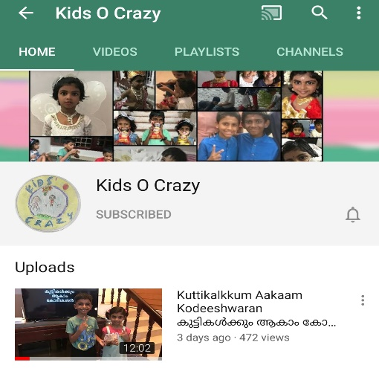
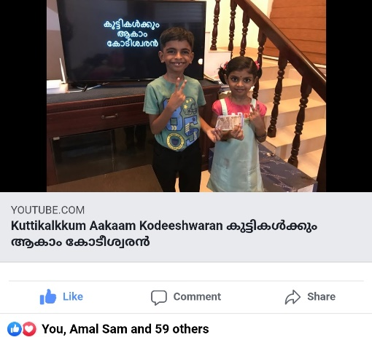
കുട്ടികൾക്കും ആകാം കോടീശ്വരൻ
Click to see the video
Click to go to the channel

Slide 2



Episode - 9
12 | 110
11 | 100
10 | 90
9 | 80
8 | 70
7 | 60
6 | 50
5 | 40
4 | 30
3 | 20
2 | 10
1 | 5
Topic - Cinema
Age Group – 4 to 10
12 Questions, 4 Lifelines

Slide 3












What is the name of the mouse which always trouble the cat ‘Tom’ in the superhit cartoon?
A: Mickey
B: Donald
C: Jerry
D: Popeye

Slide 4
12 | 110
11 | 100
10 | 90
9 | 80
8 | 70
7 | 60
6 | 50
5 | 40
4 | 30
3 | 20
2 | 10
1 | 5

Slide 5
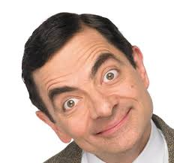
What is the name of this comedian character?
A: Charlie Chaplin
B: Sherlock Holmes
C: Mr. Bean
D: Ethan Hunt

Slide 6
12 | 110
11 | 100
10 | 90
9 | 80
8 | 70
7 | 60
6 | 50
5 | 40
4 | 30
3 | 20
2 | 10
1 | 5

Slide 7
In which team does Spider man, Hulk and Captain America appear?
A: James Bond
B: MI 6
C: G-One
D: Avengers

Slide 8
12 | 110
11 | 100
10 | 90
9 | 80
8 | 70
7 | 60
6 | 50
5 | 40
4 | 30
3 | 20
2 | 10
1 | 5

Slide 9
Which boy character lives in forest with wolf pack, Bagheera in the Rudyard Kipling novel – “Jungle Book” ?
A: Tintu Mon
B: Mowgli
C: Tarzan
D: Balu

Slide 10
12 | 110
11 | 100
10 | 90
9 | 80
8 | 70
7 | 60
6 | 50
5 | 40
4 | 30
3 | 20
2 | 10
1 | 5

Slide 11
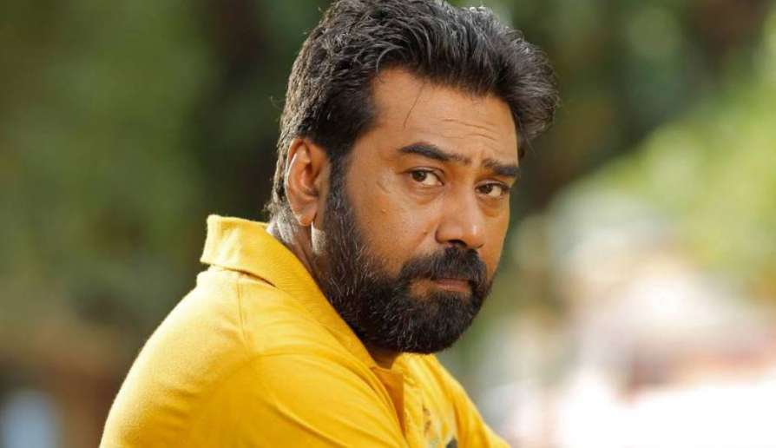
Identify the actor?
A: Suresh Gopi
B: Biju Menon
C: Fahad Fasil
D: Prithvi Raj

Slide 12
12 | 110
11 | 100
10 | 90
9 | 80
8 | 70
7 | 60
6 | 50
5 | 40
4 | 30
3 | 20
2 | 10
1 | 5

Slide 13
In which 2019 Malayalam movie does a ‘Robot’ character appeared, which does all the maid job at house?
A: Mr. Robot
B: Kumbalangi Nights
C: Android Kunjappan
D: Lucifer

Slide 14
12 | 110
11 | 100
10 | 90
9 | 80
8 | 70
7 | 60
6 | 50
5 | 40
4 | 30
3 | 20
2 | 10
1 | 5

Slide 15
Which character in ‘Marvel’ movies becomes Iron Man?
A: Peter Parker
B: Tony Stark
C: John Honai
D: Dr. Bruce Banner

Slide 16
12 | 110
11 | 100
10 | 90
9 | 80
8 | 70
7 | 60
6 | 50
5 | 40
4 | 30
3 | 20
2 | 10
1 | 5

Slide 17

What is the name of this cartoon character?
A: Dinkan
B: Superman
C: Scobie doo
D: Popeye

Slide 18
12 | 110
11 | 100
10 | 90
9 | 80
8 | 70
7 | 60
6 | 50
5 | 40
4 | 30
3 | 20
2 | 10
1 | 5

Slide 19
Which Malayalam movie was based on the Nipah virus attack?
A: Contagion
B: Pandemic
C: Bacteria
D: Virus

Slide 20
12 | 110
11 | 100
10 | 90
9 | 80
8 | 70
7 | 60
6 | 50
5 | 40
4 | 30
3 | 20
2 | 10
1 | 5

Slide 21
Which superhit Malayalam Actor appear in popular infotainment show – “Nigalkkum Akaam Koddeshwaran”?
A: Suresh Gopi
B: Mohan Lal
C: Mammotty
D: Jayaram

Slide 22
12 | 110
11 | 100
10 | 90
9 | 80
8 | 70
7 | 60
6 | 50
5 | 40
4 | 30
3 | 20
2 | 10
1 | 5

Slide 23
Which famous movie awards ceremony is generally held during February every year at Dolby Theatre, Hollywood, also known as Academy Awards?
A: Arjuna
B: Oscar
C: Nobel Prize
D: Padma Shri

Slide 24
12 | 110
11 | 100
10 | 90
9 | 80
8 | 70
7 | 60
6 | 50
5 | 40
4 | 30
3 | 20
2 | 10
1 | 5

Slide 25
Who is known as Father of Indian Cinema?
A: Louis Lumière
B: Amitabh Bachan
C: J.C Daniel
D: Dada Saheb Phalke

Slide 26
12 | 110
11 | 100
10 | 90
9 | 80
8 | 70
7 | 60
6 | 50
5 | 40
4 | 30
3 | 20
2 | 10
1 | 5

Slide 27
Answers
12 | D
11 | B
10 | A
9 | D
8 | A
7 | B
6 | C
5 | B
4 | B
3 | D
2 | C
1 | C

