Slide 1
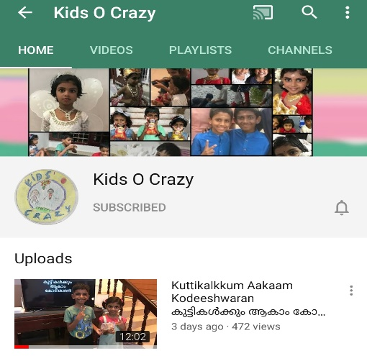
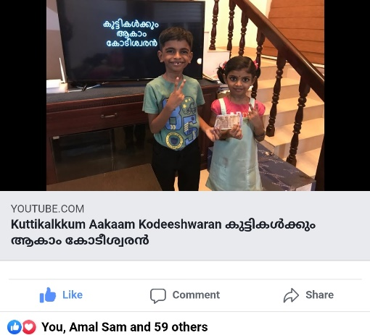
കുട്ടികൾക്കും ആകാം കോടീശ്വരൻ
Click to see the video
Click to go to the channel

Slide 2



Episode - 10
12 | 110
11 | 100
10 | 90
9 | 80
8 | 70
7 | 60
6 | 50
5 | 40
4 | 30
3 | 20
2 | 10
1 | 5
Topic - IT
Age Group – 4 to 10
12 Questions, 4 Lifelines

Slide 3



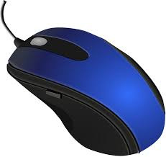








Which is this?
A: Keyboard
B: Monitor
C: Laptop
D: Mouse

Slide 4
12 | 110
11 | 100
10 | 90
9 | 80
8 | 70
7 | 60
6 | 50
5 | 40
4 | 30
3 | 20
2 | 10
1 | 5

Slide 5

Who is father of Computer?
A: Charles Babbage
B: Albert Einstien
C: Linus Torvalds
D: Richard Stallman

Slide 6
12 | 110
11 | 100
10 | 90
9 | 80
8 | 70
7 | 60
6 | 50
5 | 40
4 | 30
3 | 20
2 | 10
1 | 5

Slide 7
What is the technology behind Google Map?
A: Infra Red
B: Satellite based GPS
C: Big Data
D: Artificial Intelligence

Slide 8
12 | 110
11 | 100
10 | 90
9 | 80
8 | 70
7 | 60
6 | 50
5 | 40
4 | 30
3 | 20
2 | 10
1 | 5

Slide 9
What is ‘P’ in CPU ?
A. Protect
B. Processing
C. Perfect
D. Page

Slide 10
12 | 110
11 | 100
10 | 90
9 | 80
8 | 70
7 | 60
6 | 50
5 | 40
4 | 30
3 | 20
2 | 10
1 | 5

Slide 11
Which company owns Windows operating system?
A: IBM
B: Adobe
C: Microsoft
D: Dell

Slide 12
12 | 110
11 | 100
10 | 90
9 | 80
8 | 70
7 | 60
6 | 50
5 | 40
4 | 30
3 | 20
2 | 10
1 | 5

Slide 13
Where will you generally find Q W E R T Y?
A: Keyboard
B: Internet
C: Google
D: CPU

Slide 14
12 | 110
11 | 100
10 | 90
9 | 80
8 | 70
7 | 60
6 | 50
5 | 40
4 | 30
3 | 20
2 | 10
1 | 5

Slide 15
What is the mobile operating system from Google known as ?
A: iOS
B: Android
C: Blackberry
D: Symbian

Slide 16
12 | 110
11 | 100
10 | 90
9 | 80
8 | 70
7 | 60
6 | 50
5 | 40
4 | 30
3 | 20
2 | 10
1 | 5

Slide 17
What is AI in computer terminology?
A: Animation Information
B: Alaska Ink
C: Agile Inside
D: Artificial Intelligence

Slide 18
12 | 110
11 | 100
10 | 90
9 | 80
8 | 70
7 | 60
6 | 50
5 | 40
4 | 30
3 | 20
2 | 10
1 | 5

Slide 19

Identify the operating System?
A: Ubuntu
B: Windows
C: Power PC
D: Debian

Slide 20
12 | 110
11 | 100
10 | 90
9 | 80
8 | 70
7 | 60
6 | 50
5 | 40
4 | 30
3 | 20
2 | 10
1 | 5

Slide 21
Illegal way of attack on a computer is known as ________
A: Knocking
B: Wi-fi
C: Hacking
D: Meeting

Slide 22
12 | 110
11 | 100
10 | 90
9 | 80
8 | 70
7 | 60
6 | 50
5 | 40
4 | 30
3 | 20
2 | 10
1 | 5

Slide 23
What are the numbers in Binary Number system?
A: 0 & 1
B: 0 to 9
C: 1 to F
D: 0 to 16

Slide 24
12 | 110
11 | 100
10 | 90
9 | 80
8 | 70
7 | 60
6 | 50
5 | 40
4 | 30
3 | 20
2 | 10
1 | 5

Slide 25
Which is India’s first Supercomputer called?
A: Param 8000
B: Rohini
C: Shakthi
D: Aryabhatta

Slide 26
12 | 110
11 | 100
10 | 90
9 | 80
8 | 70
7 | 60
6 | 50
5 | 40
4 | 30
3 | 20
2 | 10
1 | 5

Slide 27
Answers
12 | A
11 | A
10 | C
9 | A
8 | D
7 | B
6 | A
5 | C
4 | B
3 | B
2 | A
1 | D

