Slide 1
Service & Protocol
Aj.Drusawin Vongpramate
Information Technology
Science, BRU

Slide 2
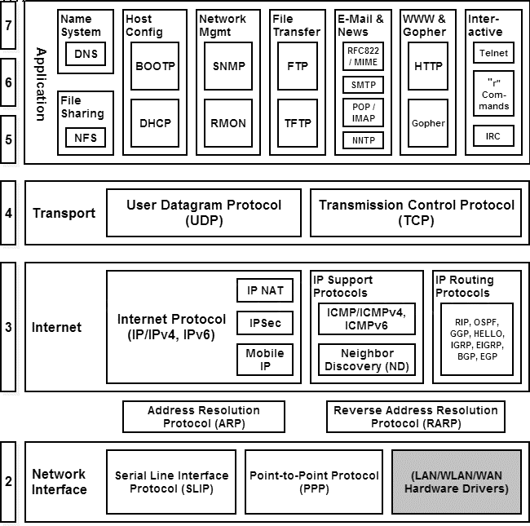

Slide 3
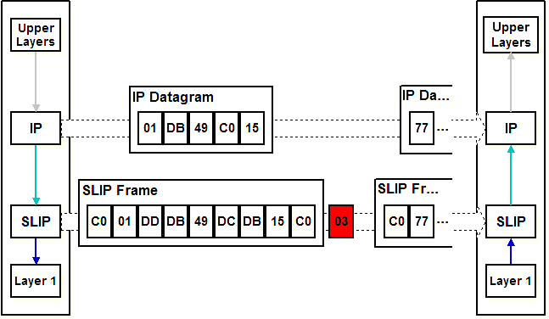
Layer 2 : Network Interface
SLIP : Serial Line Internet Protocol

Slide 4
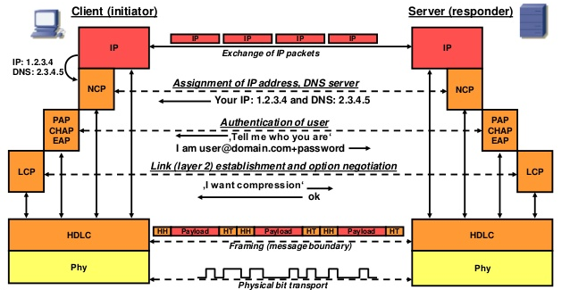
Layer 2 : Network Interface
PPP : Point to Point Protocol

Slide 5
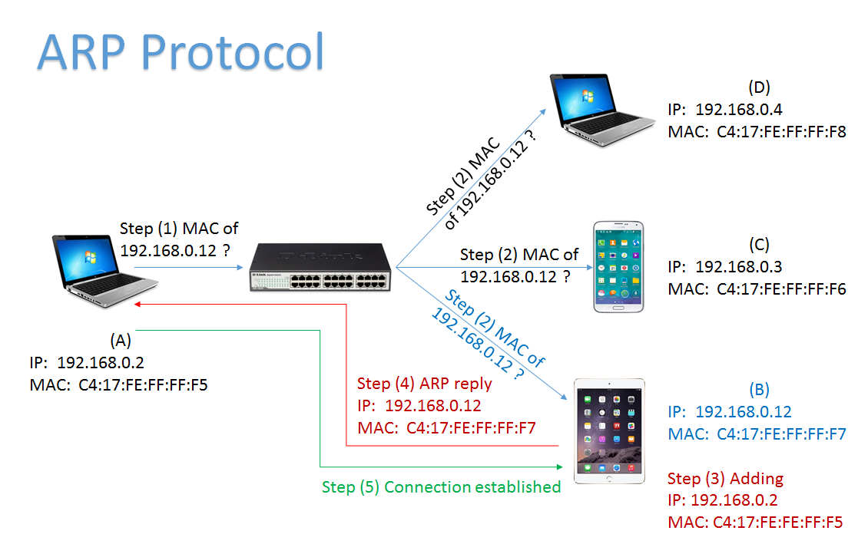
Address Resolution Protocol (ARP)

Slide 6
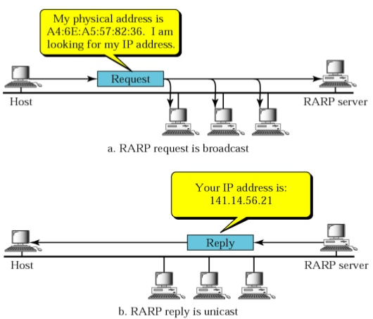
R (Reverse ) ARP

Slide 7
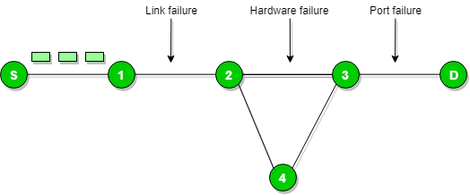
Layer 3 : Internet
ICMP : Internet Control Message Protocol

Slide 8
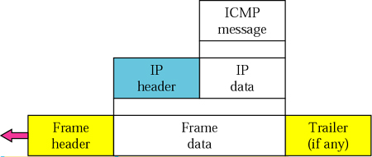
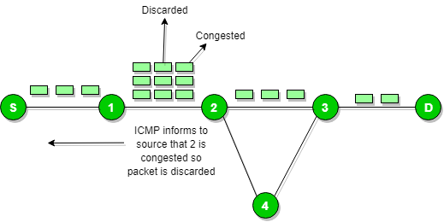
Layer 3 : Internet
ICMP : Internet Control Message Protocol

Slide 9
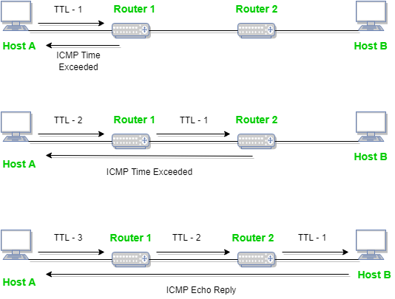
Layer 3 : Internet
ICMP : Internet Control Message Protocol

Slide 10
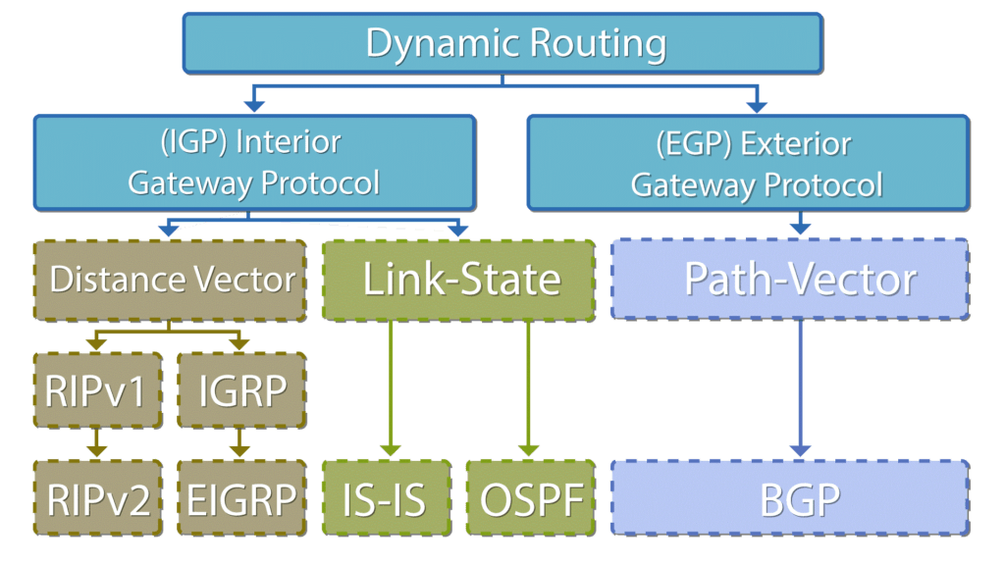
Layer 3 : Internet
Types of Routing Protocols

Slide 11
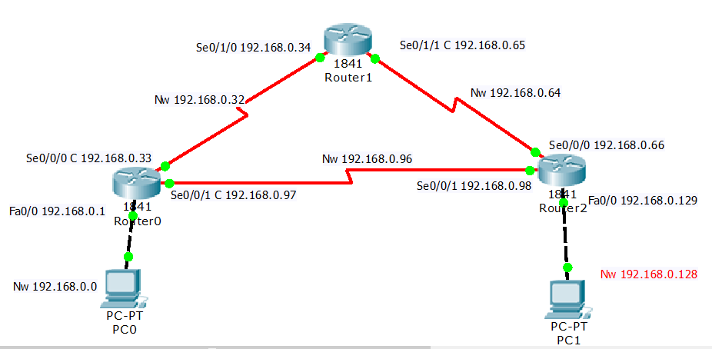
Layer 3 : Internet
RIPv2 : Routing Information Protocol
Notes:
RIPv1 is Classful routing protocol and RIPv2 Classless routing protocol.

Slide 12
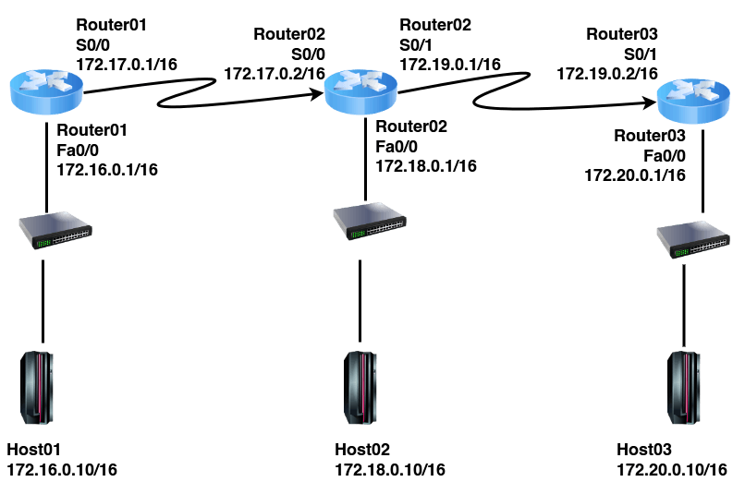
Layer 3 : Internet
IGRP : Interior Gateway Routing Protocol

Slide 13
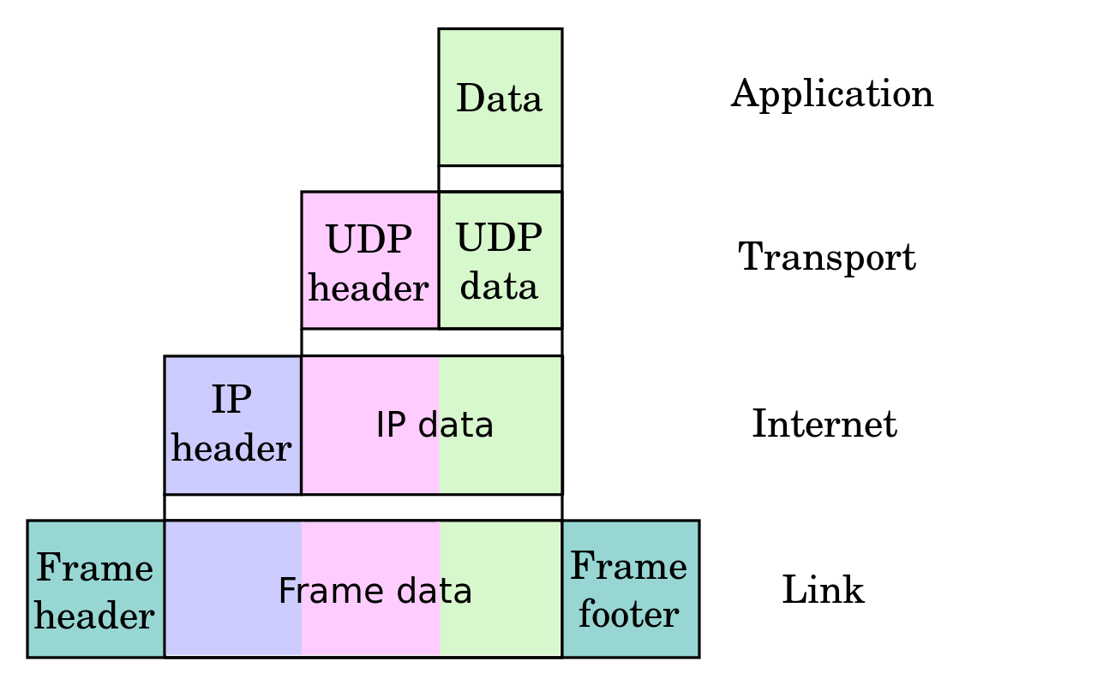
Layer 4 : Transport
User Datagram Protocol : UDP

Slide 14
Layer 4 : Transport
Transmission Control Protocol : TCP

Slide 15
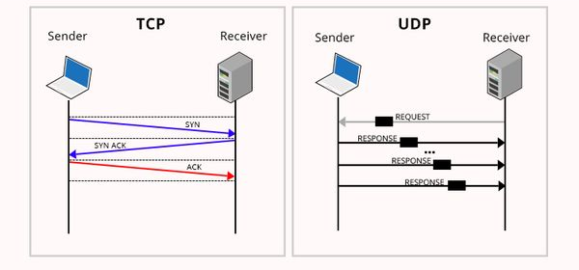
TCP vs UDP

Slide 16
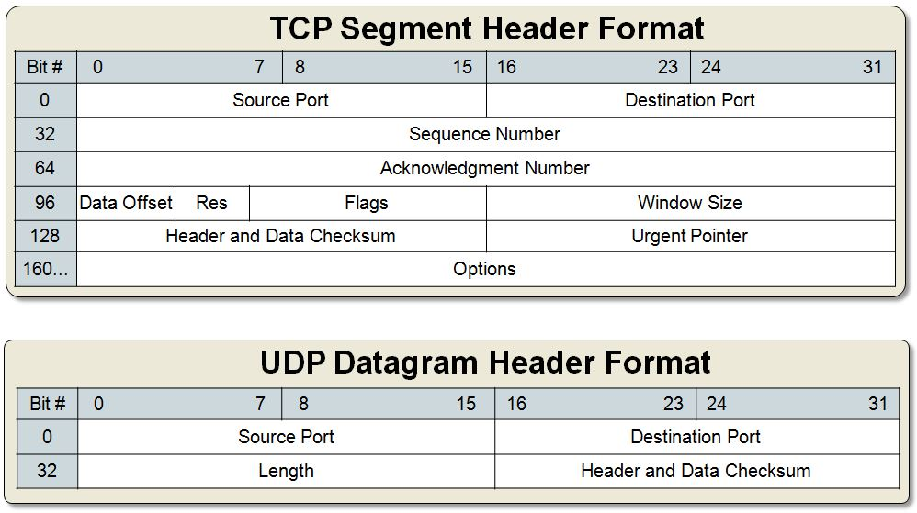
TCP vs UDP

Slide 17
Q & A

