Slide 1
Communication System & Web
Asst.Prof.Drusawin Vongpramate
Information Technology
Science, BRU

Slide 2
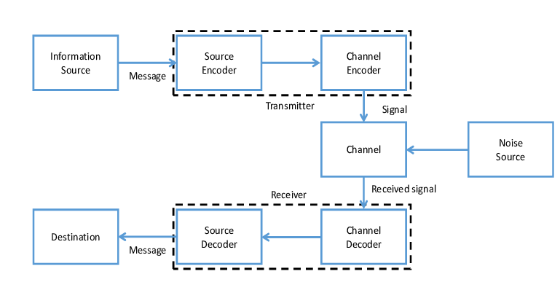
Communication System

Slide 3
Communication System
Laser
Radio
Optical
Satellite
Telegraph
Microwave
Etc.

Slide 4
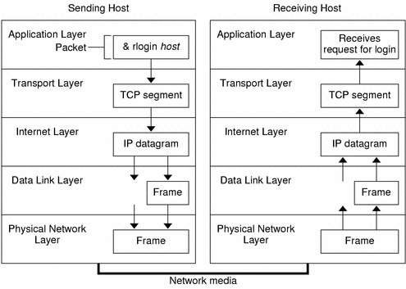
Internet System

Slide 5
Digital Communication System
Digital communication is a mode of communication where the information or the thought is encoded digitally as discreet signals and electronically transferred to the recipients. Digital communication is one of the most commonly used mode of communication in the current scenario. Organizations generally rely on this mode for all their business communications.

Slide 6
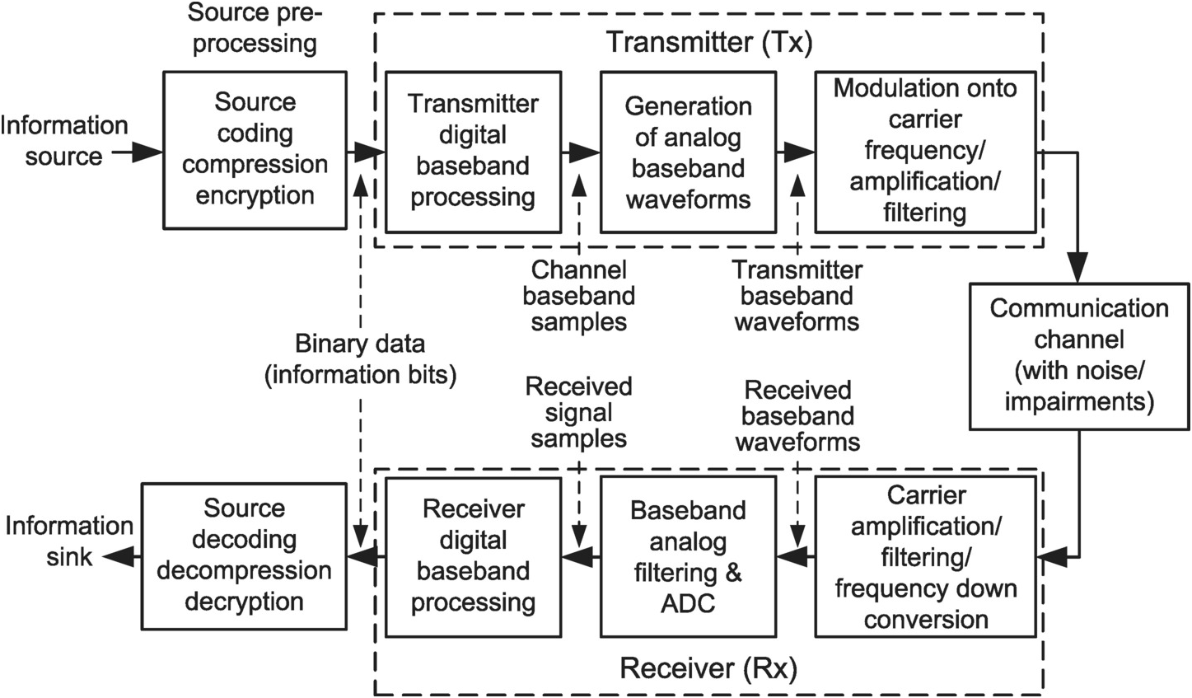
Digital Communication System

Slide 7
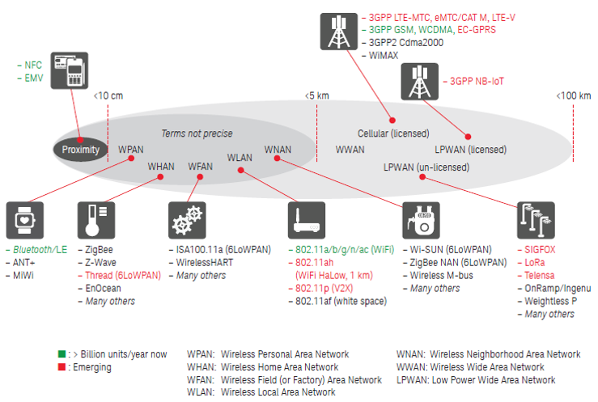
Applications

Slide 9
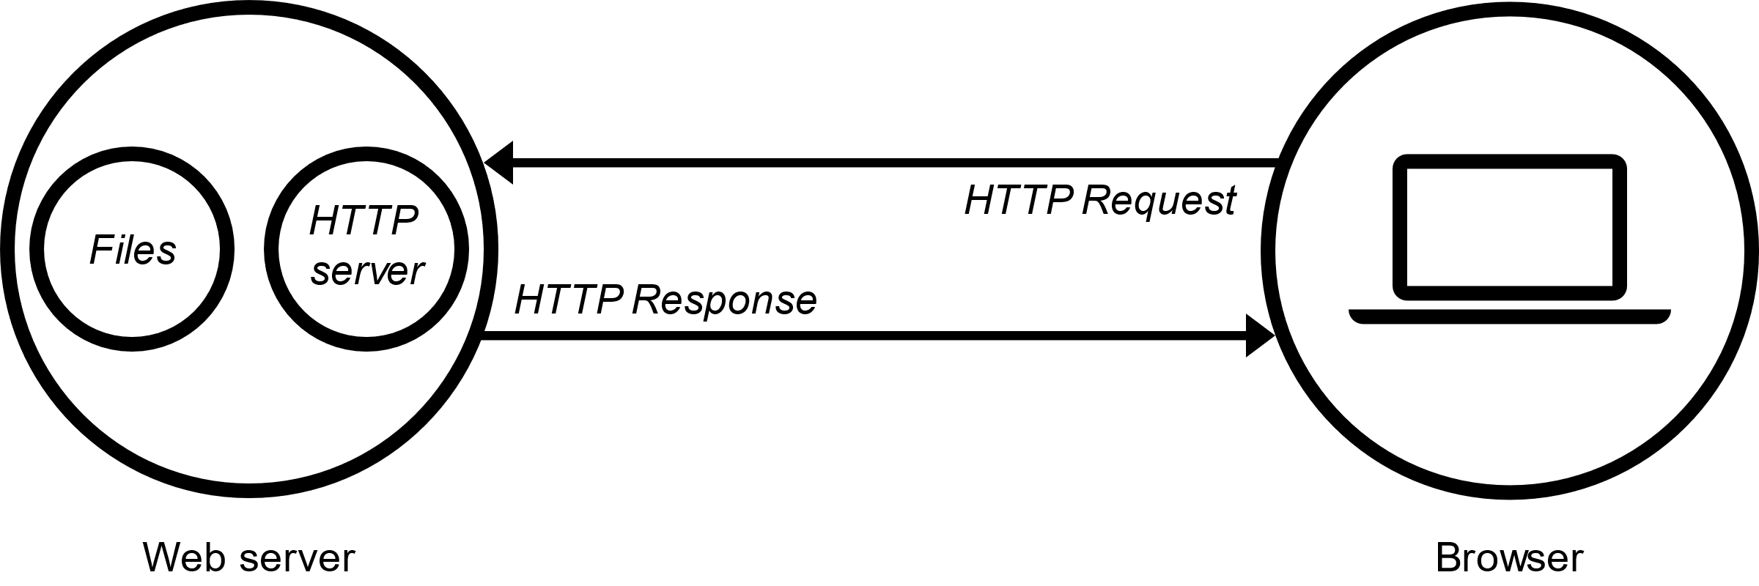
Web Server
Static / Dynamic pages

Slide 10
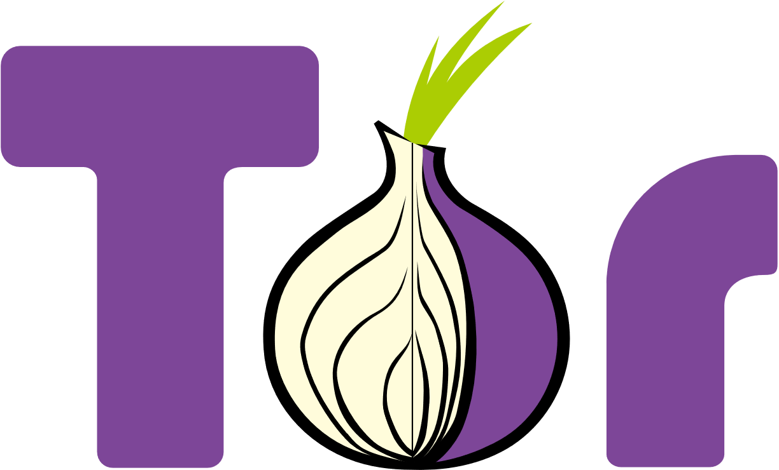
Tor
Tor is an anonymity tool used by those who want to stay private and uncensored when browsing the Internet. Over time, it’s grown to be pretty darn good at this. This makes the security, stability, and speed of the underlying network critical to those depending on it.

Slide 11
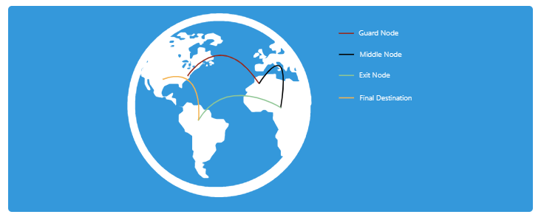
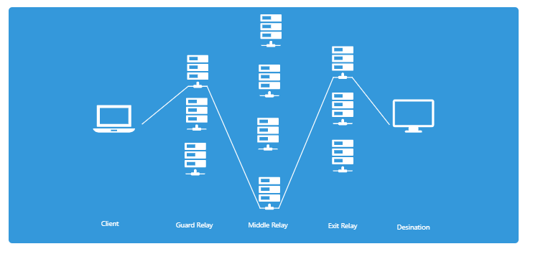
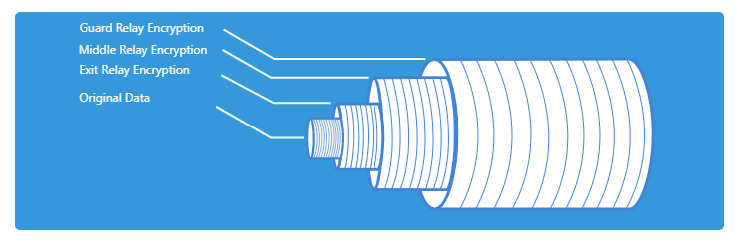
.Onions ?

Slide 12
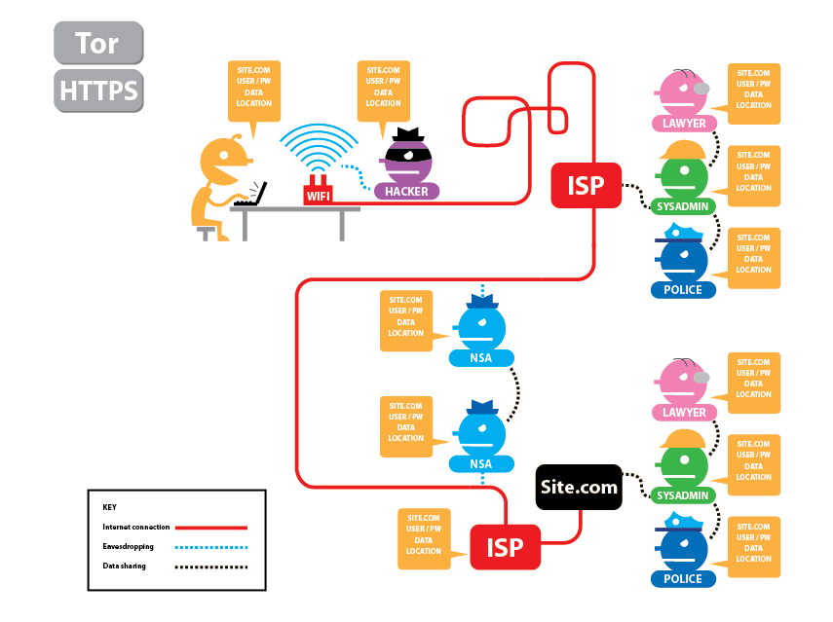

Tor

Slide 13
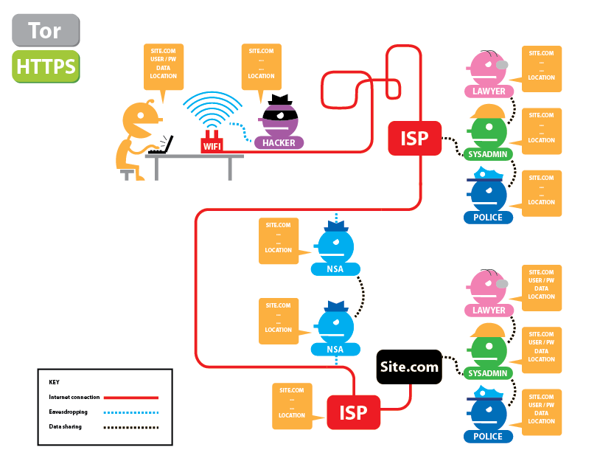
Tor

Slide 14
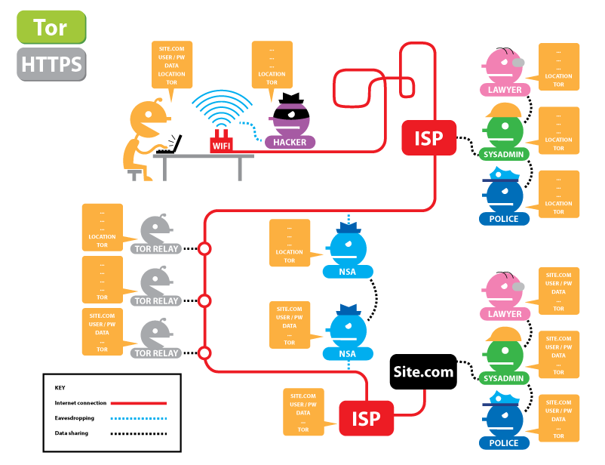
Tor

Slide 15
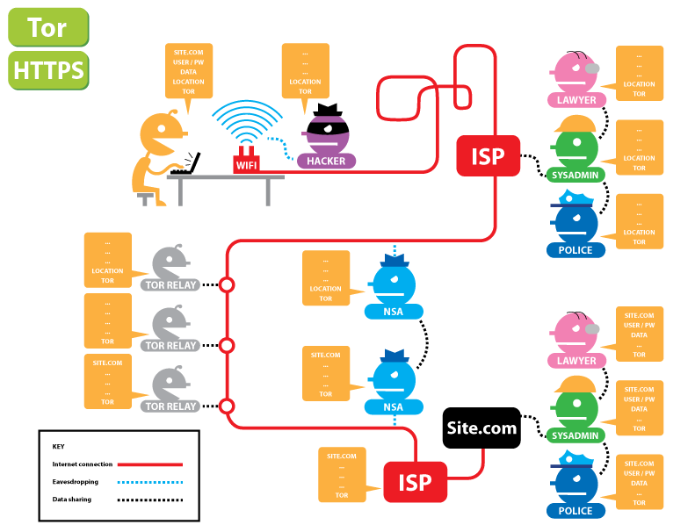
Tor

Slide 16
Q & A

