Slide 1
Agent & Messaging
Asst.Prof.Drusawin Vongpramate
Information Technology
Science, BRU

Slide 2


Slide 3

Software Agent
A software agent is an piece of software that functions as an agent for a user or another program, working autonomously and continuously in a particular environment. It is inhibited by other processes and agents, but is also able to learn from its experience in functioning in an environment over a long period of time.

Slide 4
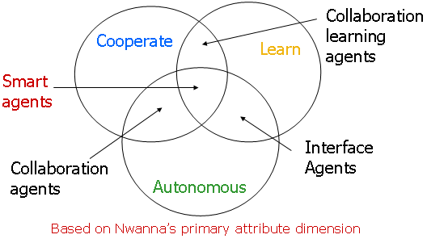
Software Agent
(Adaptation)

Slide 5
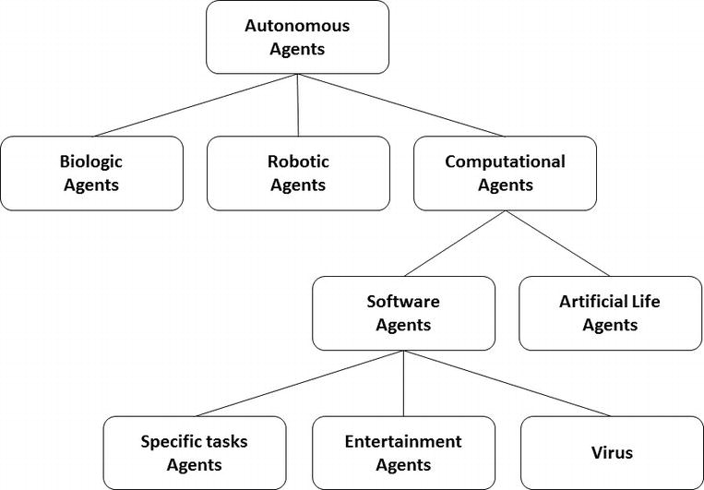
Software Agent
Franklin and Graesser

Slide 6
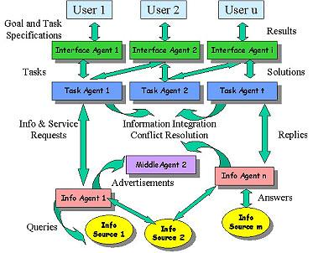

Slide 7
Example

Slide 8
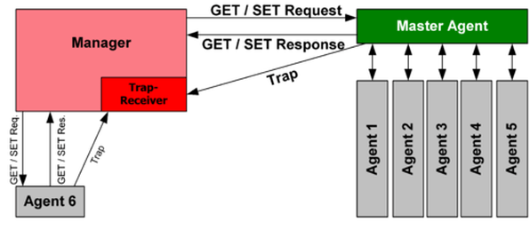
Simple Network Management Protocol (SNMP)
Notes:
Application Layer - UDP 161

Slide 9
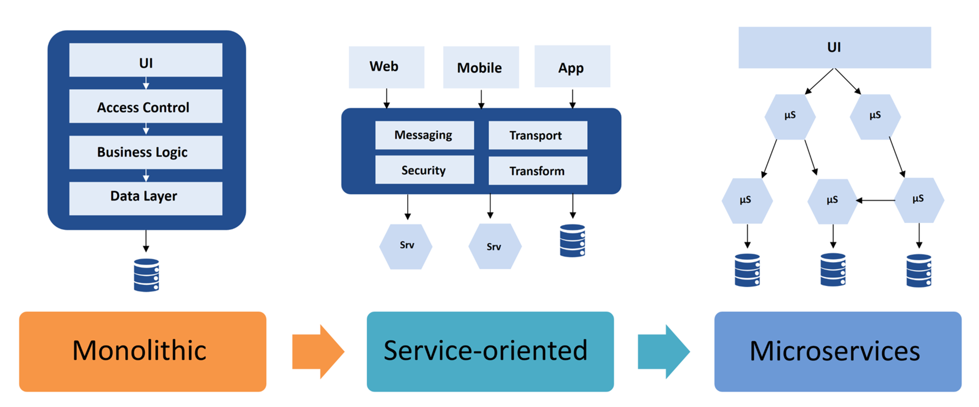
Software Architecture

Slide 10
More Examples
- Google uses software agents (spiders/robots) to periodically visit web sites to index them in google search engine. An e commerce agent finds the best price for a phone model on e commerce sites
- A chatbot is a a computer program designed to simulate an intelligent conversation with human users. Most chat bots simply scan for keywords within the input and pull a reply with the most matching answer from a database.

Slide 11
Messaging
Instant messaging (IM) technology is a type of online chat that offers real-time text transmission over the Internet. Some IM applications can use push technology to provide real-time text. More advanced instant messaging can add file transfer, clickable hyperlinks, Voice over IP, or video chat.

Slide 12
Messaging Protocols
Protocol | Publisher |  | Protocol | Publisher
IRC | Jarkko Oikarinen |  | SMS/MMS /EMS/Call | Friedhelm Hillebrand
MSNP | Microsoft |  | Skype | Skype
OSCAR (AIM, ICQ) | AOL |  | YMSG | Yahoo!
Signal Protocol | Signal Messenger |  | Gadu-Gadu | GG Network

Slide 13
Messaging Clients
Client | Creator |  | Client | Creator
AOL Instant Messenger (AIM) | AOL |  | Line | LINE Corporation
Google Allo | Google, Inc. |  | WeChat / QQ | Tencent Holdings
ICQ | Mail.Ru |  | Skype | Skype Technologies
Facebook Messenger | Facebook, Inc. |  | FaceTime | Apple Inc.

Slide 14
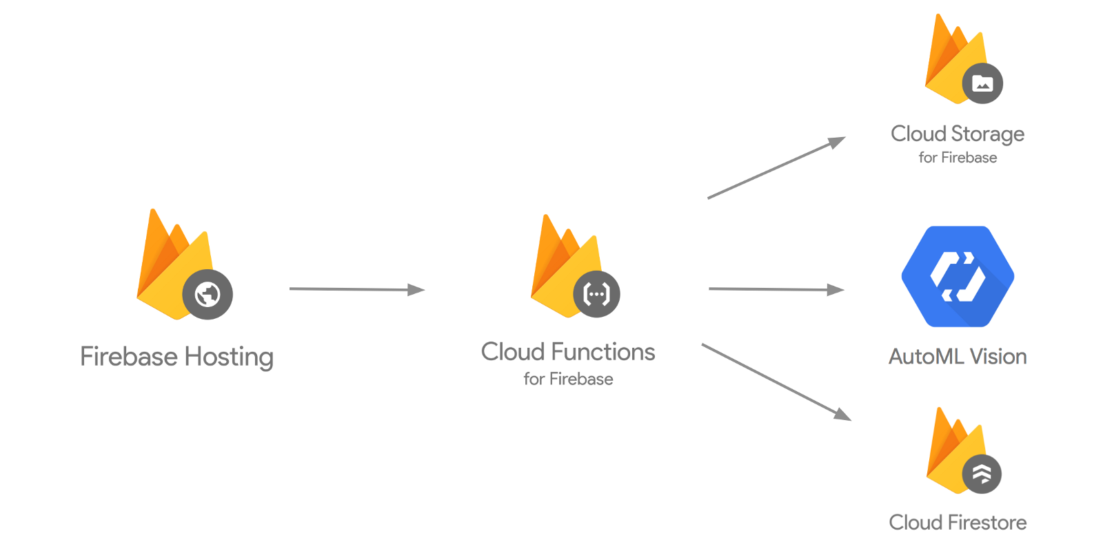
Firebase
Firebase is Google's mobile platform that helps you quickly develop high-quality apps and grow your business.

Slide 15

Firebase Cloud Messaging
Firebase Cloud Messaging (FCM) is a cross-platform service that handles the sending, routing, and queuing of messages between server applications and mobile client apps. FCM is the successor to Google Cloud Messaging (GCM), and it is built on Google Play Services.

Slide 16
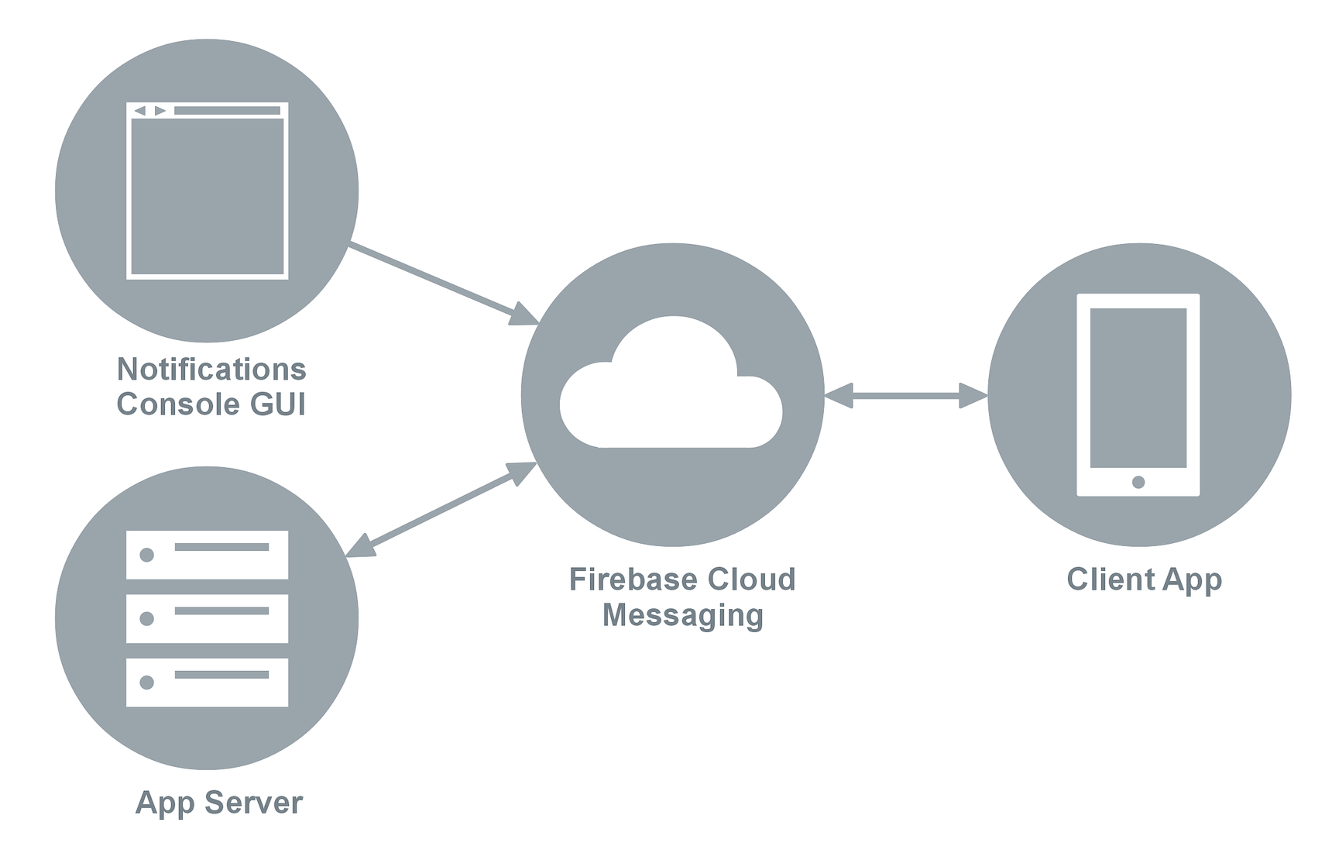
FCM Architecture
Ref :: https://docs.microsoft.com/en-us/xamarin/android/data-cloud/google-messaging/firebase-cloud-messaging#setup_fcm

Slide 17
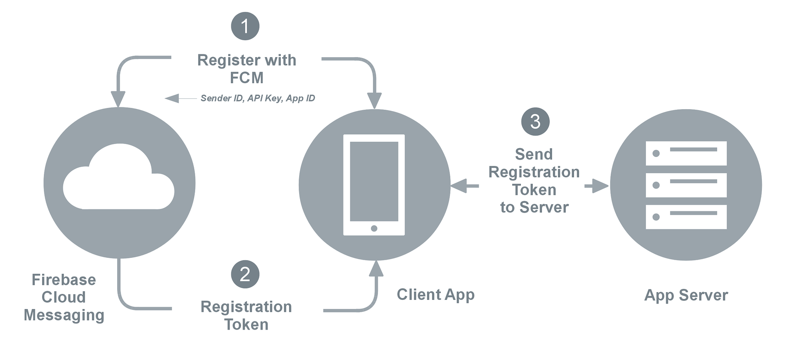
Registration
Sender ID : 496915549731
API Key : AJzbSyCTcpfRT1YRqbzjIwp1h06YdauvewGDzk.
App ID : 1:415712510732:android:0e1eb7a661af2460
Registration Token : fkBQTHxKKhs:AP91bHuEedxM4xFAUn0z ... dsaeZ (a very long string)

Slide 18
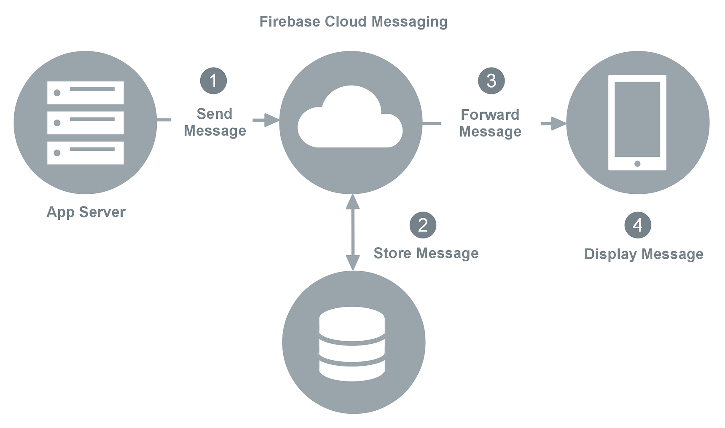
Downstream messaging

Slide 19
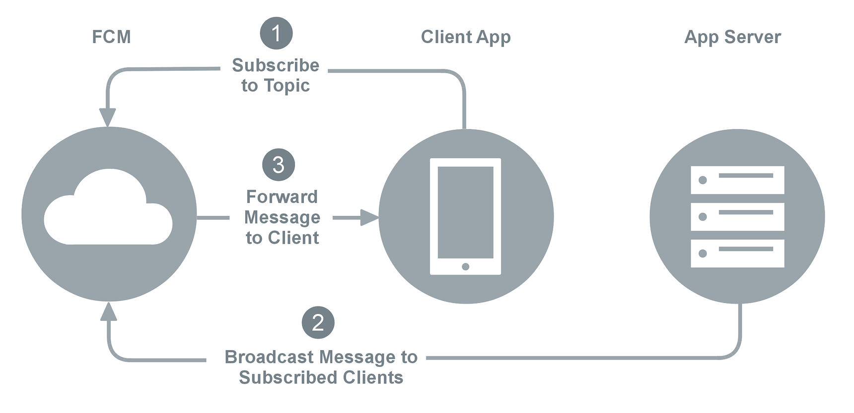
Topic messaging

Slide 20
Q & A

