Slide 1
Search Engines & Online Auction
Asst.Prof.Drusawin Vongpramate
Information Technology
Science, BRU

Slide 2
Search Engines
Crawl: Scour the Internet for content, looking over the code/content for each URL they find.
Index: Store and organize the content found during the crawling process. Once a page is in the index, it’s in the running to be displayed as a result to relevant queries.
Rank: Provide the pieces of content that will best answer a searcher's query, which means that results are ordered by most relevant to least relevant
Ref : https://moz.com/beginners-guide-to-seo/how-search-engines-operate

Slide 3
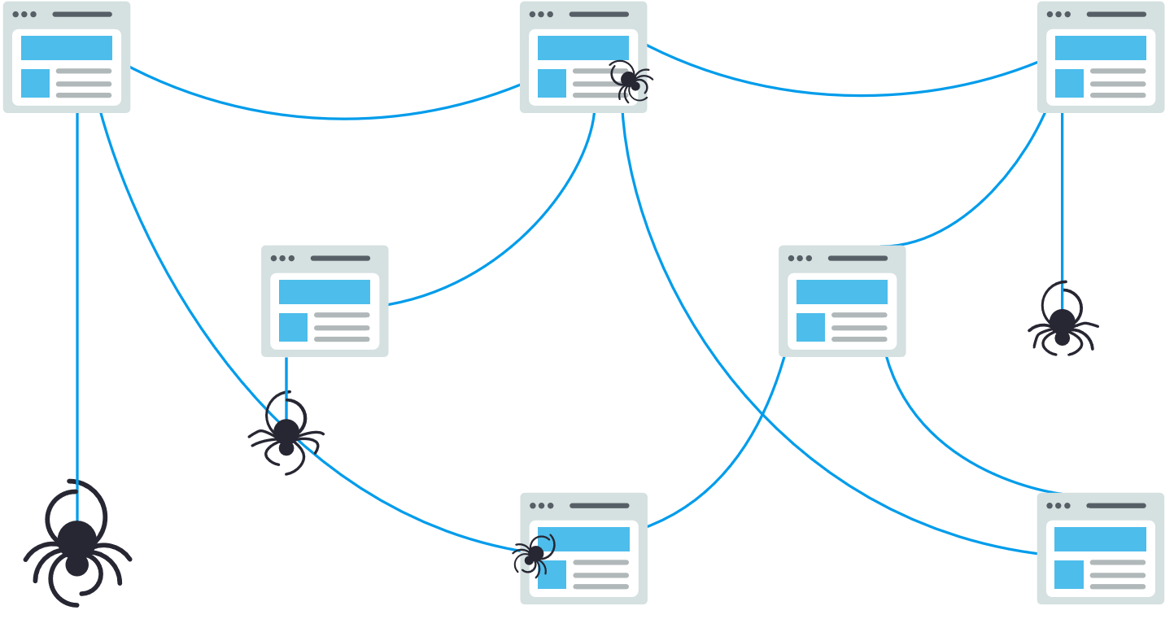
Crawling

Slide 4
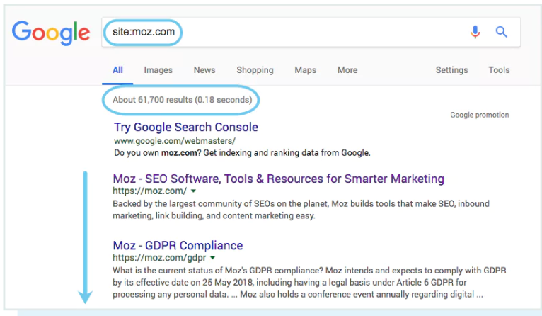
Crawling
One way to check indexed pages is "site:yourdomain.com", an advanced search operator. This will return results Google has in its index for the site specified:

Slide 5
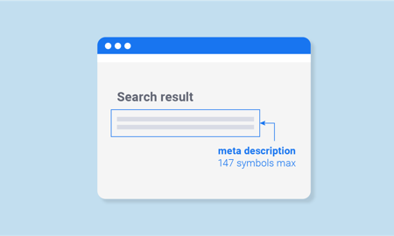
Robot
Meta directives (or "meta tags") are instructions you can give to search engines regarding how you want your web page to be treated.

Slide 6
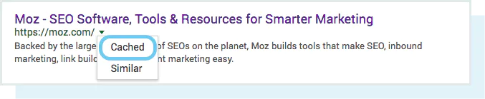
Googlebot
Google crawls and caches web pages at different frequencies. More established, well-known sites that post frequently

Slide 7
Robots meta tag
An example of a meta robots noindex, nofollow tag:
<!DOCTYPE html>
<html>
<head>
<meta name="robots" content="noindex, nofollow" />
</head>
<body>...</body>
</html>

Slide 8
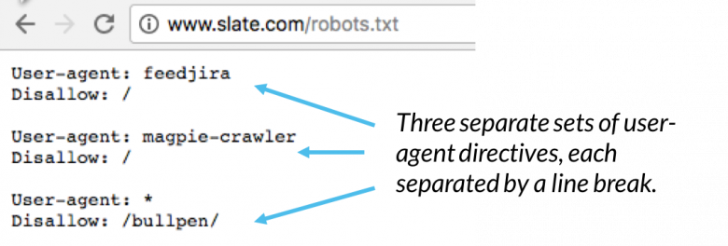
Robots.txt
Robots.txt files are located in the root directory of websites
ex. yourdomain.com/robots.txt
and suggest which parts of your site search engines should and shouldn't crawl, as well as the speed at which they crawl site

Slide 9
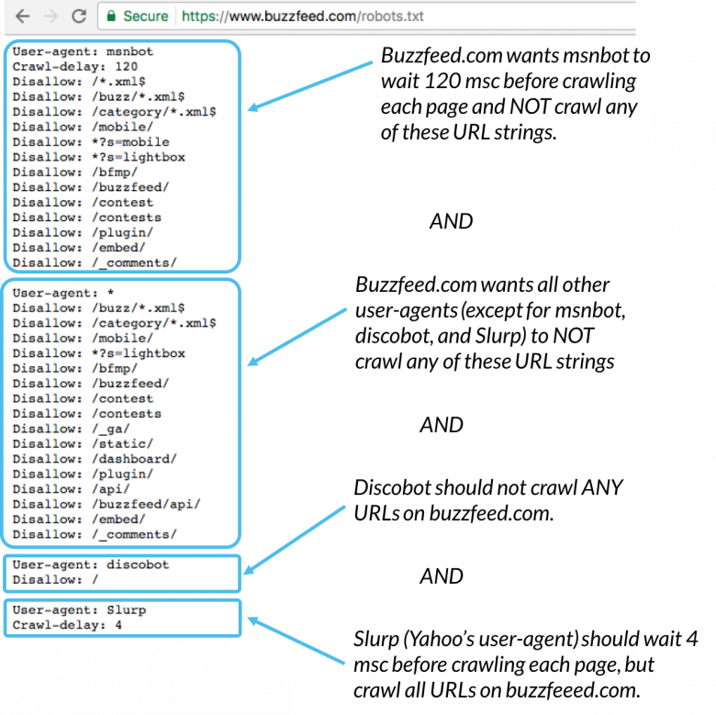

Slide 10

Crawl Errors
In the process of crawling the URLs on site, a crawler may encounter errors. Server log files can also show you this, as well as a treasure trove of other information such as crawl frequency, but because accessing and dissecting server log files is a more advanced tactic.

Slide 11
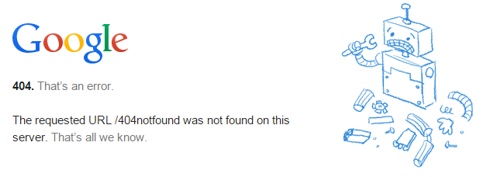
Crawl Errors
4xx Codes: When search engine crawlers can’t access your content due to a client error
5xx Codes: When search engine crawlers can’t access your content due to a server error

Slide 12
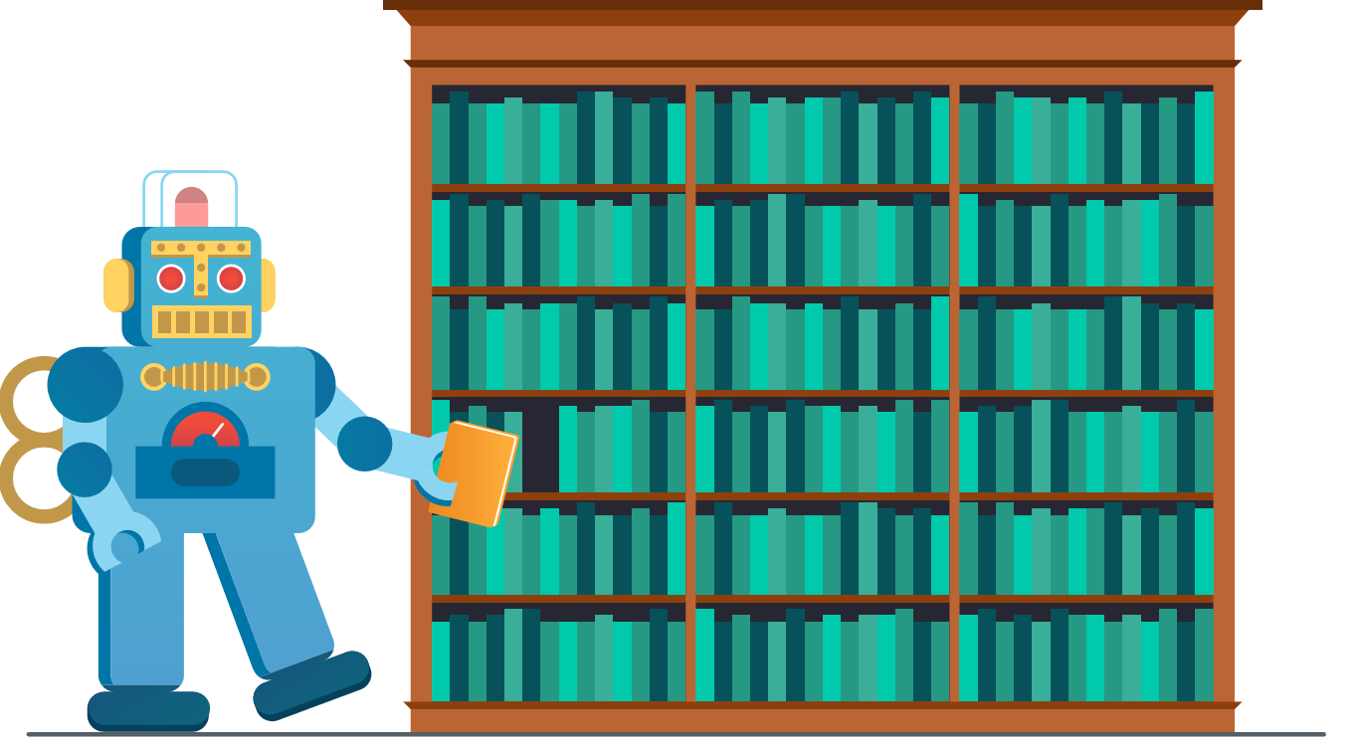
Indexing
The index is where your discovered pages are stored. After a crawler finds a page, the search engine renders it just like a browser would. In the process of doing so, the search engine analyzes that page's contents. All of that information is stored in its index.

Slide 13
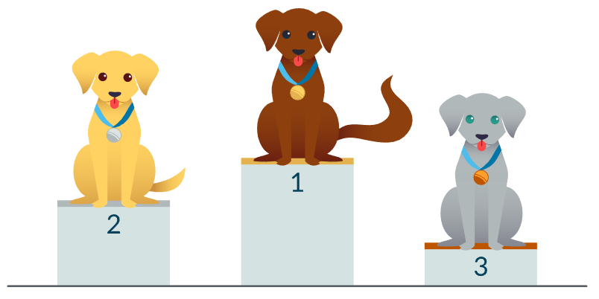
Ranking
Search engines have always wanted the same thing: to provide useful answers to searcher’s questions in the most helpful formats. If that’s true, then why does it appear that SEO (Search Engine Optimization) is different now than in years past?
https://moz.com/google-algorithm-change

Slide 14
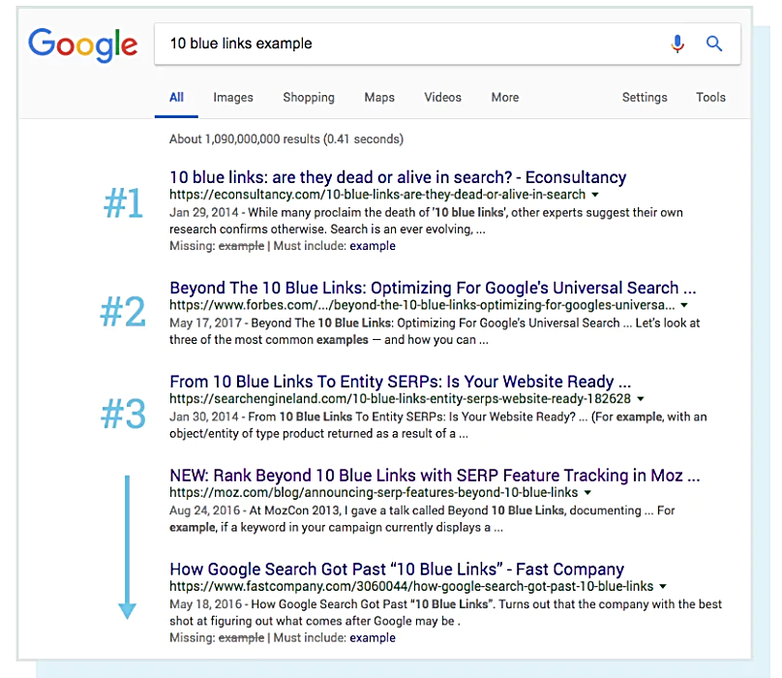

Slide 15
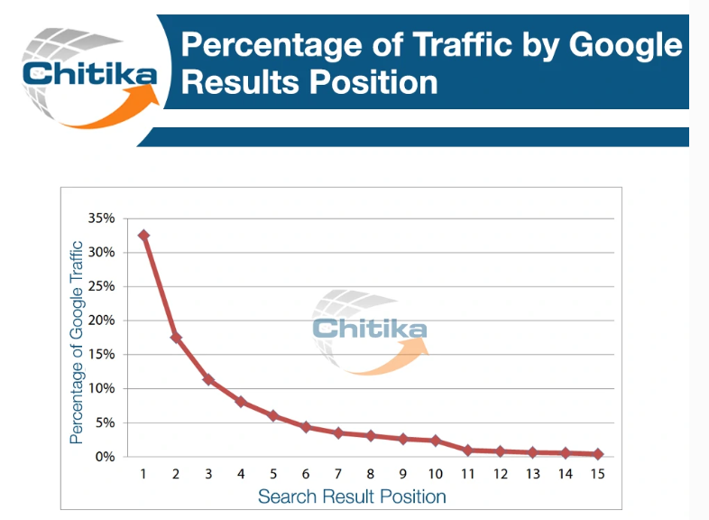

Slide 16
Removed pages from index
The URL is returning a "not found" error (4XX) or server error (5XX) – This could be accidental (the page was moved and a 301 redirect was not set up) or intentional (the page was deleted and 404ed in order to get it removed from the index)
The URL had a noindex meta tag added – This tag can be added by site owners to instruct the search engine to omit the page from its index.

Slide 17
Removed pages from index
The URL has been manually penalized for violating the search engine’s Webmaster Guidelines and, as a result, was removed from the index.
The URL has been blocked from crawling with the addition of a password required before visitors can access the page.

Slide 18
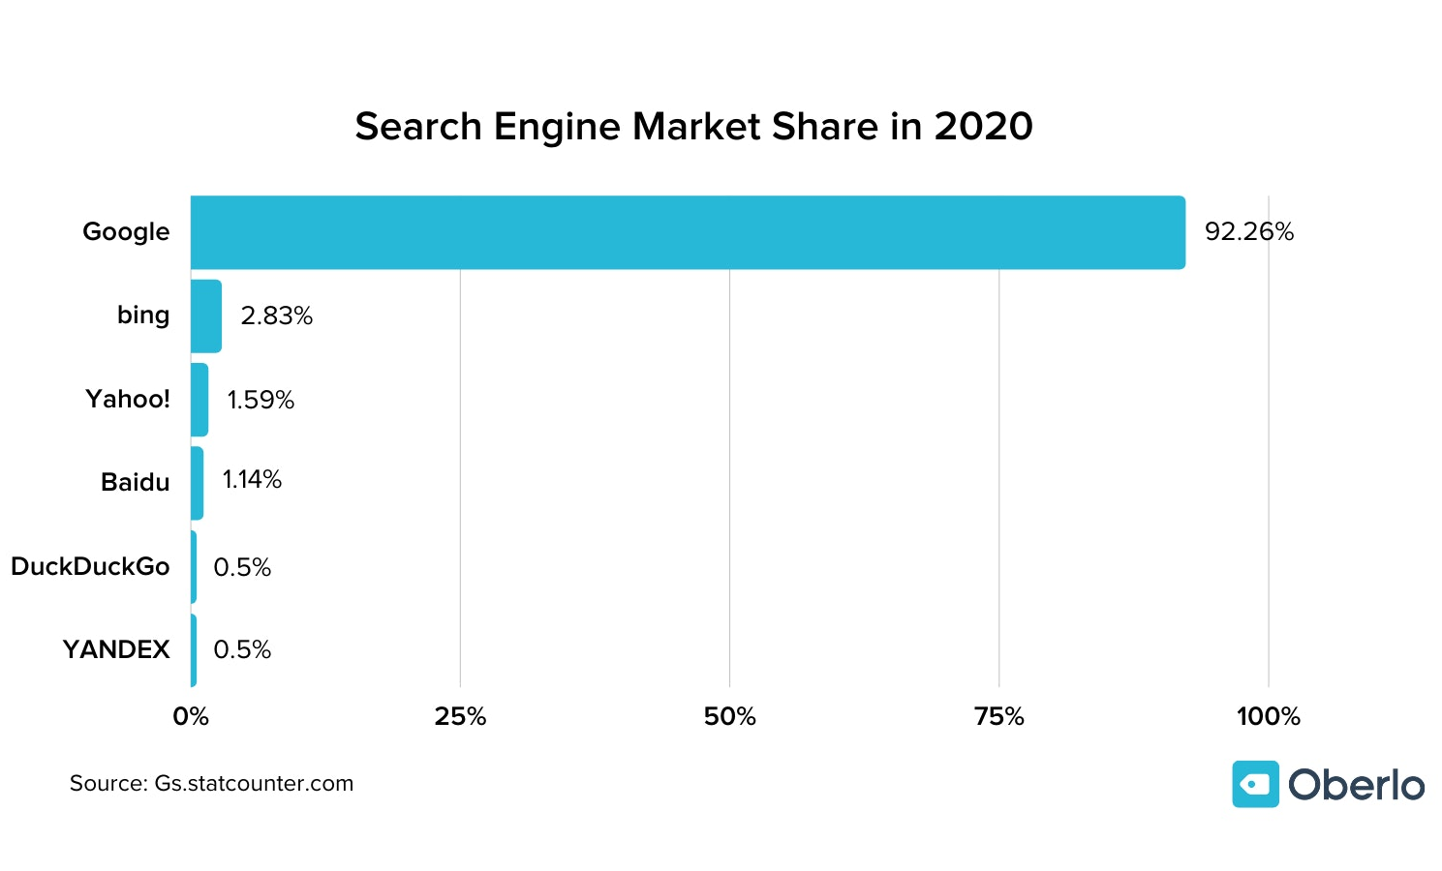

Slide 19
Online Auction
An online auction is an auction which is held over the internet. Online auctions come in many different formats, but most popularly they are ascending English auctions, descending Dutch auctions, first-price sealed-bid, Vickrey auctions, or sometimes even a combination of multiple auctions, taking elements of one and forging them with another.

Slide 20
Types
English auctions (max price) / Forward Auction [Sale]
Dutch auctions (up-down) [Buy]
First-price sealed-bid
Vickrey auction (Second Price sealed)
Reverse auction (Lowest price)
Bidding fee auction

Slide 21
Models
Common-value model
In this model all individual bidders have different information about the actual value of the object even though the value is known to every bidder. In this situation bidders typically change their estimates of the value according to the information they get from the behavior of the people they bid against.
Private-value model
In this model information from the competitors is not taken into account when estimating the actual value of the object. In these models, each bidder gets a private signal, and the value to the bidder is a function of all signals.

Slide 22

Top 10 Best Auction Sites
Webstore
eCrater
Listia
Ubid
Bonanza
OnlineAuction.com
Atomic Mall
Ebid
Liquidation

Slide 23
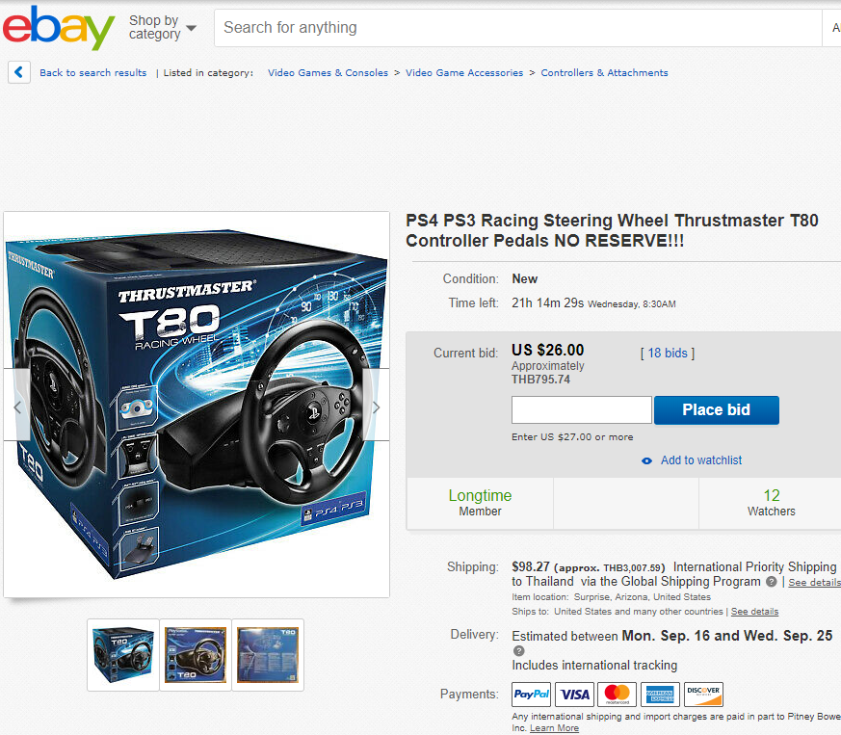

Slide 24
Q & A

