Slide 1
eCommerce
Aj.Drusawin Vongpramate
Information Technology
Science, BRU

Slide 2
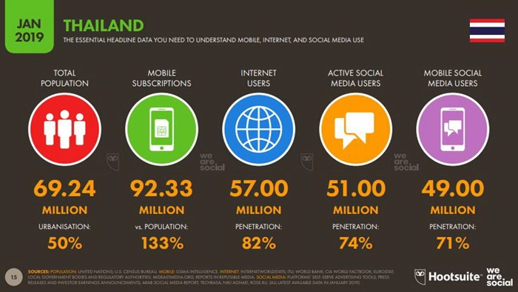

Slide 3
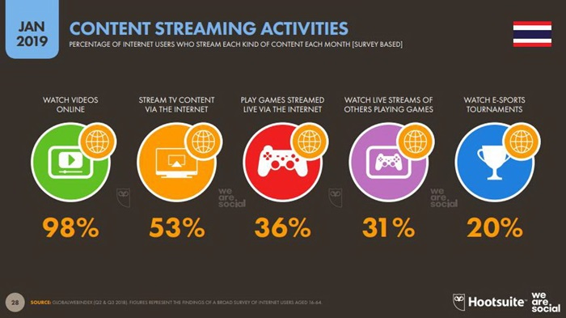

Slide 4
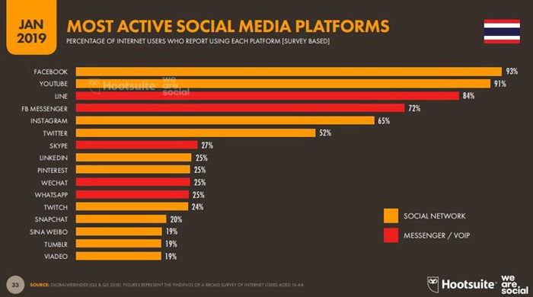

Slide 5
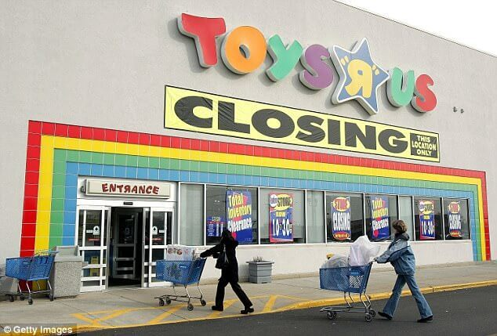
eCommerce Trends To Watch For In 2019
Retail will either evolve or continue to die
REF : https://www.coredna.com/blogs/ecommerce-trends https://www.psdcenter.com/top-20-ecommerce-trends-for-2019-to-boost-your-sales

Slide 6

eCommerce Trends To Watch For In 2019
Consumers will drive retail innovation

Slide 7
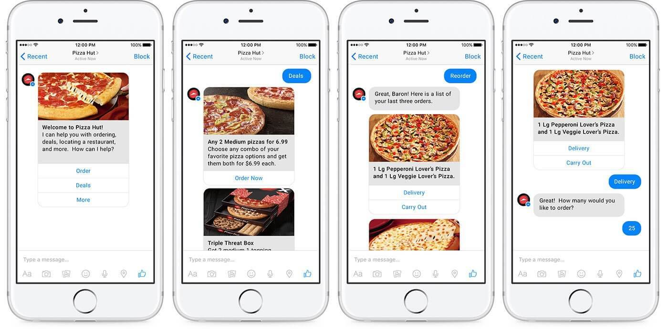
eCommerce Trends To Watch For In 2019
Chatbots will become a standard part of the eCommerce toolkit

Slide 8
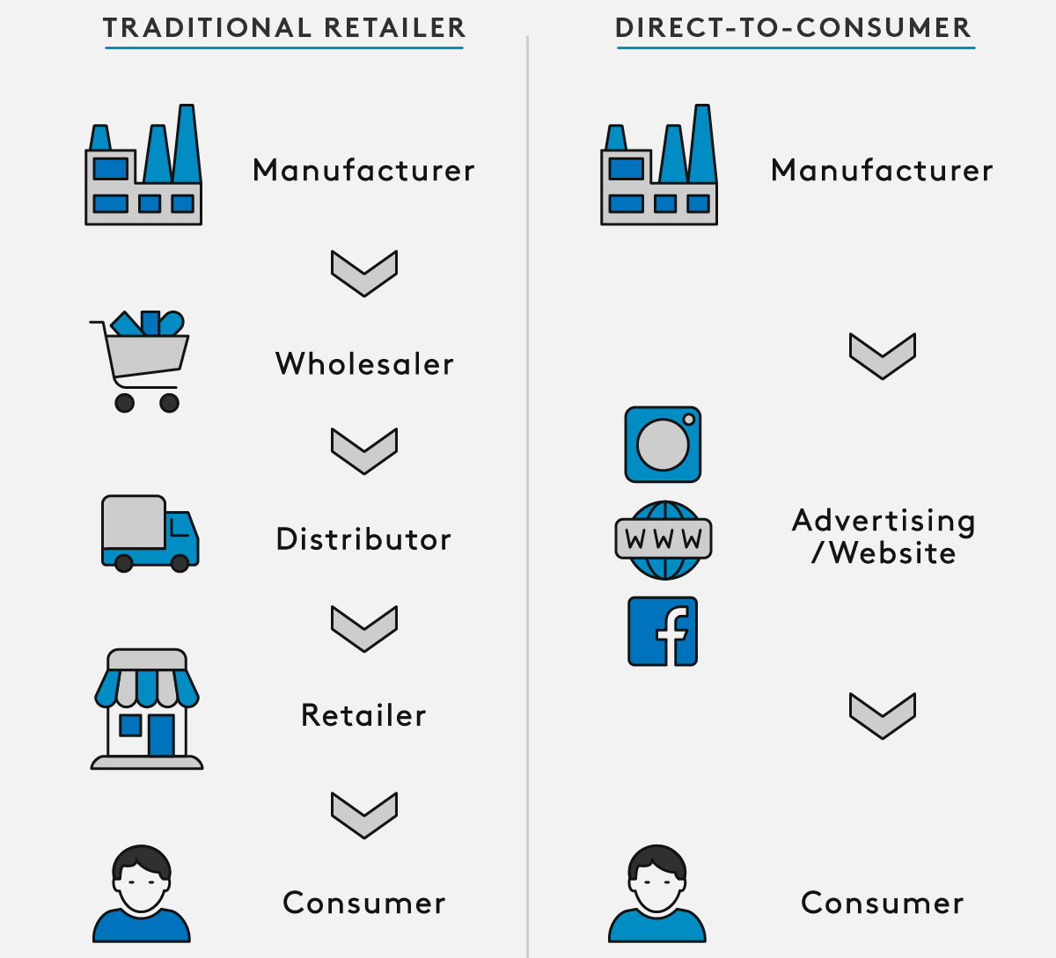
21 eCommerce Trends To Watch For In 2019
A shift toward D2C (Direct to Customer)

Slide 9
21 eCommerce Trends To Watch For In 2019
eCommerce brands are going brick-and-mortar
“Going brick-and-mortar” has a number of benefits, including:
The ability to engage more directly with your customers
The ability to provide an enhanced experience to said customers

Slide 10
eCommerce Trends To Watch For In 2019
B2B eCommerce growth will accelerate = B2C
Death of the middleman
Smart home assistants & voice recognition systems will emerge as a new eCommerce battleground
Machine learning and AI-assisted eCommerce will smooth out sales funnels
Better Payment Methods (Cryptocurrency)
Expect even more subscription boxes

Slide 11
eCommerce Trends To Watch For In 2019
Mobile payments will increase
Brands will unite to create larger marketplaces
Personalization gets “fancy”
Fulfillment comes to the share economy
Brands are pouring money on TrueView Shopping
The rise of decoupled or headless content and commerce systems
Companies will get more creative with Shoppable Instagram Stories

Slide 12
eCommerce Trends To Watch For In 2019
Influencer marketing will keep driving sales
Analytics platforms will continue to evolve
To Amazon or not to Amazon... (SEO)
Voice Search will change the face of SEO
Research Online Purchase Offline (ROPO)
Advanced Product Search
Image Search

Slide 13
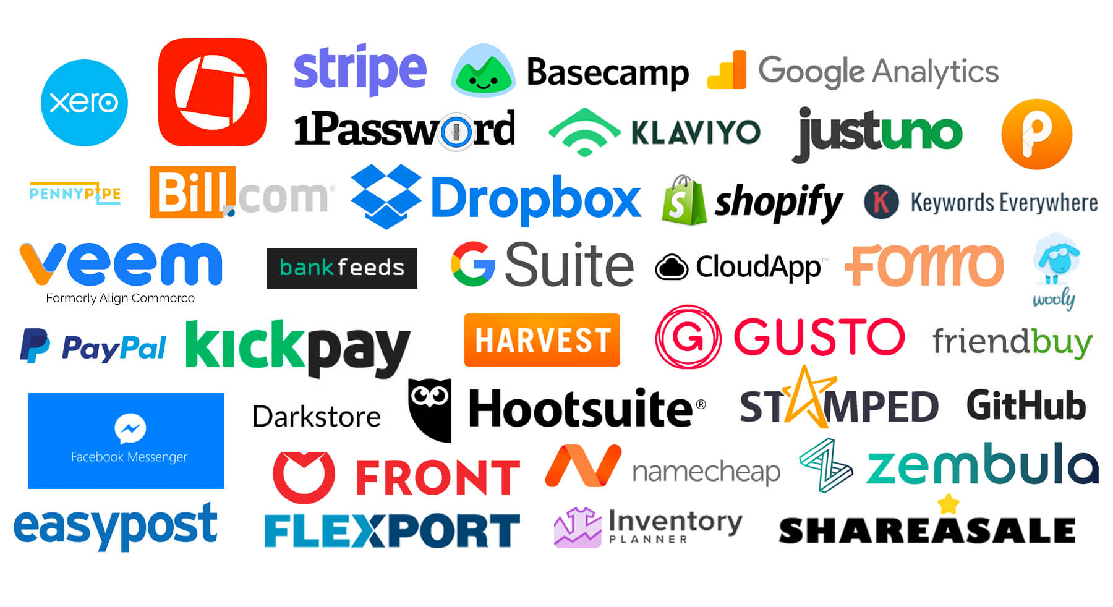
Tools

Slide 14
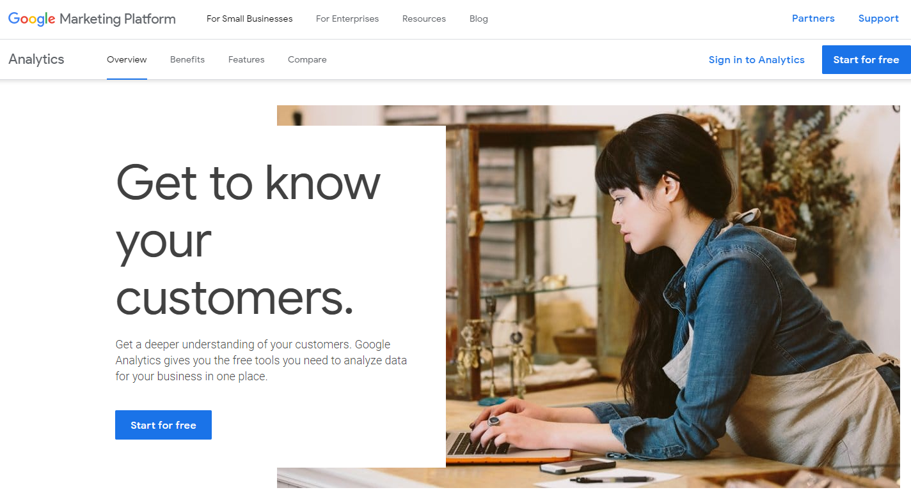
Google Marketing Platform

Slide 15
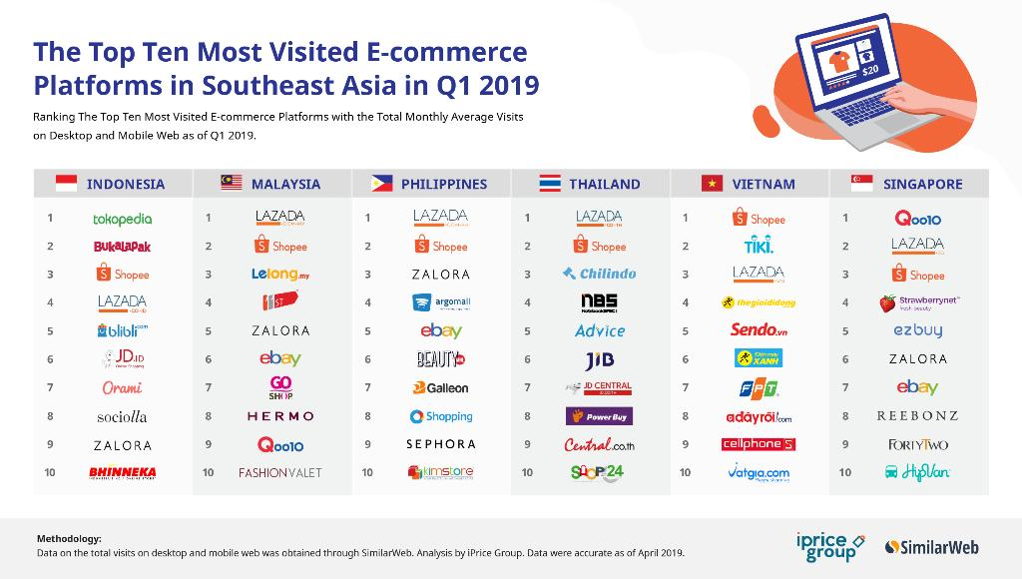
Platform

Slide 16
Advantage
Speed up the buying process and save time for customers
Makes wider options for customers than to buy products from physical store
Saves costs for the business owner for employees that can be replaced with virtual support
Easy to retarget customers. For example, with coupons, left e-mail addresses, google search analysis
REF : https://medium.com/magebit/advantages-and-disadvantages-of-ecommerce-40313012d3a9

Slide 17
Advantage
Easy to encourage impulsive purchases
Available reviews and recommendations
Available detailed information about the product
Possibility to lower costs due to cutting physical store rent, staff, store design etc.
Quicker marketing because it is easier to pull eCommerce business into online marketing
Flexibility for customers to shop 24/7

Slide 18
Advantage
Less store set up costs and quicker return of investments
Quicker training for new employees because all information about products is already given
Less human errors on eCommerce owners’ side
Possibility to easily compare products and prices
No geographical limits

Slide 19
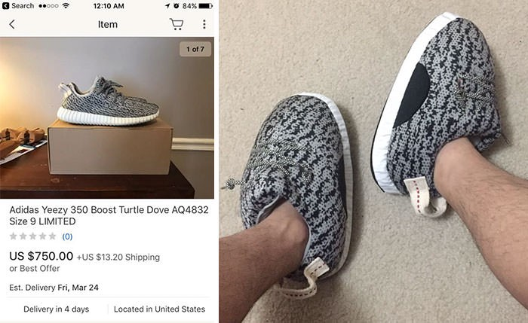
Disadvantage
Lack of personal touch
Insecurity about the quality

Slide 20
Disadvantage
Possible late delivery due to third parties
Insecurity about personal information
Very competitive business because of the growth of online stores
Mostly there is no possibility to receive a sample or to try on
Site crashes

Slide 21
Q & A

