Slide 1
Streaming
Aj.Drusawin Vongpramate
Information Technology
Science, BRU

Slide 2
Streaming
In the early days of streaming media -- the mid-to-late 1990s -- watching videos and listening to music online wasn't always fun.
In 2006, 57 million people listen to Internet radio every week. They watched more than a million streaming videos a day on YouTube [source: Reuters]. The same year, television network ABC started streaming its most popular TV shows over the Web.
Ref : https://computer.howstuffworks.com/internet/basics/streaming-video-and-audio.htm

Slide 3
Streaming
All of this data gets to where it needs to go because of sets of rules known as protocols, which govern the way data travels from one device to another. You've probably heard of one protocol -- hypertext transfer protocol (HTTP) deals with hypertext documents, or Web pages. Every time you surf the Web, you're using HTTP.

Slide 4
Streaming
streaming video and audio use protocols that allow the transfer of data in real time. They break files into very small pieces and send them to a specific location in a specific order. These protocols include:
Real-time transfer protocol (RTP)
Real-time streaming protocol (RTSP)
Real-Time Messaging Protocol (RTMP)
Real-time transport control protocol (RTCP)

Slide 5
Real-Time Messaging Protocol
The "plain" protocol which works on top of and uses TCP port number 1935 by default.
RTMPS, which is RTMP over a TLS/SSL connection.
RTMPE, which is RTMP encrypted using Adobe's own security mechanism. While the details of the implementation are proprietary, the mechanism uses industry standard cryptographic primitives.^{[1]}
RTMPT, which is encapsulated within HTTP requests to traverse firewalls. RTMPT is frequently found utilizing cleartext requests on TCP ports 80 and 443 to bypass most corporate traffic filtering. The encapsulated session may carry plain RTMP, RTMPS, or RTMPE packets within.
RTMFP, which is RTMP over UDP instead of TCP, replacing RTMP Chunk Stream. The Secure Real-Time Media Flow Protocol suite has been developed by Adobe Systems and enables end‐users to connect and communicate directly with each other (P2P).

Slide 6
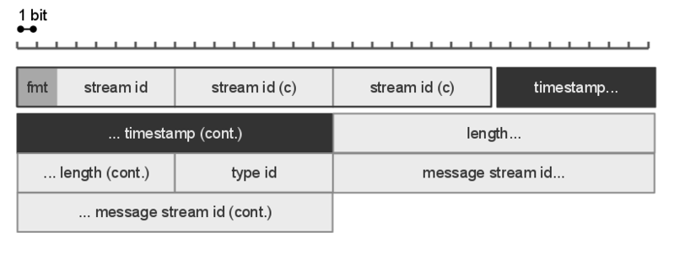
RTMP Packet Diagram

Slide 7
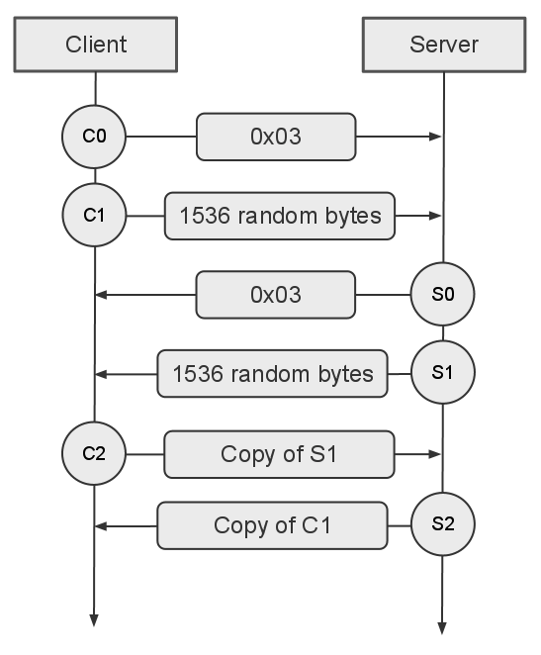
RTMP Handshake Diagram

Slide 8
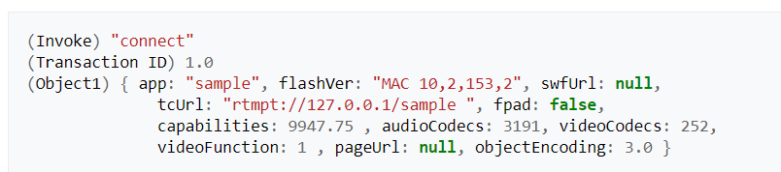
Connect
At this point, the client and server can negotiate a connection by exchanging AMF encoded messages. These include key value pairs which relate to variables that are needed for a connection to be established. An example message from the client is:
Notes:
Action Message Format

Slide 9
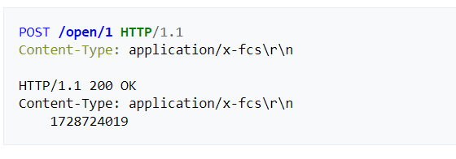
HTTP tunneling (RTMPT)
This refers to the HTTP tunneled version of the protocol. It communicates over port 80 and passes the AMF data inside HTTP POST request and responses. The sequence for connection is as follows:

Slide 10
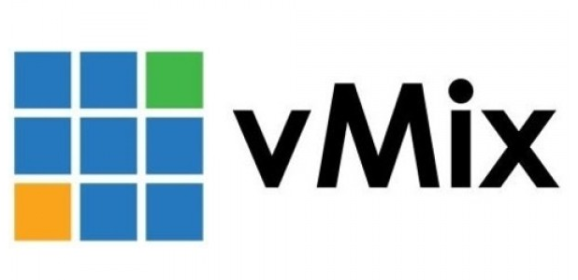



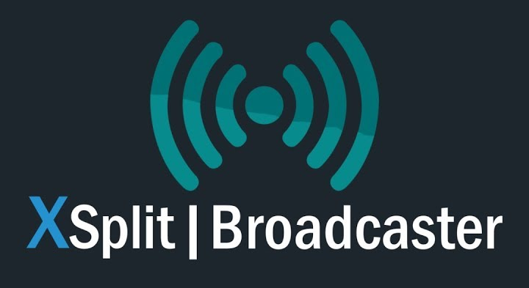
Tools

Slide 11
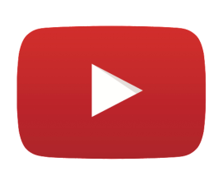
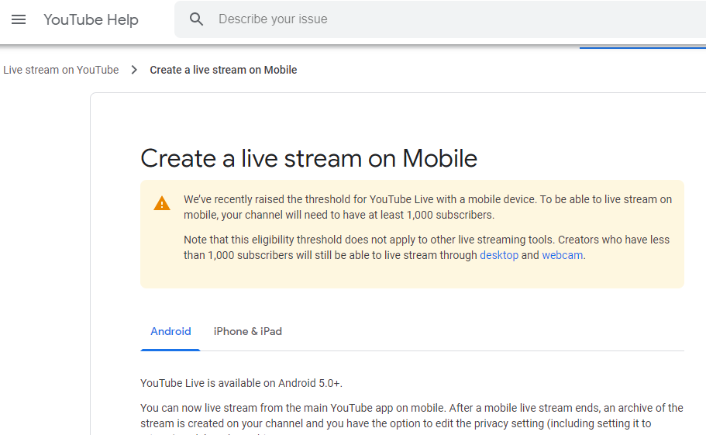
Tools (Mobile)

Slide 12
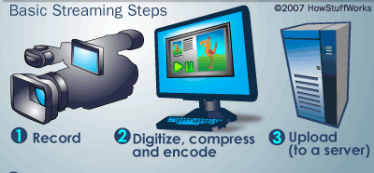
Creator

Slide 13
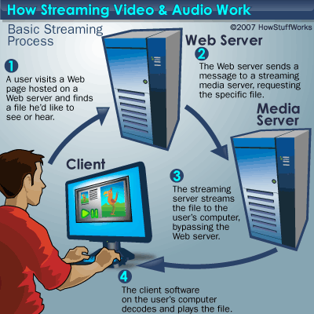
User

Slide 14
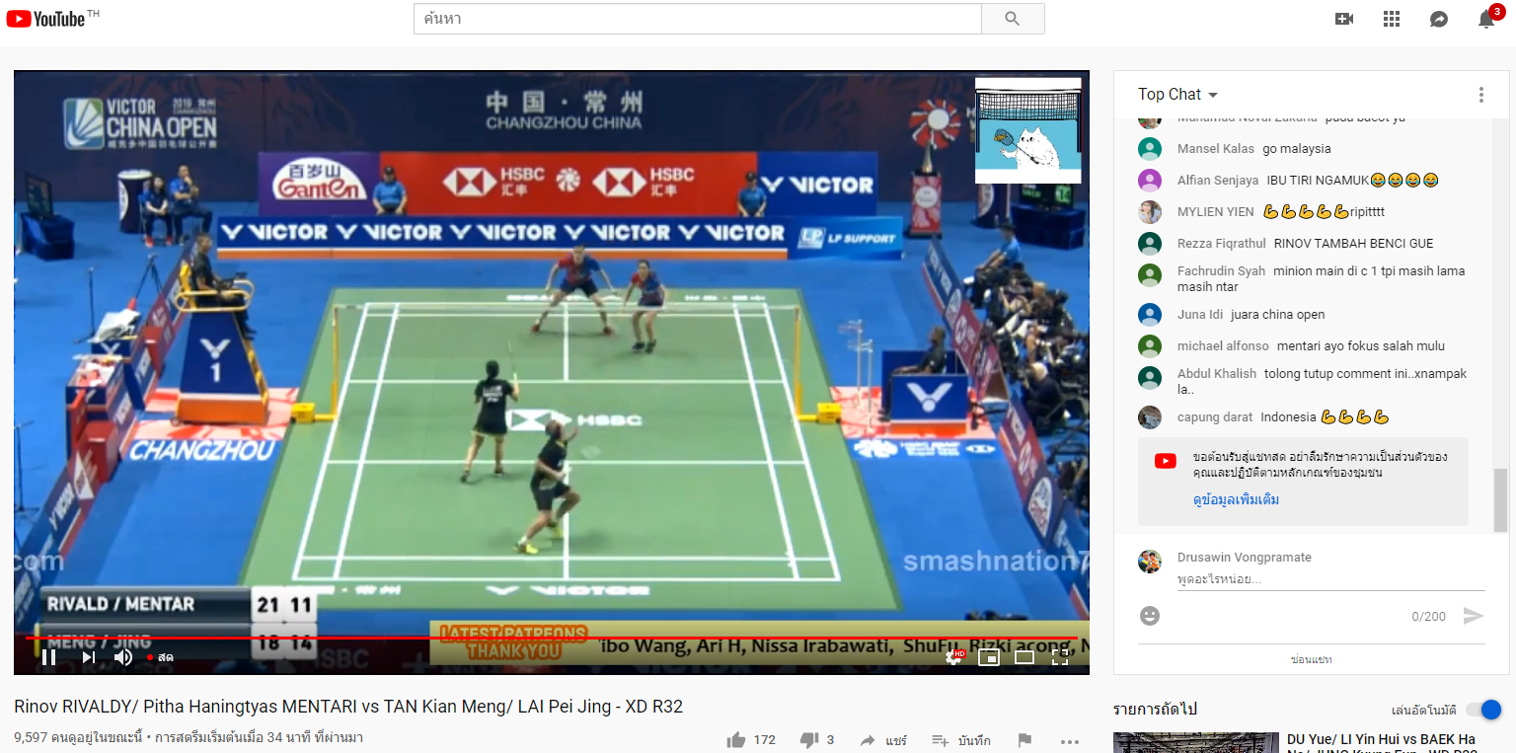
Example

Slide 15
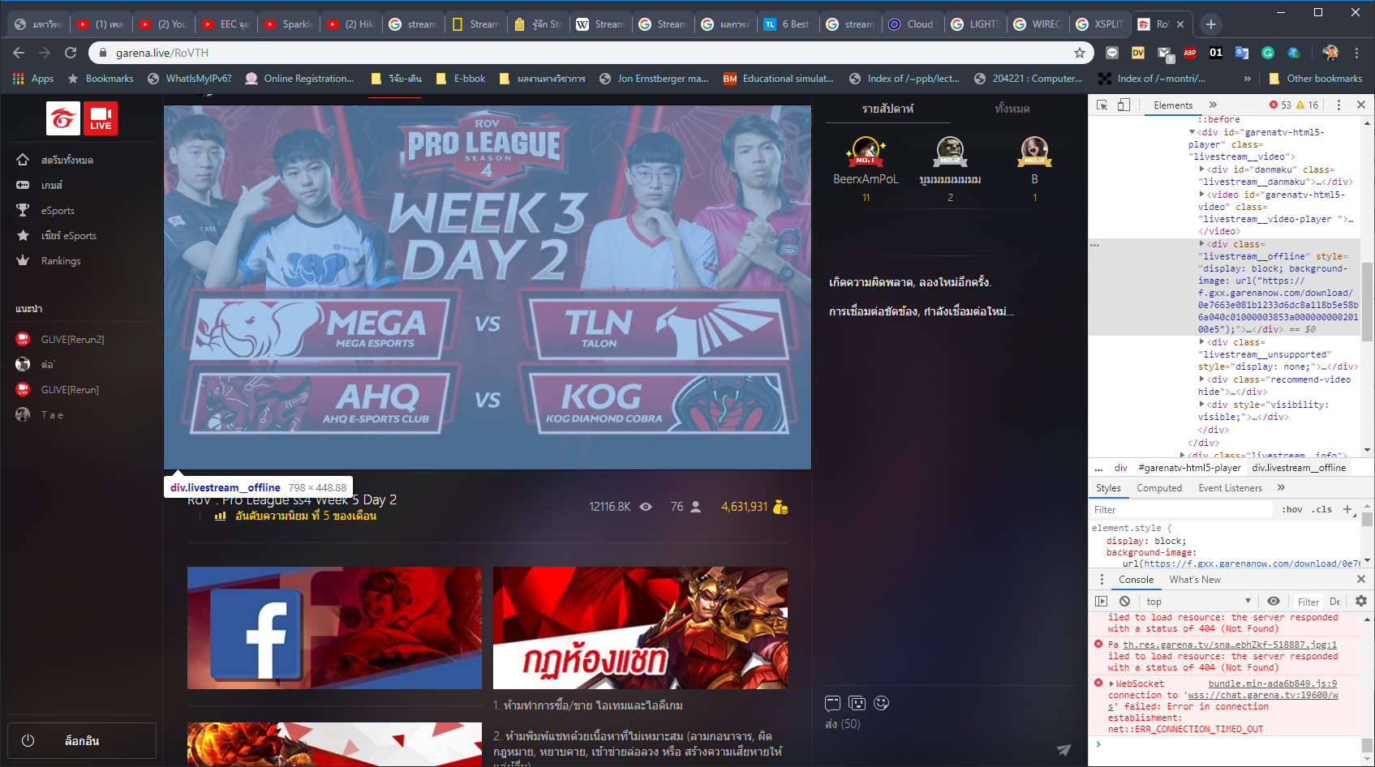
Example

Slide 16
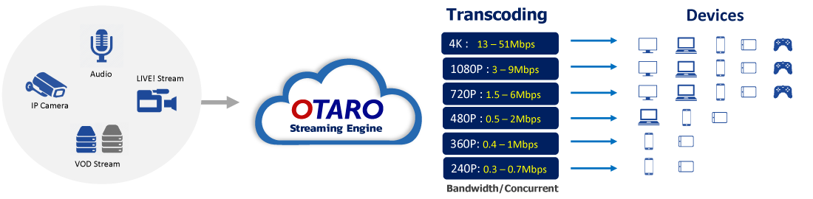
Cloud Streaming Service

Slide 17
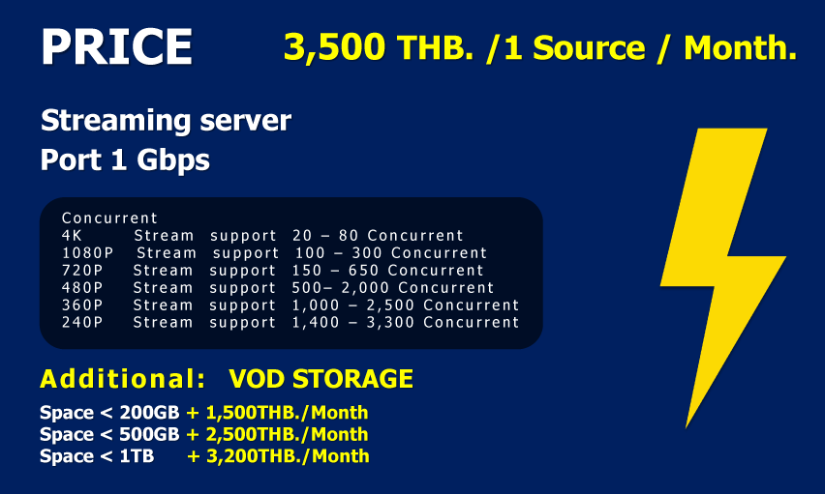
Cloud Streaming Service

Slide 18
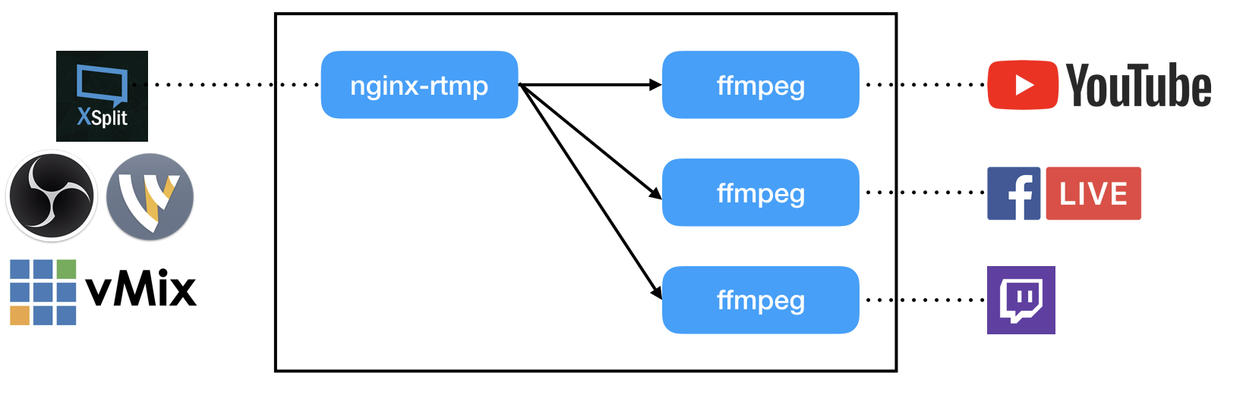
Restreaming
Upload a single stream and simultaneously rebroadcast to multiple other streaming destinations (e.g. Facebook, YouTube, Periscope, Twitch, Steam etc). Also broadcast to a custom server or any platform that accepts RTMP input.

Slide 19
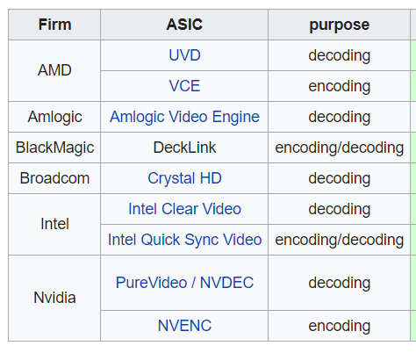
FFmpeg
A free and open-source project consisting of a vast software suite of libraries and programs for handling video, audio, and other multimedia files and streams.

Slide 20
Example
docker run --rm --link nginx-rtmp:nginx-rtmp -d jrottenberg/ffmpeg -i rtmp://nginx-rtmp/live/<your stream key> -c copy -f flv
'rtmp://a.rtmp.youtube.com/live2/<youtube stream key>'
docker run --rm --link nginx-rtmp:nginx-rtmp jrottenberg/ffmpeg -i rtmp://nginx-rtmp/live/sodsodnaja -c:a libfdk_aac -b:a 128k -c:v libx264 -b:v 3000k -f flv -g 30 -r 30 -s 1280x720 -profile:v baseline
'rtmp://rtmp-api.facebook.com:80/rtmp/facebook-stream-key'

Slide 21
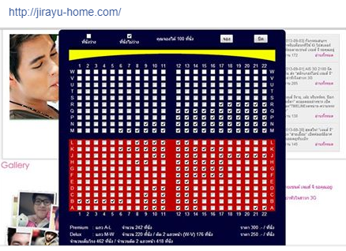
Example

Slide 22
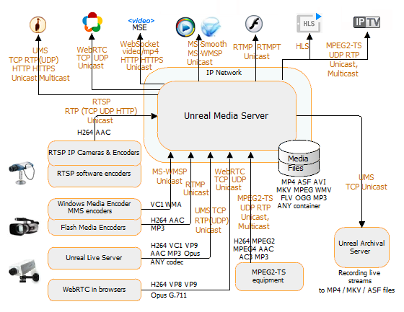
Example

Slide 23
Q & A

