Slide 1
Security
Aj.Drusawin Vongpramate
Information Technology
Science, BRU

Slide 2

The Need for Security
The Internet has, in many ways, become a victim of its own success. The Internet community now comprises many millions of people world-wide and as in any large community there are the
“good-guys” and the “bad-guys”.
REF: Keith Sutherland.2018.Understanding the Internet A Clear Guide to Internet Technologies, p77-96

Slide 3
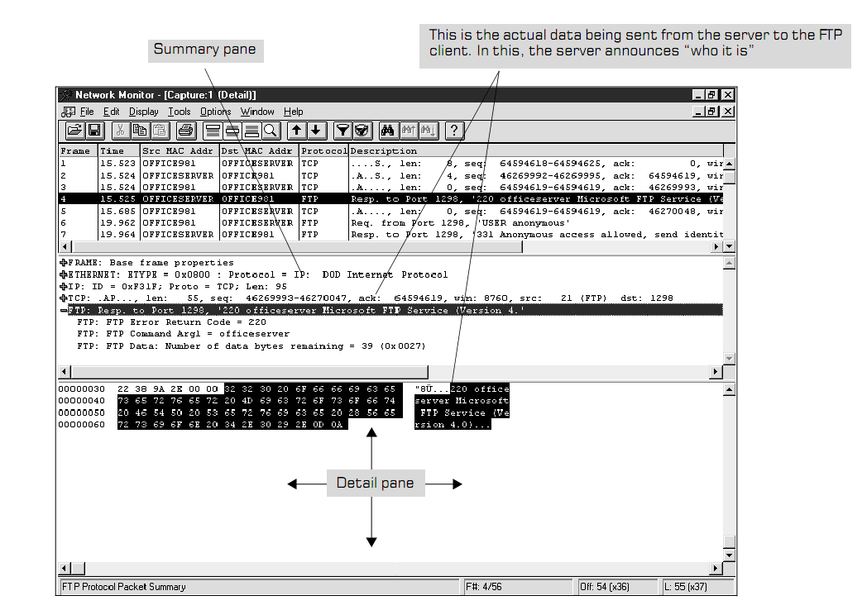
sniffer

Slide 4
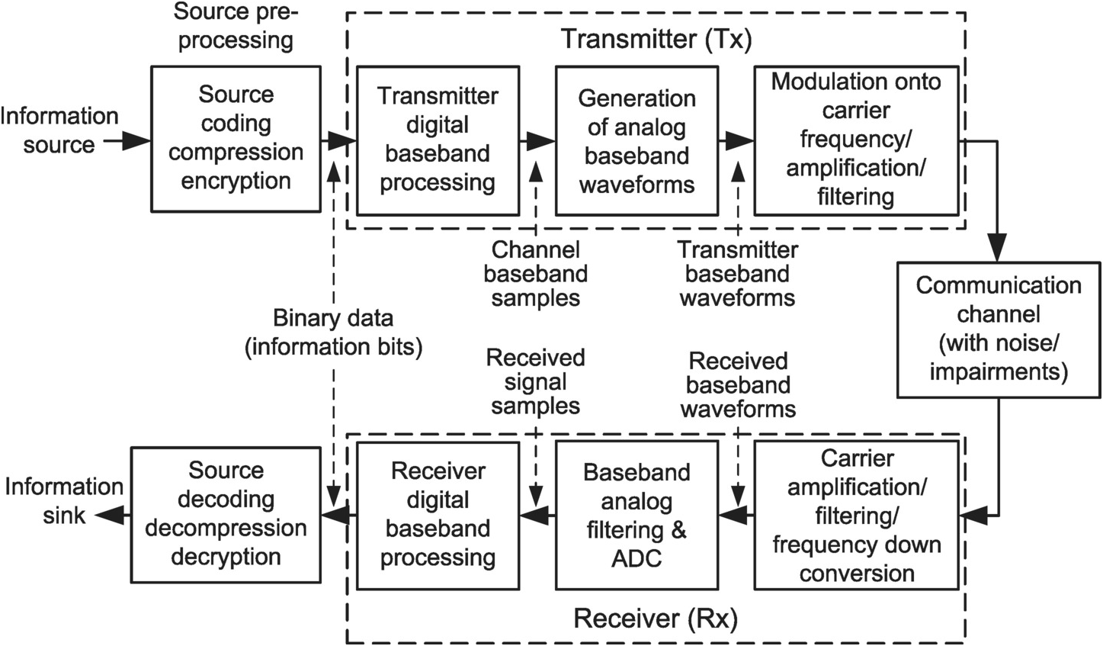
Digital Communication System (CH3)

Slide 5
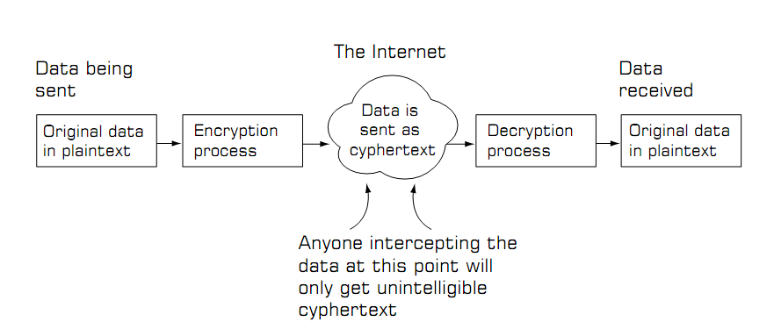
Protecting Data

Slide 6
Protecting Data
Most systems use a means of securing the data that can be divided into two parts. These are the algorithm (process) and the key.
Algorithms are the techniques used to conceal the patterns of data in a message.
The keys are patterns of binary digits that are fed into the algorithm together with the data to produce an unreadable and indecipherable output. This output is often referred to as cyphertext.

Slide 7
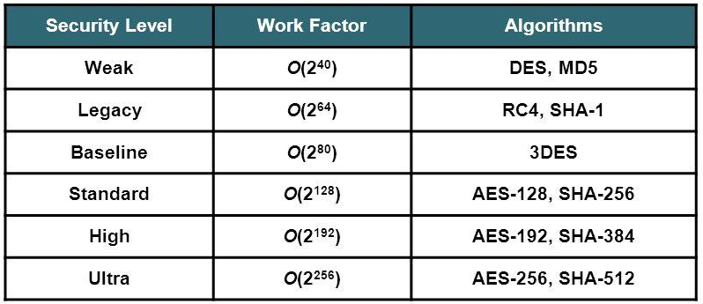
Secret Algorithm
Caesar cipher
HELLO => JGNNQ
MD5
HELLO => c65f99f8c5376adadddc46d5cbcf5762f9e55eb7
1,099,511,627,776 possibilities.

Slide 8
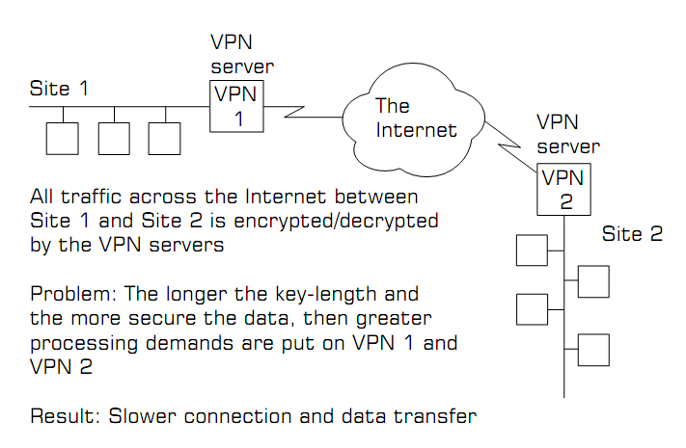
Virtual Private Networks
In such a VPN set-up the keys used to encrypt and decrypt the data are
the same. This is referred to as symmetric key encryption.

Slide 9
Public–Private Keys
If we want to authenticate our clients, and we want to be able to prove our existence to prospective customers, then a more flexible and elegant solution is required.
The answer to this is in public key encryption (often referred to as asymmetric key encryption).

Slide 10
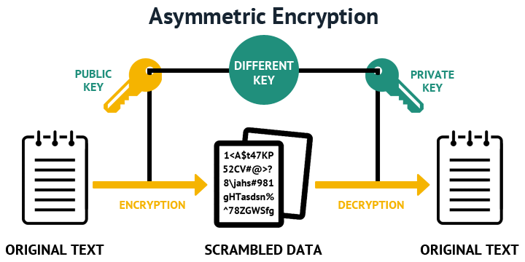
Public–Private Keys

Slide 11
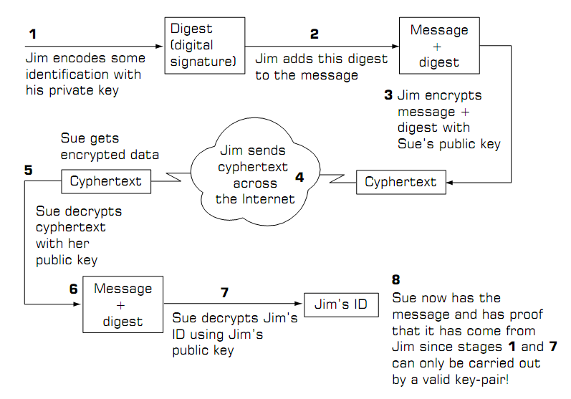
Digital Signature

Slide 12
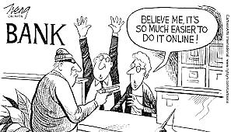
Other Solutions
Most banks and other financial organisations use a combination of certification and an authenticating system called challenge/response to guarantee authentication. Once this has been done then a combination of public/private key encryption is used to protect the data.
https://www.techspot.com/news/77780-hacker-steal-millions-eastern-european-banks-sneaking-devices.html

Slide 13
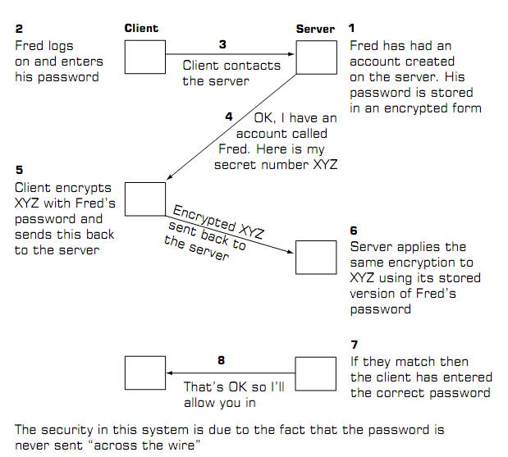
Challenge/Response
P : Personal
I : Identification
N : Number
O : One
T : Time
P : Password

Slide 14
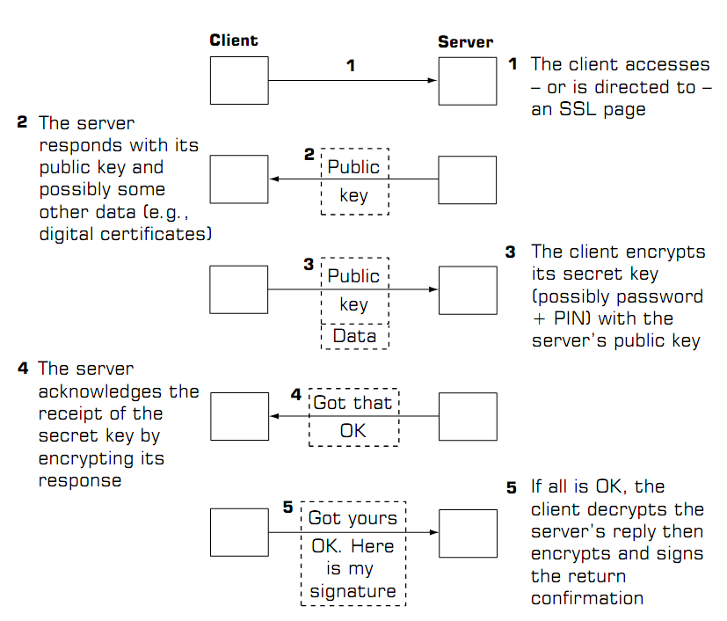
Secure Sockets Layer (SSL)
password-based

Slide 15
Q & A

