Slide 1
HTML & PHP
Aj.Drusawin Vongpramate
Information Technology
Science, BRU

Slide 2
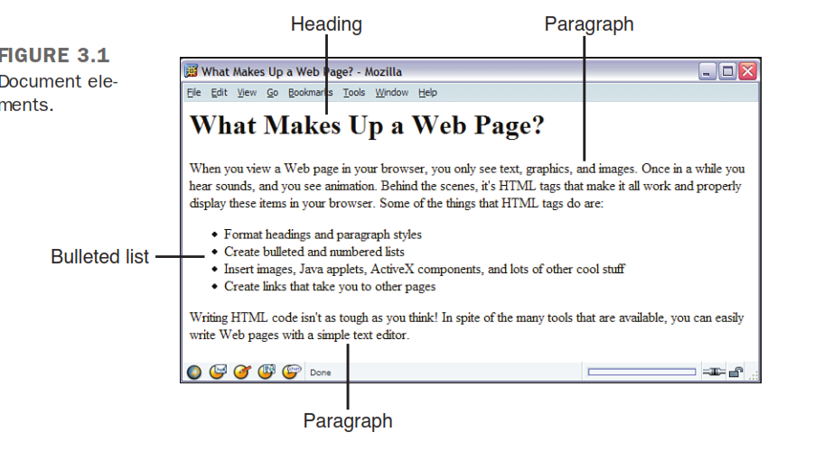
What HTML Is (And What It Isn’t)
HTML Describes the Structure of a Page

Slide 3
What HTML Is (And What It Isn’t)
HTML Does Not Describe Page Layout
HTML doesn’t go this far. For the most part, the HTML specification doesn’t say anything about how a page looks when it’s viewed. HTML tags just indicate that an element isa heading or a list; they say nothing about how that heading or list is to be formatted.
The only thing you have to worry about is marking which section is supposed to be a heading, not how that heading should look.

Slide 4
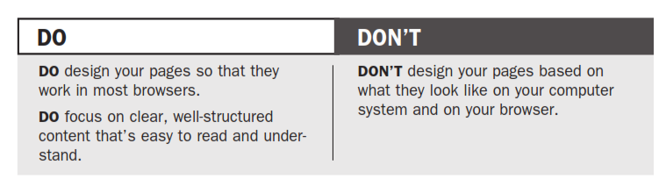
Why It Works This Way

Slide 5
How Markup Works
HTML is a markup language . Writing in a markup language means that you start with
the text of your page and add special tags around words and paragraphs. The tags indicate
the different parts of the page and produce different effects in the browser. You’ll learn
more about tags and how they’re used in the next section.

Slide 6
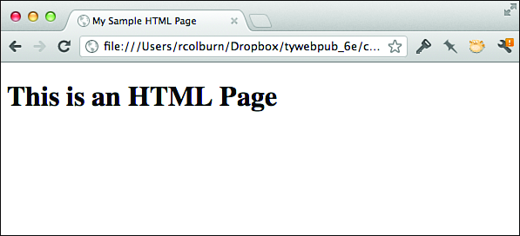
Creating Your First HTML Page
<!DOCTYPE html>
<html>
<head><title>My Sample HTML Page</title>
</head>
<body>
<h1>This is an HTML Page</h1>
</body>
</html>

Slide 7
Text Formatting and HTML
<h1>Everything You Need to Know About HTML </h1>
<h1>
Everything You Need to Know About HTML</h1>
<h1>
Everything You Need to Know About HTML
</h1>
<h1>Everything You Need to Know
About HTML </h1>

Slide 8
HTML Attributes
<h1 id="theTopHeading">Everything You Need to Know About HTML</h1>
<h1 id="theTopHeading" class="first">Everything You Need to Know About HTML</h1>

Slide 9
Using the style Attribute
<h1 style="font-family: Verdana, sans-serif;">Heading</h1>
<h1 class="headline" id="leadstoryheadline">Lead Story Headline</h1>

Slide 10
Structuring Your HTML
HTML defines three tags that are used to define the page’s overall structure and provide
some simple header information . These three tags—<html>, <head>, and <body>—make up the basic skeleton of every web page. They also provide simple information about the page (such as its title or its author) before loading the entire thing. The page structure tags don’t affect what the page looks like when it’s displayed; they’re only there to help
browsers.

Slide 11
<html> Tag
<!DOCTYPE html>
<html>
...your page...
</html>

Slide 12
<head> Tag
<!DOCTYPE html>
<html>
<head>
<title>Th
is is the Title. It will be explained later on</title>
</head>
...your page...
</html >

Slide 13
<body> Tag
<!DOCTYPE html><html>
<head>
<title>This is the Title. It will be explained later on</title>
</head>
<body>
...your page...
</body>
</html>

Slide 14
The Title
<!DOCTYPE html><html>
<head>
<title>The Lion, The Witch, and the Wardrobe</title>
</head>
<body>
...your page...
</body>
</html>

Slide 15
Headings
<h1>Movies</h1>
<h2>Action/Adventure</h2>
<h3>Caper</h3>
<h3>Sports</h3>
<h3>Thriller</h3>
<h3>War</h3>
<h2>Comedy</h2>
<h3>Romantic Comedy</h3>
<h3>Slapstick</h3>
<h2>Drama</h2>
<h3>Buddy Movies</h3>
<h3>Mystery</h3>
<h3>Romance</h3>
<h2>Horror</h2>

Slide 16
Paragraphs
Paragraphs are created using the <p> tag. The Enigern story should look like this:
<p>Slowly and deliberately, Enigern approached the mighty dragon.
A rustle in the trees of the nearby forest distracted his attention
for a brief moment, a near fatal mistake for the brave knight.</p>
<p>The dragon lunged at him, searing Enigern's armor with a rapid
blast of fiery breath. Enigern fell to the ground as the dragon
hovered over him. He quickly drew his sword and thrust it into the
dragon's chest.</p>

Slide 17
Comments
<!-- This is a comment -->
Here are some examples:
<!-- Rewrite this section with less humor -->
<!-- Neil helped with this section -->
<!-- Go Tigers! -->

Slide 18
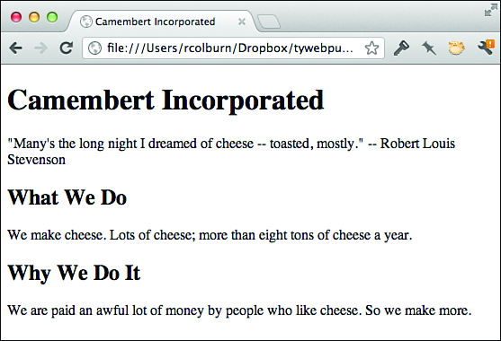
Creating a Real HTML Page
<!DOCTYPE html><html>
<head>
<title>Camembert Incorporated</title>
</head>
<body>
<h1>Camembert Incorporated</h1>
<p>"Many's the long night I dreamed of cheese -- toasted, mostly."
-- Robert Louis Stevenson</p>
<h2>What We Do</h2>
<p>We make cheese. Lots of cheese; more than eight tons of cheese
a year.</p>
<h2>Why We Do It</h2>
<p>We are paid an awful lot of money by people who like cheese.
So we make more.</p>
</body>
</html>

Slide 19
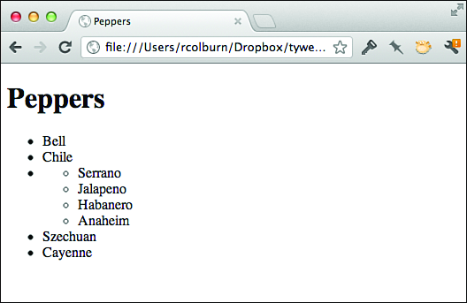
Lists
<h1>Peppers</h1>
<ul>
<li>Bell</li>
<li>Chile</li>
<li>
<ul>
<li>Serrano</li>
<li>Jalapeno</li>
<li>Habanero</li>
<li>Anaheim</li>
</ul>
</li>
<li>Szechuan</li>
<li>Cayenne</li>
</ul>

Slide 20
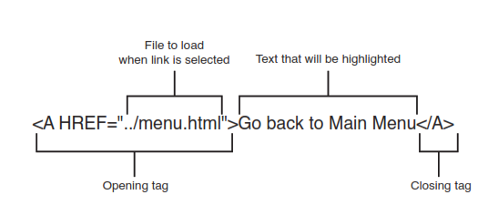
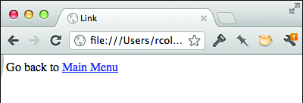
Links
<a href="menu.html" title="The Twelve Caesars">

Slide 21
Formatting Text with HTML and CSS
Semantic HTML Tags
<em> This tag indicates that the characters are emphasized in some way.Most browsers display <em> in italics. For example:
<p>The anteater is the <em>strangest</em> looking animal, isn't it?</p>
<strong> With this tag, the characters are more strongly emphasized than with
<em> usually in boldface. Consider the following:
<p>Take a <strong>left turn</strong> at <strong>Dee's Hop Stop</strong></p>

Slide 22
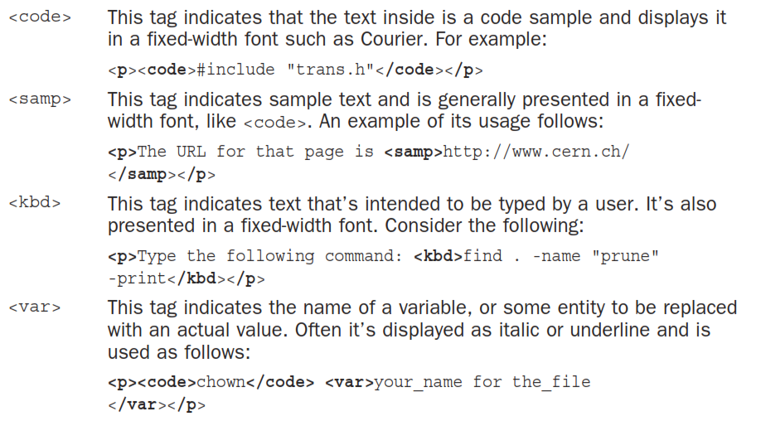
Formatting Text with HTML and CSS

Slide 23
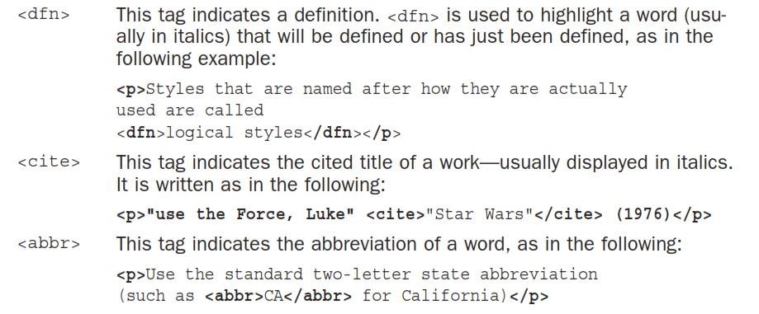
Formatting Text with HTML and CSS

Slide 24
Example
<p>The anteater is the <em>strangest</em> looking animal, isn't it?</p>
<p>Take a <strong>left turn</strong> at <strong>Dee's Hop Stop
</strong></p>
<p><code>#include "trans.h"</code></p>
<p>The URL for that page is <samp>http://www.cern.ch/</samp></p>
<p>Type the following command: <kbd>find . -name "prune" -print</kbd></p>
<p><code>chown </code><var>your_name the_file</var></p>
<p>Styles that are named after how they are used are called <dfn>logical
styles</dfn></p>
<p>Eggplant has been known to cause nausea in some
people<cite> (Lemay, 1994)</cite></p>
<p>Use the standard two-letter state abbreviation (such as
<abbr>CA</abbr> for California)</p>

Slide 25
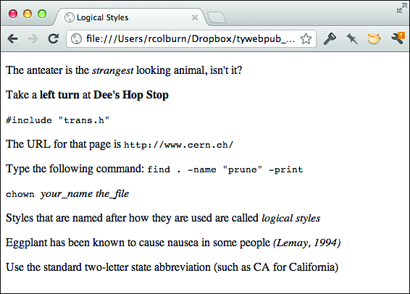

Slide 26
Changes to Physical Style Tags in HTML5
<b> Text that is usually bold
<i> Text that is usually displayed as italic
<u> Text that is usually displayed as underlined
<small> Text that displays as small print
<sub> Subscript
<sup> Superscript

Slide 27
Character Formatting Using CSS
<p>This is an example of the <span>usage of the span tag</span>.</p>

Slide 28
The Text Decoration Property
<p>Here is some <span style="text-decoration: underline;">underlined text
</span>.</p>
<p>Here is some <span style="text-decoration: overline;">overlined text</span>.
</p>
<p>Here is some <span style="text-decoration: line-through;">line-through text
</span>.</p>
<p>Here is some <span style="text-decoration: blink;">blinking text</span>.</p>

Slide 29
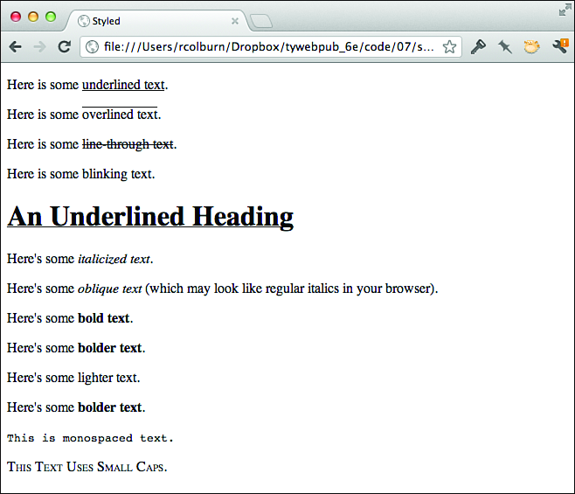
Font Properties
<p>Here's some <span style="font-style: italic;">italicized text</span>.</p>
<p>Here's some <span style="font-style: oblique;">oblique text</span>
(which may look like regular italics in your browser).</p>

Slide 30
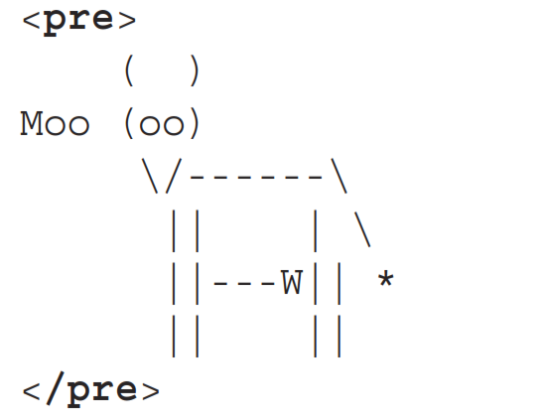
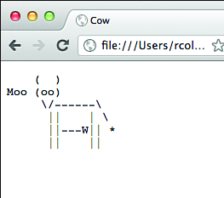
<pre> Tag

Slide 31
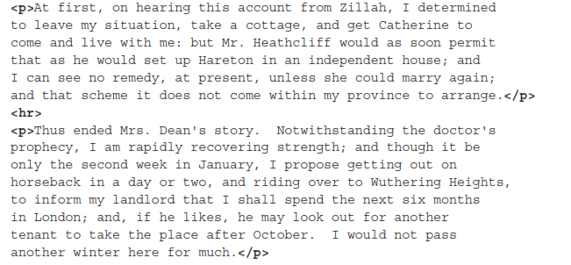
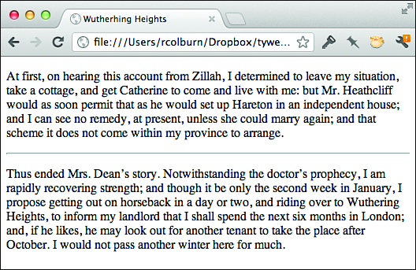
Horizontal Rules (or Thematic Breaks)

Slide 32
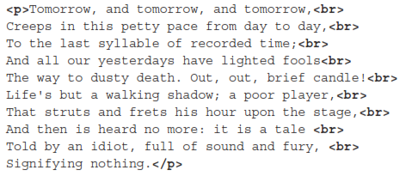
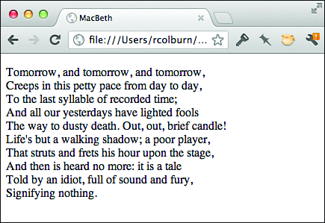
Line Break

Slide 33
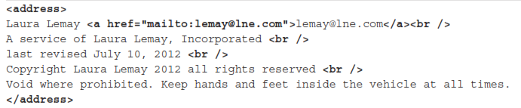
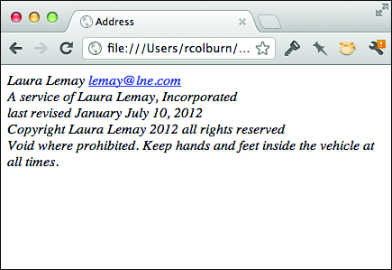
Addresses

Slide 34
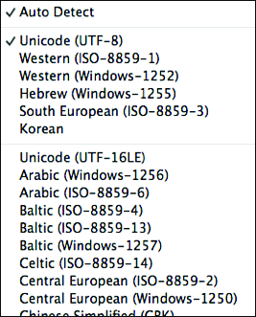
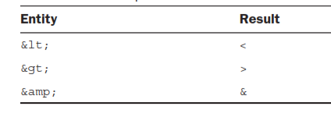
Special Characters

Slide 35
Fonts and Font Sizes
<p style="font-family: Verdana, Trebuchet, Arial, sans-serif;">
This is sans-serif text.</p>
<p style="font-family: ‘Courier New', monospace;">This is
monospace text.</p>
<p style="font-family: Georgia;">This text will appear in the
Georgia font, or, if that font is not installed, the browser's
default font.</p>

Slide 36
Using CSS to Style a Site
In the past few lessons, I’ve discussed how to lay out web pages using
Hypertext Markup Language (HTML) tags. In this lesson, I describe how you can create complex pages using Cascading Style Sheets (CSS). You’ve already learned about the advantages CSS can provide for formatting smaller snippets of text. In this lesson, you’ll learn how to use CSS to control the appearance of an entire page.

Slide 37
Creating Page-Level Styles
<style type="text/css">
h1 { font-size: x-large; font-weight: bold; }
h2 { font-size: large; font-weight: bold; }
</style>
<link rel="stylesheet" href="styles.css" type="text/css" >
selector { property1: value1; property2: value2; .. }

Slide 38
Selectors
p, ol, ul { color: blue; }
OR
p { color: blue; }
ol { color: blue; }
ul { color: blue; }

Slide 39
Contextual Selectors
p cite { font-style: italic; font-weight: normal; }
li cite { font-style: normal; font-weight: bold; }
Attribute Selectors
p[class="highlight"] { font-weight: bold; }

Slide 40
Classes and IDs
CLASS
<div class="imprtnt">Some text.</div>
CSS
.imprtnt { color: red; font-weight: bold; }
ID
<div id="footer">Copyright 2010, Example Industries.
</div>
CSS
#footer { font-size: small; }

Slide 41
Cascading
body { font-size: 200%; }
div { font-size: 80%; }
p { font-size: 80%; }
span.smaller { font-size: 80%; font-weight: bold; }
#smallest { font-size: 80%; font-weight: normal; }

Slide 42
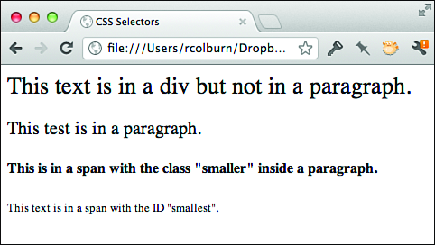
EXAMPLE
<div>
This text is in a div but not in a paragraph.
<p>This test is in a paragraph.</p>
<p><span class="smaller">This is in a span with the class "smaller"
inside a paragraph.</span></p>
<p><span class="smaller"><span id="smallest">This text is in a
span with the ID "smallest".</span></span></p>
</div>

Slide 43
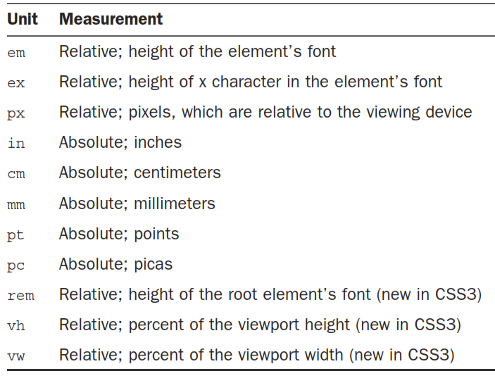
Units of Measure

Slide 44
Specifying Colors
Hexadecimal shorthand—A three-character string that comprises three singledigit hexadecimal numbers that are duplicated to represent the intensity of red, green, and blue on a scale of 00 to FF (255 in decimal)
RGB—Three percentages representing the intensity of red, green, and blue
RGB—Three decimal numbers representing the intensity of red, green, and blue on a scale of 0 to 255
HSL—Three numbers representing the hue (from 0 to 360 degrees), saturation percentage, and lightness percentage
Transparency or alpha channel—Add a fourth number to the RGB and HSL colors that ranges from 0 to 1 to specify the opacity

Slide 45
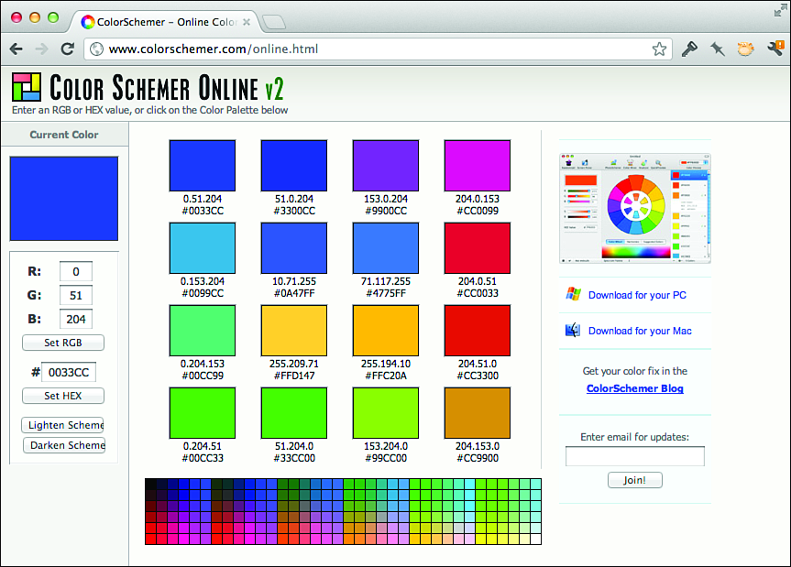
Specifying Colors
black rgb(0,0,0) 000000 hsl(0,0,0)
white rgb(255,255,255) FFFFFF hsl(0,0,100)
red rgb(255,0,0) FF0000 hsl(0,100,50)
yellow rgb(255,255,0) FFFF00 hsl(60,100,50)
coral rgb(255,127,80) FF7F50 hsl(16,100,66)

Slide 46
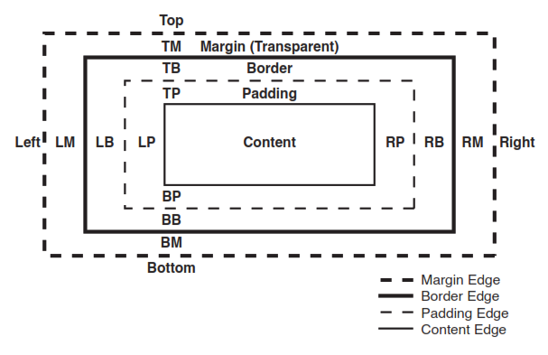
The Box Model

Slide 47
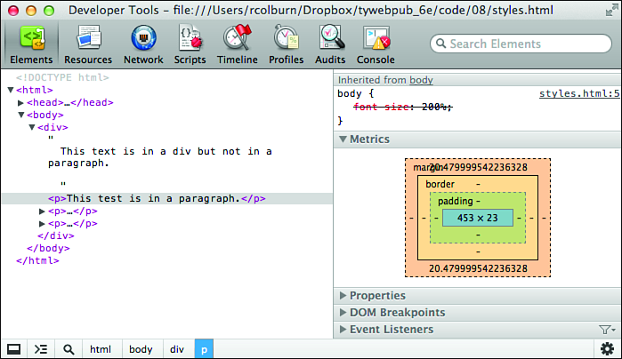
The Metrics view in the Chrome Developer Tools.

Slide 48
<img> Tag
Internal
<img src="../image.gif">
External
<img src="http://www.example.com/example.gif">

Slide 49
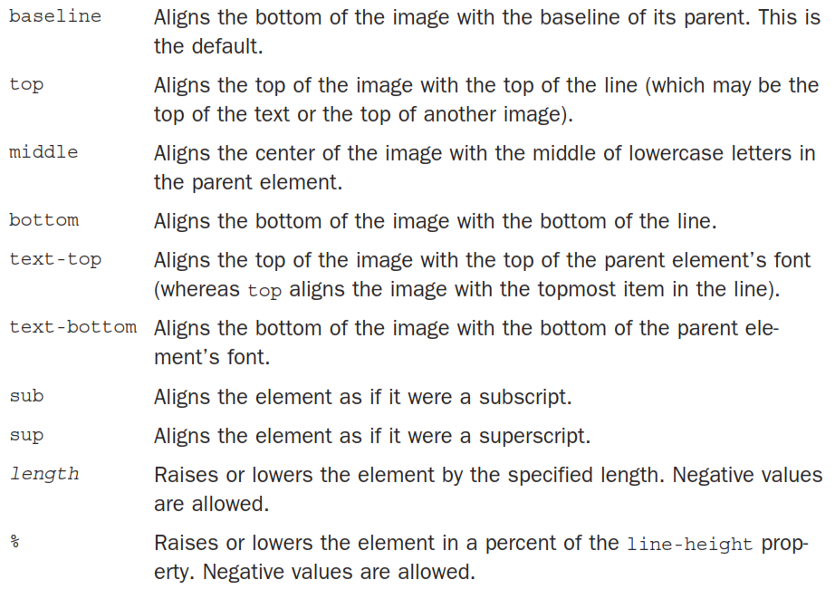
Text and Image Alignment

Slide 50
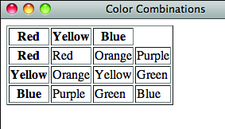
<table> Tag
<table border="1">
<tr>
<th>Red</th>
<th>Yellow</th>
<th>Blue</th>
</tr>
<tr>
<th>Red</th>
<td>Red</td>
<td>Orange</td>
<td>Purple</td>
</tr>
<tr>
<th>Yellow</th>
<td>Orange</td>
<td>Yellow</td>
<td>Green</td>
</tr>
<tr>
<th>Blue</th>
<td>Purple</td>
<td>Green</td>
<td>Blue</td>
</tr>
</table>

Slide 51
The PHP Language
When you think about the English language, you think about it in terms of parts of speech. Nouns name things, verbs explain what things do, adjectives describe things, and so on. Programming languages are similar. A programming language is made up of various “parts of speech,” too. In this section, I explain the parts of speech that make up the PHP language—comments, variables, conditional statements, and functions.

Slide 52
How PHP Works
<!DOCTYPE html>
<html>
<head><title>A PHP Page</title></head>
<body>
<?php echo "Hello world!"; ?>
</body>
</html>

Slide 53
Comments
// My function starts here.
$old_color = 'purple';
/*
$color = 'red';
$count = 55; // Set the number of items on a page.
// $count = $count + 1;
*/

Slide 54
Variables
$color = "red";
$last_published_at = time();
Arrays
$colors = array('red', 'green', 'blue');
$state_capitals = array(
'Texas' => 'Austin',
'Louisiana' => 'Baton Rouge',
'North Carolina' => 'Raleigh',
'South Dakota' => 'Pierre'
);

Slide 55
Conditional Statements
if ($var == 0) {
echo "Variable set to 0.";
} else {
echo "Variable set to something other than 0.";
}

Slide 56
PHP Conditional Operators
1 == 2 // false
'cat' == 'dog' // false
5.5 == 5.5 // true
5 > 0 // true
5 >= 5 // true
5 < 10 // true

Slide 57
Loops
$synonyms = array('large' => 'big',
'loud' => 'noisy',
'fast' => 'rapid');
foreach ($synonyms as $key => $value) {
echo "$key is a synonym for $value.\n";
}
While , do..while, for

Slide 58
Controlling Loop Execution
$colors = array('red', 'green', 'blue');
$looking_for = 'red';
foreach ($colors as $color) {
if ($color = $looking_for) {
echo "Found $color.\n";
break;
}
}

Slide 59
User-Defined Functions
function myOtherFunction($arg1, $arg2, $arg3)
{
// Do stuff
}
Returning Values
function add($a = 0, $b = 0) {
return $a + $b;
}

Slide 60
Q & A

