Slide 1
Putty
Aj.Drusawin Vongpramate
Information Technology
Science, BRU

Slide 2

Putty
PuTTY is an SSH and telnet client, developed originally by Simon Tatham for the Windows platform, along with an xterm terminal emulator on port 22. It allows you to securely connect to your systems while on the go. PuTTY is open source software that is available with source code and is developed and supported by a group of volunteers.

Slide 3
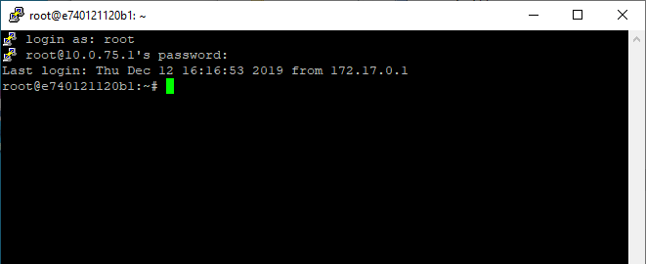
HOST
IP : 10.0.75.1 (NAT)
PORT : 2222
CONTAINER
IP : 172.17.0.1
PORT : 22
SSH

Slide 4
Install on Docker
Step 1 : Pull image
>> docker pull rastasheep/ubuntu-sshd
Step 2 : Check existing image
>> docker images
Step 3 : Start container
>> docker run -d -p 2222:22 --name ubuntu rastasheep/ubuntu-sshd

Slide 5
Install on Docker
Step 5 : Check container process
>> docker ps (-a for created container)
/////////////////////////////////////////////
Stop container
>> docker stop ubuntu
Start container
>> docker start ubuntu
Delete container process
>> docker rm -f ubuntu

Slide 6
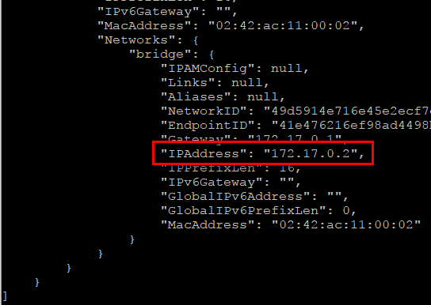
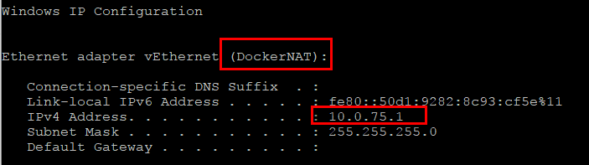
Check IP
Docker (server)
>> docker inspect ubuntu
OR
>> docker-machine ip
Windows (client)
>> ipconfig

Slide 7
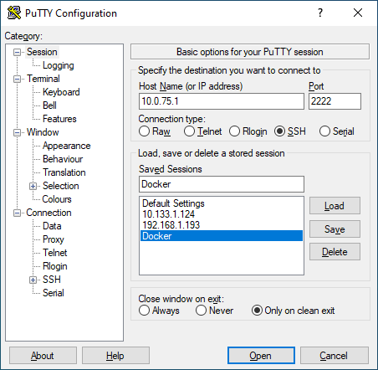
Windows Client

Slide 8
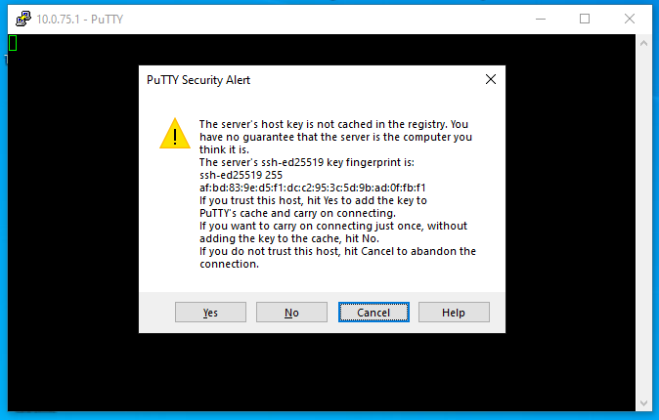
Windows Client
User : root
Password : root

Slide 9
Test SSH
$ cat /etc/*release
Create user
$ useradd itbru $ passwd itbru
Create home user
$ mkhomedir_helper itbru

Slide 10
Test SSH
Create home user
$ usermod -aG sudo itbru
Update OS
$ sudo apt-get update
Install Text Editor
$ sudo apt-get install nano
$ nano .profile
Add command (red text) at last line
bash

Slide 11
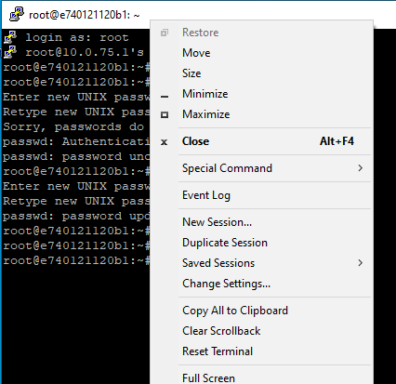
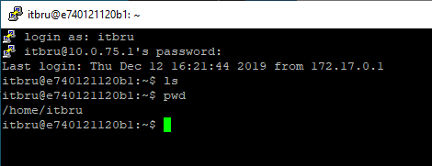
Test SSH
Re-login by user: itbru

Slide 12
Q & A

Slide 13
COMMIT CONTAINER
>> docker commit [CONTAINER_ID] temporary_image

