Slide 1
Email Server on Docker
Aj.Drusawin Vongpramate
Department of Information Technology
Science, BRU

Slide 2
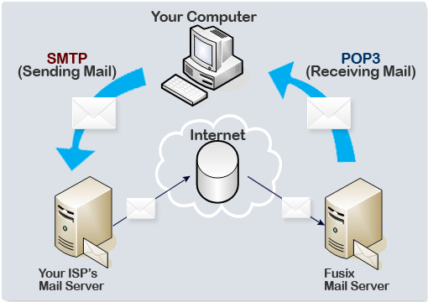
SMTP : Simple Mail Transfer Protocol
PORT : 25
PORT : 110

Slide 3
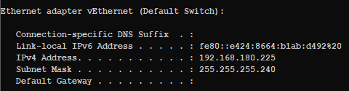
Install container
Step 1 :: Pull email container
>> docker run -d -p 1080:80 -p 25:25 djfarrelly/maildev
Step 2 :: Check Host IP (docker)
>> ip config

Slide 4
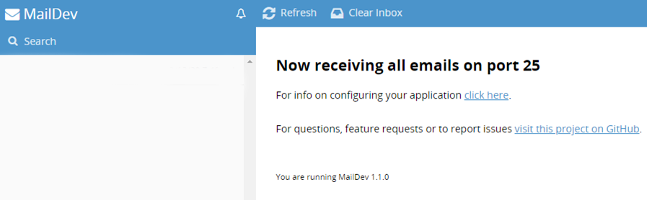
Install container
Step 3 :: Test host by 127.0.0.1:1080

Slide 5
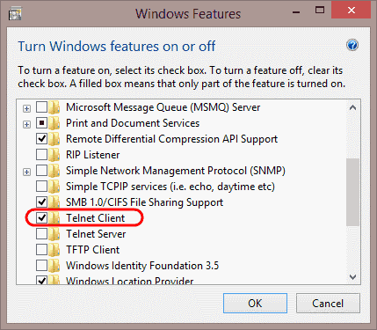
Install Telnet Client
Check Telnet Client
>> telnet

Slide 6
Test on Telnet
>> telnet 19.168.21.1 25 //25 or smtp
> ehlo lo
//helo 19.168.21.1
> mail from:<sender mail>
//email must use “<“ and “>” character
//etc. <drusawin@bru.ac.th>
> rcpt to:<receive mail>
> data
> Message …………………… // subject: ……….
> . //end
> quit //exit telnet

Slide 7
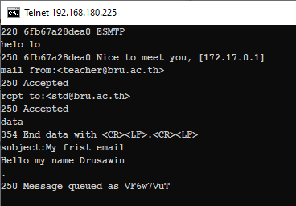
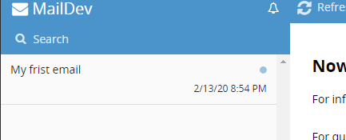

Slide 8
Q & A

