Slide 1
Defining Formal Elements
CS 4730 – Computer Game Design

Slide 2
Topics / Goals
We’ve discussed analyzing game under the MDA lens
MDA is great, but somewhat limited
Let’s add more vocabulary / formal definitions to the elements of games

Slide 3
Ludic Structure of Games
Players – voluntary participation
Objectives - goals
Procedures – actions of play, limited by rules
Rules – define game parameters
Resources – valuable objects defined by rules
Conflict – hindrances to objective
Information – What info available
Outcome – uncertainty toward ultimate goal

Slide 4
Narrative/Engagement in Games
Challenge – tension to resolve a problem
Play – “free movement within a structure”
Premise – context
Character – vessel for participation and interest
Story – narrative within a context
Dramatic Elements – climax of game element

Slide 5
Players
Determine what is your player interaction pattern (1 vs. game, pvp, team competition…)
Determine what are your player modes
A player mode is a way in which the player interacts with the game
Example: Final Fantasy
Overworld, Battle, Status/Inventory
Each behaves differently and has a different purpose
Some simpler games might only have 1 mode

Slide 6
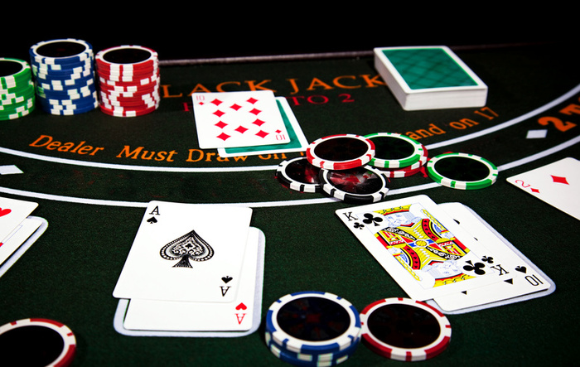
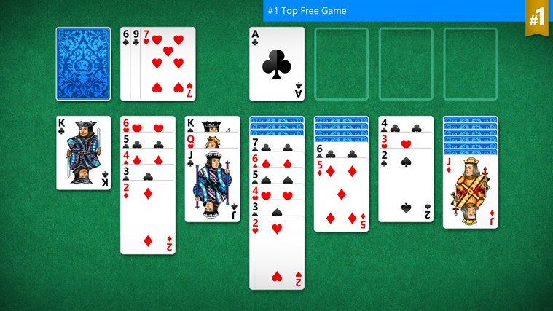

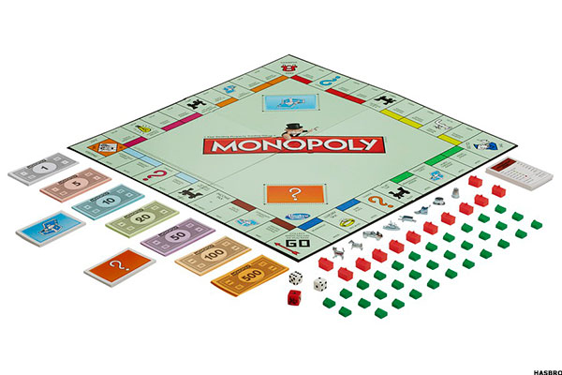
Players: More Examples
BlackJack: Separate Individuals Against System
Solitaire: 1 vs Game
Monopoly: Free-For-All
Assassins: Predator-Prey Structure

Slide 7
Objectives
Anything the player is striving for
Could be:
Primary: main objective of game, “dream”
Secondary: achievements, high score, etc.
Player-driven: your own self-created goal
Name some objectives in games

Slide 8
Objective Categories
Capture: take or destroy something
Race: well… race against something
Alignment: perfect positioning
Rescue/Escape: get out of dungeon
Forbidden Act: get someone else to break rules
Construction: build something
Exploration: uncover all hidden things
And so many more!

Slide 9
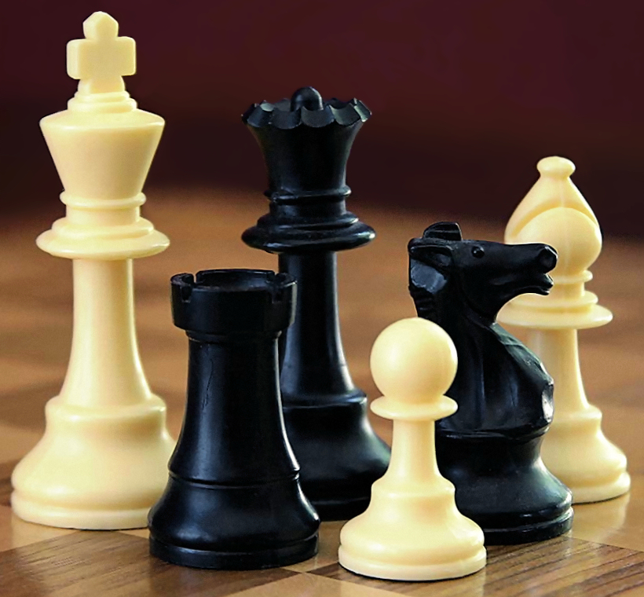
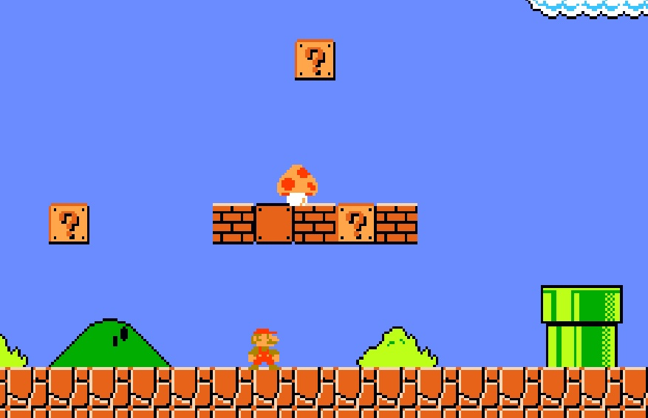
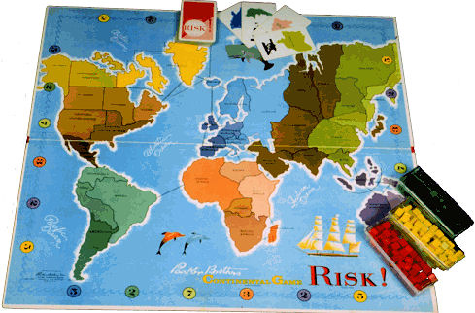
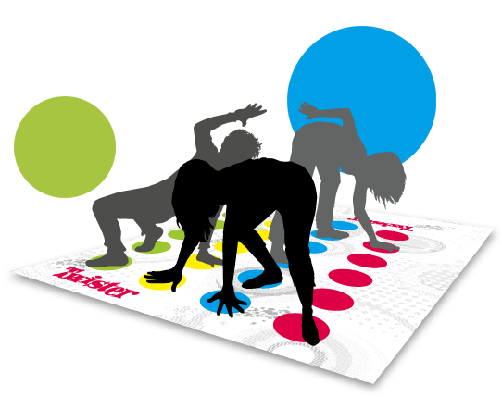
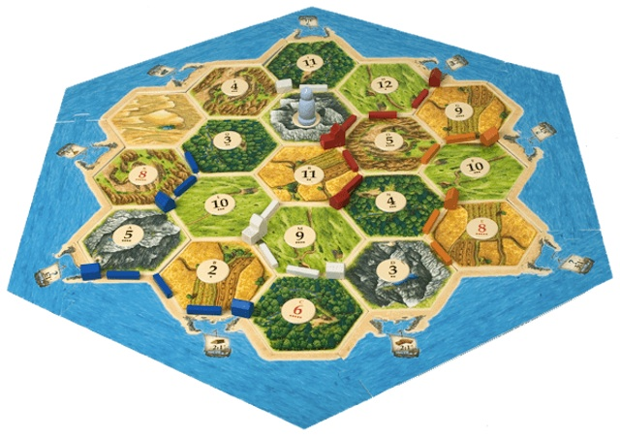
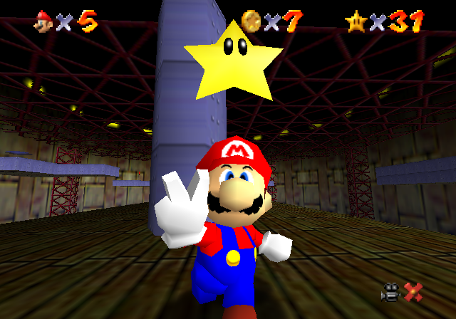
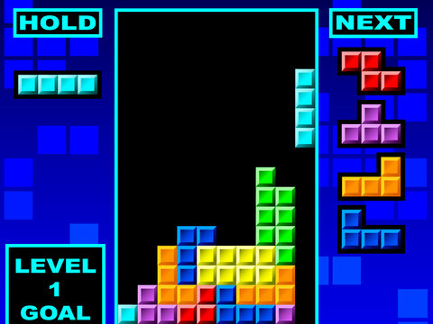

Objective Categories: Examples
Race / Chase / Escape
Capture / Destroy
Capture / Destroy
Build
Alignment
Solve
Negation of another goal
Collect

Slide 10
Procedures and Rules
Procedures are the actions that players can take to achieve their objectives
Rules define the game objects and set limits on the player procedures

Slide 11
Procedures and Rules
Three types of rules (Salen & Zimmerman):
Setup: Things to do before beginning to play
Progression of Play: How play progresses towards the goal during play
Resolution: How the game resolves / ends
These, together, are called the Operational Rules. Are these the only rules of the game?

Slide 12
Procedures and Rules
Not really…there are others:
E.g., In Monopoly, I could just stall and never make my move when losing. No formal rule that stops me from doing this.
Rules such as this (you can’t stall) are called implied rules
Other examples?
Do you have these in video games?

Slide 13
Resources
Resources are the elements of the game that hold some value and also by definition have some notion of scarcity
Resources can be just about anything:
Lives / Health
Time
Currency
Ammo
Resources define the “interesting bits”

Slide 14
Conflict
Conflict is not only defined as PvP
It can also be player vs. game and obstacles put up to keep player from the goal
The role of the difficulty in the notion of conflict is a tough balancing act
Hard enough to promote player interest and play, but easy enough that the goal is eventually reachable (usually)

Slide 15
Information
How much of the game state is visible to each player.
Total Info – everyone knows everything
Some Private – Poker, BlackJack, etc.
One privileged – One player is “special” and has their own info. Wolf vs Sheep structure.
Game Private – Game itself has private info
Combinations – e.g., “Fog of war” in RTS games. Map is shared, but must have unit present to see.

Slide 16
Outcome
There must be a “finish” of some kind
(Yes, some games don’t finish, but consider player-created outcomes)
Some games are zero-sum, some are not

Slide 17
Formal Elements Framework
These elements provide a framework in which you can begin to formalize your game
They are not an end-all, be-all list, but certainly should make you consider things that are important to the game
When you analyze games in your critical eyes, consider these things.

