Slide 1
Game Balancing
CS 4730 – Computer Game Design
Credit: Some slide material courtesy Walker White (Cornell)

Slide 2
Main Point Up Front!
What is Game Balancing?
What does it mean for a game to be balanced?
Is it different for different games?
How does this relate to things we’ve discussed?
MDA
Ludic structure of games
Etc.

Slide 3
Question!
What does it mean for a game to be balanced?

Slide 4
Probabilities of D&D
How hard should it be for the PCs to overcome the wall?
We approximate this in the game world using a Difficulty Class (DC)
Level | Easy | Moderate | Hard
7 | 11 | 16 | 23
8 | 12 | 16 | 23
9 | 12 | 17 | 25
10 | 13 | 18 | 26
11 | 13 | 19 | 27

Slide 5
Probabilities of D&D
Easy – not trivial, but simple; reasonable challenge for untrained character
Medium – requires training, ability, or luck
Hard – designed to test characters focused on a skill
Level | Easy | Moderate | Hard
7 | 11 | 16 | 23
8 | 12 | 16 | 23
9 | 12 | 17 | 25
10 | 13 | 18 | 26
11 | 13 | 19 | 27

Slide 6
Balancing
Balancing a game is can be quite the black art
A typical player playing a game involves intuition, fantasy, and luck – it’s qualitative
A game designer playing a game… it’s quantitative
They see the systems behind the game and this can actually “ruin” the game a bit

Slide 7
Building Balance
General advice
Build a game for creativity’s sake first
Build a game for particular mechanics
Build a game for particular aesthetics
Then, after all that…
Then balance
Complexity can be added and removed if needed
Other levers can be pulled
Complexity vs. Depth

Slide 8
What makes a game balanced?
When evaluating a game for balance, we typically look at three aspects:
Fairness
Stability
Engagement

Slide 9
Fairness
A game is considered fair if each of an evenly matched group of players has an a priori equal chance of winning for any given starting position
In a normal fair game for two players, each player should win about 50% of the time with both players playing at the same level

Slide 10
Fairness
What does it mean for two players to be equally matched?

Slide 11
Fairness
What does it mean for two players to be equally matched?
Similar heuristics
Ability to search the outcome tree the same distance ahead
Knowledge of probabilities

Slide 12
What’s the Probability of Winning?
Consider older games
Consider modern games
What’s the probability of winning?
How does save games affect this probability?

Slide 13
The “Going First” Problem
A traditional problem in fairness is the “who goes first” problem
Assume you have a game in which the player that goes first wins 2/3 of the time
How would you fix this problem?

Slide 14
The “Going First” Problem
Rotate who goes first
Who lost last game?
Randomize
Age / skill
Disadvantaged player gets some extra resources
Reduce effectiveness of the first turn
Limited move set

Slide 15
Balancing a One Player Game
Changing the difficulty of the game over time is called pacing
How do we measure difficulty?
What’s the difference in scale vs. kind for pacing?

Slide 16
Stability
Before discussing stability, we need to discuss the general idea of reinforcement.

Slide 17
Reinforcing Behaviors
As players do things in games, we want to either reinforce or punish certain behaviors to establish appropriate balance and pacing
Positive feedback encourages a behavior to be repeated in the future
Negative feedback discourages a behavior to be repeated in the future
Adjusting feedback adjusts the game balance

Slide 18
Psych 101: Reinforcement

Slide 19
Classic Example: Parenting
Positive Reinforcement: Praise / rewards. Good job on your homework, here is some ice cream.
Negative Reinforcement: I’m taking away your Switch until you clean your room.
Positive Punishment: Spankings, yelling at your child, etc.
Negative Punishment: Time out. Taking away toys because you pushed your brother, etc.

Slide 20
Examples in Games??
Can you come up with an example of each from games?
Positive Reinforcement: ???
Negative Reinforcement: ???
Positive Punishment: ???
Negative Punishment: ???

Slide 21
Reinforcement Schedules
People respond differently to reinforcement based on the schedule
Fixed Ratio: stimulus applied after a specific number of behaviors (kill 5 monsters and get cool item).
Fixed Interval: stimulus applied after fixed amount of time (play for 10 minutes and get a reward).

Slide 22
Reinforcement Schedules
People respond differently to reinforcement based on the schedule
Variable Ratio: stimulus applied after a variable number of behaviors (slot machines!).
Variable Interval: stimulus applied after fixed amount of time (boss checks your work periodically, you never know when she is coming).

Slide 23
Reinforcement Schedules
Which schedule is best? and what does best even mean here?

Slide 24
Do we care?
Well, most Game Designers don’t care about the distinction:
Positive Feedback: Any mechanic that encourages a player’s behavior (reinforcement)
Negative Feedback: Any mechanic that discourages a player behavior (punishment)

Slide 25
Reinforcing Behaviors
Consider basketball
When you scores, the other team gets the ball
This is negative feedback
We don’t want a team to be able to get ahead too quickly
Consider Mario Kart
When you’re in the lead, you get crappy items
This is negative feedback
Rubber-banding is also negative feedback

Slide 26
Reinforcing Behaviors
Consider RPGs
If you use a sword a lot, it might level up
Leveling up a sword makes it hit harder or more accurately
If the sword is better than the axe, you’ll use it more
This is positive feedback

Slide 27
Perfect Imbalance
But what happens if that sword gets too powerful?
What does in mean to have “perfect imbalance” in a game?
How does it affect the way we look at and adjust the systems in our games?

Slide 28
Balancing For Skill
Some actions/verbs of high power can (and should) have low skill requirements
However, the progression should promote increasing skill to then move to other actions with power
First Order Optimal strategies in gaming

Slide 29
Reinforcing Behaviors
Both types of feedback have their own place in games
We use different feedbacks to move players along or to increase challenge

Slide 30
Stability
A game is considered stable if:
Feedback is negative at the opening, slightly positive at midgame, and very positive at endgame
It has multiple viable strategies to win

Slide 31
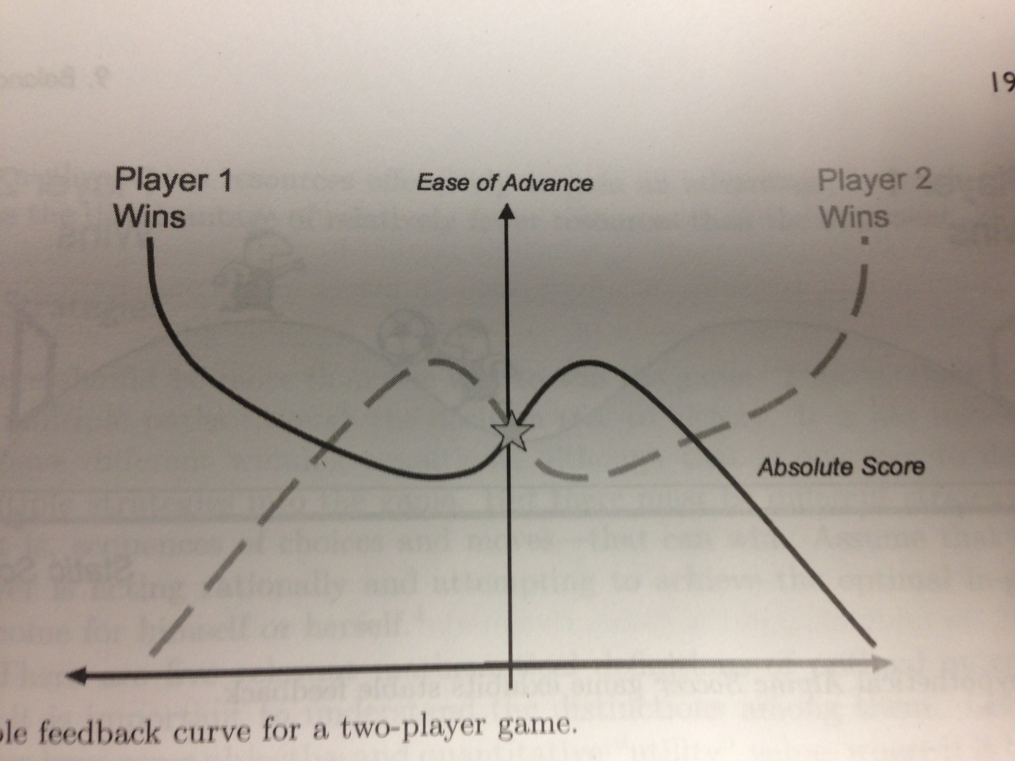
Stability Curve

Slide 32
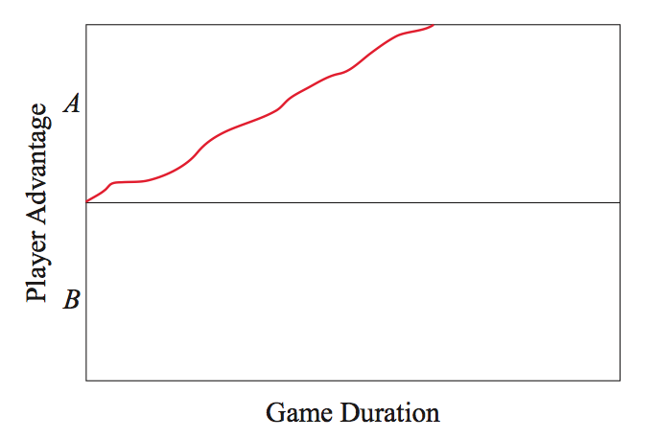
Curve of Progression

Slide 33
No Feedback Provided

Slide 34
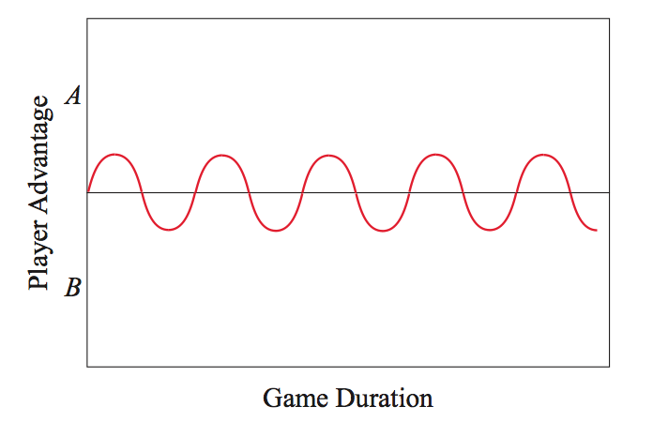
Curve of Progression

Slide 35
Too Little Positive Feedback

Slide 36
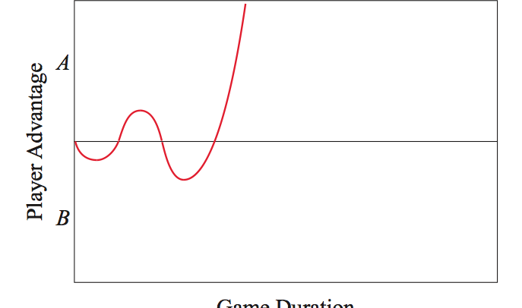
Curve of Progression

Slide 37
Too Much Positive Feedback

Slide 38
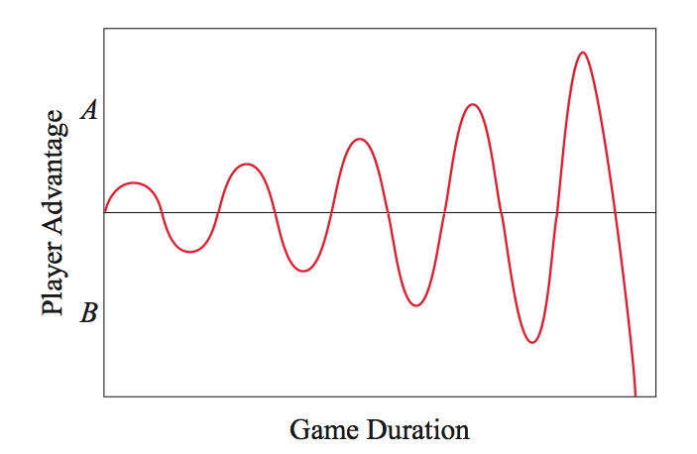
Curve of Progression

Slide 39
Powerful Negative Feedback

Slide 40
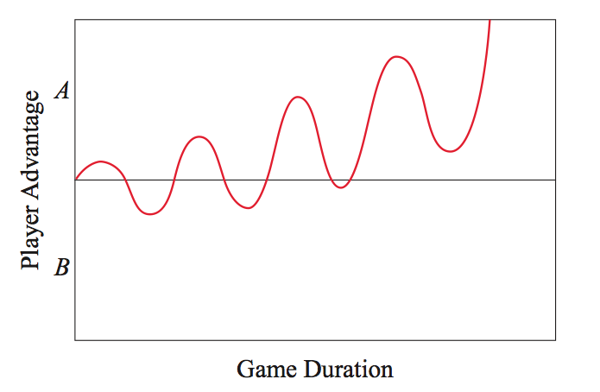
Curve of Progression

Slide 41
Ideal Game Progression

Slide 42
Multiple Strategies
For good balance (and for engagement), there should be multiple ways to reach the win condition
Doesn’t necessarily mean there needs to be multiple win states, but that can be done as well
We can mathematically reason about winning outcomes
Def of “utility” = anything used to measure progress toward victory

Slide 43
Multiple Strategies
Player optimal outcome - my utility is as high as possible
Pareto optimal outcome - my utility cannot increase without decreasing another player's
Equitable outcome - everyone's utility is the same and as high as it can be
Efficient outcome - the sum of everyone's utility is as high as it can be
Nash optimal outcome - my utility is as high as it can be, given other players played to their own interests

Slide 44
Multiple Outcomes
Some of these outcomes are not necessarily feasible for all games
Some require at least one player to play to lose
Nash optimal is the most common as it assumes all players are playing to win and your ability to win is limited by how well others play (to some degree)

Slide 45
But who plays to win?
Really! Who plays a game to win?
In a 4 person game, your odds of winning are terrible
Do you play a game if you know you’re going to win every time?

Slide 46
But who plays to win?
You play a game for the experience!
Games that are unfair or unstable are not engaging
Can you think of some examples?

Slide 47
Last One: Engagement
Once you establish fairness and balance, you need to establish game flow
Flow is technically a state of mind recognized by psychologists
A challenging activity that requires skill and concentration with a well-defined goal and direct responses
Merging action and awareness that increases self-confidence and a loss of self-consciousness (and sense of time)

Slide 48
Other Parts of Engagement
Adversity – things to overcome
Desire – the want of something
Empowerment – enforcing one’s will
Value – something that has meaning
Drama – fantasy and storytelling
Randomness – relieves the player from having to go too far down the decision tree (try to avoid “analysis paralysis”)

Slide 49
Differences in Scale vs. Kind
Why does this matter?
How does this play into engagement?

Slide 50
Optimizing for Real People
Everyone playing to win is good…
… but “successful” play must merge with “enjoyable” play
Camping is a great strategy
But it can be boring
And it can really piss off other people

Slide 51
Optimizing for Real People
We want the strategies that lead to a player winning to also be strategies that result in all players being entertained and achieving social harmony
If both players camp in an FPS, this is technically a player optimal outcome but it really isn’t fun
A Pareto outcome here (both non-camp) is more optimal

Slide 52
Optimizing for Real People
Thus, we need to decrease the utility of camping to increase the likelihood of non-camping
How are you balancing your game?

