Slide 1
What is a game?
CS 4730 – Computer Game Design

Slide 2
What is a game?
Name some games!

Slide 3
Is this a game?
Chess
Monopoly
Hopscotch
Poker
Roulette
Golf
Flight simulator
Dating
Treaty Negotiation
Tending a fire
Karaoke
Playing piano
Investing in stocks
Reading a book
Writing poetry
Hiking

Slide 4
What makes a game “a game”?
Thoughts?

Slide 5
Several Definitions
“Playing a game is the voluntary attempt to overcome unnecessary obstacles.”
Bernard Suits
“A game is a system in which players engage in artificial conflict, defined by rules, that results in a quantifiable outcome.”
Salen & Zimmerman, Rules of Play

Slide 6
So… is this a game?
Chess
Monopoly
Hopscotch
Poker
Roulette
Golf
Flight simulator
Dating
Treaty Negotiation
Tending a fire
Karaoke
Playing piano
Investing in stocks
Reading a book
Writing poetry
Hiking

Slide 7
All games have…
Goals
Rules
Feedback
Voluntary participation (aka “players”)
Another thought:
What things are NOT listed here?
*Jane McGonigal

Slide 8
Not all games have…
Winners and losers
Narrative
Competition
FUN
And others!

Slide 9
Wait… NOT FUN?
Escapism
Narrative
Victory
(a whole lot more…)

Slide 10
Wait… NOT FUN?
Ok, that is games. What about players?
Why do you play games? Or why do people play games in general?

Slide 11
Wait… NOT FUN?
Richard Bartle in 1996
Bartle’s Four Types of Online Gamers
Achiever: overcome challenges, gather rewards
Explorer: discover, understand game worlds
Socializer: interact and role-play
Killer: competitive. wants to win and everyone else to lose

Slide 12
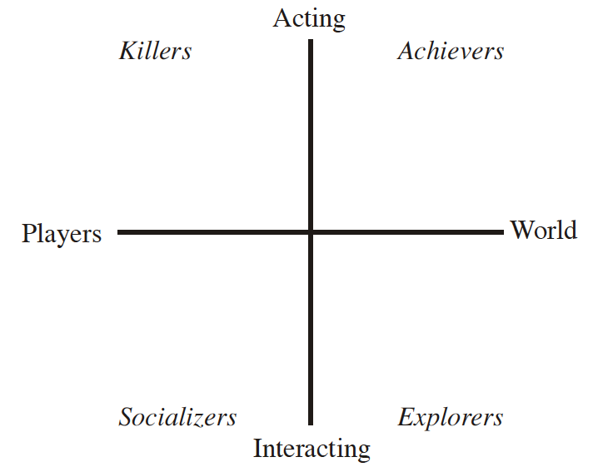
Bartle’s Taxonomy

Slide 13
Bartle Extended
Later, Bartle added a 3rd axis (implicit vs explicit), leading to eight types
Achievers:
Planner (explicit): sets goal and aims to achieve it
Opportunist (implicit): looks around for things to do and achieve them once found.
Explorers:
Scientist (explicit): exploring methodically
Hacker (implicit): intuitive understand of world, do not need to test every idea they have

Slide 14
Bartle Extended
Later, Bartle added a 3rd axis (implicit vs explicit), leading to eight types
Socializers:
Networker (explicit): Assess who is worth playing / hanging with
Friend (implicit): Enjoy company of others
Killers:
Politician (explicit): Aim is to get a big / good reputation
Griefer (implicit): Aim is to get a big / bad reputation

Slide 15
Summary
So we have a basic, first definition of a game
… and we have an initial understanding / taxonomy of players
Last thing that might be of interest:
Interactivity: How much the player has agency over the game’s outcome / result.
Not really part of our definitions yet. Let’s discuss.

Slide 16
Possible Scale
On one end: Low Interactivity
Extreme = a movie
Or a game where you watch long cutscenes and click a button or two.
Was Black Mirror: Bandersnatch a game?
Other end: High Interactivity
You can do ANYTHING you want in this world
Grand Theft Auto, open-world games maybe best examples.

Slide 17
“I play it for the story”
See, I bet most of you started thinking about video games…
But let’s back up
How about that riveting story in Chutes and Ladders? Candy Land? Monopoly?
Okay, now video games…
Exactly how many times has Princess Peach been kidnapped? Is it even a crime anymore?

Slide 18
“I play it for the story”
What drives you to play a certain game?
Do you play a game solely for the story/lore?
Or do you play the game for the mechanics/playstyle?

Slide 19
“I play it for the story”
Are games a vehicle for telling a story?
Or are games about how we empower the player to do things they don’t normally get to do?
Is it the author’s voice we care about, or is it the gamers?

Slide 20
“I play it for the story”
Name a game where the author’s voice is paramount – over that of the player’s.
Name a game where the player’s voice is paramount – over that of the author’s.
What characteristics do the two types of games have?

Slide 21
Beware the Extremes
Either extreme is dangerous.
Pure story often has poor mechanics, or is simply watching a movie. Why watch a movie holding a controller?
Pure mechanics often leads to lack of player motivation and interest. Why use your agency in a world you don’t care about?

Slide 22
A Playcentric Approach
Gameplay MATTERS
This is your job as a game designer!
We will have to find graphics, audio, etc for our games, but our focus here is on GAMEPLAY
How do we think about gameplay?
How do we tease out game mechanics?

