Slide 1
Ruminations on the History of Video Game Design
CS 4730 – Computer Game Design

Slide 2
My Gaming CV
Game Systems Owned
Early: ColecoVision, Atari
Nintendo: NES, SNES, N64, Gamecube, Wii, Game Boy, GB Color, Switch.
Sega: Uh…no. But played at friend’s houses many times
Sony: PS1, PS2, PS3
Microsoft: Xbox
PC: Of course!

Slide 3
Achievement Unlocked
First issue(s) of Nintendo Power
Dissertation on using games for AI
First game owned? Cabbage Patch Kids (Coleco)
Toughest game beaten? Ninja Gaiden 2 (NES)
Most recent game beaten? Hollow Knight
Most recent purchase? Witcher 3 (haven’t started)

Slide 4
The Stage of History
I grew up during some important times in gaming that affect how I view games now
BTW – the average gamer today is 37 years old
We come from different gaming pasts
What was your first system?

Slide 5
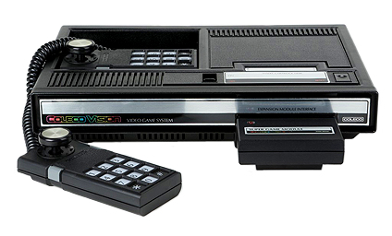
Coleco Vision

Slide 6
The Stage of History
From 1979 through 1983, the video game industry was booming
New consoles practically every year
Atari 2600, Atari 5200, ColecoVision, Intellivision (and all its clones), Odessey, Vectrex
Startups were appearing all the time, pushing new titles consistently

Slide 7
The World of Balance
In 1982, Atari was clearing $2B and was recognized as the fastest growing US company EVER
Microcomputers were starting to appear with reasonable prices
Like the C64 and the TRS80

Slide 8
The World of Ruin
However, it was too much of a good thing
Many of the games that came out were just terrible
The publishers had little to no control over the content
In fact, this is when Activision was founded as an offshoot of Atari because Atari wouldn’t pay royalties based on sales

Slide 9
The World of Ruin
So many games came out that retailers ran out of shelf space
Games were discounted or sent back to publishers, who couldn’t pay the retailers for the unsold copies
Atari then published the “worst game ever”…
Actually, two worst games ever.

Slide 10
The World of Ruin
First: Pac Man (Atari 2600). 1982

Slide 11
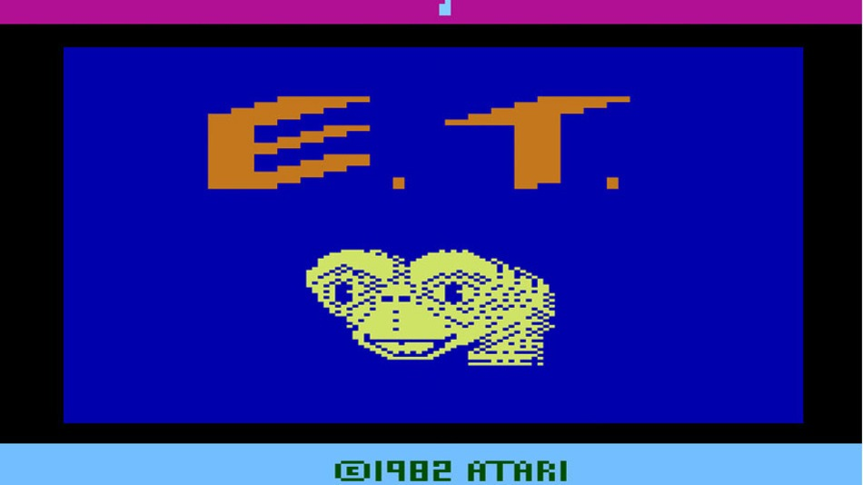
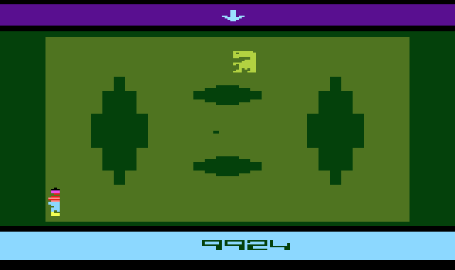
The World of Ruin
E.T.
Not only was it bad – it was also a movie license!

Slide 12
The World of Ruin
By 1984, Atari had filed for bankruptcy
It was at this point that the emerging dominance in the new electronic entertainment market moved from the US to Japan
To a company known for making playing cards
Nintendo

Slide 13
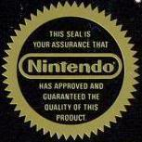
The Nintendo Seal of Quality

Slide 14
Now You’re Playing With Power
The NES was introduced in 1985 and took over the US market in 1987
It’s safe to say that the NES saved the video game industry
This is partially due to the more meticulous nature in which Nintendo reviewed games before approving them
Also consider the franchises that were born during this time frame

Slide 15
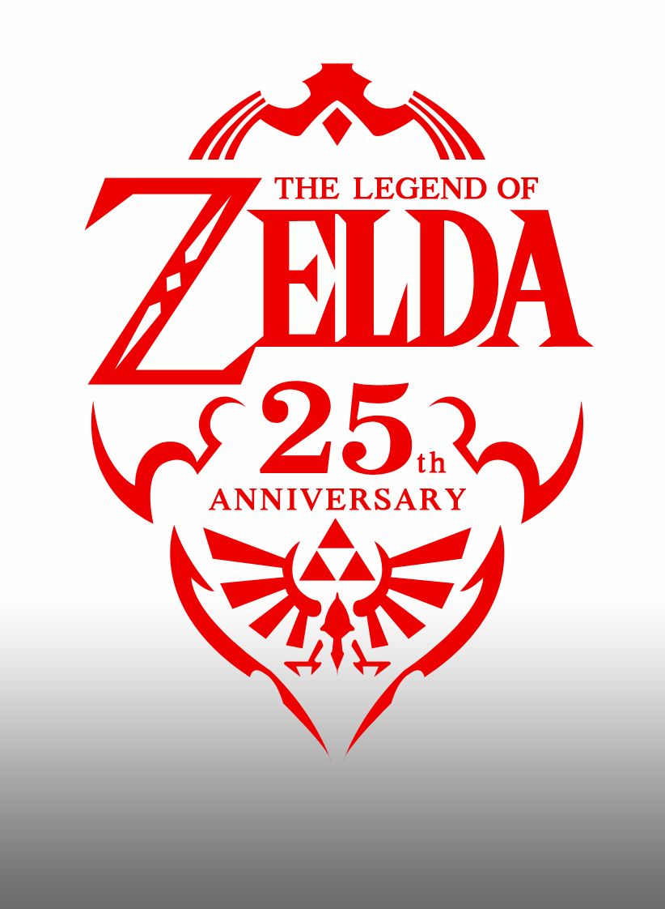
It’s dangerous to go alone…

Slide 16
The Rest of the Story
The stories just kept coming…
SNES vs. Genesis
Remember “blast processing”?
GameBoy
The emergence of Tetris
Sega begins to bow out
SegaCD, 32X, Saturn, Dreamcast
The rise of new players
Sony and Microsoft enter the market

Slide 17
History in your Hands
But let’s talk about the history of gaming by looking at how we played the games

Slide 18
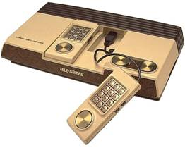
Sears Super Video Arcade

Slide 19
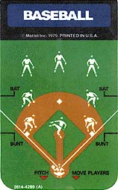
Game Overlays

Slide 20
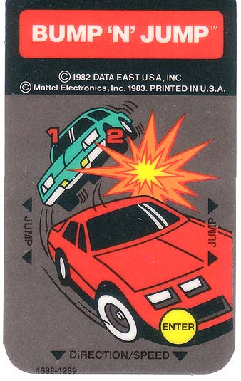
Game Overlays

Slide 21
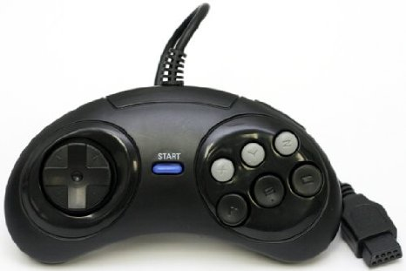
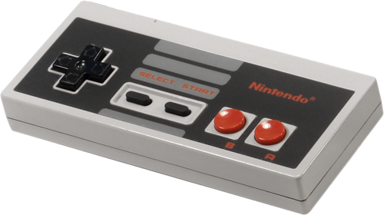
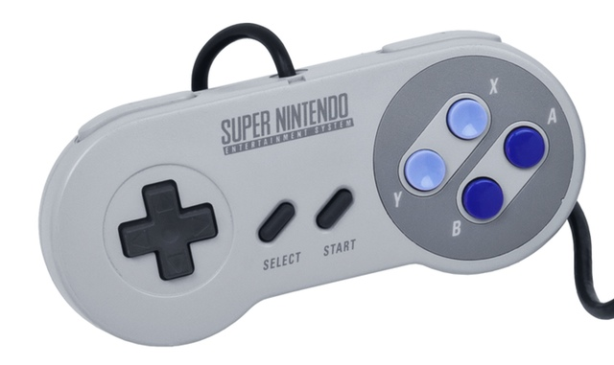
Game Controllers
1985
1988
1990

Slide 22
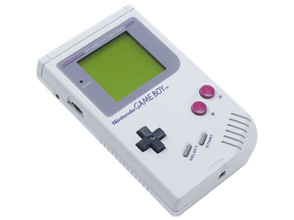
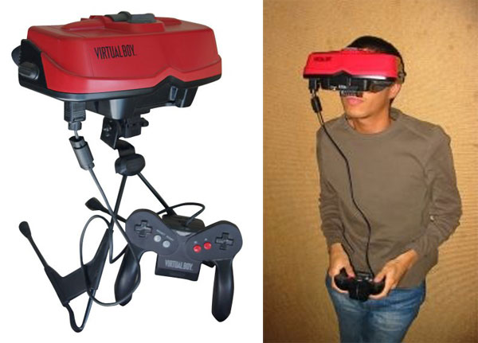
Handheld Games (Gameboy: 1989)!

Slide 23
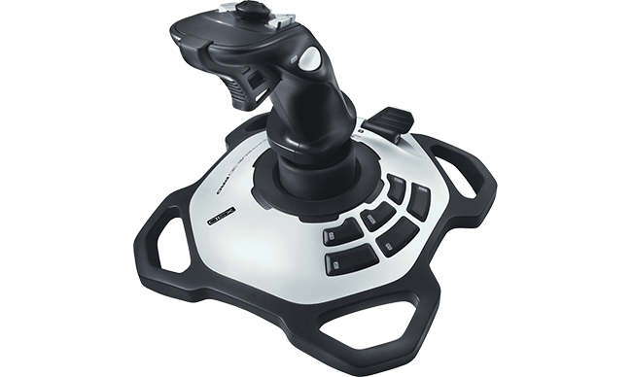
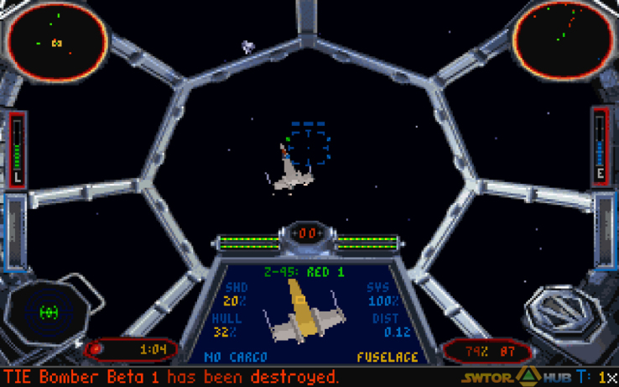
Accessories (early to mid 1990s)!
Joysticks around for a while (70s). I experienced them as seen above in early to mid 90s.

Slide 24
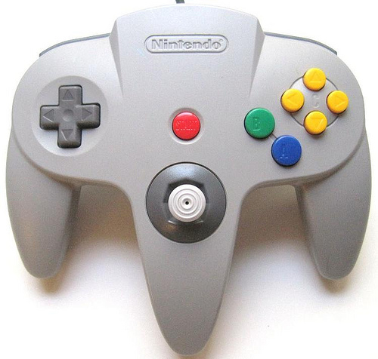
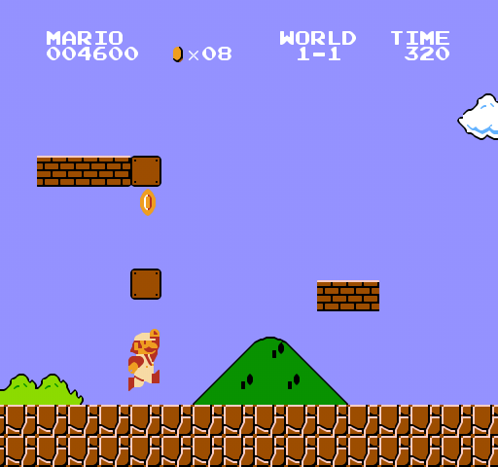
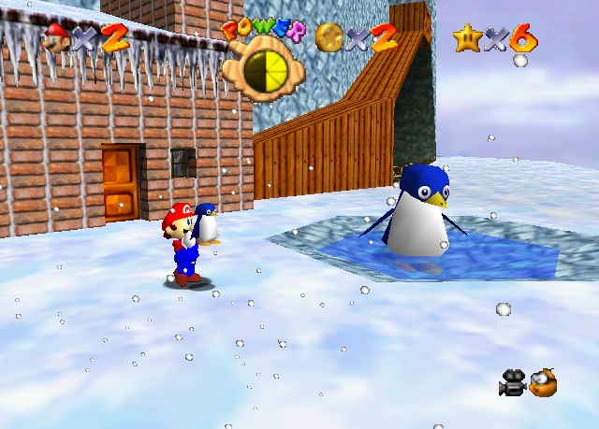
The Jump to 3D (1996)!

Slide 25
Modern Controllers
First Dual-Stick Controller. PS1 (1997)

