Slide 1
Sprite Graphics
CS 4730 – Computer Game Design
*Some slide material courtesy Walker White (Cornell)

Slide 2
Topics
Sprites
Spritesheets, animation, etc.
Affine Transforms / moving objects in space
2D and 3D
Coordinate systems

Slide 3
Pretty, Pretty Pictures
“Though still rooted in the work of the first two games, X improves on the visuals even more and features impressive graphical effects.”
“And despite all of their saccharin-sweet cuteness, the graphics are magnificent. X's dream of producing an interactive cartoon has been fully realized -- the animation is lavish, the textures rich, and even the most superfluous touches have been completely executed.”

Slide 4
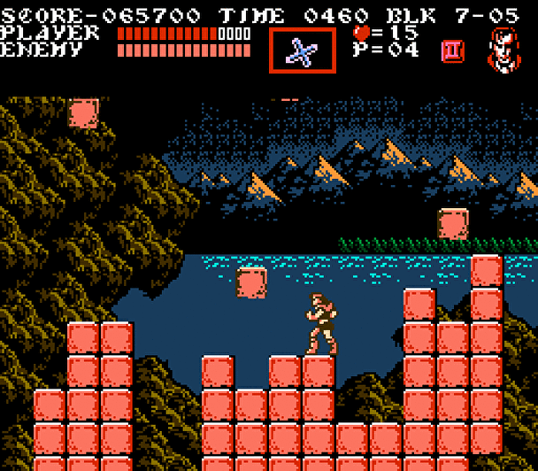
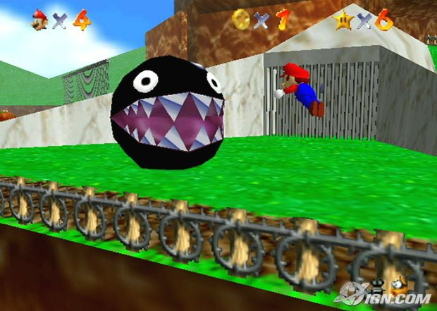
Pretty, Pretty Pictures
Castlevania 3 (NES) Super Mario 64 (N64)
So… it’s all relative, huh?

Slide 5
Graphics vs. Visual Design
Sometimes (most times) you don’t have to have AMAZING graphics
You need to have the RIGHT graphics
Tetris wouldn’t be “better” with sweet bump mapping
Just because we’re using 2D, that doesn’t mean you’re being held back

Slide 6

Graphics vs. Visual Design

Slide 7
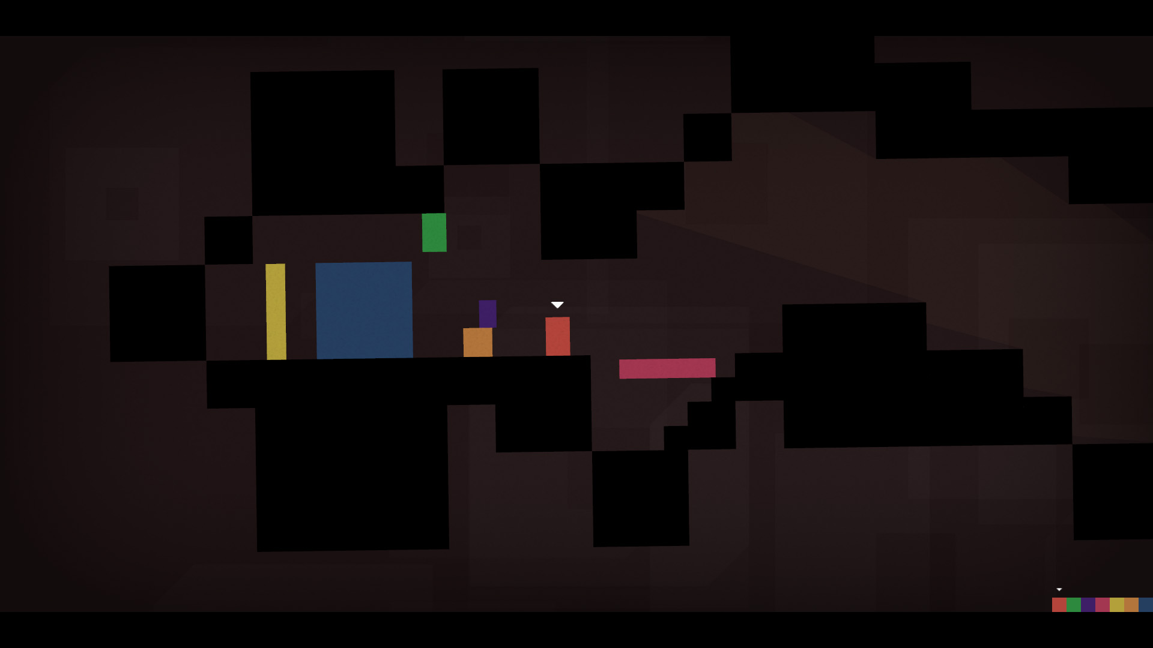
Graphics vs. Visual Design

Slide 8
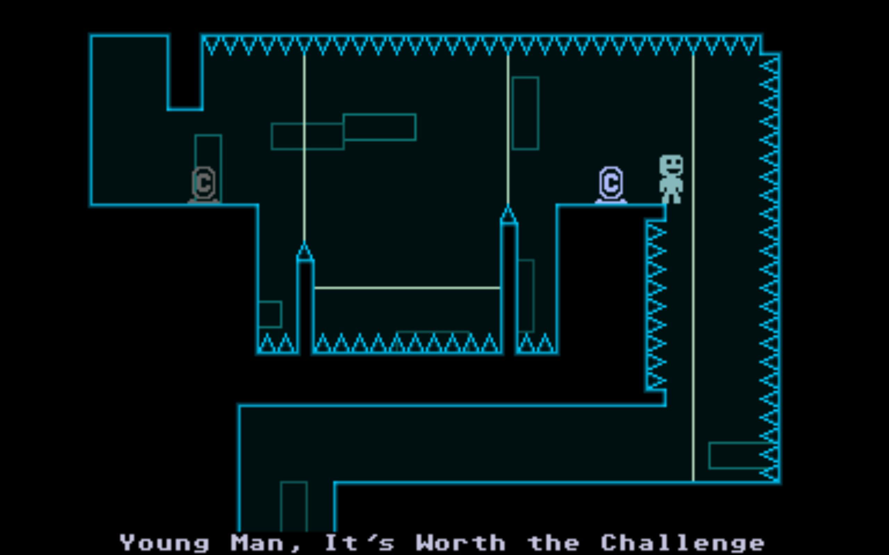
Graphics vs. Visual Design
*vvvvvv; 2010

Slide 9
What is a Sprite?
The Sprite is a single image (or entity) in your game scene or level.
Usually a png or something that supports transparent pixels
Usually many sprites on a single screen that move independently, etc.
With each frame, we need to clear the screen, update the sprites, then draw them all to the screen

Slide 10
Sprite Properties
A Sprite has the following fields:
id: unique string identifier
displayImage: the image being drawn
Visible: true iff sprite is visible and should be drawn
Position: X,Y coordinates of this sprite
PivotPoint: rotation point (more on this later)
scaleX/scaleY: How much to scale image by
Rotation: How much to rotate image
Alpha: amount of transparency of this image
Parent: another sprite that is my parent (more on this in next slide deck)

Slide 11
Sprite vs. DisplayObject
A DisplayObject is going to represent anything that can be on the screen and drawn
So…all of the fields and associated functionality on the previous slide will go in our DisplayObject class in hw 1
Sprite will extend DisplayObject
DisplayObject
Sprite extends DisplayObject
Sprite will initially be a pretty much empty class.
Why are we doing this? This will be become clear next week. I promise!
We are going to be putting another class between these two.

Slide 12
DisplayObject Psuedo-code
/*NOTICE THIS IS JAVA-LIKE, BUT NOT EXACTLY VALID JAVA*/
/* Also notice that this draws only a single Disp. Obj. as it */
/* is within the Disp. Obj. class */
Private Image displayImage;
protected override void Draw(AffineTransform g)
{
/*Private method that applies rotations, translations, etc.*/
applyTransformations(g);
g.drawImage(displayImage, 0, 0, this.getWidth(), this.getHeight());
/*Reverse the transformations. Why? Because we don’t want this…*/
/*Object’s rotation and translation to be applied to other images*/
reverseTransformations(g);
}

Slide 13
Game Psuedo-Code
/*NOTICE THIS IS JAVA-LIKE, BUT NOT EXACTLY VALID JAVA*/
/*Suppose my game stores all the sprites in the game in a list*/
Private ArrayList<Sprite> allSpritesInGame;
/* Your MAIN game loop’s draw method might be something like:*/
protected override void Draw(AffineTransform g)
{
for(Sprite sprite: allSpritesInGame){
sprite.draw(g);
}
}
/*EUREKA! That was such an easy method!!!*/

Slide 14
Does order matter?
Does it matter what order I draw my sprites in?
YES!
In 2D engines, we have two options:
Most recently drawn sprite always in front
This is the most common way to handle this (at least in my experience).
So programmer must think about the order things are drawn. We will deal with this in more detail next time.
Sprites contain a field called Z
Z value determines depth of the image.
Sprites with higher Z are drawn in front of Sprites with lower Z (Notice there is not actual depth here, e.g., further sprites are not drawn smaller, just behind)

Slide 15
Coordinates

Slide 16
Sprite Coordinates
Sprites are an abstraction of all graphical content
Three kinds of coordinates: world, screen, and object
We can manipulate sprites using linear algebra
Some examples include translation, scaling, and rotation

Slide 17
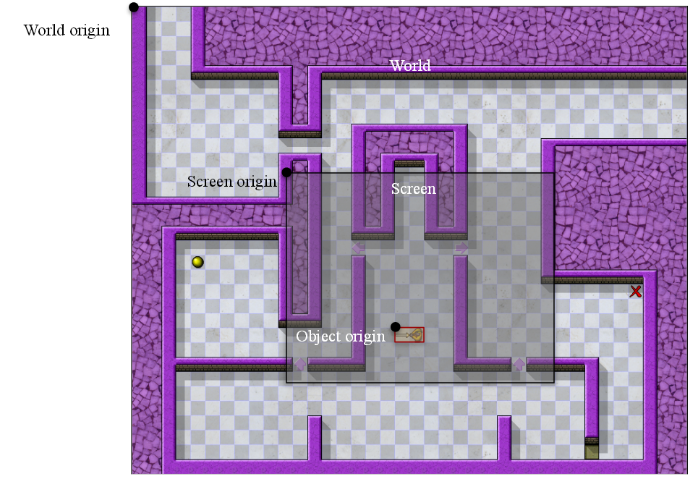
Screen and world coordinates

Slide 18

Pivot Points!
The Pivot point changes which point around which a Sprite is rotated. Thus, every DisplayObject (and thus Sprite) will need a pivot point field and react accordingly.

Slide 19
Transformations

Slide 20
2D Transformations
A function T :
Moves one set of points to another set of points
Transforms one coordinate system to another
The new coordinate system is the distortion
The Idea: Draw then “distort” it
Examples: Stretching, rotating, reflecting
Allows us to get multiple images for free! (i.e. character facing both directions)

Slide 21
Scaling
Changes the size of an object by scalar multiplication
Can be uniform or non-uniform

Slide 22
Rotation
Moves each point around an axis
(x’,y’)
x’ = x cos(θ) – y sin(θ)
y’ = x sin(θ) + y cos(θ)
(x,y)
θ

Slide 23
Translation
Moves a point within one plane

Slide 24
Transformation Matrices
Problem: Want a quick way to convert between standard coordinates and transformed coordinates.
Solution: Represent the transformations in a matrix. Multiple any x,y point by the matrix in standard coordinates to get the transformed point location.

Slide 25

Affine Transforms
A 3x3 Matrix representing transformations in Sprite’s local coordinate system.
Begin with identify matrix
$$\left[\begin{aligned}1 0 0 \\ 0 1 0 \\ 0 0 1\end{aligned}\right]$$

Slide 26
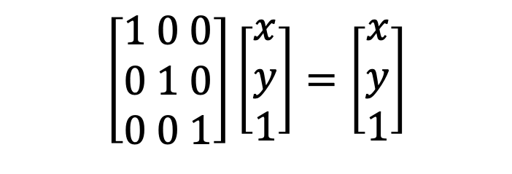
Affine Transforms
To transform a point, multiply the coordinates by the matrix. Identity matrix will never change the point
Begin with identify matrix
So far, not too interesting.
$$\left[\begin{aligned}1 0 0 \\ 0 1 0 \\ 0 0 1\end{aligned}\right]\left[\begin{aligned}x \\ y \\ 1\end{aligned}\right]=\left[\begin{aligned}x \\ y \\ 1\end{aligned}\right]$$

Slide 27
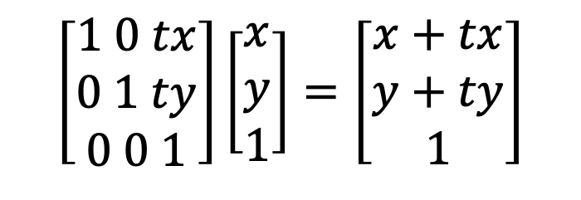
Affine Transforms: Translation
To model translation, use set a[0][2] and a[1][2] to the offset values
$$\left[\begin{aligned}1 0 tx \\ 0 1 ty \\ 0 0 1\end{aligned}\right]\left[\begin{aligned}x \\ y \\ 1\end{aligned}\right]=\left[\begin{aligned}x+tx \\ y+ty \\ 1\end{aligned}\right]$$

Slide 28
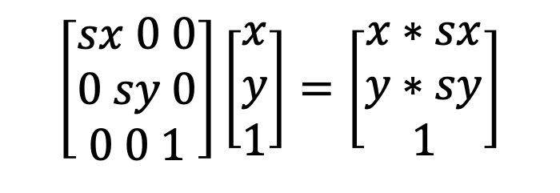
Affine Transforms: Scaling
To model scaling, use set a[0][0] and a[1][1] to the scaling multipliers
*Note scaling occurs in and out from 0,0 (pivot point / origin)
$$\left[\begin{aligned}sx 0 0 \\ 0 sy 0 \\ 0 0 1\end{aligned}\right]\left[\begin{aligned}x \\ y \\ 1\end{aligned}\right]=\left[\begin{aligned}x∗sx \\ y∗sy \\ 1\end{aligned}\right]$$

Slide 29

Affine Transforms: Rotation
To model rotation, set the transformation matrix as seen below
*Note rotation occurs around the origin / pivot point of the Sprite, so the picture above assumes origin was move to the center of the square, unlike the previous slide.
$$\left[\begin{aligned}\cos\left(p\right) −sin⁡(p) 0 \\ sin⁡(p) cos⁡(p) 0 \\ 0 0 1\end{aligned}\right]\left[\begin{aligned}x \\ y \\ 1\end{aligned}\right]=\left[\begin{aligned}xcos\left(p\right)−ysin(p) \\ xsin\left(p\right)+ycos(p) \\ 1\end{aligned}\right]$$

Slide 30
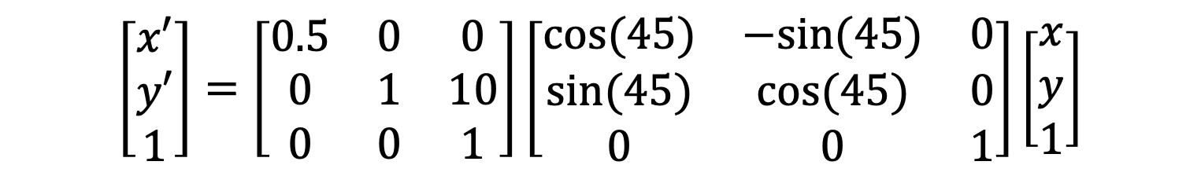
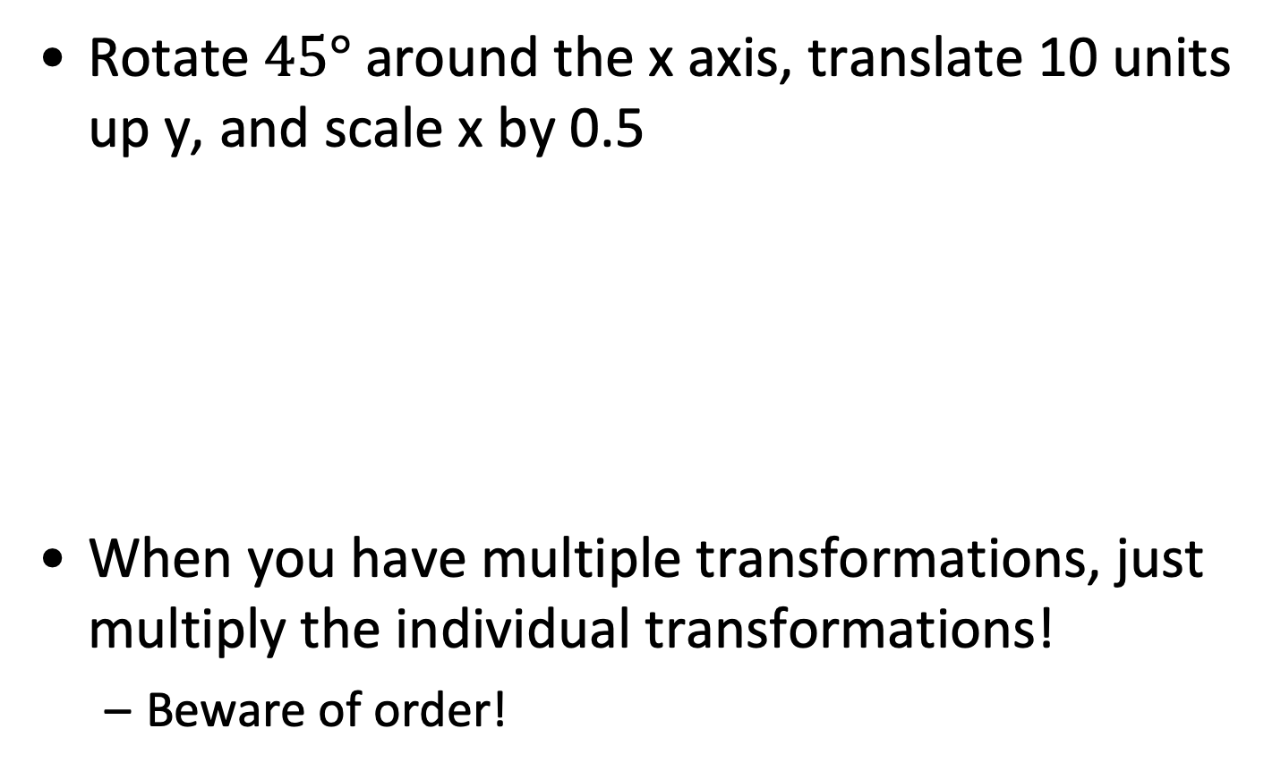
Combining Transformations
Rotate $45°$ around the x axis, translate 10 units up y, and scale x by 0.5
When you have multiple transformations, just multiply the individual transformations!
Beware of order!
$$\left[\begin{aligned}x′ \\ y′ \\ 1\end{aligned}\right]=\left[\begin{matrix}0.5 & 0 & 0 \\ 0 & 1 & 10 \\ 0 & 0 & 1\end{matrix}\right]\left[\begin{matrix}cos⁡(45) & −sin⁡(45) & 0 \\ sin⁡(45) & cos⁡(45) & 0 \\ 0 & 0 & 1\end{matrix}\right]\left[\begin{matrix}x \\ y \\ 1\end{matrix}\right]$$

Slide 31
Beware Some Transforms!
Scaling can be tough
If you up-scale an image, you are increasing the number of pixels, but not the amount of information
This leads to “jaggies” or blocky images
Scaling down is okay (usually)

Slide 32
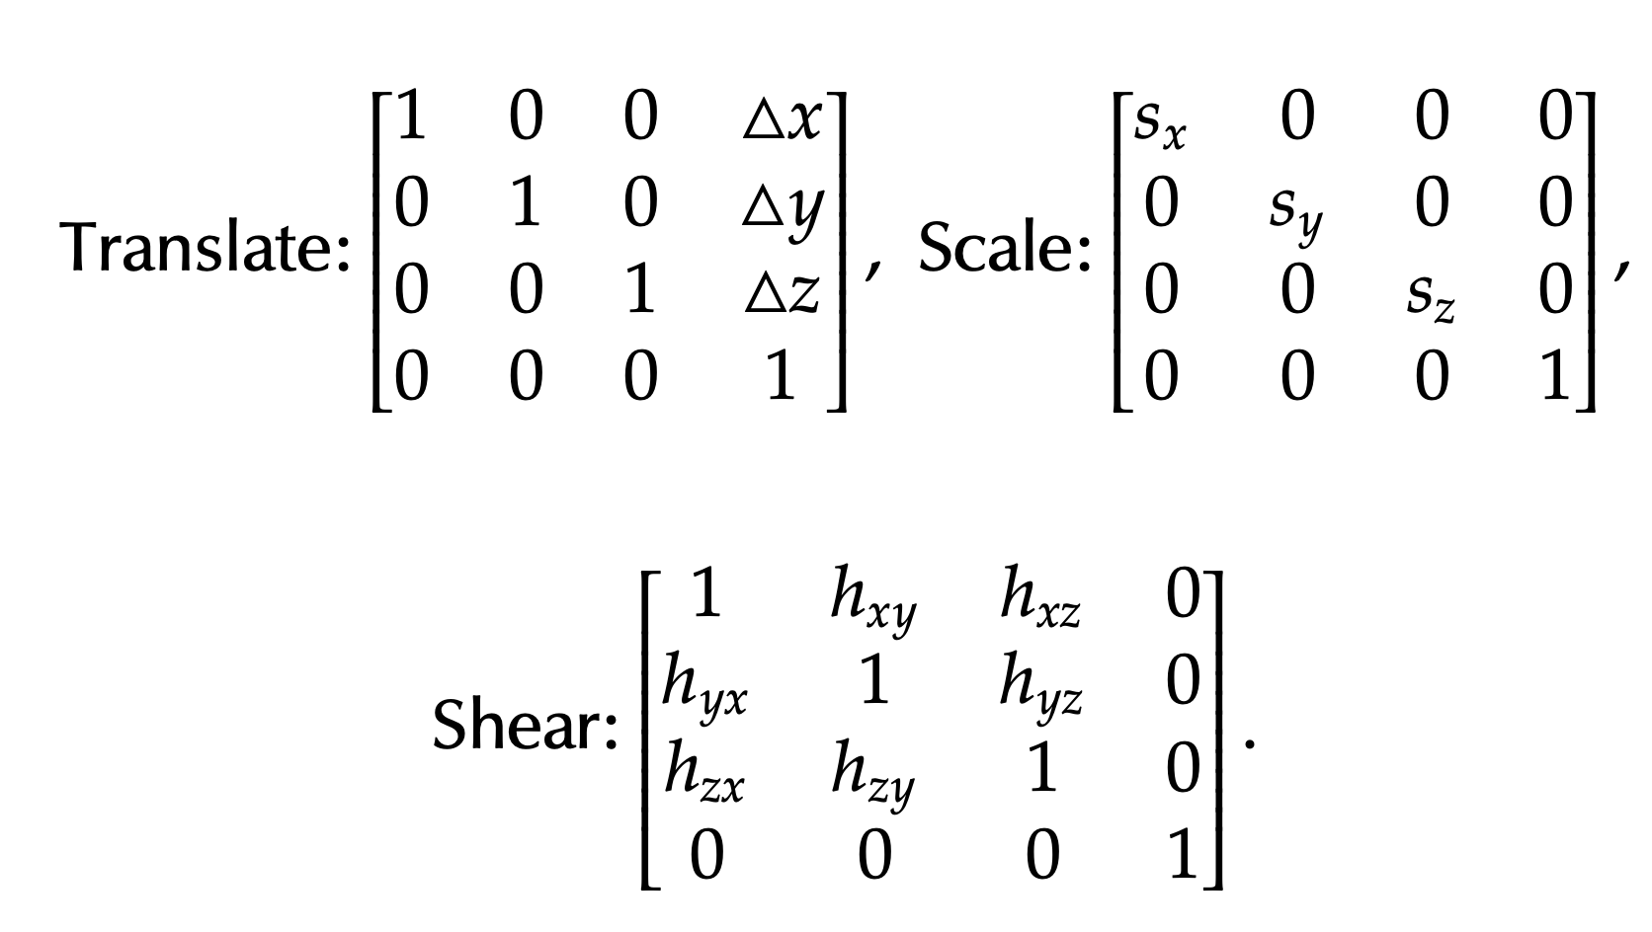
What about 3D Games?
Affine Transforms work in 3D too!!
Simply add a new row and column:

Slide 33
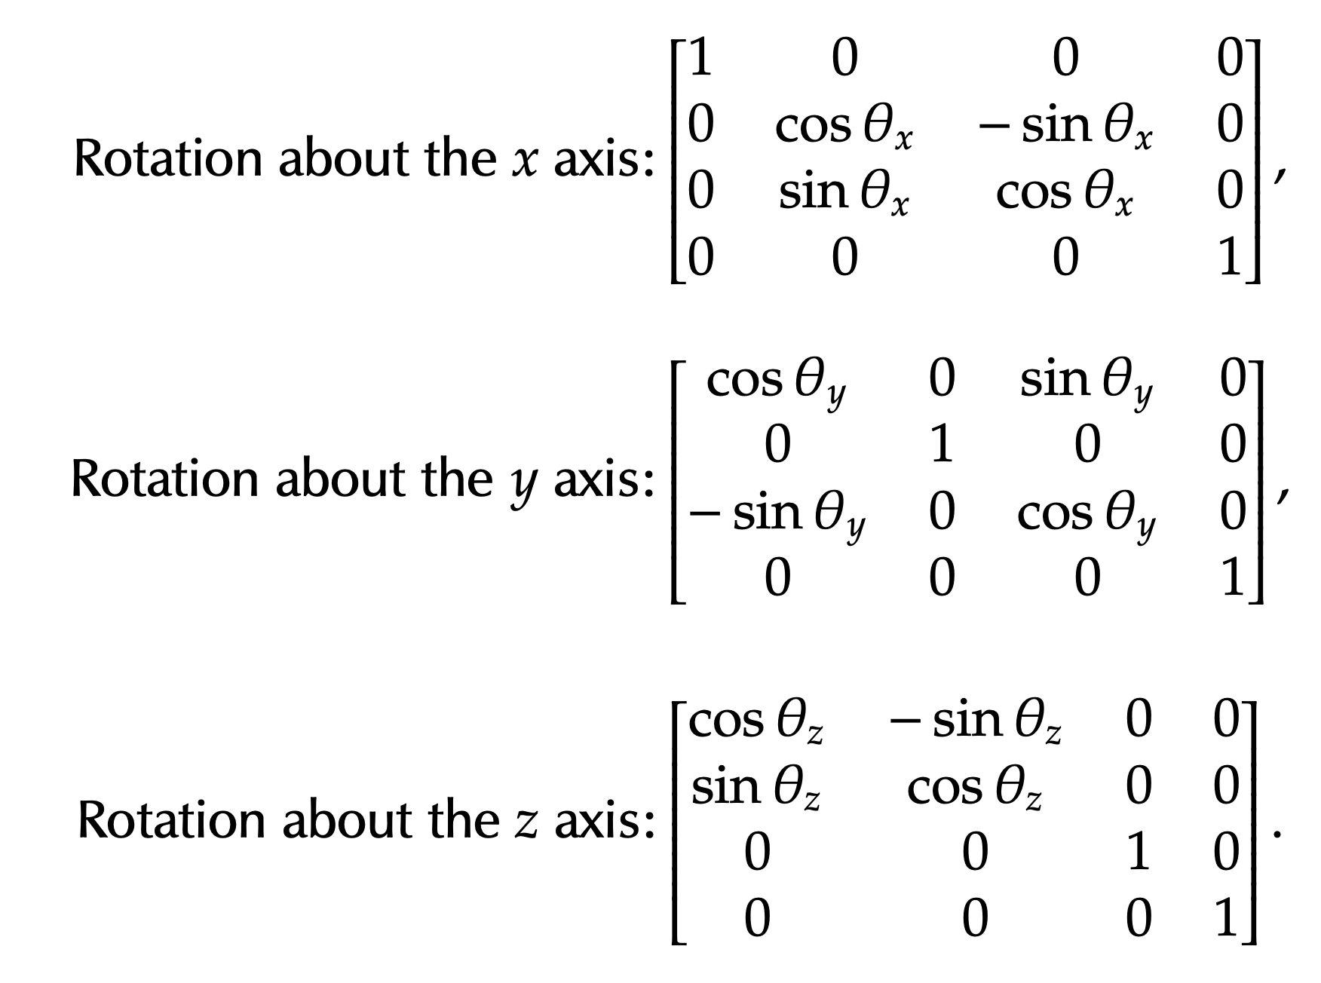
What about 3D Games?
Affine Transforms work in 3D too!!

Slide 34
What about 3D Games?
BEWARE! Rotations in 3D are very finnicky because the ORDER of the rotations matter.
Euler’s rotation theorem: Any rotation of a 3D object can be broken down into three rotations (one along each axis). Also states that any configuration is one rotation around some axis.
However, when using Affine Transforms, the order in which. We multiply the three rotations can affect the outcome.

Slide 35
What about 3D Games?
Gimbal Lock:
A situation in which one rotation causes two of the other rotation axes to become aligned.
https://en.wikipedia.org/wiki/Gimbal_lock
Is unavoidable when you have a set rotation multiply order.
Unity uses y-rotation, then x, then z
You can “FIX” Gimbal Locks by altering the multiply order on the fly, but very cumbersome and difficult to implement.

Slide 36
What about 3D Games?
Gimbal Lock:
How to avoid?
If using affine transforms, unavoidable. Best to know about them and consider rotations carefully
Or…you can use Quaternions. A rotation scheme that uses a complex number coordinate space.
We won’t go over these today.

Slide 37
Animations

Slide 38
Animation
An animation is simply a Sprite that has multiple images that cycle through.
So, we might have a new class:
AnimatedSprite extends Sprite

Slide 39
AnimatedSprite
AnimatedSprite should contain:
Playing: true iff this animation is currently playing
Frames: List of images of all of the frames
currentFrame/startFrame/endFrame: indices for which frame is playing, etc.
animationSpeed: How fast/often the frames switch
Anything else?
Remember this extends Sprite, so already has that functionality. DisplayObject will need a setImage() method that allows us to switch the image of this sprite.

Slide 40
AnimatedSprite Psuedo-code
/*NOTICE THIS IS JAVA-LIKE, BUT NOT EXACTLY VALID JAVA*/
protected override void Update(){
if(playing){
if(clock.elapsedTime >= animationSpeed){
currentFrame++; //need currentFrame to wrap, so this is buggy
super.setImage(frames.get(currentFrame));
}
}
}
/* Notice that draw does not need to do anything differently */
protected override void Draw(Graphics g)
{
/* Call the super draw method in DisplayObject class */
super.draw(g);
}

Slide 41
AnimatedSprite: Different Animations
Sometimes, an AnimatedSprite should contain different types of animations
E.g., a walking animation and a jumping animation.
Thus, you class should support this. I should be able to say:
Object.setAnimation(“jumping”)
Object.play()
…and have the jump animation play.
How might this work in code?
Let’s discuss? There are several ways we could implement this.

Slide 42
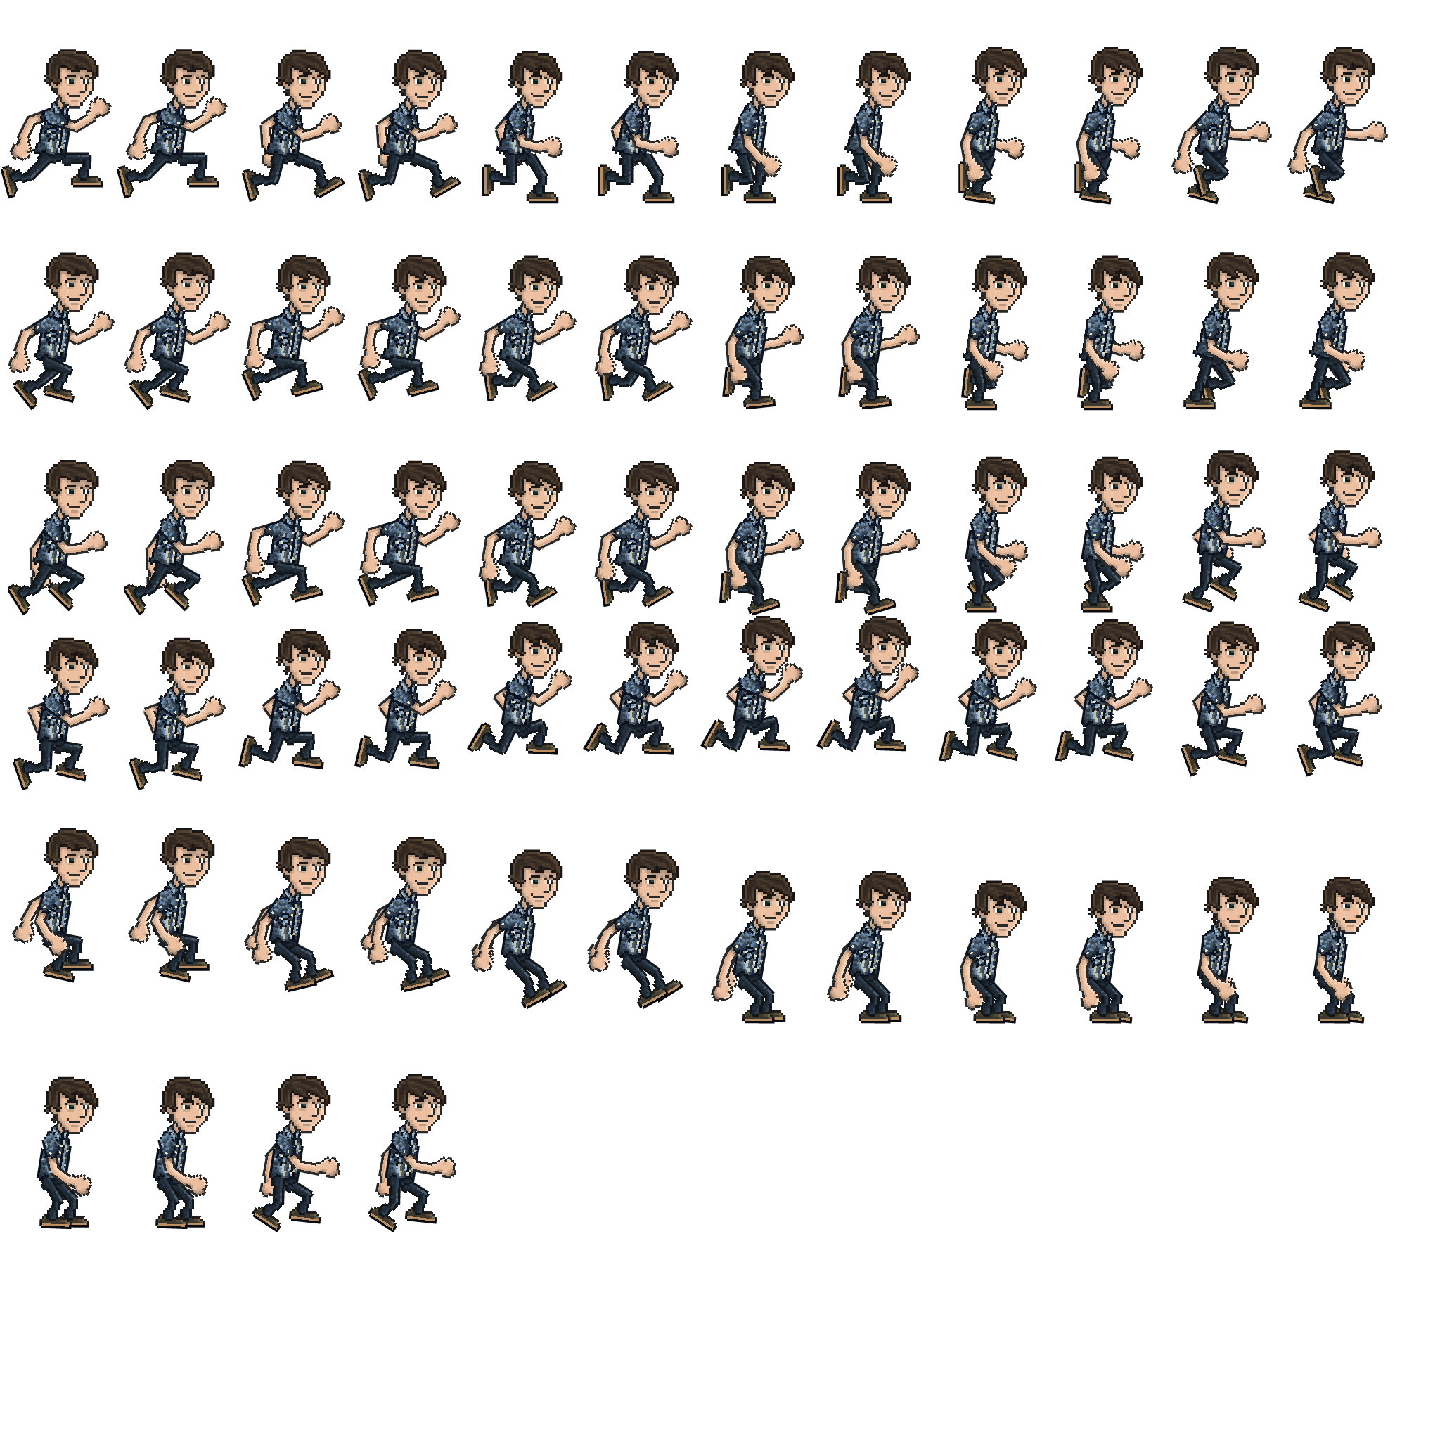
Sprite Sheets

Slide 43
Sprite Sheets
Sprite sheets always come paired with an xml document.
This describes:
A) what the unique animations are (jumping, etc.)
B) Where each frame of that animation is located in the sprite sheet (upper left corner in image and width height from there).
Engine takes this information and parses it out, find the appropriate cutout from the spritesheet, etc.
Good because we only have to load one image into memory and just use subsets of that one image. Only good if compact.
Your engine does not need to support this. Individual images for each frame is fine.

Slide 44
Summary
Classes You will be writing for your lab:
DisplayObject: A thing that can be drawn on the screen. Contains draw() and update methods. Everything on the screen MUST extend DisplayObject.
????? There will be another class we put here between DisplayObject and Sprite. See next slide deck for details.
Sprite extends DisplayObject: Placeholder for now. Contains basically no code but useful for programmer (i.e., new Sprite() instead of new DisplayObject()). Will have extra functionality once the mystery class above is filled in.
AnimatedSprite extends Sprite: Just like a sprite, but changes its image rapidly to give the appearance of animation.

