Slide 1
Tweening
CS 4730 – Computer Game Design
Notes:
1

Slide 2
WTF is a Tween?
A Tween is simply a name given to a visual effect in which a Sprite is animated from a start to end state smoothly (and automatically).
2

Slide 3
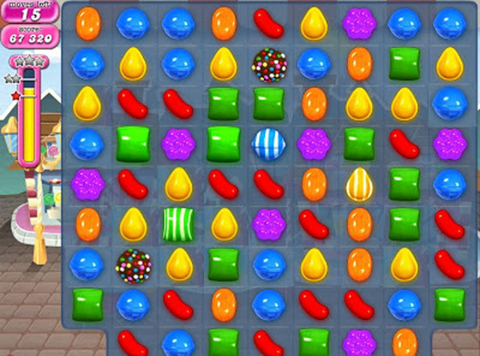
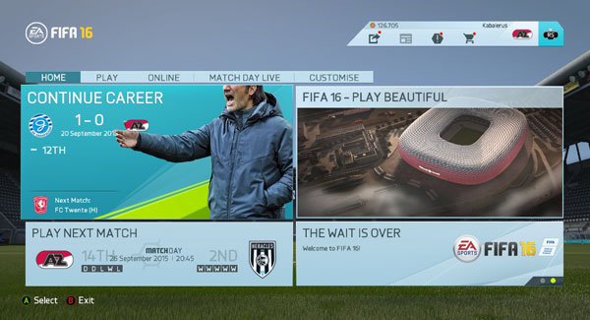
Examples in Games
3

Slide 4
Usage
Programmer can use a Tweening engine conveniently like this:
/* A tween object stores the display object that will be manipulated */
Tween marioTween = new Tween(marioSprite);
/* You can call animate to tell the tween how you want the object to be altered and in how much time */
marioTween.animate(TweenableParams.SCALE_X, 2.0, 500);
marioTween.animate(TweenableParams.SCALE_Y, 2.0, 500);
/* This TweenJuggler class has a static method that allows you to add tween to queue */
TweenJuggler.add(marioTween);
What different parameters can/should be tweenable?
Can I set different time parameters? Different end value parameters?
Can I tween the same parameter in two different directions (e.g., make X large and small)?
4

Slide 5
What would you use this for?
What you would use this for:
Dead enemies fading out of existence smoothly
Points appearing and moving up to corner where point total is
UI elements sliding in and out, or appearing and disappearing smoothly.
Used (usually) when you KNOW the exact end position of the thing that is moving and don’t want to manually code it up. You want to use a simple function call instead.
What you would probably NOT use this for:
Moving Mario from user input
Projectiles
5

Slide 6
So we need to write
TweenableParams
Just a list of the fields that can be tweened
Tween Param
Object storing info related to a single field’s change over time
Tween
Stores data about what is being tweened, where it is going, what fields are being manipulated, etc.
TweenJuggler
A large class that handles all tweens. Sets the DisplayObjects of all tweens to their proper values each frame. Disposes the tween once complete.
Throws events to let other objects now when the tween has started, when its completed, progress, etc.
6

Slide 7
Let’s work these out first
TweenableParams
Just a list of the fields that can be tweened
How would we implement this?
TweenParam
Object storing info related to a single field’s change over time
Do we NEED this? No! Could just store in Tween class directly
I’m going to describe it this way just to over OO it.
*Note this class does NOT store the object being tweened…not necessary. Why?
FIGURE OUT ON BOARD->
7

Slide 8
Let’s work these out first
Tween
What fields are necessary?
What methods?
What should each do?
FIGURE OUT ON BOARD->
8

Slide 9
TweenJuggler
The TweenJuggler is meant to be a class that ‘juggles’ all of the tweens running in the game at once. So, any tween that occurs in the game must be submitted to this class, and this object will automatically update the Tweens in its list every frame.
There is only ONE instance of the TweenJuggler (Singleton, see next slide).
The method add(Tween tween) is static and accessible from anywhere in your code
TweenJuggler does most of the work of handling active tweens, disposing ones that are complete, etc.
9

Slide 10
Aside: Singleton Design Pattern
In software engineering, the singleton pattern is a design pattern that restricts the instantiation of a class to one object. This is useful when exactly one object is needed to coordinate actions across the system.
So, we use this pattern when we need:
A class that is coordinating across the system and needs to be accessed from many areas of the code.
A class that only has (and will only ever need) ONE instantiation.
The singleton pattern allows us an easy way to implement this idea.
The TweenJuggler is implemented as a singleton (usually) because there is one instance of it that is accessible from any other object in the game.
* The singleton pattern is often seen as BAD programming practice. People abuse it to get easy access to objects they don’t have in scope. Be careful using this, as it is only appropriate in very specific circumstances.
10

Slide 11
Aside: Singleton Design Pattern
To implement the singleton pattern we use:
Public class MyClass{
private static MyClass instance;
public MyClass(){
if(instance != null) S.O.P(“ERROR: Cannot re-initialize singleton class!”);
instance = this;
}
public static MyClass getInstance(){return instance;}
public void oneMethod(){}
}
Now, from anywhere else in the code, I can access the one object by doing:
MyClass.getInstance().oneMethod();
11

Slide 12
Ok, back to the TweenJuggler
Let’s figure out the other methods and fields.
On board->
12

Slide 13
Tween Transitions
Great! We are done!!!! Well…almost:
If we implement what we've described so far, the tweens will all be pretty boring. Why?
Only linear interpolations. Kind of boring, no cool swooshes or anything like that.
Let's give this a slight upgrade. How?
13

Slide 14
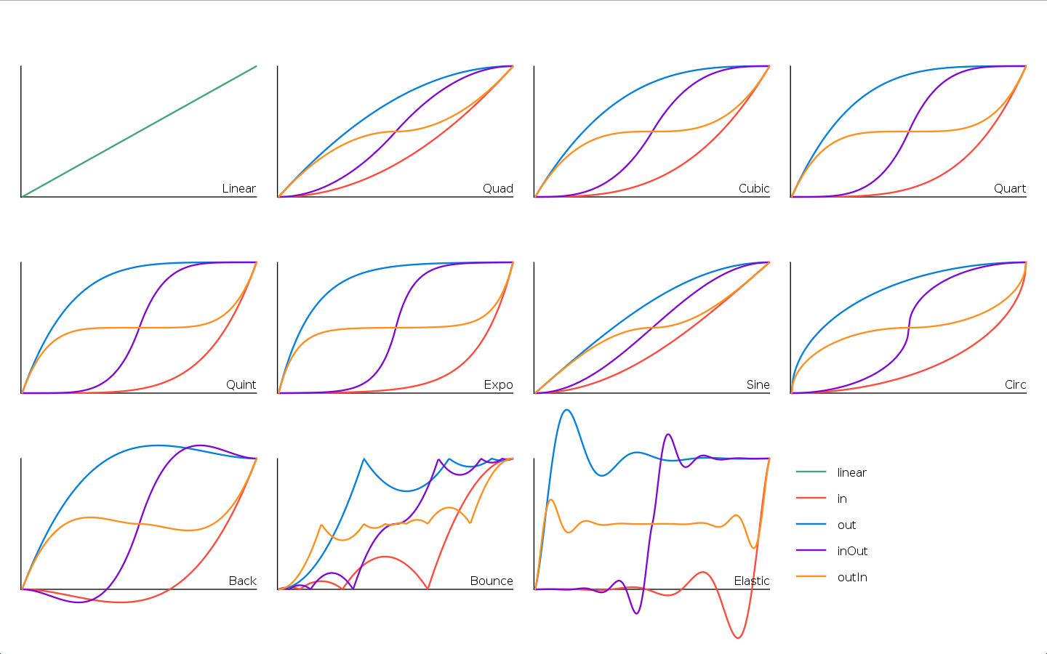
Transition Functions!
A Transition Function maps the percent time completed on the tween to the percent of the actual transition that should occur.
14

Slide 15
Transition Functions!
A Transition Function maps the percent time completed on the tween to the percent of the actual transition that should occur.
How do we implement this in code!!!???
15

Slide 16
Events!
We already know the observer design pattern. Tweens, when used correctly, really should be throwing events.
Why? Because the rest of our code might need to know the status of a tween. We might be waiting on something before we move on to accomplish another task.
Example:
Suppose when your character picks up a coin, you want a number to appear for point total in that position, swoop smoothly to the upper right corner where the points total is, and then after it gets there, fade out.
16

Slide 17
Events!
Example:
Suppose when your character picks up a coin, you want a number to appear for point total in that position, swoop smoothly to the upper right corner where the points total is, and then after it gets there, fade out.
What does this code do:
/* A tween object stores the display object that will be manipulated */
Tween marioTween = new Tween(marioSprite);
/* You can call animate to tell the tween how you want the object to be altered and in how much time */
marioTween.animate(TweenableParams.X, 50, 500);
marioTween.animate(TweenableParams.Y, 800, 500);
marioTween.animate(TweenableParams.ALPHA, 0.0, 500);
/* This TweenJuggler class has a static method that allows you to add tween to queue */
TweenJuggler.add(marioTween);
17

Slide 18
Events!
Let's talk about some Events the Tweens will have.
What do you think?
Some choices include:
TweenStartEvent: The tween just began
TweenUpdateEvent: The tween has a new location/scale/etc.
TweenCompleteEvent: Probably most important. Another object might be waiting for this tween to be complete before moving onto another one or to something else.
The tween object should be dispatching these events as it ticks so that any object of interest will know the current status of the tween.
18

Slide 19
Then we can do:
/* A tween object stores the display object that will be manipulated */
Tween marioTween = new Tween(marioSprite);
/* You can call animate to tell the tween how you want the object to be altered and in how much time */
marioTween.animate(TweenableParams.X, 50, 500);
marioTween.animate(TweenableParams.Y, 800, 500);
/* Listen for the tween to be complete */
marioTween.addEventListener(TweenEvent.TWEEN_COMPLETE, this);
/* This TweenJuggler class has a static method that allows you to add tween to queue */
TweenJuggler.add(marioTween);
…
public void handleEvent(TweenEvent event){
marioSprite.removeEventListener(TweenEvent.TWEEN_COMPLETE, this);
Tween fadeTween = new Tween(marioSprite);
fadeTween.animate(TweenableParams.ALPHA, 0.0, 500);
TweenJuggler.add(fadeTween);
}
19

