Slide 1
Level Design
CS 4730 – Computer Game Design
Credit: Several slides from Walker White (Cornell)

Slide 2
What does it mean to design a level?
You have to understand the player’s capabilities
Mechanics / actions available to player
Assumption of player skill level
You are laying out the game geography
Location and interaction of challenges
Dynamic features (NPCs)
You are also determining player progression
How does the player progress through the game

Slide 3
focus on each of these…
1. Focus on the player’s capabilities
That’s when we train the player to understand the game’s systems and improve their own skills
2. Focus on player progression
That’s when we focus on storytelling (or the experience overall)
3. Focus on game geography
That’s when we come up with the actual layout

Slide 4
1. Teaching the Game
A player coming into your game falls into one of these categories:
Has no idea how to play the game or any game of this type (complete novice)
Has never played your specific game, but knows the conventions of the genre (some knowledge)
Has played similar games or prequels (domain knowledge)
Has played this specific game before (expert)

Slide 5
1. Teaching the Game - Novice
Someone who has never played your game, nor any other game in the genre
Well, they could read the manual…
Yeah, no. That’s the best way to turn off a player
(Back in the day, manuals mattered… but not really to learn how to play…)
Let’s make some tutorial levels!
Start playing immediately
AND learn while doing it!

Slide 6
The Tutorial Level
Start with your design doc
Remove everything except the simplest core mechanic
Disable numerous actions and interactions
“Dumb down” your game
Add mechanics back in one at a time
You don’t HAVE to add a new mechanic for EACH level
Some take time. This can affect your layouts.

Slide 7
Thomas Was Alone
Let’s look at the first levels of Thomas Was Alone
https://www.youtube.com/watch?v=Qtqe9x4s7LA

Slide 8
Super Mario Bros. 2
Let’s look at the first level of SMB 2

Slide 9
TWA vs. SMB 2
How do these two games compare with how they teach the mechanics to the player?

Slide 10
2. Focus on Player Progression
Two schools of thought here:
Start very small and build up
Give everything and let the user get a taste of what’s coming
“Finish the first level last.” – John Romero, creator of Doom
Another option: put a lot of content in the tutorial level to encourage replay with different ideas

Slide 11
Upgrading Mechanics
How do we introduce new mechanics one at a time?
Gated by new PCs (Thomas Was Alone)
Item pickups (Metroid, Castlevania: SOTN)
Leveling (many RPGs)
Often treated as a form of training
“Master this thing and then you can have another thing”
Bad end to this: grinding

Slide 12
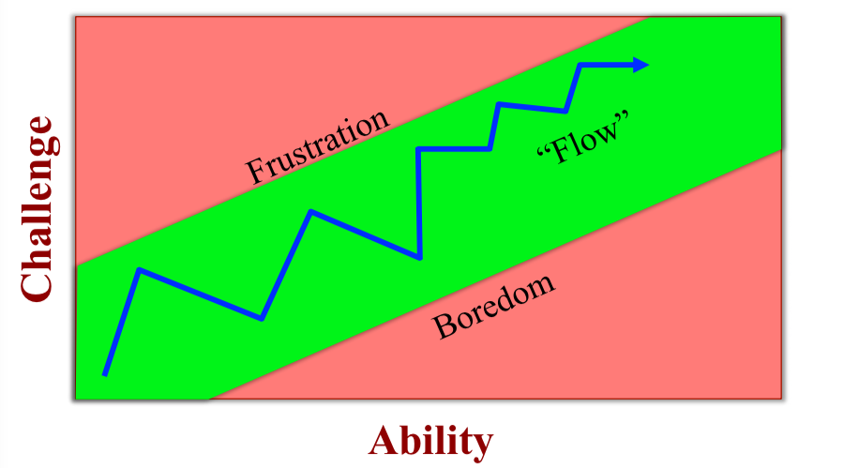
Training and Flow

Slide 13
Enabling Flow
Challenging activity that requires some skill
Physical, mental, or social skill
Without skill => Cannot do it
Goals and Feedback
Player has to know what they are working toward
Constant feedback as to whether the goal is being approached
Have to know if success or failure is achieved (clear win/fail state)

Slide 14
Designing a Tutorial Level
Identify the learning objective
What should the player learn?
Not necessarily the same as beating the level
Identify player assumptions
What should the player know how to do now with the mechanics?
How much skill should the player have?
Storyboard the progress
Note: Puzzle design is the inverse of this

Slide 15
Super Metroid
Super Metroid (SNES) is a genius work of game design
All tutorial / learning is done synchronously with normal gameplay
Let’s check it out!

Slide 16
3. Focus on Game Geography
Games are all about “meaningful choice”
Players need to be able to “own” their playthrough of the game
Choosing a new weapon that +1 better than something with power of 530 already isn’t choice
Choosing to “go high” or “go low” in a level IS choice

Slide 17
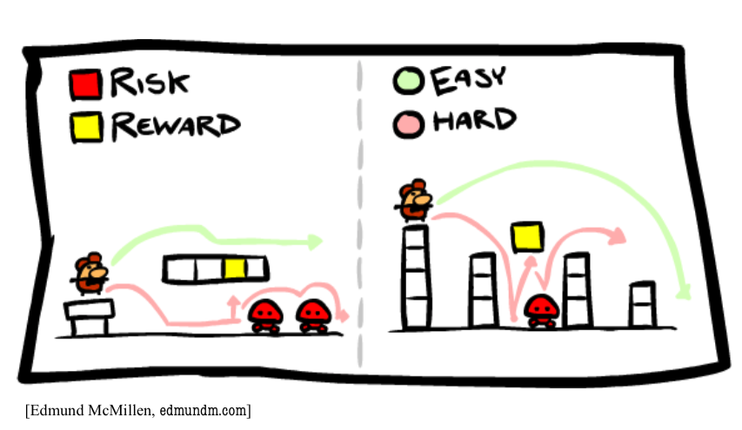
Analysis Paralysis – Risk and Reward

Slide 18
Build up the Level
Design individual challenges
Maybe not quite “set pieces”, but similar
Choose a single obstacle or mechanic or NPC
Figure out where in the level this might occur
This could be a single frame in a storyboard
Combine pieces to make a full level

Slide 19
Super Mario Bros. 3
Level 1-1
http://www.mariouniverse.com/images/maps/nes/smb3/1-1.png
Level 1-5
http://www.mariouniverse.com/images/maps/nes/smb3/1-5.png

Slide 20
Doom Hangar
Why was this level interesting?

Slide 21
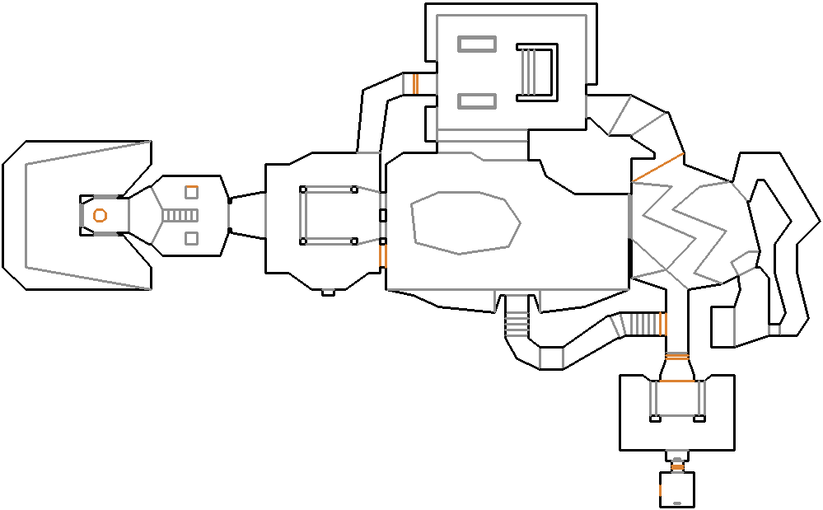
The Hanger - Doom

Slide 22
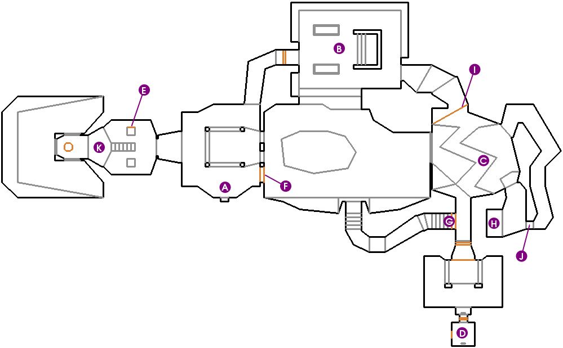
The Hanger - Doom

