Slide 1
Enemy / AI Design
CS 4730 – Computer Game Design
Mark Floryan
Some slides from Mark Sherrif, Tiffany Barnes (NCSU)

Slide 2
Topics
Character Design:
Choosing a set of moves, thinking about risk vs reward of that move set
State machines for programming characters
Enemy Design
Balancing AI, behaviour, risk, etc.
State machines for programming enemies

Slide 3
Discussion
Are people more fun than NPCs? Why?

Slide 4
Enemy / AI Design

Slide 5
Enemy / AI Design
Game Loop handles Enemy and NPC decisions:
Needs to be complicated enough to seem somewhat realistic
Simple enough to run VERY efficiently and easily code.
Also:
Difficult enough to be fun
Easy enough to not be unfair (imagine an AI that acts perfectly in all situations, not fun!)

Slide 6
Enemy / AI Design
Most common solution to AI design in games is the state machine:
Enemies and NPCs are given a set of states
Each state is a uniquely programmable action
e.g., lunge attack, run away, or dodging
Programmer develops each individual action
Transitions determine when to change enemy pattern from one state to another
e.g., when health drops enter enraged state, or if character is close then do melee attack

Slide 7
Enemy / AI Design
In addition to state machines, enemies will use the think-sense-act paradigm
Sense: Look at the world around you and determine if state changes based on that.
Plan: Plan out the enemy’s next moves.
Act: Choose a final state and execute it.

Slide 8
Enemy / AI Design
Let’s look at some concrete examples
4 Examples (increasing complexity)
Super Mario Bros. 3 (Koopa Troopa)
Super Metroid (Ridley)
Hollow Knight (Soul Master)
Metal Gear Solid (Soldier)

Slide 9
Super Mario Bros. 3: Koopa Troopa

Slide 10
SMB3: Koopa Troopa
Coding this up? Basically just four states:
Walking
Stomped (but still)
Stomped and kicked
Dead

Slide 11
SMB3: Koopa Troopa
Model with simple state machine.
Let’s do together on the board

Slide 12
Super Metroid (Ridley)

Slide 13
Ridley
Primary States:
Ramming: Lunging into Samus
Grabbing: Attempting to pick up Samus
Pogo: Using tail as pogo stick and striking down
Swoop: Big swoop from one side of screen to other
Thinking: Just floats above for a bit
Dying: Health=0, goes into a rage and gets faster and stronger. Dies as soon as he picks up Samus
A couple other states (hidden when fight first starts, sometimes dodges attacks from Samus)

Slide 14
Ridley
Basic Loop:
Choose action
Perform action
Repeat
Independently:
Wave tail around (depending on state)
Shoot fireballs
Is somewhat random and dependent on state

Slide 15
Ridley
Let’s draw a basic state machine:

Slide 16
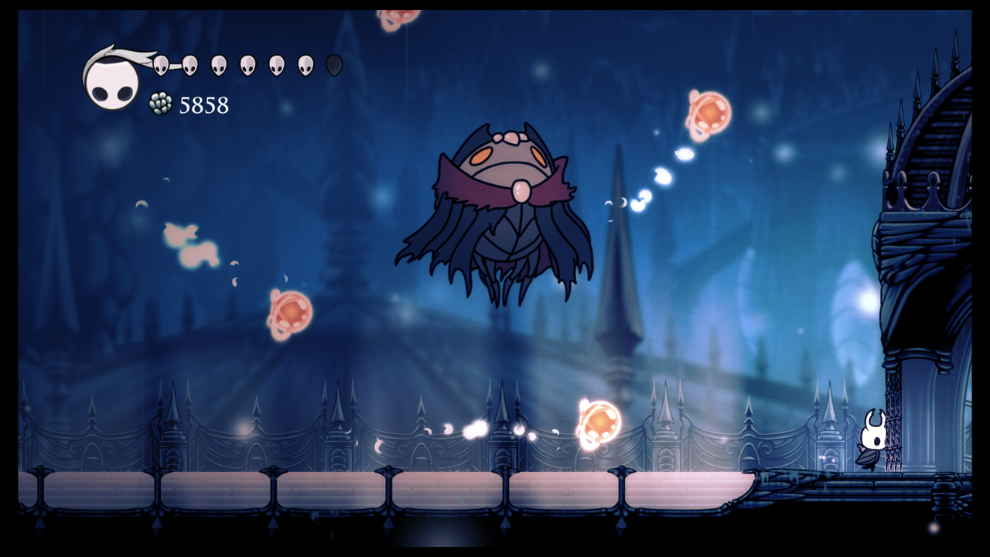
Hollow Knight Soul Master

Slide 17
Soul Master
4 attacks
float across screen
float across (w/ four orange orbs)
homing orb
Ground slam (+ fake out version)
Other states:
deflated
second phase (we will ignore for today)

Slide 18
Soul Master
Basic loop is easy:
Teleport out
Select attack
Teleport in and perform attack
repeat
Notice
Sometimes boss will teleport in and quickly abandon choice (knight is too close) and choose another attack

Slide 19
Soul Master
Recommendations:
Program each attack individually (in one method maybe)
Code to just select an attack is pretty easy
This boss works because
Each attack is interesting and requires some skill to avoid
Each attack a little different
Speed and pacing between each is just right

Slide 20
Soul Master
Let’s attempt the state machine

Slide 21
Metal Gear Solid (Soldier)

Slide 22
MGS
Has VERY complicated AIs (for games anyway)
Four high level states:
Normal: Solider doesn’t know snake is around, normal patrolling
Noise: Snake made a noise. Solider hears it and plans to investigate
Alert: Snake is seen! This is not good!
Evasion: We were in alert, snake is now hidden. Enemies know he is nearby and are still searching

Slide 23
MGS
In each mode, the soldiers can do many various things.
Normal:
Snake can hide in boxes
Throw food or magazines at soldier to distract them
Knock on walls to get them to investigate in wrong direction
They might see body of a colleague
etc.

Slide 24
MGS
Other states are a bit more simple
Alert:
Attack snake, call in reinforcements
Evasion:
Look around aggressively for Snake, additional enemies are around moving quickly, opening up doors, etc.

Slide 25
Problems with State Machines
Too Predictable
Sometimes a good thing, sometimes not
Player can learn the pattern of the NPC with some practice
Limited
e.g., Ridley has several states, but doesn’t feel like a super complex or smart character.

Slide 26
Probabilistic FSMs
Suggestion: Make FSMs more interesting by introducing randomness combined with intelligent action selection (more sensing)
e.g., Soul master won’t pick a move that makes him appear right next to the knight. Tries to pick good actions.
Transitions between states are probabilistic which makes enemy less predictable.

Slide 27
Probabilistic FSMs
Even Better: Update probabilities based on success. If one move is working well against player, the chance of selecting it goes up.
Examples:
If fireball keeps hitting player, select it more often to force player to learn it.
If a move keeps not hitting and player is avoiding, start selecting it less often.

Slide 28
Summary
Here, we’ve focused on a single type of AI (state based) which are very common.
Other types:
Strategy / Move-based: Like enemies in a turn-based RPG. More discrete. Chooses actions among a set of possible actions.
Global vs. Local States: Think Starcraft. AI makes high level decisions (build troops vs grow economy) and micro decisions (each individual unit movement)

