Slide 1
Character Design
CS 4730 – Computer Game Design
Mark Floryan
Some slides from Mark Sherrif, Tiffany Barnes (NCSU)

Slide 2
Topics
Character Design:
Choosing a set of moves, thinking about risk vs reward of that moveset
State machines for programming characters
Enemy Design
Balancing AI, behaviour, risk, etc.
State machines for programming enemies

Slide 3
Enemy / AI Design

Slide 4
Enemy / AI Design
4 Examples (increasing complexity)
Super Mario Bros. 3 (Koopa Troopa)
Super Metroid (Ridley)
Hollow Knight (Soul Master)
Metal Gear Solid 3 (Soldier)

Slide 5
Super Mario Bros. 3: Koopa Troopa

Slide 6
SMB3: Koopa Troopa
Coding this up? Basically just four states:
Walking
Stomped (but still)
Stomped and kicked
Dead

Slide 7
SMB3: Koopa Troopa
Model with simple state machine.
Let’s do together on the board

Slide 8
Super Metroid (Ridley)

Slide 9
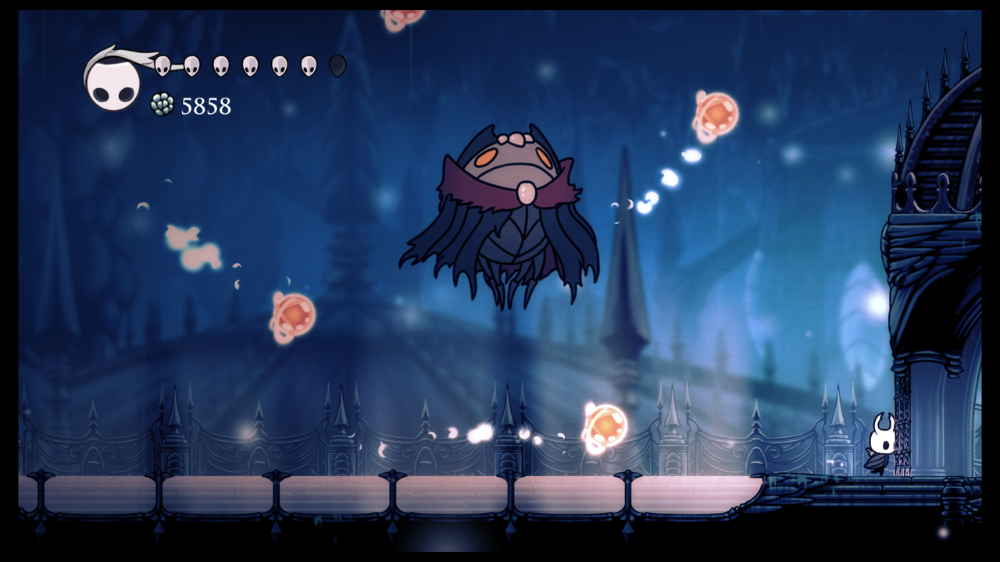
Hollow Knight Soul Master

Slide 10
Soul Master
4 attacks
float across screen
float across (w/ four orange orbs)
homing orbs
Ground slam (+ fake out version)
Other states:
deflated
second phase (we will ignore for today)

Slide 11
Soul Master
Basic loop is easy:
Teleport out
Select attack
Teleport in and perform attack
repeat
Possible improvements
Be a bit smarter about which attack to select, etc.

Slide 12
Soul Master
Recommendations:
Program each attack individually (in one method maybe)
Code to just select an attack is pretty easy
This boss works because
Each attack is interesting and requires some skill to avoid
Each attack a little different
Speed and pacing between each is just right

Slide 13
Soul Master
Let’s attempt the state machine

Slide 14
Metal Gear Solid (Soldier)

Slide 16
The Game Loop
Tasks
Handling time
Gathering player input
Networking
Simulation
Collision detection and response
Object updates
Rendering
Other miscellaneous tasks

Slide 17
The Game Loop
Tasks
Handling time
Gathering player input
Networking
Simulation
Collision detection and response
Object updates
Rendering
Other miscellaneous tasks

Slide 18
What all do you have to simulate?
Physics
Environments
Lighting
Sounds
Behaviors

Slide 19
Discussion
How good should the AI be?

Slide 20
Discussion
Are people more fun than NPCs? Why?

Slide 21
AI vs. Game AI
Modern AI research is more in genetic algorithms and neural networks
This isn’t really an option for game AI (right now)
We value efficiency over complexity
Too much other stuff to do in the game loop!
AI for us just has to be “good enough” to be fun
We will look at three main AI roles:
State-based behavior, planning/strat, pathfinding

Slide 22
What Makes “Good AI”?
Perceived by user as challenging
Cruel, but fair!
User is surprised by the game
but later understands why
Feeling that reality will provide answers
able to make progress solving problem
What games have used AI effectively?

Slide 23
The Bar To Reach
Have you failed in your attempt to create a game if your NPCs can’t pass the Turing Test?
NO! Of course not!
Sometimes NPCs can pass the Turing Test in very specific circumstances
Computer chess player
Sometimes NPCs will never pass the Turing Test and we’re okay with that!
Koopa Troopas in Super Mario Bros. 3

Slide 24
“Good Enough”
Your AI needs to be “good enough for the player to be challenged…”
And “bad enough for the player to have fun…”
Games are often played to escape from reality
Playing against an AI that’s “too good” is incredibly frustrating
Imagine a computer player of Othello or Scrabble that ONLY took optimal moves

Slide 25
The AI Loop
Given the changes to the environment, what should the NPC do?
Cognition of the NPC
Perception (processing the state of the environment) or “Sense”
Decision making (decide what to do based on perception) or “Plan”
Control (update NPC one time step) or “Act”

Slide 26
Perception
The NPC’s estimation of game-related information
Includes perceived strategies of PCs
Identifies most important factors for the NPC to respond to
Think of it as the NPCs “attention span”

Slide 27
Decision Making
Determining a course of action for this time step for this particular state of the game
Usually requires a trade off between accuracy of the decision and speed of computation
Computer COULD simulate out several steps to make a “better” decision, but at a cost of speed and potentially “fun”

Slide 28
Control
Adjusting the appropriate variables of the NPC to carry out the decision made
Steering or throttle in a racing game
Crouching or taking a shot in an FPS
Using a potion or casting a spell in an RPG

Slide 29
The Sum Of The Parts
The sum of all these parts makes up the AI of an NPC
It can be incredibly complex
Large fight in a tactical shooter
It can be pattern based
Behaviors of a sentry in Metal Gear Solid
Behaviors of any boxer in Punch Out
It can be … well, stupid
Goombas or Koopas in Super Mario Bros. 3

Slide 30
Pong AI
What is the challenge in creating the AI for Pong?

Slide 31
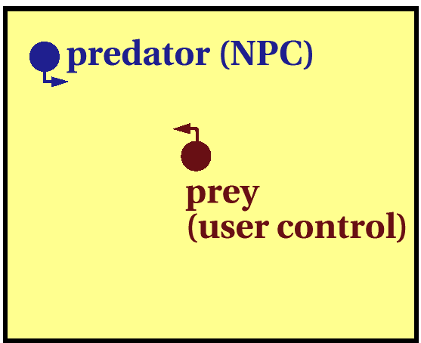
Chase/Evade
Consider a very simple AI task
Algorithm for the predator?

Slide 32
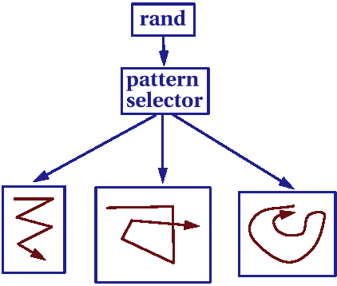
Enhancements to Chase
Speed Control
Velocity, Acceleration max/min
Limited turning Radius
Randomness
Moves
Patterns

Slide 33
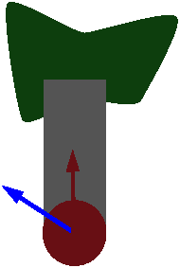

Steering Behaviors
Pursue
Evade
Wander
Obstacle Avoidance
Wall/Path following
Queuing
Combine behaviors with weights
What could go wrong?

Slide 34
AI Strategies
Reaction vs. Deliberation
When having the NPC make a decision, how much thought goes into the next move?
How is the AI different in:
Frozen Synapse
Kingdom Hearts
Civilization
Halo

Slide 35
AI Strategies
Reaction-Based
Fast, but limited capabilities
Implementations
Finite-State Machines
Rule-Based Systems
Set Pattern

Slide 36
AI Strategies
Deliberation-Based
Much slower, but more adaptable
Implementations
A* / Dijkstra
Roadmaps
Genetic Algorithms

Slide 37
Set Pattern
Describe the AI behavior of a Koopa Troopa
Or any other bad guy from SMB3

Slide 38
Finite-State Machines
An abstract construct for determining the behavior of an NPC
Any given behavior state is represented along with rules for transitioning between states
The standard bad guys in Metal Gear Solid are excellent examples of this

Slide 39
Switch FSM

Slide 40
Switch FSM
void RunLogic( int * state ) {
switch( state )
{
case 0: //Wander
Wander();
if( SeeEnemy() ) { *state = 1; }
break;
case 1: //Attack
Attack();
if( LowOnHealth() ) { *state = 2; }
if( NoEnemy() ) { *state = 0; }
break;
case 2: //Flee
Flee();
if( NoEnemy() ) { *state = 0; }
break;
}
}

Slide 41
Switch FSM
Within each state can be more complex AI
In Metal Gear Solid, when an enemy sees you, they follow you as long as you are “discovered”
When the discovery period expires, the enemies return to their previous state, which is set pattern

Slide 42
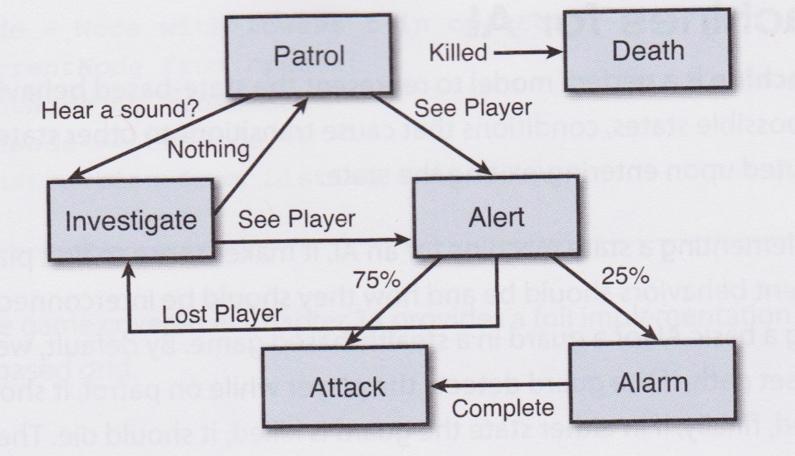
More Advanced FSM

Slide 43
Problems with State Machines
Too Predictable
Sometimes a good thing, sometimes not
Limited
Can have a very small set of options available at any one time

Slide 44
Probabilistic FSMs
We can change the personality of an NPC by adjusting the state probabilities

Slide 45
Probabilistic FSMs
Other aspects:
Sight
Memory
Curiosity
Fear
Anger
Sadness
Sociability
Modify probabilities on the fly?

Slide 46
Goal Based
The NPC has a central goal to achieve and a set of operations it can use
It will selectively choose an operation based on which will get it closer to the goal at that moment
Goal could be nearly anything
A particular score
Health of the PC

