Slide 1
Observer Design Pattern

Slide 2
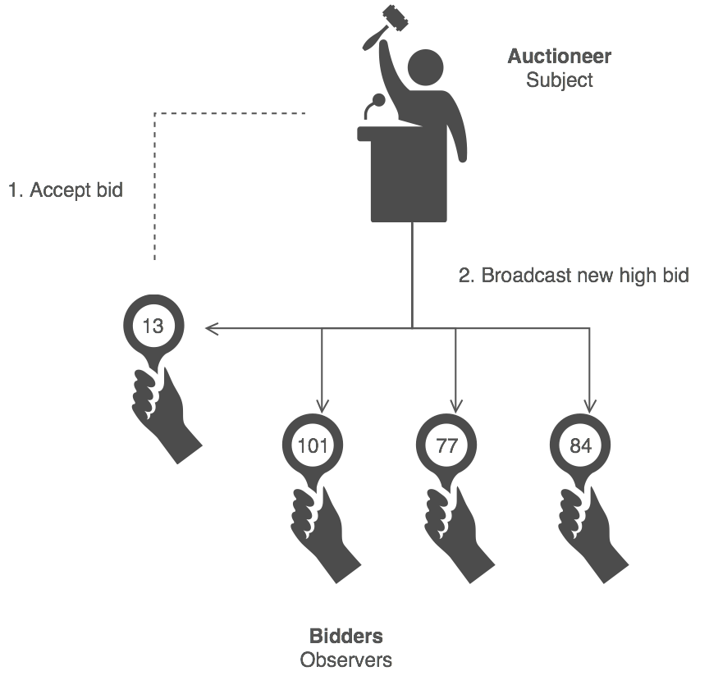
Observer Design Pattern
Define a one-to-many dependency between objects so that when one object changes state, all its dependents are notified and updated automatically.

Slide 3


When to use the observer pattern
When you need many other objects to receive an update when another object changes
Examples in Games:
Notifying UI elements that game state has changed and thus health bar or other needs to be updated immediately
Notifying a quest module that certain events have happened that lead towards quest completion

Slide 4
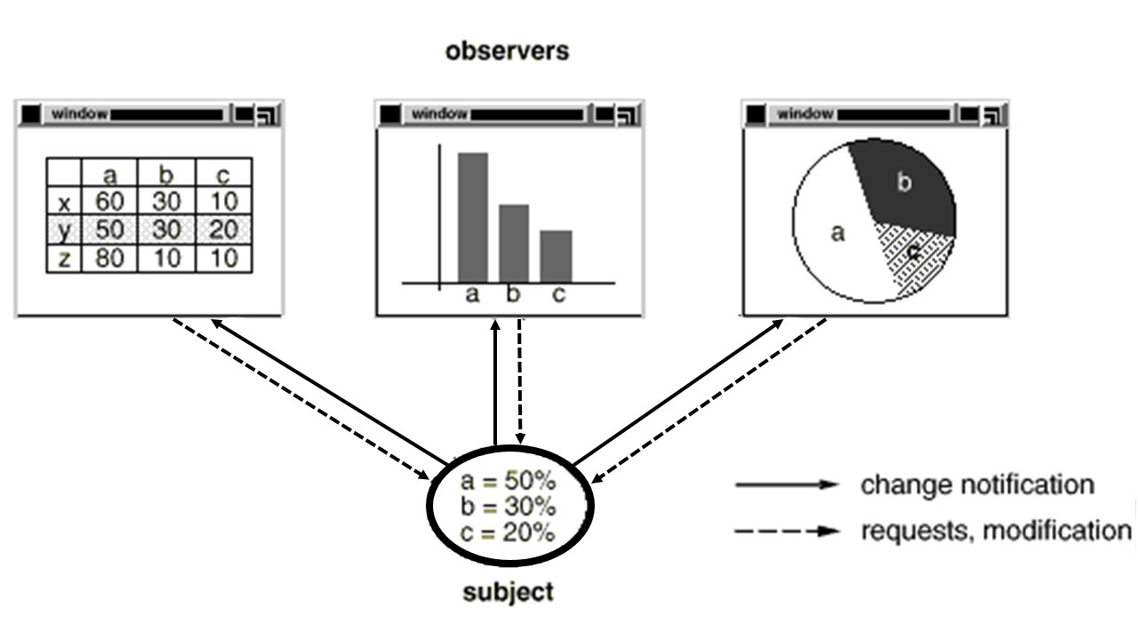
Structure Of Observer

Slide 5
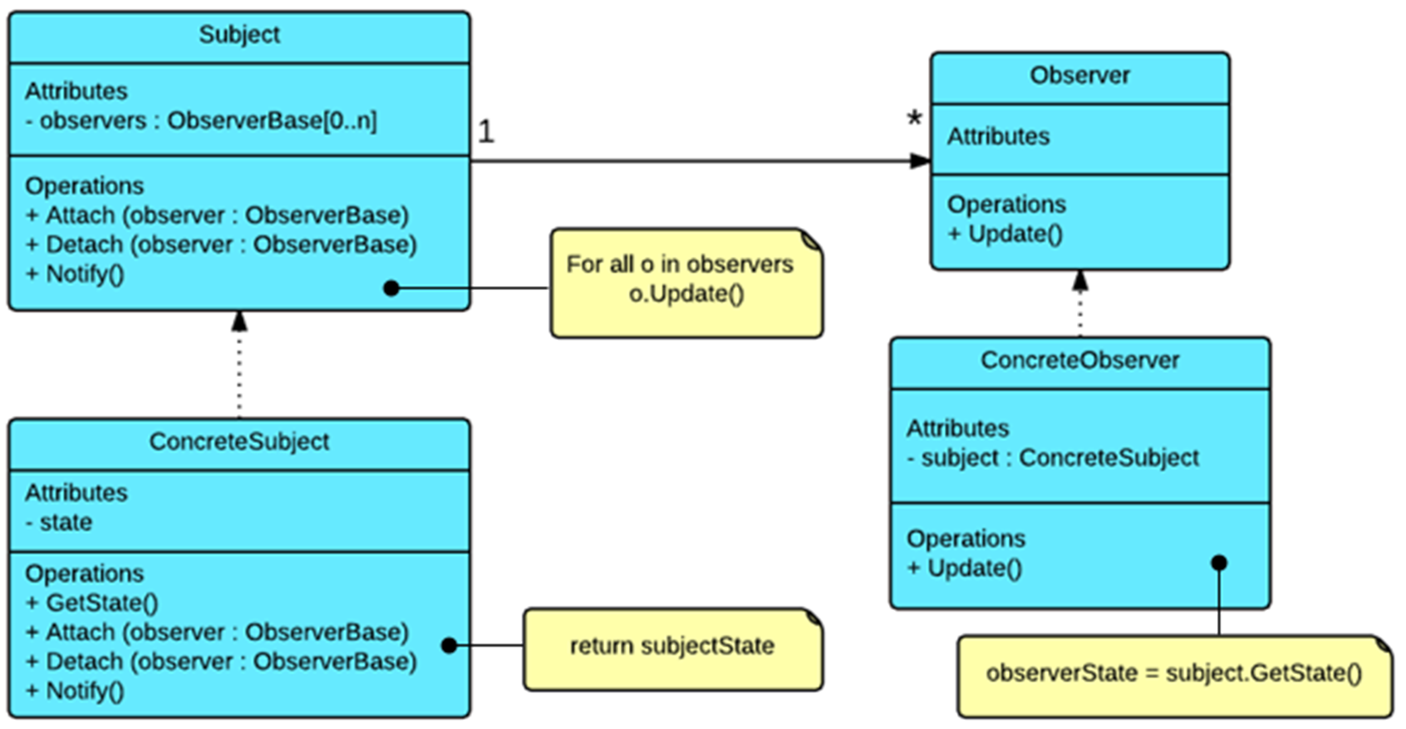
Class Diagram

Slide 6
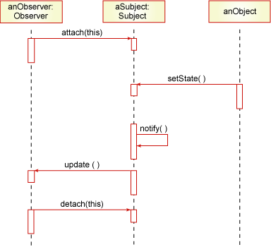
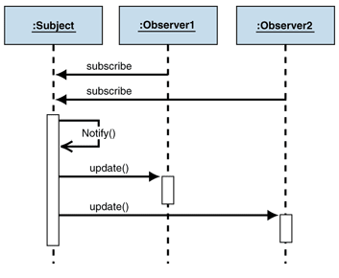
Sequence Diagram

Slide 7
Demo
Subject.java
//e.g., Player object extends Subject that contains health, ammo, etc.
public interface Subject {
public void registerObserver(Observer observer);
public void removeObserver(Observer observer);
public void notifyObservers();
}

Slide 8
Simple Example
Product.java
import java.util.ArrayList;
public class Player implements Subject{
private ArrayList<Observer> observers = new ArrayList<Observer>();
public void registerObserver(Observer observer) {
observers.add(observer);
}
public void removeObserver(Observer observer) {
observers.remove(observer);
}

Slide 9
Simple Example
Continue…
private int health;
private int ammo;
String id;
public Player(int health, int ammo,String id) {
super();
this.health = health;
this.ammo= ammo;
this.id = id;
}

Slide 10
Simple Example
Continue…
public void reduceHealth(int amount) {
this.health = this.health - amount;
notifyObservers(new HealthChangeEvent(this));
}
public void notifyObservers(Event e) {
for (Observer ob : observers) {
ob.update(e);
}
}
}

Slide 11
Simple Example
Observer.java
public interface Observer{
public void update(Event e);
}
HealthBar.java
public class HealthBar implements Observer{
GUIElement theBar;
public void update(Event e) {
//health is now e.getSubject().getHealth();
theBar.showHealth(e.getSubject().getHealth());
}
}

Slide 12
Simple Example
ObserverPatternMain.java
public class ObserverPatternMain {
public static void main(String[] args) {
Player p = new Player();
HealthBar b = new HealthBar();
p.registerObserver(b);
}

Slide 13
Observer Pattern Pros & Cons
Pros:
Supports the principle to strive for loosely coupled designs between objects that interact.
Allows you to send data to many other objects in a very efficient manner.
No modification is needed to be done to the subject to add new observers.
You can add and remove observers at anytime.
Cons:
If not used carefully the observer pattern can add unnecessary complexity
The order of Observer notifications is undependable

