Slide 1
Action vs. Interaction
CS 4730 – Computer Game Design
Credit: Several slides from Walker White (Cornell)

Slide 2
Procedures and Rules
Procedures are the actions that players can take to achieve their objectives
Rules define the game objects and set limits on the player procedures

Slide 3
Procedures
At their most basic, procedures map to the input device you are using
You will fall into one of a few categories
Gamepad: a controller input device with a specified set of directional and interactive command buttons
Mouse: a pointer interface that can interact with click, hover, drag, and drop
Keyboard: like a gamepad, but with far more discrete command button options
Combination: such as Mouse/Keyboard

Slide 4
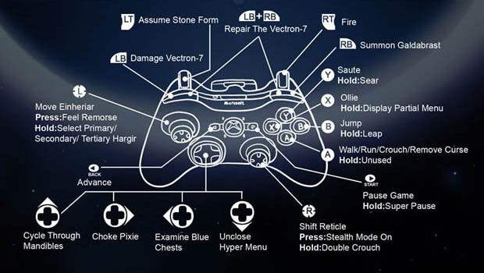
Is this real?

Slide 5
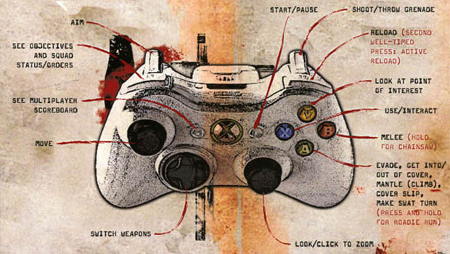
Is this real?

Slide 6
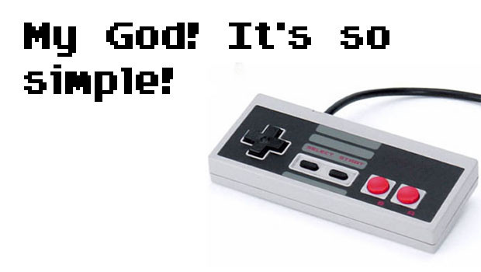
Is this real?

Slide 7
Actions vs. Interactions
In a game context, an action is a procedure that is mapped to a control input.
Examples: Jump, Move, Run, Shoot, Slide, etc.
An interaction is an outcome of the game state and may not be the result of any direct action from the player and can happen without any input.
Examples: Collisions, Line-of-sight, Resource change

Slide 8
Game Mechanic
A game mechanic is the relationship and combination of any number of actions and interactions.
Each relationship/combination could be considered a separate rule in the game world.
Example: Super Mario Bros.
Actions: Run left and right; jump
Interaction: Collision with opponent
Rule: If collision is on top of enemy, enemy changes state according to its rule set; otherwise take damage according to rule set

Slide 9
Let’s Create Some Actions!
Verbs that describe what the player can do
Does not have to be attached to an avatar!
Let’s play!

Slide 10
Designing Actions
Start by brainstorming verbs that make sense in the world you are building
Define the types of verbs
Define the scope of the verbs
Do the verbs directly help the player achieve the goal?
How many verbs do I need?
Well, enough to avoid being too simple
And…

Slide 11
OMG So Many VERBS!

Slide 12
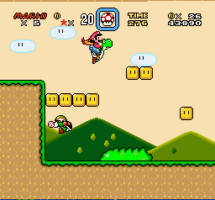
Primary vs. Secondary Verbs
Imagine you had no obstacles or challenges in a game… what verbs would you actually need?

Slide 13
Primary vs. Secondary Actions
Imagine you had no obstacles or challenges in a game… what verbs would you actually need?
Platformers:
Goal: Reach exit
Movement is only need verbs!
Killing enemies is secondary
Concentrate on primary verbs; too many secondary leads to bloat!

Slide 14
Verb Analysis
Pick a game; find the verbs

Slide 15
Finding Good Verbs
Keep number of verbs to minimum; utilize interesting interactions
Avoid verb proxies
“use an item” -> What is the item doing?
“shoot” -> What does the weapon do?
Outcome oriented verbs
Ask if the goal helps the player reach the goal?
Does it overcome a challenge or obstacle?

Slide 16
Combining Actions
Verbs can combine in interesting ways
What verbs can you combine in Super Mario Bros?
How can a verb change based on the environment (interactions)?
This is called emergent behavior
NOTE: Not all combos are emergent – not all have to do with interactions with environment

Slide 17
Interactions
Specifically NOT the direct action of a player
Outcome of the game state
Can happen without player input
Example: Collisions
Can happen by player movement OR can happen by game state changing
What are some other interactions?

Slide 18
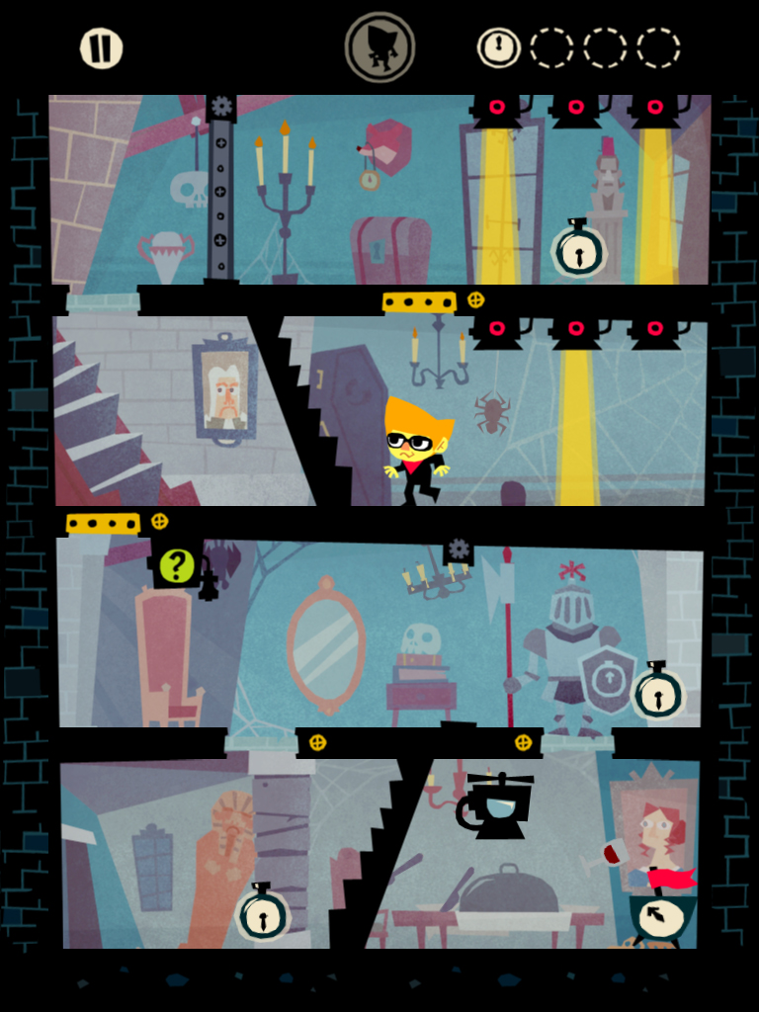
Interaction Example
Beat Sneak Bandit
Verb: Move
Rhythm game where you move to the beat
All movement is on rails
Turns at obstacles

Slide 19
Procedures vs. Rules
Rules are formal schemas
In general, we have three types of rules
Operational - the “English” rules of a game as the player understands them
Constitutive - the underlying math and logic behind the operational rules
Implicit - extra rules understood by the players to make the game move forward

Slide 20
Operational Rules
The rules of the game as if you were explaining them to a friend
“In Mario, you can run and jump and land on top of goombas and they die!”
Consider this the instruction book approach to rules – highest level of abstraction

Slide 21
Constitutive Rules
The operational rules as understood by the game system itself
A goomba dies iff the bottom of Mario’s sprite collides with the top of the goomba’s sprite
This is how the game is actually programmed

Slide 22
Implicit Rules
Agreed upon rules of a game that are not part of the formal rule set, but are important to make the game work
For instance, a time limit on a move on a board game – not an actual time limit, but you know when someone is taking too long

Slide 23
Designing Good Rules
Should lead players to interesting choices
Player MUST be able to make some decisions!
System MUST respond and give feedback!
Bad rules
Pure luck based
Lack of interaction
Doesn’t relate to goal

Slide 24
Mechanics vs. Rules
Mechanics are created by game designers in the framework of rules
Dynamics are created by players as interpretations of mechanics within the rules
Rules are the formal implementation of the game world

Slide 25
Formalizing Everything
The game state is the current positioning/value of all entities in the game world
Actions a player takes is input into the current game state
An interaction is a function between game states as determined by the actions (of both player and world) in generating a new game state
The Game Loop

