Slide 1
Observer Design Pattern

Slide 2
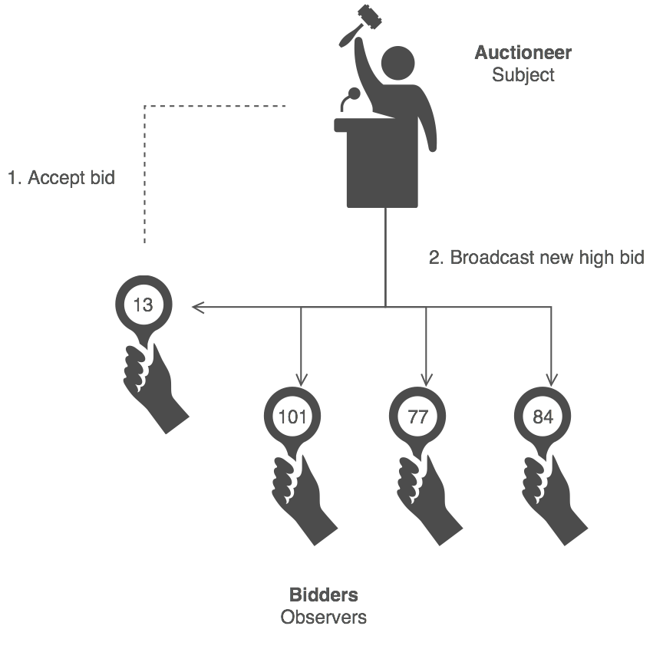
Observer Design Pattern
Define a one-to-many dependency between objects so that when one object changes state, all its dependents are notified and updated automatically.

Slide 3

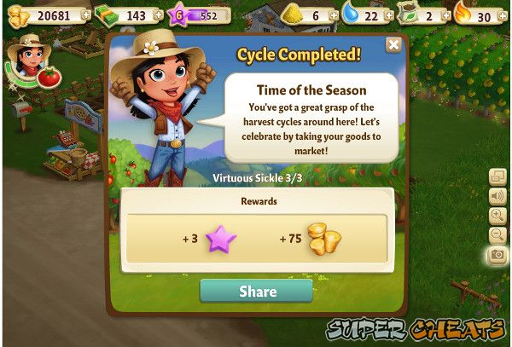
When to use the observer pattern
When you need many other objects to receive an update when another object changes
Examples in Games:
Notifying UI elements that game state has changed and thus health bar or other needs to be updated immediately
Notifying a quest module that certain events have happened that lead towards quest completion

Slide 4
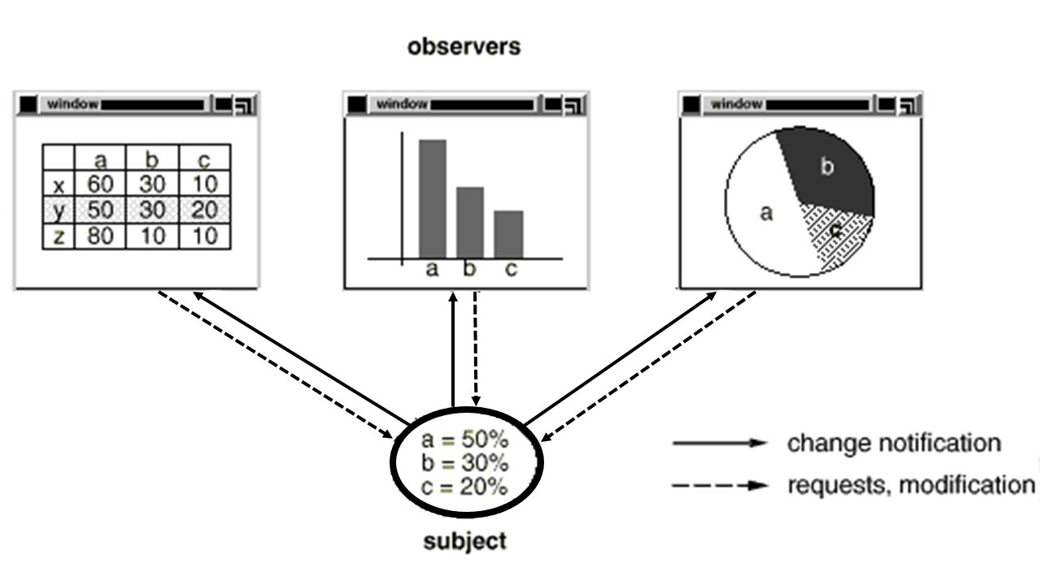
Structure Of Observer

Slide 5
Events vs. Polling

Slide 6
Events vs. Polling
Polling – A software design pattern (using “design pattern” a bit loosely here) in which a process repeatedly checks another entity for a status change.
Examples:
- Keep pinging a server to make sure a connection stays alive
- Every 10 ms, check the printer for readiness
- In a game, check every frame whether the player incapacitated
*Often used in low-level programming (more so than high level)

Slide 7
Polling Example
Main Application
Were you clicked?
Button
Nah
Button
Were you clicked?
Nah
Button
Were you clicked?
Yep!!!!!
Button

Slide 8
Events vs. Polling
Events– A software design pattern in which a process waits patiently for an event of interest to occur and only reacts when necessary.
Examples:
- Server, tell me when you are ready to connect
- Printer, let me know when you are ready to print
- Game over screen waits to be notified that player is dead
*Important: is NOT implemented using polling.

Slide 9
Events Example
Main Application
Let me know when you get clicked, k?
Button
Sure thing friend!
Cool, I’ll do something neat
I was clicked yo!
Button
Cool, I’ll do something neat
I was clicked yo!
Button
Hey, so I don’t care about your clicks anymore, k?
No prob friend!

Slide 10
Observer Design Pattern
How is event based programming usually implemented?

Slide 11
Observer Design Pattern
Observer Design Pattern: A software design pattern in which an object, called the subject, maintains a list of its dependents, called observers, and notifies them automatically of any state changes, usually by calling on of their methods.

Slide 12
Observer Design Pattern - Example
Observable (e.g., jcrew.com)
Contains several state changes of interest:
Sale Begins
New Store Opening
New Product Available
Floryan
OBSERVERS
Sherriff
Brunelle

Slide 13
Observer Design Pattern - Example
Observable (e.g., jcrew.com)
Contains several state changes of interest:
Sale Begins
FLORYAN
New Store Opening
New Product Available
FLORYAN
Floryan
I want to know when sales begin and when new products come out
Sherriff
Brunelle

Slide 14
Observer Design Pattern - Example
Observable (e.g., jcrew.com)
Contains several state changes of interest:
Sale Begins
FLORYAN
New Store Opening
Sherriff
New Product Available
FLORYAN
SHERRIFF
Floryan
I care about when new stores open and new products available
Sherriff
Brunelle

Slide 15
Observer Design Pattern - Example
Observable (e.g., jcrew.com)
Contains several state changes of interest:
Sale Begins
FLORYAN
New Store Opening
Sherriff
New Product Available
FLORYAN
SHERRIFF
Floryan
Sherriff
Brunelle
You guys are lame, I don’t care about any of that stuff.

Slide 16
Observer Design Pattern - Example
Observable (e.g., jcrew.com)
***A NEW PRODUCT IS AVAILABLE (PANTS)
Sale Begins
FLORYAN
New Store Opening
Sherriff
New Product Available
FLORYAN
SHERRIFF
Floryan
Sherriff
Brunelle

Slide 17
Observer Design Pattern - Example
Observable (e.g., jcrew.com)
A NEW PRODUCT IS AVAILABLE (PANTS)
Sale Begins
FLORYAN
New Store Opening
Sherriff
New Product Available
FLORYAN
SHERRIFF
Floryan
Yo! Some new pants are available
Yo! Some new pants are available
Sherriff
Brunelle

Slide 18
Observer Design Pattern
Ok, a little more detail now

Slide 19
Observer Design Pattern – UML Diagram
Observable
--------------------
Map<String, List<Observer>>
attach(String, Observer)
detach(String, Observer)
So far we have:
An observable holds a map of string event types to the list of observable objects that care about that event.
An observer can be attached (register) for an event type (or multiple types.
An observer can be removed from a list (no longer cares about getting those notifications.
One observer can register for many different events on many observables, and visa versa.

Slide 20
Observer Design Pattern – UML Diagram
Observable
--------------------
Map<String, List<Observer>>
attach(String, Observer)
detach(String, Observer)
Interface Observer
--------------------
handleEvent(Event e)
e.g., attach(“SaleBegins”, this);
“this” is the observer here (Floryan)
Concrete Observer (e.g., Floryan)
--------------------
handleEvent(Event e)

Slide 21
Observer Design Pattern – UML Diagram
Observable
--------------------
Map<String, List<Observer>>
attach(String, Observer)
detach(String, Observer)
notify(Event e)
Interface Observer
--------------------
handleEvent(Event e)
Concrete Observer (e.g., Floryan)
--------------------
handleEvent(Event e)
Event Occurred – Call handleEvent on any observer that is registered

Slide 22
Observer Design Pattern – UML Diagram
Observable
--------------------
Map<String, List<Observer>>
attach(String, Observer)
detach(String, Observer)
notify(Event e)
Interface Observer
--------------------
handleEvent(Event e)
Concrete Observer (e.g., Floryan)
--------------------
handleEvent(Event e)
Event
--------------------
Observable source
String eventType
Event contains the source (which thing fired this event) and the eventType (in case we are interested in more than one and need to distinguish).
ConcreteEvent adds extra data the observer might be interested in regarding the event that just occurred and is passed into the handleEvent() method
ConcreteEvent (e.g., SaleBeginsEvent)
--------------------
//Extra data associated w/ event
Data SaleDate
Location
Etc…

Slide 23
Observer Design Pattern – UML Diagram
Observable
--------------------
Map<String, List<Observer>>
attach(String, Observer)
detach(String, Observer)
notify(Event e)
Attaches, detaches
Interface Observer
--------------------
handleEvent(Event e)
Notifies – Passes Event
Concrete Observer (e.g., Floryan)
--------------------
handleEvent(Event e)
Button (e.g.,)
--------------------
Parameter to Notify()
Reacts to event in meaningful way
Event
--------------------
Observable source
String eventType
ConcreteEvent (e.g., SaleBeginsEvent
--------------------
//Extra data associated w/ event
Data SaleDate
Location
Etc…

Slide 24
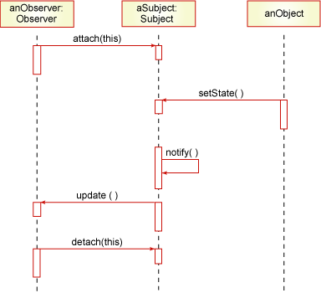
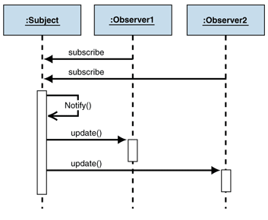
Sequence Diagram

Slide 25
Demo
Subject.java
//e.g., Player object extends Subject that contains health, ammo, etc.
public interface Subject {
public void registerObserver(Observer observer);
public void removeObserver(Observer observer);
public void notifyObservers();
}

Slide 26
Simple Example
Product.java
import java.util.ArrayList;
public class Player implements Subject{
private ArrayList<Observer> observers = new ArrayList<Observer>();
public void registerObserver(Observer observer) {
observers.add(observer);
}
public void removeObserver(Observer observer) {
observers.remove(observer);
}

Slide 27
Simple Example
Continue…
private int health;
private int ammo;
String id;
public Player(int health, int ammo,String id) {
super();
this.health = health;
this.ammo= ammo;
this.id = id;
}

Slide 28
Simple Example
Continue…
public void reduceHealth(int amount) {
this.health = this.health - amount;
notifyObservers(new HealthChangeEvent(this));
}
public void notifyObservers(Event e) {
for (Observer ob : observers) {
ob.update(e);
}
}
}

Slide 29
Simple Example
Observer.java
public interface Observer{
public void update(Event e);
}
HealthBar.java
public class HealthBar implements Observer{
GUIElement theBar;
public void update(Event e) {
//health is now e.getSubject().getHealth();
theBar.showHealth(e.getSubject().getHealth());
}
}

Slide 30
Simple Example
ObserverPatternMain.java
public class ObserverPatternMain {
public static void main(String[] args) {
Player p = new Player();
HealthBar b = new HealthBar();
p.registerObserver(b);
}

Slide 31
Observer Pattern Pros & Cons
Pros:
Supports the principle to strive for loosely coupled designs between objects that interact.
Allows you to send data to many other objects in a very efficient manner.
No modification is needed to be done to the subject to add new observers.
You can add and remove observers at anytime.
Cons:
If not used carefully the observer pattern can add unnecessary complexity
The order of Observer notifications is undependable

