Slide 1
Probability and Risk
CS 4730 – Computer Game Design
Credit: Several slides from Walker White (Cornell)

Slide 2
Topics
**VERY** quick overview of Probability
Random variables
Using distributions to your advantage, etc.
Degree of Randomness
All random versus no random.
Types of randomness in games
Input vs output randomness, examples
Psychology of randomness

Slide 3
Quick Discussion
Why have randomness in games?
What does it provide?
Strengths?
Weaknesses?

Slide 4
My View
Randomness is a useful tool for the following (non-exhaustive):
A form of information hiding
Providing variety of gameplay
Providing unexpected obstacles (e.g., random enemies arrive mid-battle)
Providing an avenue for epic comebacks
…and more

Slide 5
Probability

Slide 6
It All Start With Numbers
Hope you remember your APMA classes…
Statistics is the study of what HAS happened
Probability predicts what WILL happen
The interesting thing is that people are reasonably good at statistics, but horrible at probability
“There’s no way another 6 comes up!”
^Ok, sometimes this is possible…when?

Slide 7
Randomness
Computers are actually horrible at being truly random
Which is both good and bad
Bad for security purposes
Good for networked games to have the same state without transmitting that state
Probability of any value is written as P(x)

Slide 8
Random Variables
Core element of probability
Variable (let’s say A) which has some degree of uncertainty.
A = ”Event of getting a critical hit upon attack”
0 <= P(A) <= 1.0
Not always Boolean of course. Can have:
B = “number of coins earned from playing minigame”

Slide 9
Combining Probabilities
P(not A) = 1 – P(A)
P(A or B) = P(A) + P(B) – P(A and B)
P(A and B) = P(A) * P(B)
//if A and B are independent events

Slide 10
Expected Value
The expected value is the average of all the possibilities of a random variable
Each value is weighted by its probability
E(x) = Sum(k * P(“x=k”)) over the possible values of k
E(1d2) = 1 * P(“x=1”) + 2 * P(“x=2”)
= 1 * .5 + 2 * .5
= 1.5

Slide 11
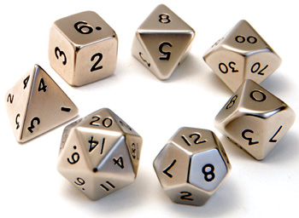
Dice Expected Values
E(1d4) = 2.5
E(2d6) = 7
E(1d8) = 4.5
E(1d10) = 5.5
E(1d12) = 6.5
E(1d20) = 10.5

Slide 12
Variance
What is the distribution of possible values about the expected value?
Var(x) = E((x – E(x))²)
Uniform (high variance)
Bimodal (low and high variance)
Gaussian (low and high variance)
Zero variance

Slide 13
Probabilities of Catan
Let’s look at the math of Catan to figure out how probabilities play into the game
Quick overview of the rules of Settlers of Catan
http://www.catan.com/service/game-rules

Slide 14
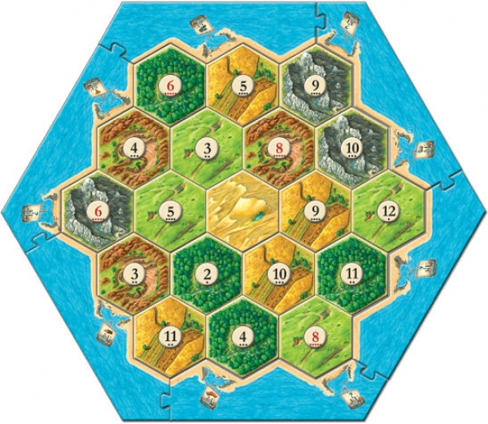
Settlers of Catan

Slide 15
Probabilities of Catan
It’s actually pretty easy to know what’s the “best” option
Just add up the dots!
Probability and randomness plays a HUGE role in Catan working “correctly.”
What about games in which probability and randomness is the entire game?

Slide 16
All Random vs. No Random

Slide 17
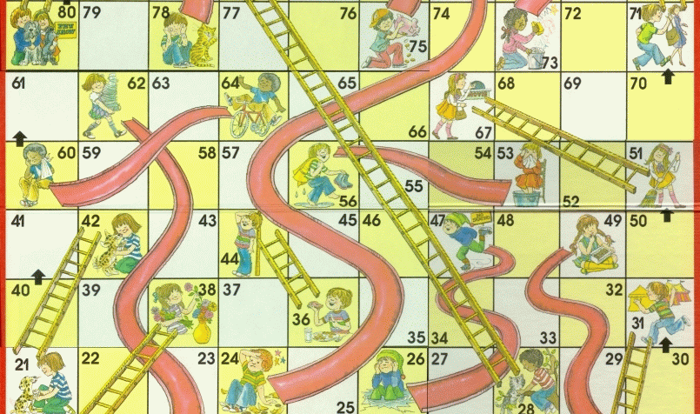
Chutes and Ladders

Slide 18
Chutes and Ladders
The game is ALL RANDOM.
But a video game that is ALL SKILL can eventually get boring!
You’ve learned every pattern
You’ve seen every level and enemy
Nothing varies!
We need to consider games that have some aspects of both!

Slide 19
Chess

Slide 20
Types of Randomness

Slide 21
Types of Randomness
Two types widely cited by game designers:
Input Randomness: Noise introduced BEFORE the player makes decisions / takes action.
Output Randomness: Noise introduced AFTER the player takes action that affects the result of that action.

Slide 22
Types of Randomness
Input Randomness: Noise introduced BEFORE the player makes decisions / takes action.
Examples?

Slide 23
Types of Randomness
Output Randomness: Noise introduced AFTER the player takes action that affects the result of that action.
Examples??

Slide 24
Psychology of Randomness

Slide 25
Why do people gamble?
Let’s face it – gambling in Vegas is a losing proposition
Over time, everyone loses money
But in the (very) short term, it’s definitely possible to win
And besides – risk and uncertainty can be a lot of fun!

Slide 26
Psychology of Randomness
Player’s like longshots!
How many times have you gone for the “super move” to win the game?
Even if it’s a low probability, players will optimize for it!
Player’s suffer from too much Monte Carlo
“Oh, I’ve gotten bad results for so long… a good card/good roll has to come up soon!”
Probability does not care what the last roll was, but players will think the game is “unfair” otherwise!

Slide 27
Psychology of Randomness
But think about it another way – I bet you remember those big payoff moments
Randomness Tip: Low probability, huge payoff mechanics can be really fun.

Slide 28
Psychology of Randomness
On the flip side, it is very frustrating when an event has high probability and doesn’t occur.
E.g., X-Com: Chance of landing hit is given as 99%, but misses.
That’s unfair!! It should have hit!!
E.g., Chance of getting good item is 50%, but you don’t get it 9 times in a row!
This game is cheating!!!!

Slide 29
Psychology of Randomness
Humans are BAD at probability.
Randomness Tip: So games will sometimes fudge randomness to please humans.
E.g., X-Com: Tell user chance of hit is 85% or 90%, but actually 99% in the code.
Feels more fair.
E.g., Item will appear 50% of the time, but also guarantee it appears within 3 tries.

Slide 30
Summary
Randomness is a useful, but not necessary tool.
Think about the distribution of your random variables and why that might matter!
Think about input vs output randomness
Think about manipulating random values to trick humans into thinking game is fair

