Slide 1
Game Architecture
CS 4730 – Computer Game Design
Credit: Some slide material courtesy Walker White (Cornell)

Slide 2
Event-Driven Programming
Consider all the programs you’ve written up to this point
Did they do anything when the user didn’t ask for something?
Was there processing in the background?
Or did it mainly respond to user input?

Slide 3
Event-Driven Programming
The event-driven paradigm works great for a lot of systems
Web (we REALLY want this!)
Mobile
Office apps
Well, yea…games use A LOT of event programming, but we’ll get there soon enough.

Slide 4
Things Games Use…
Event-Driven
Quest Completion
Updating UI
Syncing with Server
Loading / Initializing Levels
Completing Levels
Etc.
*Will look at these later
Game Loop
User Input (usually)
Physics / Gravity / Movement
Anything happening in real time
AI
Etc.
*Will look at this today

Slide 5
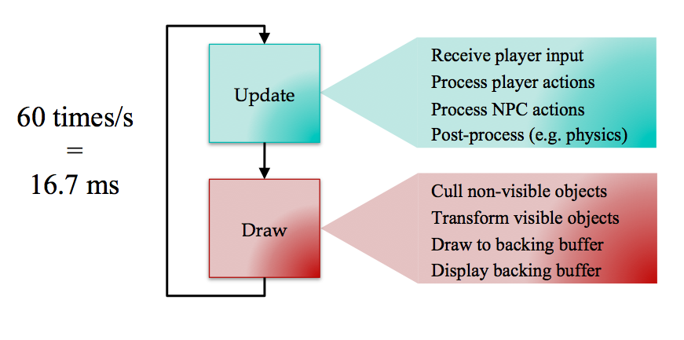
The Game Loop
Credit: Walker White

Slide 6
Remember!
Underlying Game State:
e.g., xPos, yPos, health, etc.
Read internal state and draw game in correct way to reflect that state
Write correct data to variables to set internal state.
Update
Draw

Slide 7
Step 1. Player Input
Remember: player input is one set of variables that enter our equation to affect game state
Input is typically polled during game loop
What is the state of the controller?
If no change, do no actions
However, we can only read input once per game loop cycle
What problems can this cause? How would we deal with each of those issues?

Slide 8
Step 2. Process actions
Alter the game state based on your input
However, don’t lock the controller to directly changing the state!
Place a buffer here – have it call a method which allows some flexibility in design later

Slide 9
Step 3. Process NPCs
An NPC (Non-Player Character) is anything that has volition in the world that isn’t you
NPCs take input from the AI engine (maybe!) but not from a direct controller
Work on the idea of Sense-Think-Act:
Sense the state of the world around it (how can we “cheat” here to make an NPC “harder”?)
Think about what action to perform (usually limited choices)
Act in the world

Slide 10
Step 3. Process NPCs
Problem of sensing is hard!
What does the NPC need to know?
What is the state of ALL OTHER OBJECTS? UGH.
Limit sensing? “Cheat?”
Another problem – thinking is hard!
Can take more than one frame to decide what to do!
Act without thinking?
What if one acts, then the next acts on that action?
More in AI and Pathfinding!

Slide 11
Step 4. World Processing
Physics!
Lighting!
Collisions!
So much cool stuff!
But later! ☺

Slide 12
Drawing
Well, it needs to be fast!
We want to do as little computation as possible
Draw ONLY what’s on the screen!
Keep the drawing and the state modification separate!
Some of this will be handled by a programming languages underlying graphics libraries.

Slide 13
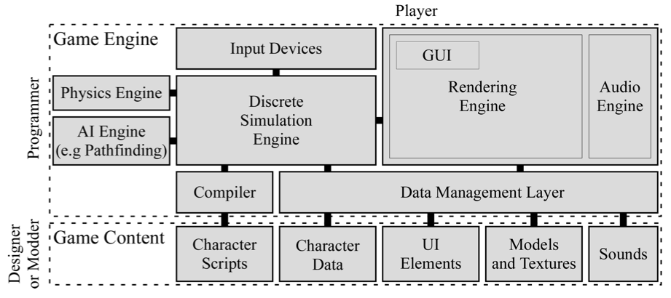
Architecture Big Picture
Credit: Walker White

Slide 14
SDL2

Slide 15
SDL2
SDL is a simple media library that allows drawing images to screen, and other simple graphics based tasks.
These slides serve as a quick introduction to the library
i.e., the SDL code that is provided in the starter pack for the class.

Slide 16
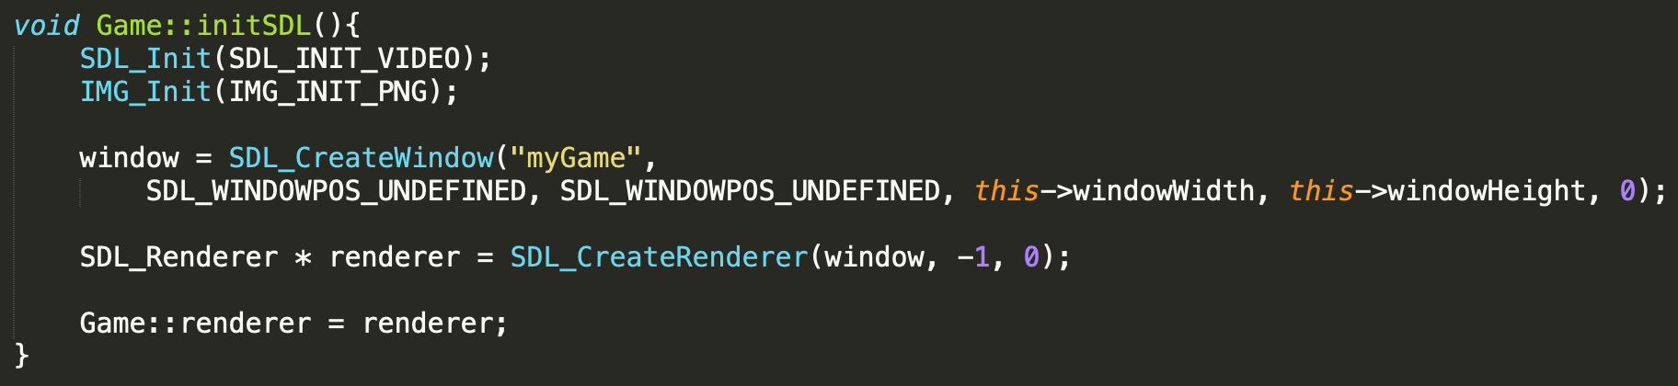
SDL2
SDL needs to be initialized
Then, you can create a window and get a pointer to a renderer.
The renderer object is like a canvas, you draw on it to make sprites appear on the screen.

Slide 17
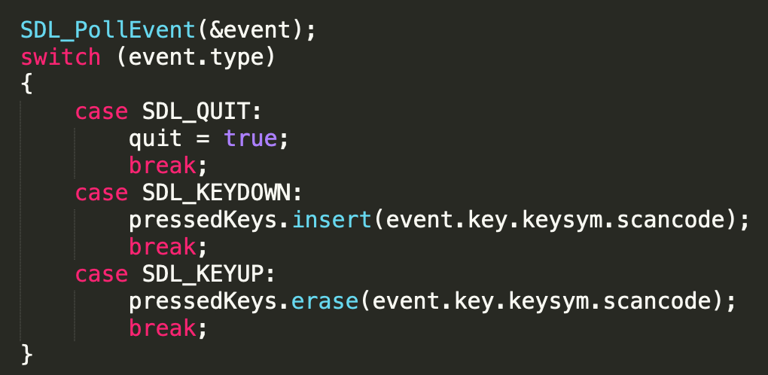
SDL2
SDL has events. These events let you know when important things happen (A key goes down or up, or the window is closed).

Slide 18
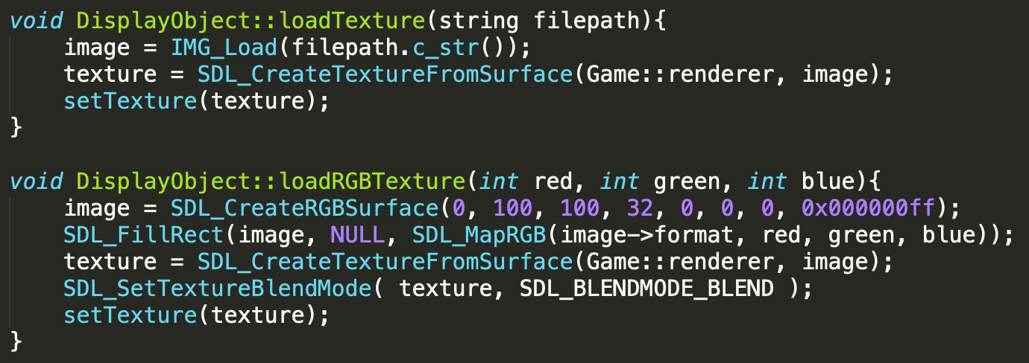
SDL2
This is how you load textures. You should only do this ONCE per Sprite. Do NOT do this every single frame.
Second method shows creating a colored rectangle (no image)

Slide 19
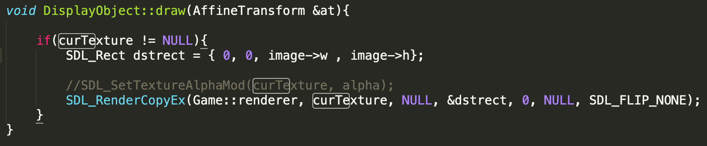
SDL2
Below is an example of drawing a texture to the renderer.
Dstrect is where on the screen the image will be drawn.

