Slide 1

Python Fundamental
Lesson 1

Slide 2
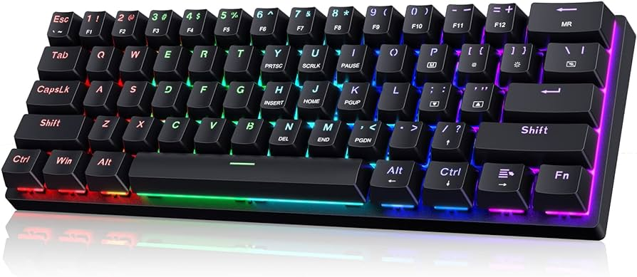

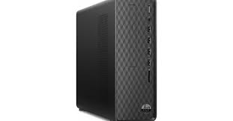
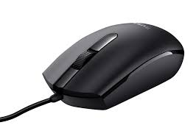
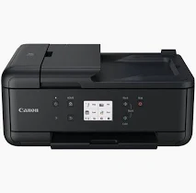
How Computer Function
INPUT
PROCESS
OUTPUT

Slide 3

Python
A language to communicate to computer

Slide 4
Math Operators
Math Operations | Python Syntax
a + b | a + b
a – b | a - b
a x b | a * b
a ÷ b | a / b
-12 (negative number) | -12
30% | 0.3
a % c Modulus | 5%3 = 2
Notes:
Try operators

Slide 5
Data Types
Data Types | Example
Integer | 1 5 20 1000 50200
Float | 3.5 4.78 10.0 100.45
Boolean | True False
String | "Boy" "2" "3.5" "%^&*" 'Boy' '2' '3.5' '%^&*'
Use single quote ' or double quote " to wrap a string

Slide 6
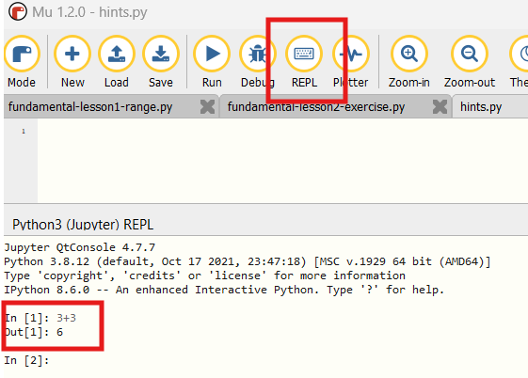
Interactive Mode

Slide 7
Math Operations or String Operations?
What is the output below? Try it out !
3+5
4*3
"3" + "5"
"4" * "3"

Slide 8
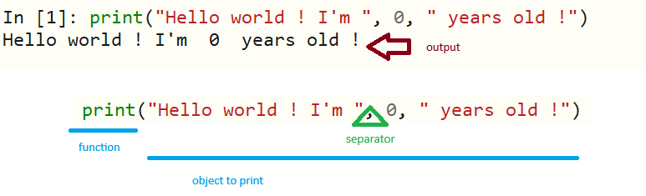
The First Output
Create few more lines using print function …

Slide 9


Syntax
No space between print and (
print (‘Hello world ‘)
print ("Hello World")
print :(‘Hello world ‘)
print:("Hello World")
print(‘Hello world ‘)
print(‘Hello world’)
a = 3 + 2
a=3+2
No symbols between print and (

Slide 10
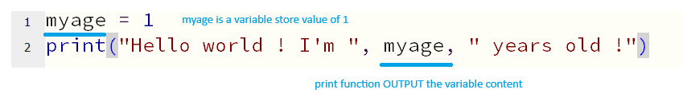
Variables
Variables are like a drawer in memory blocks store content (integer, float, string, and other data type we’ll cover later) for temporary work

Slide 11
Formatted string literals (f-strings)
F-strings make it easy to include expressions and variables directly in strings.
myage = 1
Print(f"Hello word ! I’m {myage} years old !")
Use f-strings instead of string concatenation

Slide 12
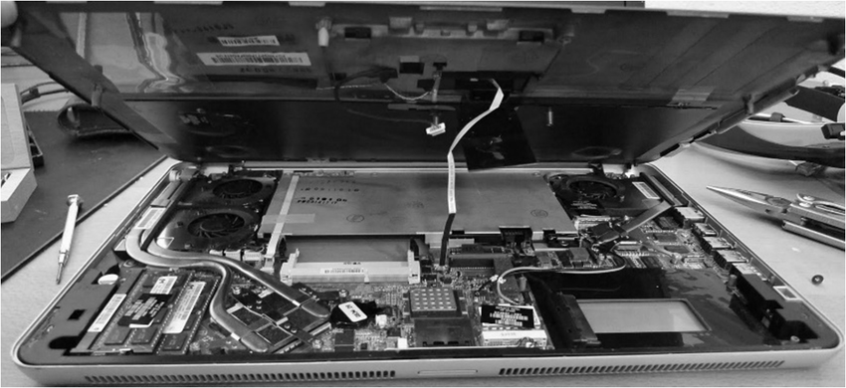
Inside the cover
Memory chips

Slide 13
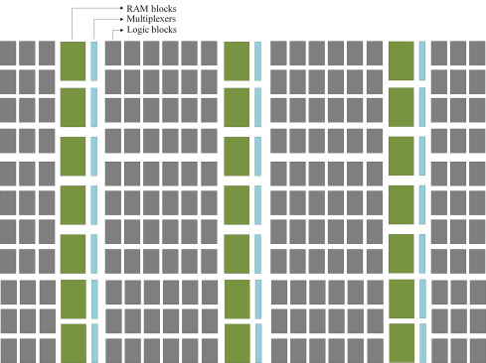
Computer Memory and Variables
Memory is organized block by block in a computer

Slide 14
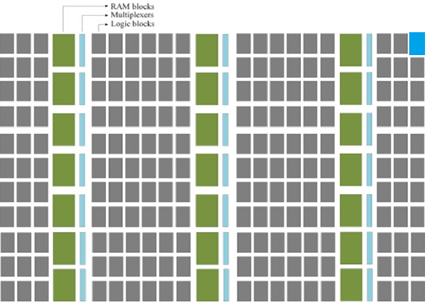
Variables
Above Code:
Allocate a block from memory named myage
Assign value 1 to myage
Some other values like string or list need more blocks

Slide 15

Lab
Create few more lines with variable
Print it out

Slide 16

Function: input()
What does it do?
You need a VARIABLE [yourName] to store user input (allocate memory block)
Line 1 – allocate a block from memory. The initial value is an empty string “”
Line 2 – use input function to capture user’s input from keyboard
Line 3 – print out the variable [yourName] to the screen

Slide 17
Rules to name a variable
Rule | Valid | Wrong
start with a letter or the underscore character | myName MyAge _address | %myName
cannot start with a number | types3 | 3types
only contain alpha-numeric characters and underscores (A-z, 0-9, and _ ) | user_10 | user_10**
case-sensitive | age is not equal to Age or AGE
cannot be any of the Python keywords | print_out input_age | print = 2 input = 4

Slide 18
Capture User Input – integer and float
The input() function always receives user input as a string
To perform calculations, you must convert it into a number using int() or float()
for whole number: use int()
age = int(input("How old are you:"))
For decimals numbers: use float()
price = float(input("How much for this item:"))

Slide 19
Quiz
What’s wrong with below code? How to correct it?
print("Calculate Square Area")
side = 0
area = 0
side = input("What is the side value in cm:")
area = side * side
print(f"The square area is {area} cm")

Slide 20
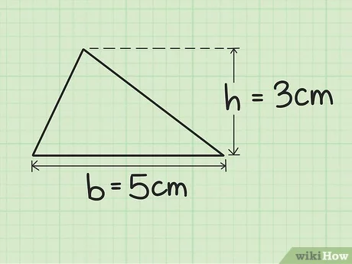
Exercise
Develop a program to calculate the area of a triangle
Hints
Declare variables: area, base, and height
Input: base and height
Process: calculate the area using the formula above and assign the value to area variable
Output: Print out the area with a proper statement
Area = ( Base * Height ) ÷ 2
Area = (5cm * 3cm) ÷ 2
= 15cm ÷ 2
= 7.5cm

