Slide 1

Python Fundamental
Lesson 2

Slide 2

Revisit
Input-Process-Ouput Concept
Setup Python and MU Editor
Math Operators
Data Types: string, integer, float
Variables: how it works, rules
Functions: print(), input(), float(), int()
Exercise: Calculate area of square and triangle

Slide 3
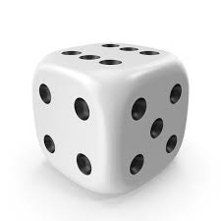
Random Number
1. import random
2. dice = random.randint(1, 6)
3. print(dice)
What it does:
Line 1 – include a random library for the program to call random.randint function
Line 2 – setup a variable in memory named dice. Use function random.randint to generate a number tween 1 and 6.
Line 3 – print out the result of variable dict

Slide 4

649 ticket
How to generate a 6/49 ticket?
Lab
Write a program to generate 6 random numbers between 1 and 49

Slide 5
Decision Making - if-elif-else
if, elif (short for 'else if'), and else allow program to make decisions based on conditions
The line of if – elif - else statement must end with a colon :
Code block inside if – elif - else must be indented using [Tab] key or 4 spaces
Example:
if age >= 13 and age <= 19:
# below line execute if condition is True
print("You are a teenager!")
# below line executes regardless the condition of if condition
print("Program is finish!")

Slide 6
Rules of if-elif-else
Example 1 – only if block and no elif and else
age = 15
if age >= 13 and age <= 19:
print("You are a teenager!")
Only one if block for each decision
Zero or More elif blocks within an if block
At most one else block
Indentation is crucial for blocks of code
Example 2 – one if block, one elif and zero else
age = 10
if age >= 18:
print("You are an adult.")
elif age >= 13:
print("You are a teenager.
Example3 – one if, elif and else
temperature = 35
if temperature > 30:
print("It's a hot day.")
elif temperature > 20:
print("It's a warm day.")
else:
print("It's cold outside.")

Slide 7
Logical Operators
Operator Name | Operator | Sample
Equal to | == | if age == 0:
Not Equal to | != | if age != 0:
Less than | < | if age < 0:
Less than or equal to | <= | if age <= 0:
Greater than | > | if age > 0:
Greater than or equal to | >= | if age >= 0:
Example 1
age = 15
if age >= 13 and age <= 19:
print("You are a teenager!")
Example 2
# Example: Password check
password = input("Enter your password: ")
if password == "python123":
print("Access granted. Welcome!")
elif password != "python123":
print("Access denied. Incorrect password.")

Slide 8
Boolean Operators
Evaluate expressions and return a Ture or False as a Boolean values.
Example 1
age = 25
is_student = True
if age > 18 and is_student: #this condition is True
print("Eligible for a student discount.")
and
or
not
Example 2
is_weekend = True
is_holiday = False
if is_weekend or is_holiday: #this condition is True
print("You can sleep in!")

Slide 9
Boolean Values
Only True and False
The first letter is upper case
Example
is_weekend = True
is_holiday = False
if is_weekend or is_holiday:
print("You can sleep in!")
True
False

Slide 10
Quiz 1
What is the output?
age = 25
if age > 30:
print("Older than 30")
elif age > 20:
print("Older than 20")
else:
print("20 or younger")

Slide 11
Quiz 2
What is the output?
Try to update 'temperature' to 25 and see the output.
temperature = 15
if temperature > 20:
print("It's warm outside.")
print("Program Completed")

Slide 12
Lab
Generate a random number between 1 to 6
Ask user to guess the number
If the answer match the random number, print 'Correct'
Otherwise, print 'Incorrect' and show the random number

Slide 13
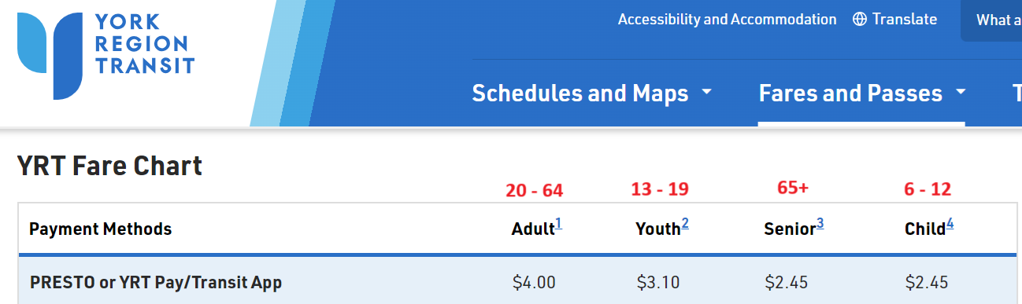
Calculate YRT fare?

Slide 14
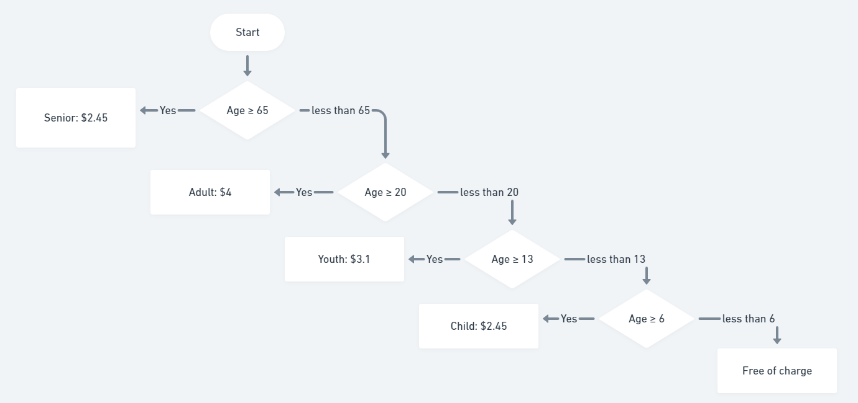
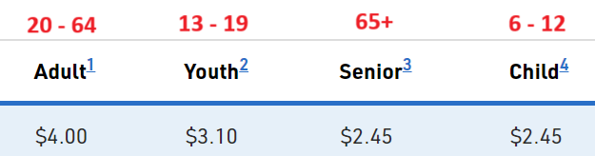
Calculate YRT Fare

Slide 15
Lab
Develop a program to calculate YRT fare
1
Ask user to input age
2
Determine the age group (senior, adult, youth, child, and little child)
3
Print out the fare amount
4

Slide 16
Function: range()
Generate a sequence of numbers
Syntax:
range(start, stop, step)
start - beginning of the sequence. The beginning of the sequence. If omitted, the default value is 0
stop - end of the sequence - the sequence will include numbers up to but not including this value
step - interval between numbers in the sequence

Slide 17
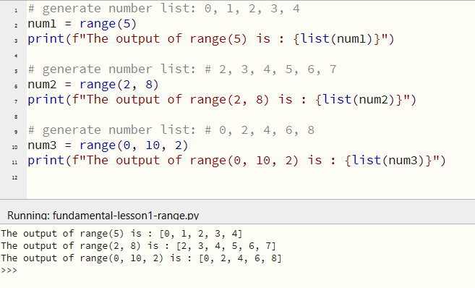
Examples of range() Usage
We’ll cover the function of list()in the lesson later

Slide 18
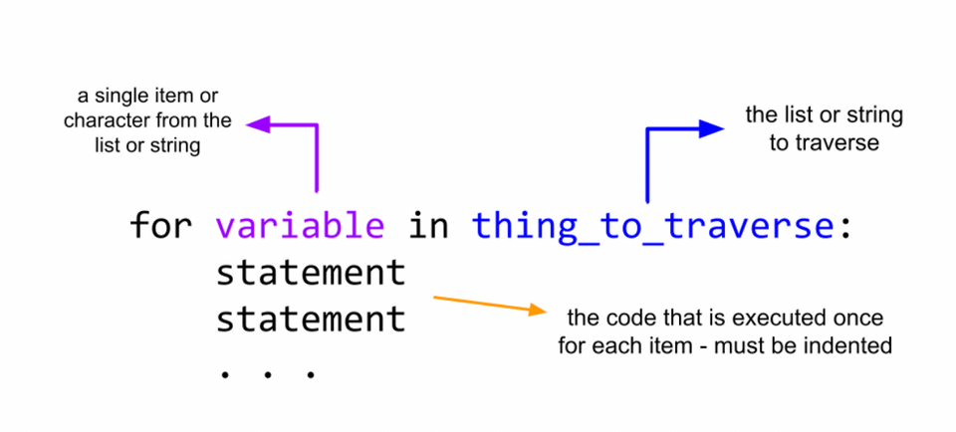
for Loop
Repeat a block of code multiple times

Slide 19
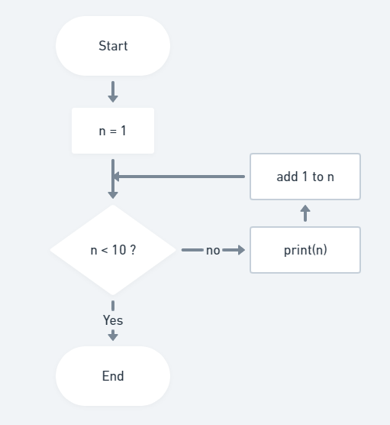
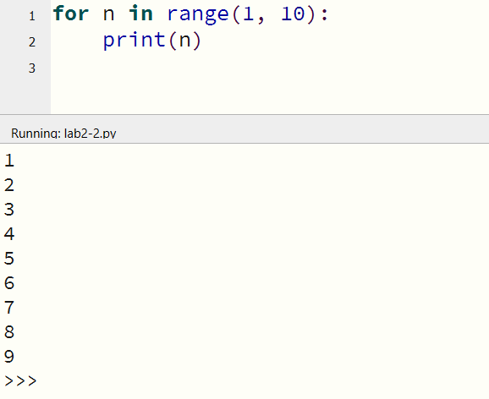
for loop
Below code executes print function 9 times.
‘start’ parameter is set to 1 and ‘stop’ parameter is set to 10 in the range function below.

Slide 20

Exercise
Generate 10 random numbers between 1 and 100
Print only the even numbers
For odd numbers greater than 50, print "High Odd"

