Slide 1

Python
Fundamental
Lesson 3

Slide 2

Revisit
Using Random Library
Decision Making: if-elif-else
Logical Operators (==, !=, <, <=, >, >=)
Boolean Operators (and, or, not)
Boolean Values (True / False)
Functions: range(start, stop, step)
Control Structure: for loop
Lab: Calculate YRT fare
Exercise: a program use random, for loop, range(), and if – elif – else block

Slide 3
Exercise 2 Review
#import random library
import random
#1. execute 10 times as a main loop
for n in range(0, 10):
# 1.1 generate a random number between 1 and 100
num = random.randint(1, 100)
# Check is num mod 2 has remainder
if num % 2 == 0:
# Print for even number
print(f"{num} - num is even")
elif num > 50:
print(f"{num} - High Odd")
else:
print(f"{num}")

Slide 4
Lab – loop and decision making
Modify your dice program to create a "Guess the Number" game.
The system generate a random number between 1 and 100.
The user will have 5 attempts to guess the number.
After each guess, provide feedback to the user:
If the guess is correct, print "BINGO!" and end the game.
If the guess is incorrect and the user still has remaining attempts, prompt them to try again.
If the user does not guess the number within 5 attempts, print "Fail" and reveal the correct number.

Slide 5
while loop
A while loop keeps running the same code again and again as long as the condition is True. True (upper T) is Boolean value in Python.
The number of times a while loop runs depends on the condition being True, unlike a for loop, which runs a set number of times.

Slide 6
Why Use a while Loop?
Sometimes, we need to repeat an action until a certain condition is met such as displaying a menu until the user select an option to exit
balance = 1000
while True:
print("\nMenu:")
print("1. Deposit")
print("2. Withdraw")
print("3. Check Balance")
print("4. Exit")
choice = input("Enter your choice: ")
if choice == "4":
print("Exiting. Goodbye!")
break

Slide 7
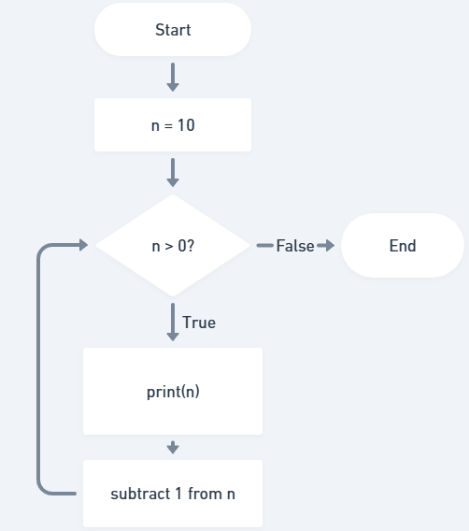
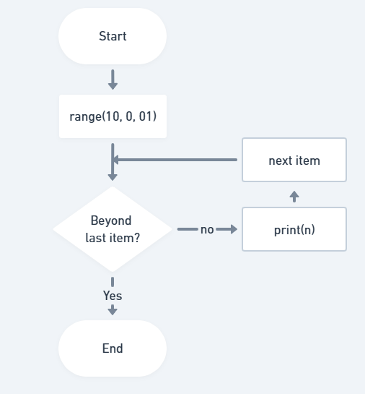
for Loop and while Loop Comparison
Counting down with a for loop
for n in range(10, 0, -1):
print(n)
Counting down with a while loop
n = 10
while n > 0:
print(n)
n -= 1

Slide 8
for Loop and while Loop Comparison
 | For Loop | While Loop
Usage | Number of iterations is known upfront | Number of iterations is condition-based
Control Variable | Managed by the loop automatically | Update manually inside the loop
Example | Iterating through a range of numbers or a list | Waiting for a user input or reaching a condition

Slide 9
Quiz 1
You want to write a program that prints numbers from 1 to 20. Which type of loop (for or while) would be more suitable, and why?
Notes:
A for loop is better because the number of iterations (20 times) is known in advance. For loops are ideal when you know exactly how many times you need to repeat a task.

Slide 10
Quiz 2
A student writes a loop that keeps running indefinitely, and their program never stops. Which type of loop (for or while) is more likely causing this issue, and why?
Notes:
A while loop is more likely causing the issue because it depends on a condition to stop. If the condition never becomes False, the loop will run forever. For loops usually have a fixed range, preventing infinite loops.

Slide 11
Quiz 3
A teacher wants students to write a loop that prints "Hello" exactly 5 times.
Student A uses a for loop.
Student B uses a while loop.
Can both students achieve the same result? Why or why not?
Notes:
Both for and while loops can achieve the same result.
A for loop is better when you know the number of repetitions in advance.
A while loop works too, but the student must manually track and update the counter to stop the loop correctly.

Slide 12
Lab
Develop a program to:
  Keep asking the user to enter numbers
  Stop if the user enters a negative number
  Print the sum of all positive numbers entered
The output should look like:
    Enter a number: 5
    Enter a number: 10
    Enter a number: -1
    Sum of positive numbers: 15
Hints: use input(), print(), int() functions in the while loop

Slide 13
Exercise
Create a program that helps plan a birthday party with a budget. Allow the user to buy party items, check remaining budget, and see their shopping list.
Refer to exercise sheet for more details and hints

