Slide 1

Python
Fundamental
Lesson 4

Slide 2

Revisit
For loop reinforcement – enhance dice program
While loop
Comparison of for loop and while loop
Boolean Operators (and, or, not)
Boolean Values (True / False)
Functions: range(start, stop, step)
Control Structure: for loop, while loop
Lab: The dice program enhancement, a while loop to sum positive inputs
Exercise: a program that simulates basic backing transactions

Slide 3
Technique We've Learned
Random Library
Decision Making: if-elif-else
Logical Operators (==, !=, <, <=, >, >=)
Boolean Operators (and, or, not)
Boolean Values (True / False)
Functions: range(start, stop, step)
Control Structure: for loop, while loop

Slide 4
Exercise 3 Review
Refer to code repository

Slide 5

Data Structure: List
A list is a collection of items stored in a specific order.
The items can be of any type, like numbers, words, or even other lists.
What is the output of below print statement?
    mylist = [1, 2, 3, 4, 5]
    print(mylist[2])

Slide 6
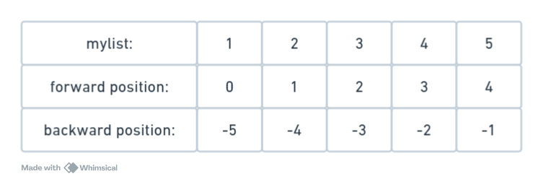
List - Positioning
Try to print below content:
print(mylist[2])
print(mylist[-2])

Slide 7
Quiz 1
True or False:
A list in Python only store values of the same data type?
(e.g., only numbers or only strings).
Notes:
Answer: False
Explanation: Lists can store multiple data types, such as numbers, strings, and even other lists.

Slide 8
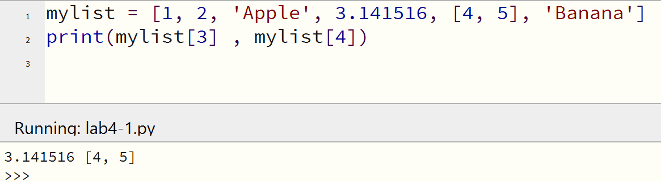
Multiple Data Types in a List
Different data types can be stored in a list
Question: How can you print the number ‘5’ form mylist?

Slide 9
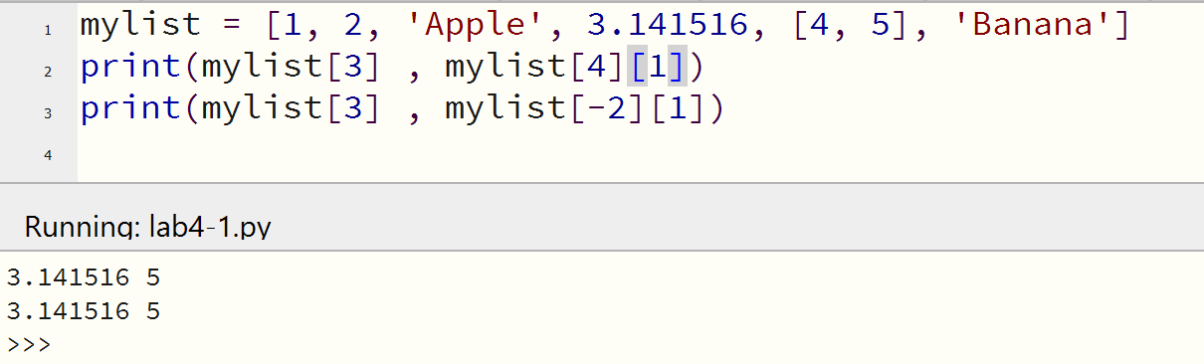
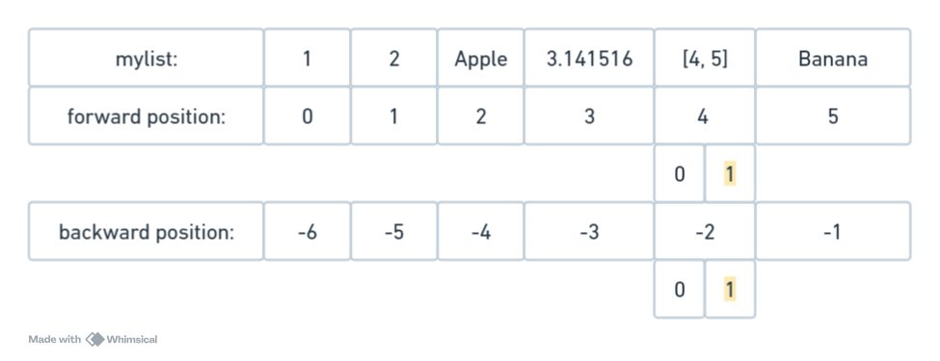
List - Slicing

Slide 10
Quiz 2
What will be the output of the following code?
A) 1
B) 3
C) 4
D) 5
mylist = [1, 2, 3, 4, 5]
print(mylist[-2])
Notes:
C) 4
Explanation: Negative indexing starts from the end, so -1 refers to the last element (5), and -2 refers to the second-to-last element (4).

Slide 11
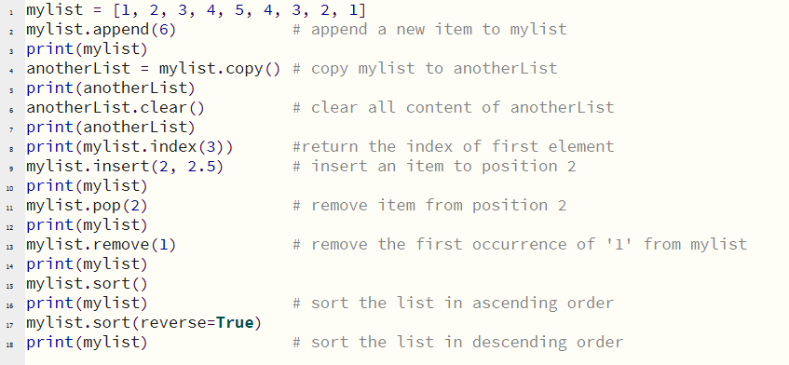
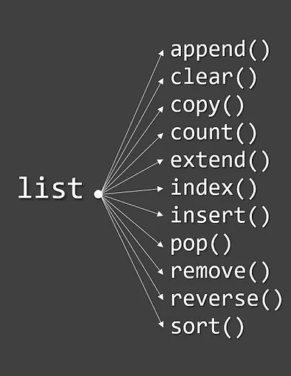
List – Manipulations

Slide 12
Quiz 3
The following list is given:
  mylist = ["apple", "banana", "cherry", "date"]
How would you modify this list to:
  Add "grape" to the end? (.append)
  Remove "banana"? (.remove)
  Sot mylist (.sort)
  Print all elements one by one? (for loop)
Notes:
mylist.append("grape") → Adds "grape" to the end.
mylist.remove("banana") → Removes "banana" from the list.
for item in mylist: print(item) → Prints each item in the list.

Slide 13
List, Tuples, Sets, Dictionaries
Tutorial

Slide 14
Exercise
Create a shopping list:
Start with an Empty List
  Create an empty list called shoppingList.
Add Items to the List:
  Ask the user to enter one shopping item at a time.
  Use a for loop to ask for 5 items.
  After the user enters each item, add (append) it to the shoppingList
  After all 5 items are entered, sort the shoppingList in alphabetical order.
Display the List:
  Use another for loop to print each item in the sorted shoppingList.
Output should look like this:
  Enter item 1: milk
  Enter item 2: bread
  Enter item 3: eggs
  Enter item 4: apples
  Enter item 5: cereal
  Your shopping list is: ['milk', 'bread', 'eggs', 'apples', 'cereal']

