Slide 1

Python Fundamental
Lesson 7

Slide 2

Revisit
Project: Hangman Game

Slide 3
Technique We've Learned
Random Library
Decision Making: if-elif-else
Logical Operators (==, !=, <, <=, >, >=)
Boolean Operators (and, or, not)
Boolean Values (True / False)
range(start, stop, step) function
Control Structure: for loop, while loop
Text File Handling: create, write, append, read
Define a Function

Slide 4
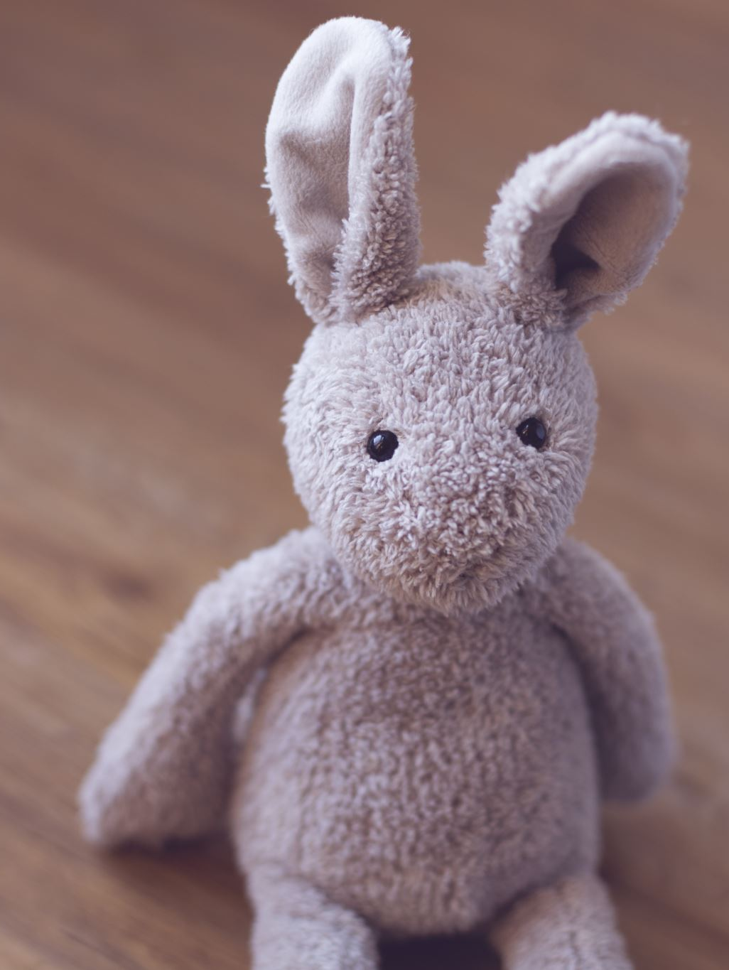
Virtual Bunny Pet Game
In this game, the player takes care of a virtual bunny.
The player feed the bunny,
play with it,
and check its status.
The bunny's hunger, happiness, and health levels change over time, requiring the player to interact regularly to keep the bunny happy and healthy.

Slide 5
Design the Game
Bunny life data is storing a in file. Load bunny’s life data.
Display a menu for user to feed, play, check status and quit the game.
Create a while main loop to display menu and call associated functions to execute feed, play, and check bunny’s status
If user decided to exit the game, save bunny’s life data to a file.

Slide 6

Project Materials
Open the page here …

