Slide 1
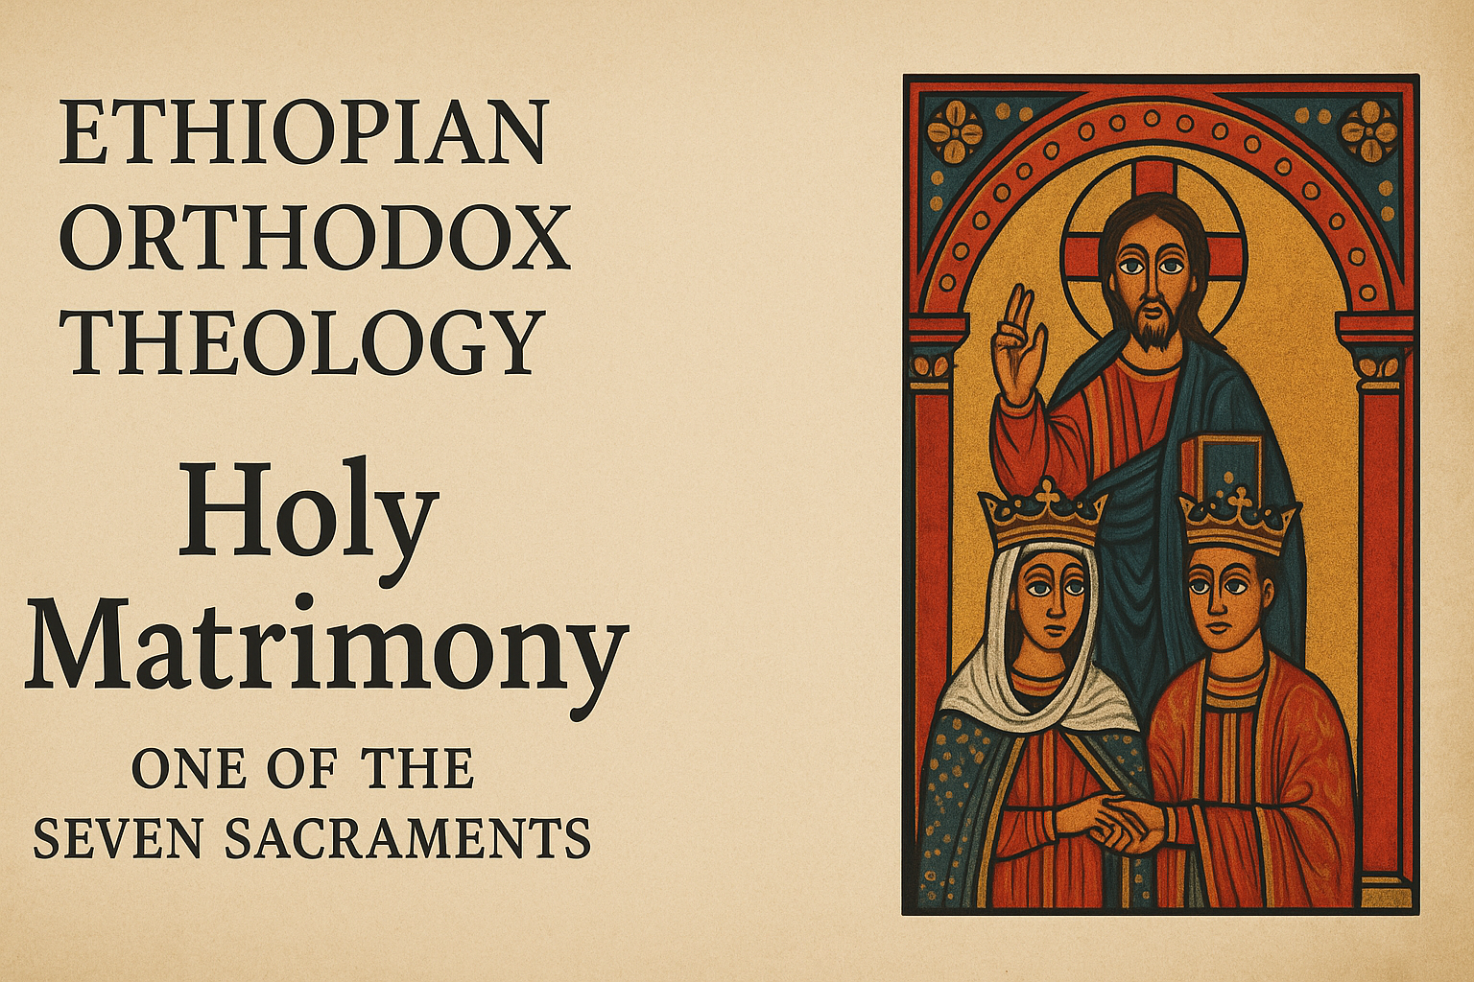
By Dn Yonnas

Slide 2
What Is the Sacrament Of Matrimony
Definition: The Sacrament of Matrimony is the holy service through which the bridegroom and the bride are united and granted divine grace. This grace sanctifies their matrimonial union, making it perfect and spiritual, like the unity of Christ and the Church.

Slide 3
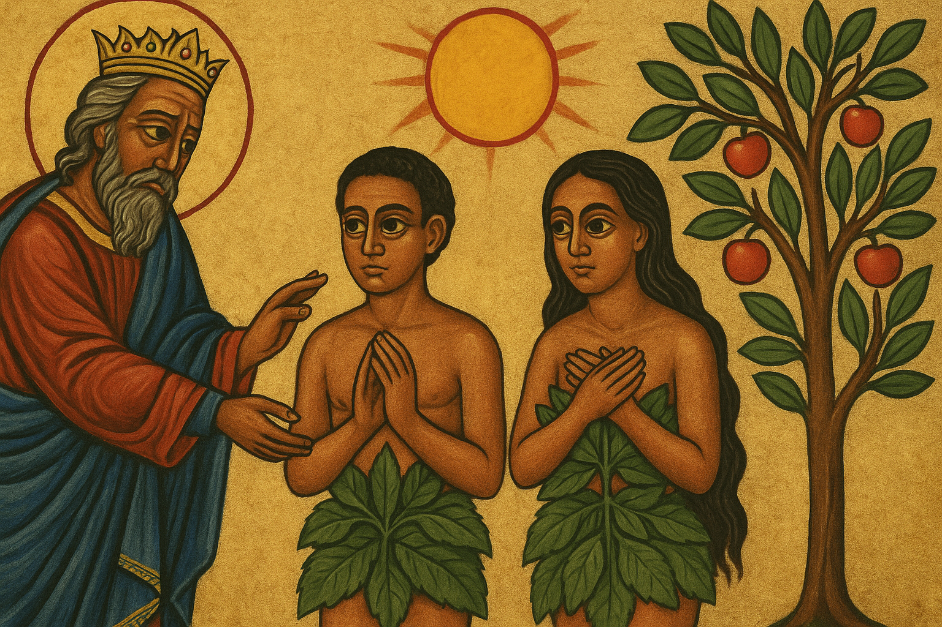
Institution of Sacrament (Old Testament)
Genesis 1:27–28 (KJV)
27 So God created man in his own image, in the image of God created he him; male and female created he them. 28 And God blessed them, and God said unto them, Be fruitful, and multiply, and replenish the earth, and subdue it
Marriage was instituted by God since the beginning of human creation.
Adam and Eve were united as husband and wife, and God Himself blessed this union. This shows that marriage was always meant to be a divine institution.

Slide 4
Institution Of Sacrament (New Testament)
Christ’s Teaching in Matthew 19:4–6
When Christ says:
“For this cause shall a man leave father and mother, and shall cleave to his wife: and they twain shall be one flesh. … What therefore God hath joined together, let not man put asunder.”
He is not introducing a brand-new teaching but restoring and elevating the original meaning of marriage that God intended “from the beginning.”
The Pharisees were testing Him about divorce. Christ pointed them back to Genesis, emphasizing that marriage was not meant to be broken.
However, in the Jewish context, marriage was often seen more in terms of family, children, and inheritance rather than explicitly as a mystical union of two becoming one flesh.
He revealed the spiritual depth of marriage: it is not just a social contract or family arrangement, but a sacramental mystery where two truly become one in God.
Matthew 19:4–6 (KJV):
4 And he answered and said unto them, Have ye not read, that he which made them at the beginning made them male and female, 5 And said, For this cause shall a man leave father and mother, and shall cleave to his wife: and they twain shall be one flesh? 6 Wherefore they are no more twain, but one flesh. What therefore God hath joined together, let not man put asunder.

Slide 5
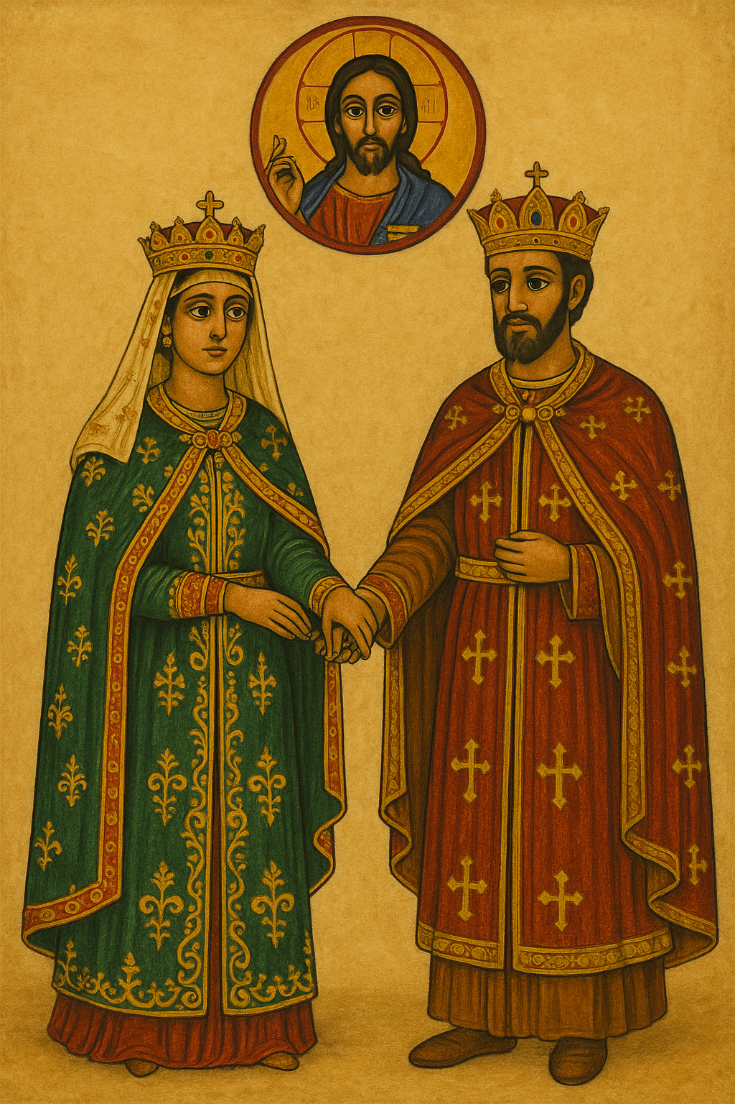
The Divine Goals of Matrimony
1. Preservation and Growth of Mankind
“Male and female He created them. And God blessed them, and said, Be fruitful, and multiply, and replenish the earth.” (Gen. 1:27–28)
2. Mutual Help Between Husband and Wife
“It is not good that the man should be alone; I will make him a help meet for him.” (Gen. 2:18)
3. Guard Against Carnal Temptation
“To avoid fornication, let every man have his own wife, and let every woman have her own husband… for it is better to marry than to burn.” (1 Cor. 7:1–9)

Slide 6
The Outward Signs
Anointing with oil
Quick Lesson
What is an “Outward Sign”?
In Orthodox theology, every Sacrament (Mystery) has:
An outward (visible) sign – something we can see, hear, or touch (words, actions, or physical elements like oil, bread, wine, water).
An inward (invisible) grace – the divine reality given by God through the Holy Spirit.
So the outward sign is the visible action or symbol that expresses and communicates the hidden grace of God.
sacramental act the priest performs
Declaration of the couple

Slide 7
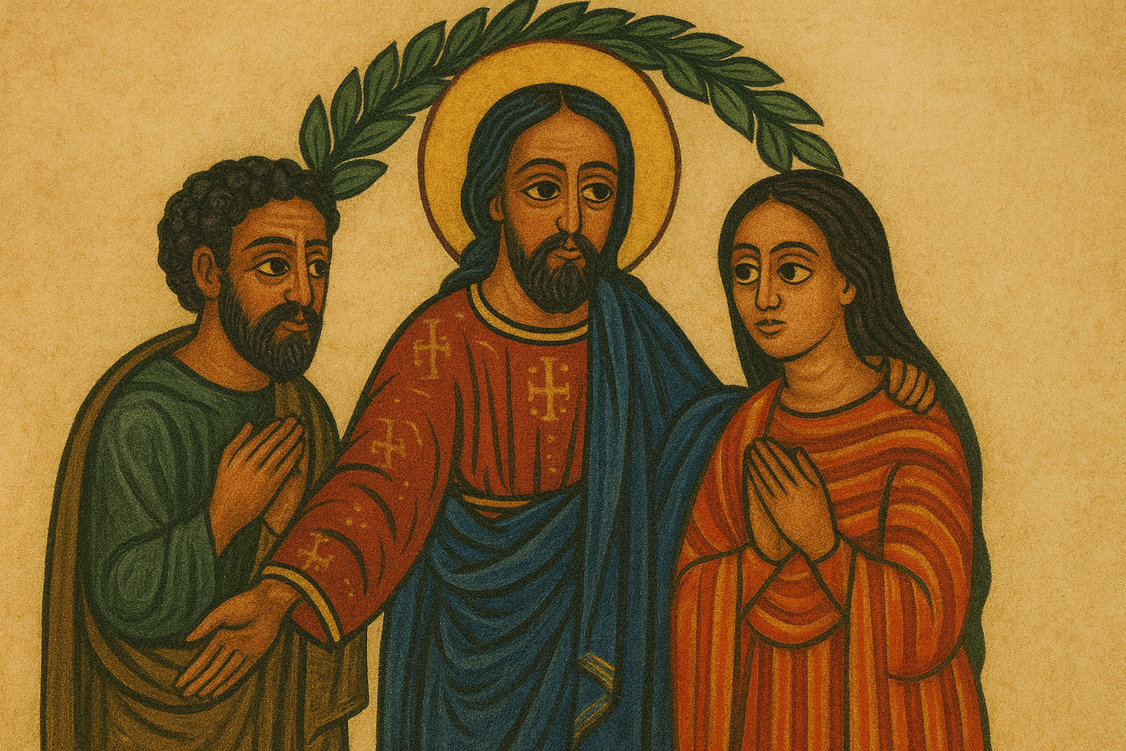
The Invisible Grace (Inward Sign)
To sanctify the matrimonial union and make it a spiritual one.
To help the husband and wife to keep themselves united together and unseparated, just as they unity of Christ with the church is everlasting.
To keep the husband and wife loyal and faithful to each other.

Slide 8
Obligations Of Wife and Husband Before Marriage
1. Both must be Christians
Why: Because the grace of Christ is given only within the Church. The sacraments, including Matrimony, cannot be bestowed upon non-Christians.
2. Both must belong to the Orthodox Church
Why: Because the sacrament of Matrimony is received within the Church. If one is not Orthodox, he or she must first be united to the Church before receiving this mystery.
3. The couple must not be bound by forbidden kinship
Why: Because carnal (blood relation) or spiritual affinity (such as godparent relationships) creates an impediment to marriage.
4. Both must freely consent to the marriage
Why: Because the sacrament requires the free will of the bride and groom. Parental desire alone is not enough. The priest must ask each of them privately and publicly to confirm their agreement.

Slide 9
Marriage: At and After the Sacrament
At Marriage:
Matrimony is a sacrament → must be performed in the Church (not outside).
Priests must teach the faithful this truth.
After Marriage:
Faithfulness & Unity – Husband and wife are joined as one flesh (Matt. 19:4–5).
Marriage until death – If a spouse dies, the other may remarry “only in the Lord” (1 Cor. 7:39).
Indissolubility – No separation except for fornication (Matt. 19:6, 9).

Slide 10
Citations
Images: AI-generated by Me (no direct photographs used)
Text & Teaching Content Drawn From:
Kesis Solomon;
Marcos Daoud, The Orthodox Church Sacraments.
Addis Ababa: Tinsae Ze Gubae Printing Press, 1952.

Slide 11
QUESTIONS?

