Slide 1
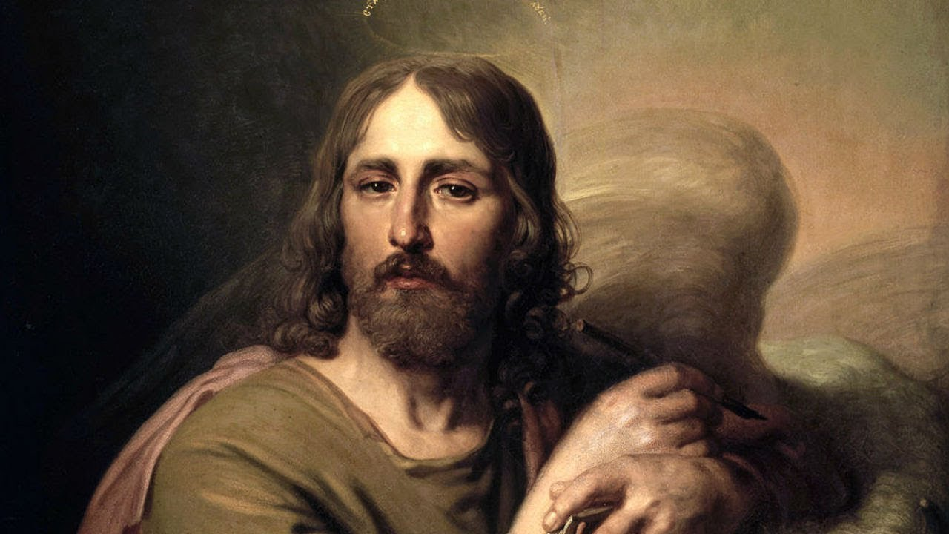
St. Luke The Apostle
The Life & Legacy of St. Luke
By Dn Yonnas

Slide 2
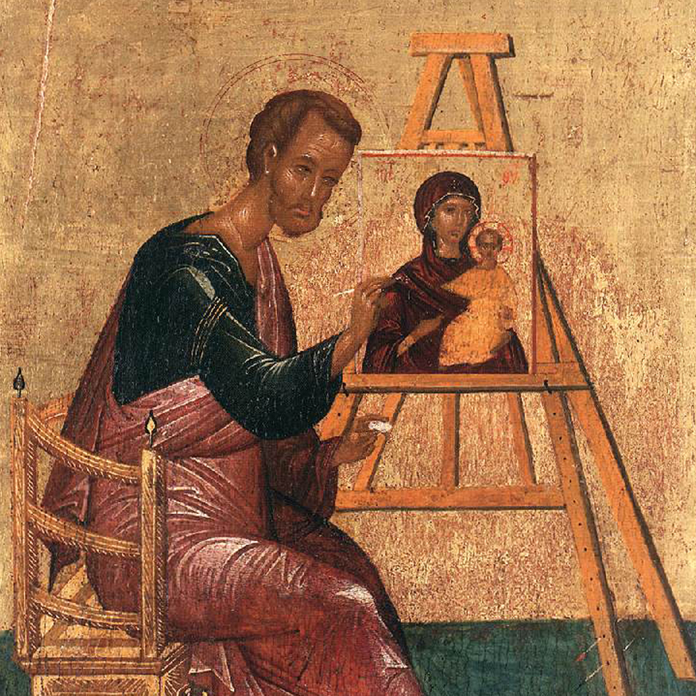
Who Was Saint Luke?
Not One of the Twelve Apostles: Luke was not among the original twelve apostles of Jesus. Instead, he is believed to have been a Gentile convert.
A Physician: Colossians 4:14 refers to him as “the beloved physician” (ὁ ἰατρὸς ὁ ἀγαπητὸς).
Companion of Saint Paul: He traveled with Saint Paul on his missionary journeys and was one of Paul's most trusted followers. In 2 Timothy 4:11, Paul states, “Only Luke is with me.”
Highly Educated: His writings in Greek are among the most refined in the New Testament, suggesting he was well-educated.

Slide 3

Saint Luke’s Gospel and Its Unique Characteristics
The Gospel of Luke is the third book in the New Testament and has distinct themes:
Saint Luke provided the world with a well-researched and orderly account of Jesus Christ’s ancestry, birth, and earthly life, followed by a structured narrative of His ministry, highlighting key teachings and events.
Focus on Christ’s Compassion: Luke’s Gospel emphasizes Jesus’ love for sinners, the poor, women, and Gentiles.
A Universal Gospel: Unlike Matthew, which was written for a Jewish audience, Luke’s Gospel presents Jesus as the Savior of all people, both Jews and Gentiles.
Emphasis on Prayer and the Holy Spirit: Luke frequently mentions Jesus praying and emphasizes the work of the Holy Spirit.
Luke 4:18-19 (NKJV)
"The Spirit of the Lord is upon Me,
Because He has anointed Me
To preach the gospel to the poor;
He has sent Me to heal the brokenhearted,
To proclaim liberty to the captives
And recovery of sight to the blind,
To set at liberty those who are oppressed;
To proclaim the acceptable year of the Lord."

Slide 4
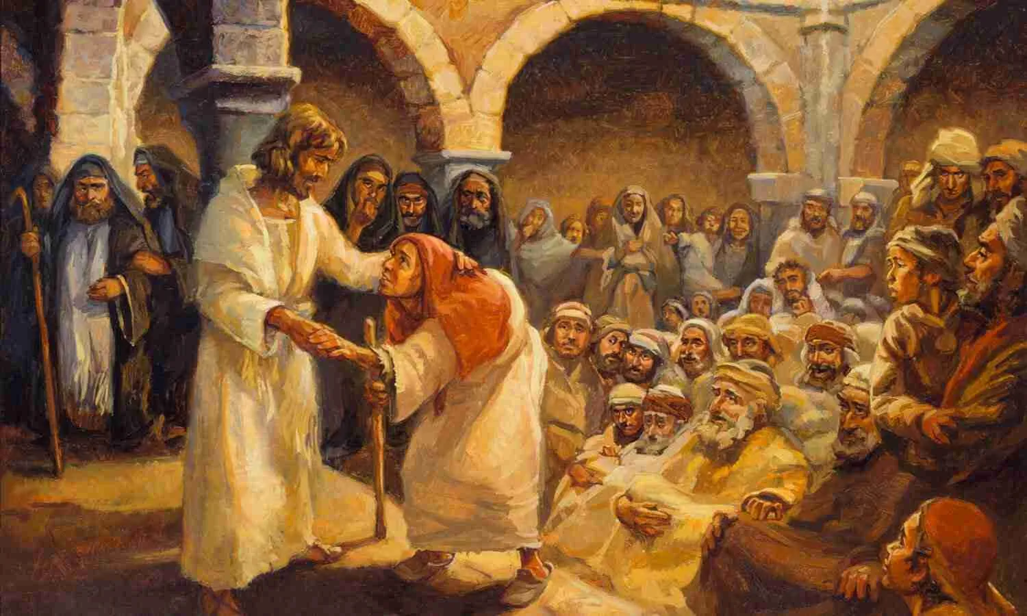
What Does Luke’s Gospel Include?
Jesus Christs Ancestry:
Found in Luke 3:23-38, tracing Jesus' lineage back to Adam (unlike Matthew, which traces it back to Abraham).
Jesus’ Birth and Early Life:
The most detailed account of the Annunciation, Nativity, and Jesus’ childhood (Luke 1–2).
Jesus Christ Ministry:
Unique parables and miracles, emphasizing Jesus' compassion and inclusion of Gentiles and outcasts.
Luke 1:3: “It seemed good to me also, having had perfect understanding of all things from the very first, to write to you an orderly account, most excellent Theophilus.”

Slide 5
Miracles and Parables Found Only in the Gospel of Luke
Miracles
The Great Catch of Fish & Calling of the First Disciples – Luke 5:1-11
Raising of the Widow’s Son at Nain – Luke 7:11-16
Healing of a Crippled Woman on the Sabbath – Luke 13:10-17
Healing of a Man with Dropsy – Luke 14:1-6
Cleansing of the Ten Lepers – Luke 17:11-19
Healing of the High Priest’s Servant’s Ear – Luke 22:49-51
Parables
The Two Debtors – Luke 7:41-43
The Good Samaritan – Luke 10:25-37
The Friend at Midnight – Luke 11:5-8
The Rich Fool – Luke 12:16-21
The Barren Fig Tree – Luke 13:6-9
The Great Banquet – Luke 14:7-24
The Cost of Discipleship – Luke 14:28-33
The Lost Coin – Luke 15:8-10
The Prodigal Son – Luke 15:11-32
The Unjust Steward – Luke 16:1-9
The Rich Man and Lazarus – Luke 16:19-31
The Persistent Widow (Unjust Judge) – Luke 18:1-8
The Pharisee and the Tax Collector – Luke 18:9-14
The Ten Minas – Luke 19:11-27

Slide 6
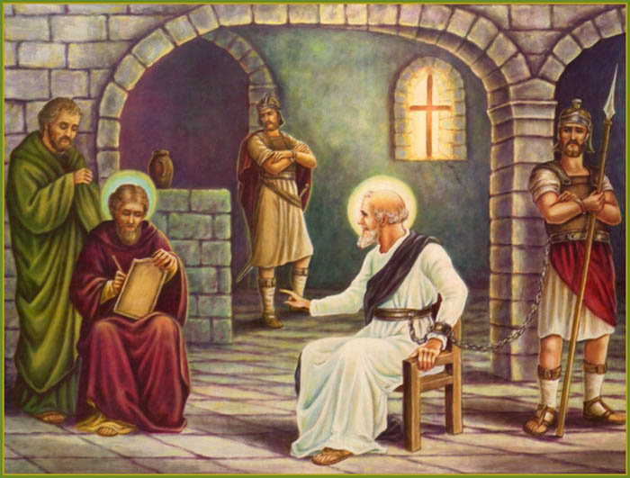
The Acts of the Apostles
The Acts of the Apostles, also written by Saint Luke, is a continuation of his Gospel. It details:
Written by St. Luke, the book of Acts provides a detailed account of the Great Commission, where Jesus commands His disciples to spread the Gospel to the world.
Luke, a close companion of St. Paul, was an eyewitness to events in Acts 13-28, accompanying Paul on many of his missionary journeys.
For Acts 1-12, he likely interviewed key figures such as St. Peter and St. John to document the early Church’s growth.
Acts was written between 62 AD and the mid-2nd century
Both the Gospel of Luke and Acts were addressed to Theophilus, a Gentile, showing Luke’s intent to present a well-researched, orderly account of Christianity’s beginnings (Acts 1:1).

Slide 7

The Martyrdom of St. Luke
After the martyrdom of St. Peter and St. Paul, St. Luke continued preaching in Rome, leading many to Christ.
Idol worshippers and non-believing Jews reported him to Emperor Nero, leading to his imprisonment.
Before his capture, he entrusted his writings to a fisherman, saying they would lead him to God’s way.
Nero ordered Luke’s hand severed, but he miraculously reattached it and then separated it again, leading 276 people, including the Emperor’s cabinet head and wife, to believe in Christ.
Enraged, Nero ordered St. Luke and the new converts to be beheaded, granting him the crown of martyrdom on 22nd Tahisas (December 31).
His body was thrown into the sea in a sack but was later found and buried with great honor on an island by a believer.

