Slide 1
Iron Sharpens Iron
By Dn Yonnas

Slide 2
Iron Sharpens Iron
“As iron sharpens iron, so one person sharpens another.” - Proverbs 27:17

Slide 3
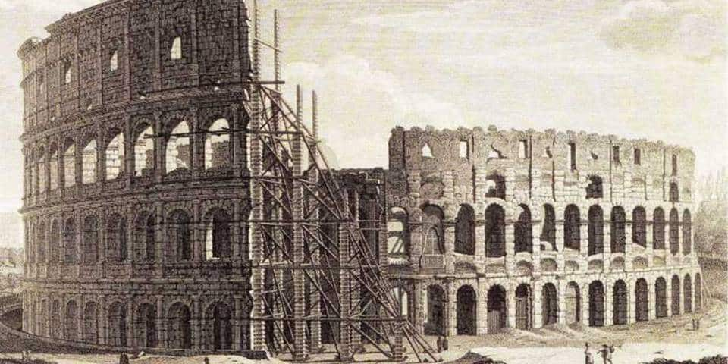
“One Man Army”
We cannot build anything extraordinary in life alone.
Rome: “Rome was not built in a day” | “Rome was not built alone”
A CEO runs a company but the employees keep it alive.
Apple: Steve Jobs would not be who he was without Steve Wozniak.
We can only go so far alone, do not let pride fool you.
Distance: “If you want to go fast, go alone; If you want to go far, go together”

Slide 4
We were designed to be together not alone
We were designed for each other.
FAMILY UNIT:
Woman + Man + Vows = Marriage
Woman + Man + Kids = Family
Sister + Brother = Siblings
What does Marriage, Family, and Siblings all have in common?
"It is not good that the man should be alone; I will make a helper suitable for him." -Genesis 2:18
Two are better than one,
because they have a good return for their labor:
¹⁰ If either of them falls down,
one can help the other up.
But pity anyone who falls
and has no one to help them up.
¹¹ Also, if two lie down together, they will keep warm.
But how can one keep warm alone?
¹² Though one may be overpowered,
two can defend themselves.
A cord of three strands is not quickly broken. - Ecclesiastes 4:9-12

Slide 5

People Can Be Difficult
Relationships are not easy.
The best relationships take time + energy + sacrifice + compassion + LOVE.
People are difficult because people have feelings, opinions, beliefs, etc..
How do you want to be remembered by people? - Our words and actions outlive us. (Nipsey Story)

Slide 6
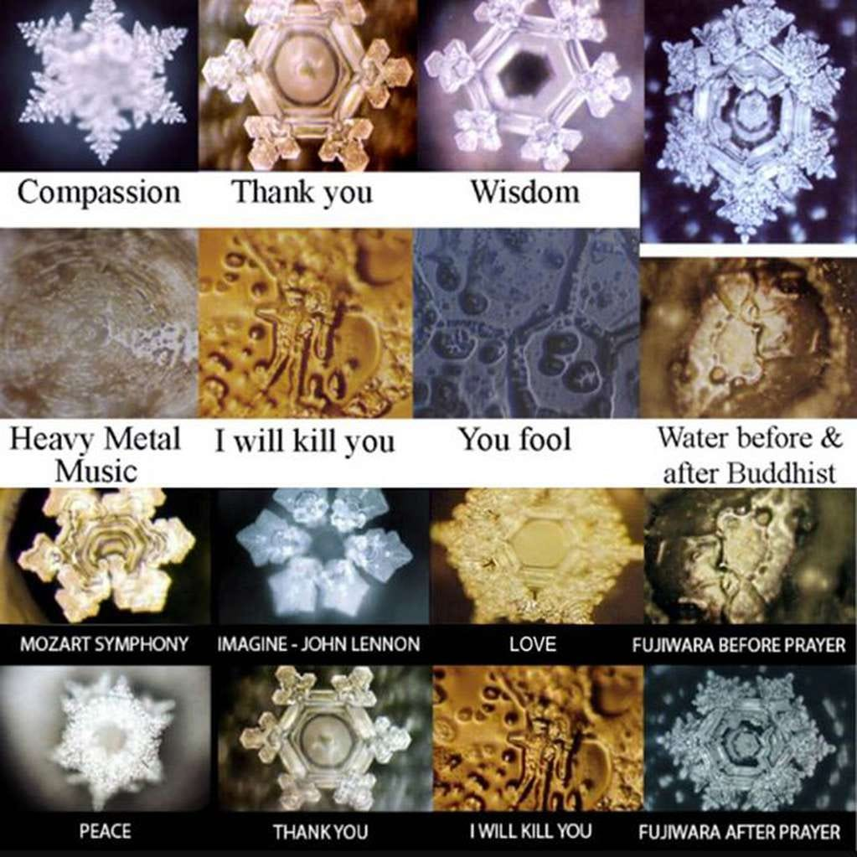
The Power Of Our Words
“Death and life are in the power of the tongue: and they that love it shall eat the fruit thereof.” - Proverbs 18:21
“sticks and stones may break my bones but words will never hurt me.” - Great misconception
"water crystal experiment" conducted by Masaru Emoto.
Our words have the ability to build and destroy

Slide 7
WHO AM I?
Who are you?
Example: I need one BRAVE volunteer.
Our Identities are comprised of thoughts, beliefs, Actions….
“We are what we repeatedly do. Excellence, then, is not an act, but a habit” - Philosopher
You have the power to choose.
Who do you choose to be?
“Watch your thoughts, they become your words; watch your words, they become your actions; watch your actions, they become your habits; watch your habits, they become your character; watch your character, it becomes your destiny.”
― Philosopher

Slide 8

Be The Difference!
Uplift the people around you.
Do not look down on people unless you have a hand there to help them up.
Compassion over Judgement
Compassion kills Judgement.
Step in other person's shoes.
Compassion bring forth understandment
Do not teach someone how to swim when they are drowning.
The story of my friend Teron
Iron sharpens Iron
A dull blade cannot sharpen a dull blade.

