Slide 1

The Purpose and Practice of Fasting in the Orthodox Christian Faith
By Dn Yonnas

Slide 2

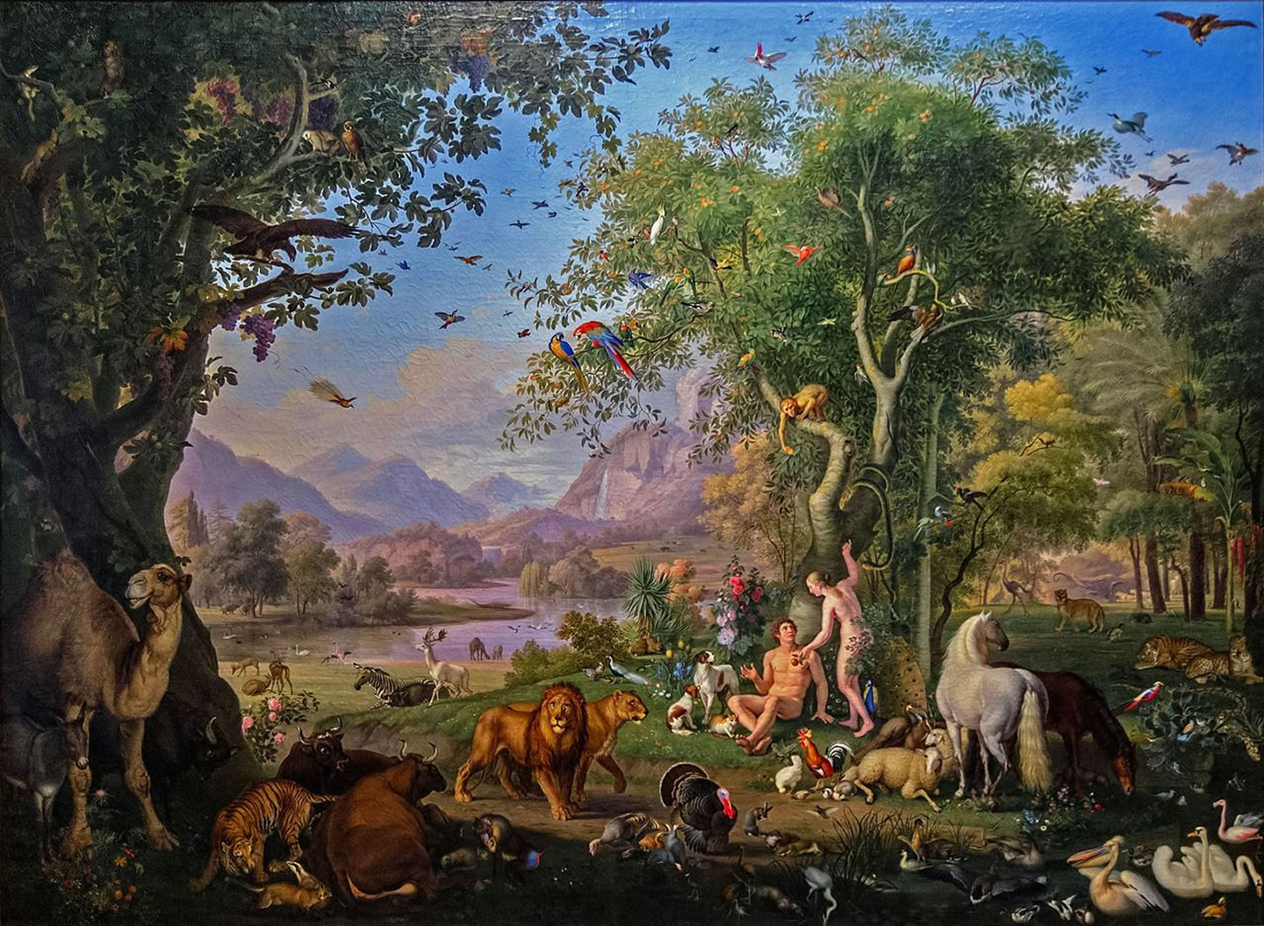
In The Beginning…
“And the Lord God commanded the man, “You are free to eat from any tree in the garden; ¹⁷ but you must not eat from the tree of the knowledge of good and evil, for when you eat from it you will certainly die.” - Genesis 2:16
God granted Adam and Eve permission to eat from the trees within the Garden of Eden. God provided a rich and abundant plant-based diet for humans in the Garden.
Humanity was originally designed to live on a plant-based diet. In the beginning, God intended for humans to thrive on fruits, vegetables, and herbs, in harmony with nature.
Animals were also given permission to eat plant-based food. Genesis 1:30 states that God provided every green herb as meat for animals, signifying that they too lived on a plant-based diet
Before the time of Noah, humans and animals were both plant-based. Prior to the Flood, there is no mention of humans eating animals. Both humans and animals consumed only plant-based foods as God intended.

Slide 3
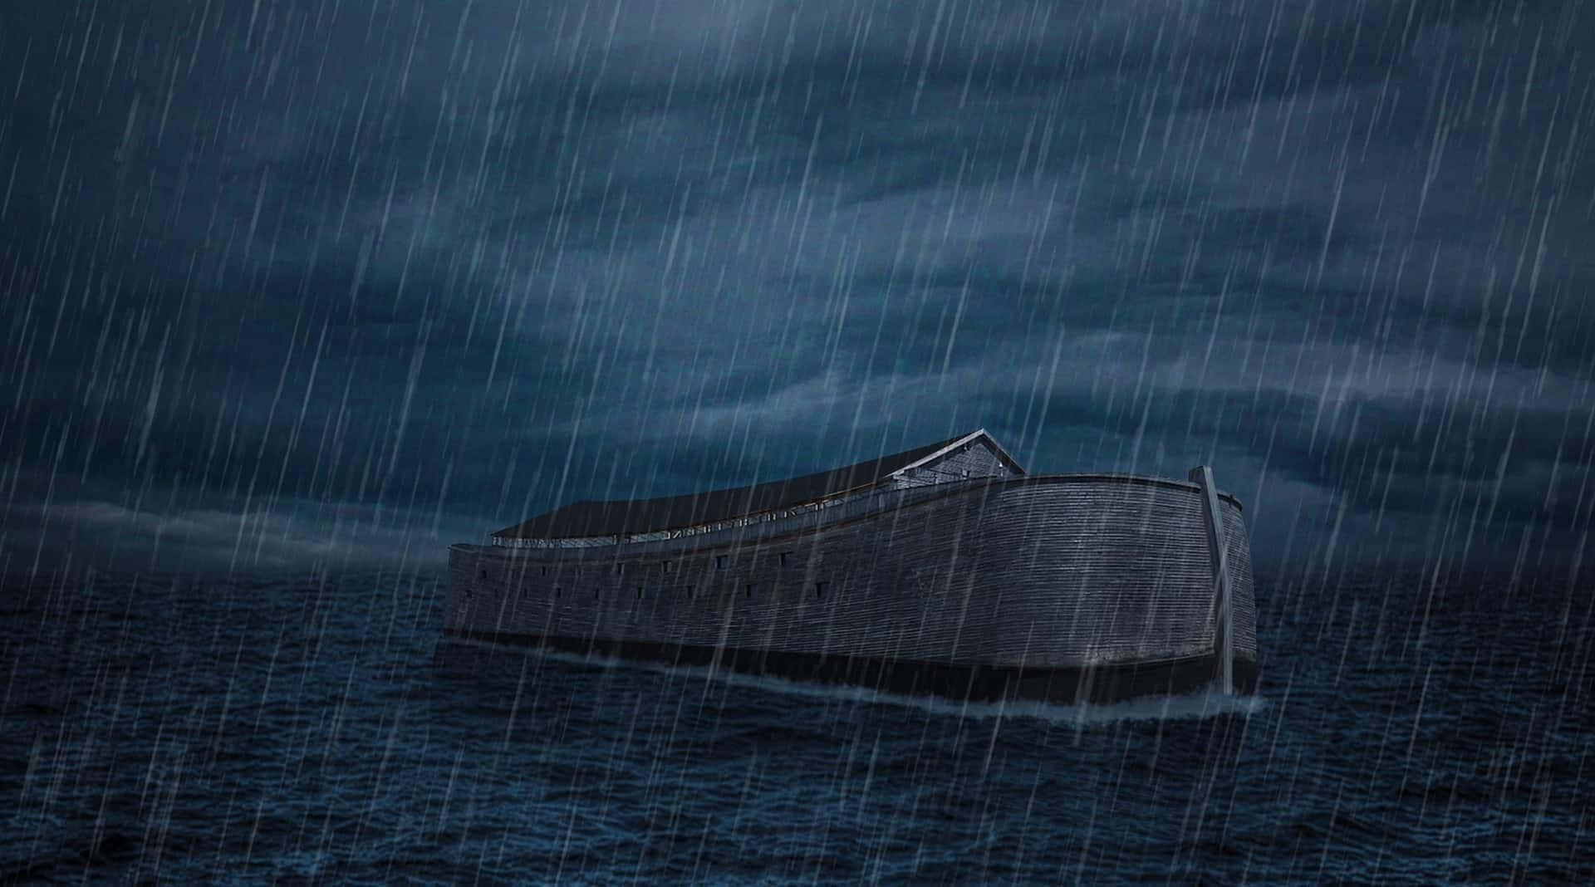
Lineage of Adam to Noah: The Shift in Diet from Plants to Meat
Adam
Adam – The first human created by God.
Seth – The son of Adam and Eve, born after the death of Abel.
Enosh – Son of Seth.
Kenan – Son of Enosh.
Mahalalel – Son of Kenan.
Jared – Son of Mahalalel.
Enoch – Son of Jared. Enoch "walked with God," and he was taken by God without experiencing death.
Methuselah – Son of Enoch. Methuselah lived 969 years, the longest recorded lifespan in the Bible.
Lamech – Son of Methuselah.
Noah – Son of Lamech. Noah is the righteous man chosen by God to survive the Great Flood and repopulate the Earth after the floodwaters receded.
Seth
Enosh
"Every moving thing that liveth shall be meat for you; even as the green herb have I given you all things." - Genesis 9:3
Noah
Kenan
Mahalalel
Jared
Enoch
Methuselah

Slide 4

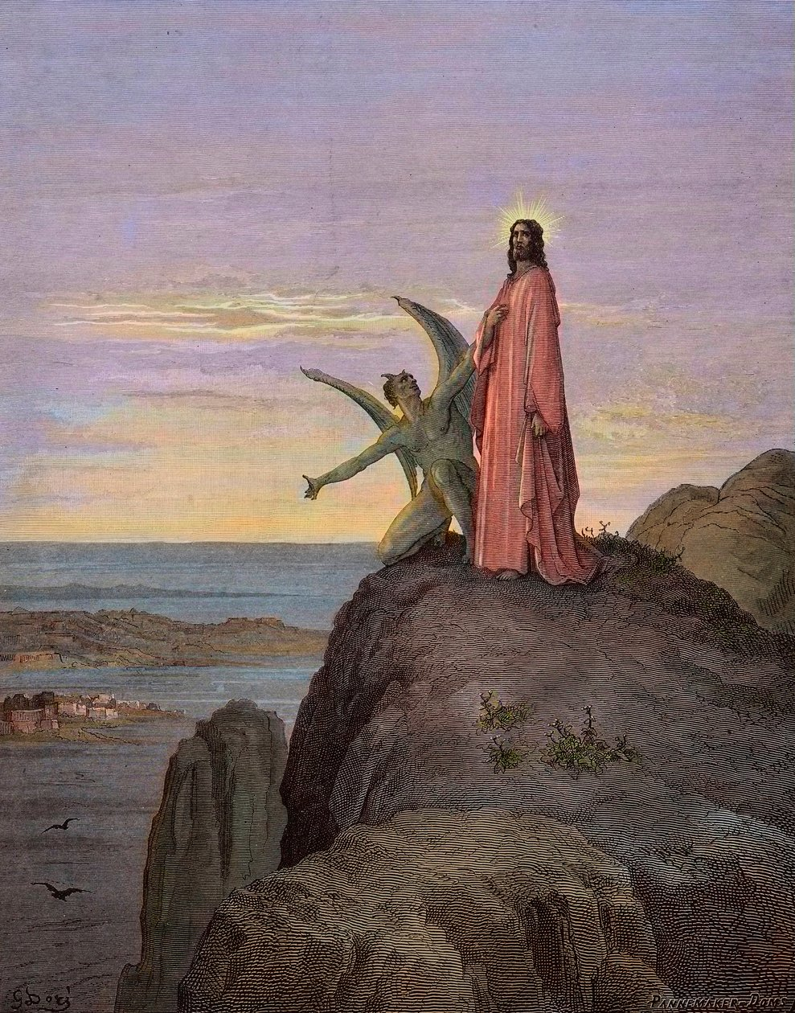
Why Do We Fast?
Matthew 4:6.
Return to the Original State: It is a way to return to the pure state of humanity before the Fall, mirroring the diet God gave to Adam and Eve.
Spiritual Purification: Fasting cleanses the body and soul, helping believers detach from worldly desires and focus on spiritual growth.
Imitation of Christ and the Prophets: By fasting, Orthodox Christians follow the example set by Jesus Christ and the prophets, who practiced fasting as a means of drawing closer to God.
Self-Control and Discipline: Fasting cultivates self-control and discipline, empowering believers to overcome temptations and strengthen their willpower.
Preparation for Holy Feasts: Fasting prepares the faithful for major feasts by focusing on prayer, reflection, and renewal of faith.

Slide 5

The Hidden Beauty in SufferinG
Challenges and suffering are part of life.
Life has up and downs
Perspective shapes experience.
View challenges as opportunities.
Purpose makes hardship easier.
Perseverance overcomes hardship.
The journey is what matters, not the end goal.
Growth comes through struggle.
Examples of Suffering That Bring Good Things:
Mother Giving Birth: The pain and sacrifice of childbirth bring the joy of new life and the deep bond between mother and child.
Physical Training and Muscle Growth: Enduring pain and fatigue during exercise leads to stronger muscles and improved health.
Self-Discipline and Freedom: The discomfort of self-discipline leads to freedom from harmful habits and greater control over one’s life.
Fasting and Spiritual Growth: The discomfort of hunger and self-denial during fasting leads to spiritual purification, heightened self-control, and a closer connection to God.
Perseverance
GROWTH
Suffering
Challenges

Slide 6

The 7 Orthodox Fasts
4. The Great Lent (55 Days):
Duration: 55 days before the Feast of Resurrection.
Includes:
Preparation Week: Precedes the 40 days.
40 Days of Fasting: Reflecting Christ's fast in the wilderness.
Pascha Week (Holy Week): Leading up to the Resurrection.
Purpose: Engages the faithful in reflection on Christ's suffering, teachings, and ultimate Crucifixion & Resurrection.
5. The Fast of the Apostles: (lasting between 10 to 40 days.)
Duration: Varies; from the day after Pentecost to July 12 (Feast of the Apostles).
Purpose: Commemorates the Apostles' fasting after receiving the Holy Spirit, as they prepared for their mission to spread the Gospel.
6. The Holy Virgin Mary Fast (15 Days):
Duration: August 7 - August 22 (Feast of the Virgin Mary).
Purpose: Honors the Assumption of the Virgin Mary's body into heaven.
7. The Nativity Fast (43-44 Days):
Duration: 43 (or 44) days before the Feast of Nativity.
Purpose: To spiritually prepare for the birth of Christ.
1. Weekly Fasts:
Every Wednesday and Friday (except during the Fifty Days after the Feast of Resurrection)
Purpose:
Wednesday: To remember the betrayal of Judas.
Friday: To remember the Crucifixion of Christ.
2. The Fast of Gehad (Epiphany):
Duration: 1 day, on the eve of the Feast of Epiphany.
Purpose: To prepare for the celebration of the Epiphany.
3. The Fast of Jonah (3 Days):
Duration: 3 days, two weeks before the Great Lent.
Purpose: Commemorates Jonah’s time in the whale’s belly and God’s salvation.

