Slide 1

The Sacrament Of Penance
By Dn Yonnas

Slide 2
Agenda
What Is the Sacrament of Penance?
Why Do We Need Penance?
What Is The Purpose Of Penance?
Why do we practice penance before Holy Communion?
Biblical Authority: How Christ Instituted Penance.
How Does Penance Work?
How Do You Prepare For Penance?
What Sins Can be Forgiven?
What is blasphemy against the holy Spirit?
Q/A

Slide 3
What Is the Sacrament of Penance?
Penance is a sacred sacrament through which a baptized believer, having fallen into sin, returns to God by sincerely repenting, confessing their sins to a priest, and receiving absolution through the grace of the Holy Spirit.
The components of Penance:
Repentance - The hearts return
Confession - The verbal act
Absolution - God's forgiveness given through a priest
Absolution
Repentance
Confession

Slide 4
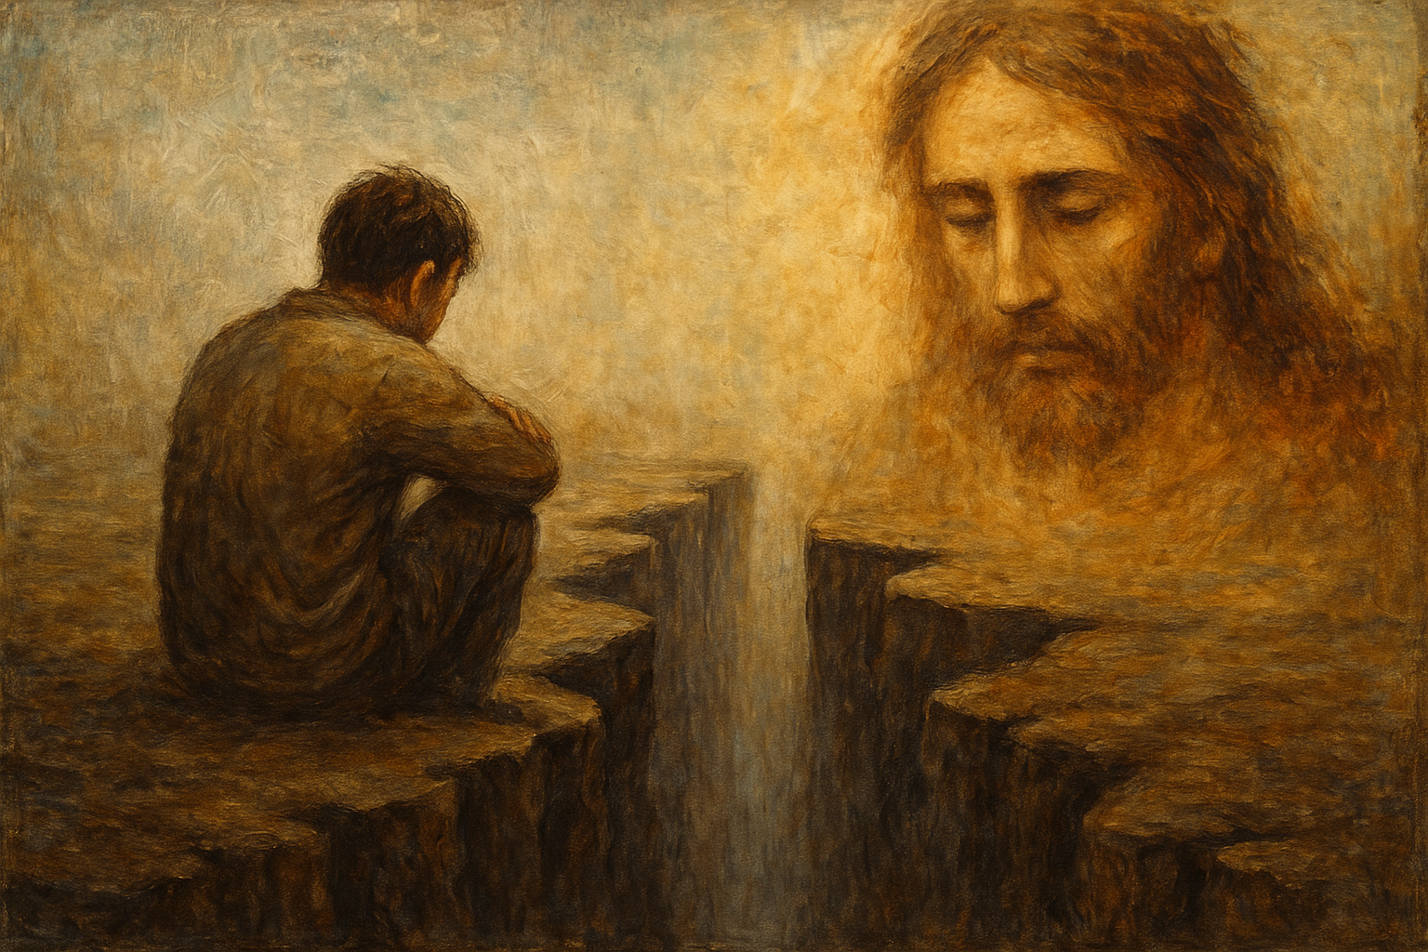
Why Do We Need Penance?
Sin separates us from God.
From the very beginning, sin created separation. In Genesis 3, when Adam and Eve sinned, they hid from God—symbolizing the inner distance sin creates.
The Prophet Isaiah says: “Your iniquities have separated you from your God; your sins have hidden His face from you.” (Isaiah 59:2)
This shows that sin is not just breaking rules; it's breaking relationship. Penance is God’s remedy for restoring communion with Him.

Slide 5
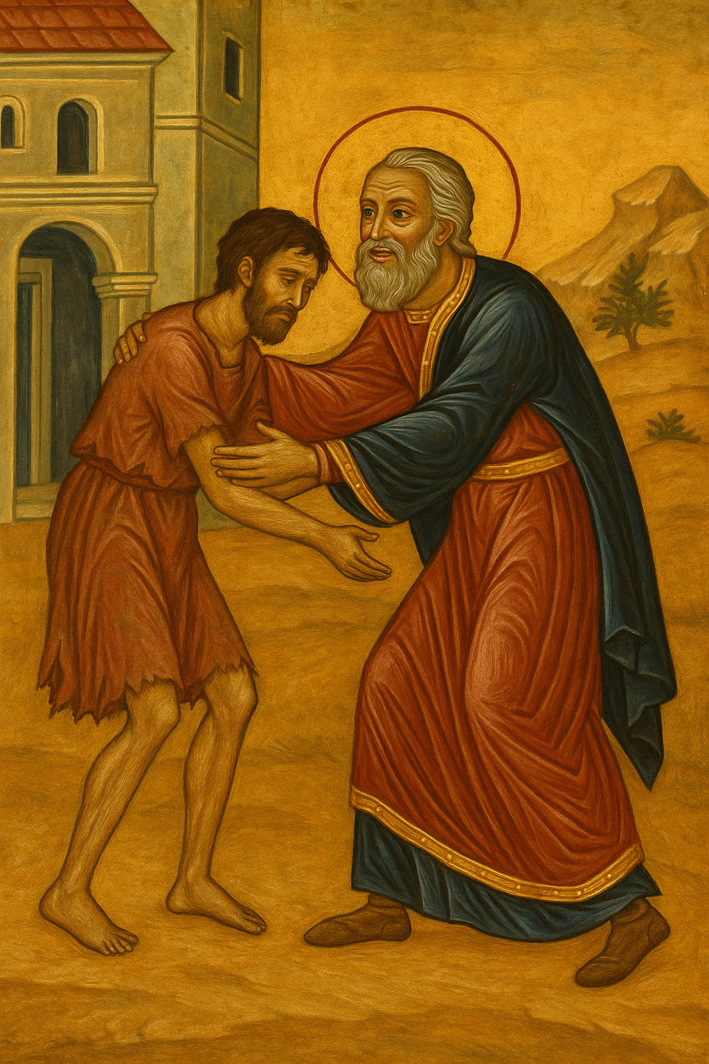

What Is The Purpose Of Penance?
Penance restores that relationship.
Through true repentance and confession, we are reconciled to God: “Return to Me, and I will return to you,” says the Lord. (Malachi 3:7)
The Parable of the Prodigal Son (Luke 15:11–32) is the perfect example:
The son left his father’s house and lived a wrong life.
When he repented and returned, the father ran to him, embraced him, and restored him to full sonship.
This is exactly what happens in the Sacrament of Penance—God rejoices when we return.
“There will be more joy in heaven over one sinner who repents than over ninety-nine just persons who need no repentance.”
— Luke 15:7

Slide 6
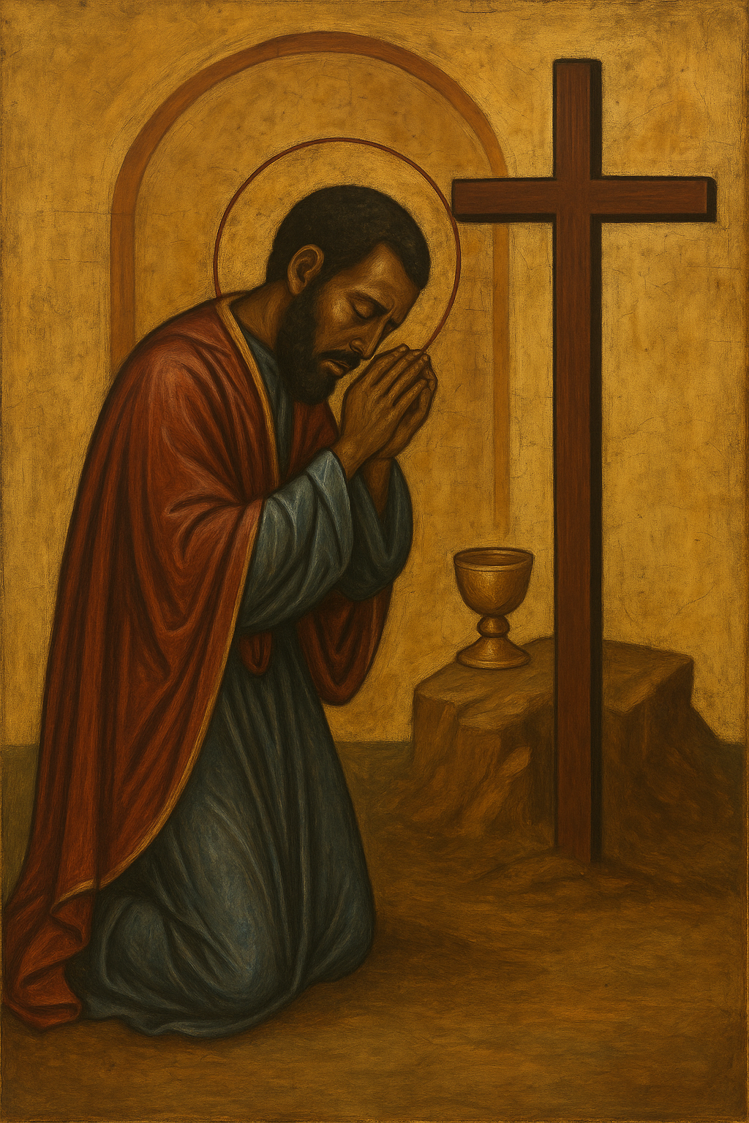
Why do we practice penance before Holy Communion?
It prepares us to receive Holy Communion worthily.
The Eucharist is union with Christ. We must approach it in a state of grace, not weighed down by unconfessed sin.
St. Paul warns:
“Let a man examine himself, and so let him eat of that bread, and drink of that cup. For he who eats and drinks in an unworthy manner eats and drinks judgment to himself, not discerning the Lord’s body.” (1 Cor. 11:28–29)
This is not a threat, but a loving warning: we must not treat Holy Communion lightly.

Slide 7
Biblical Authority: How Christ Instituted Penance.
Matthew 16:19 – Binding and Loosing
“Whatever you bind on earth shall be bound in heaven, and whatever you loose on earth shall be loosed in heaven.”
Context: Christ was speaking with peter after peter confessed Jesus was the son of God. “Binding and loosing” was rabbinic language:
To bind = to prohibit or withhold.
To loose = to permit or forgive.
Christ gave the Keys of the kingdom of heaven to Peter and the authority to forgive sins on earth.
Matthew 18:18 – Apostolic Authority for all Apostles
“Whatever you bind on earth will be bound in heaven…”
Context:
Spoken before Jesus' crucifixion and resurrection.
Christ is giving them spiritual jurisdiction as His future representatives.
The authority given was real, but not yet sacramentally empowered because the Holy Spirit had not yet been fully imparted.
Reinforces that this authority isn’t for Peter alone—it is for all the apostles and their successors (bishops and priests).
John 20:22–23 – Christ's Commission
“Receive the Holy Spirit. If you forgive the sins of any, they are forgiven them; if you retain them, they are retained.”
Context:
Spoken after the resurrection.
Jesus now breathes the Holy Spirit onto them.
This act spiritually empowers them to carry out the authority He promised earlier.
After the Resurrection, Jesus breathed the Holy Spirit onto His apostles, giving them direct power to forgive sins as His representatives.

Slide 8
How Does Penance Work?
A. The Penitent:
Repents – feels sorrow for sin (Acts 3:19).
Decides to change – doesn’t plan to return to sin (Luke 15:11–32).
Confesses to a priest – especially sins that dominate the soul.
Trusts in God’s mercy – like the woman who heard: “Your sins are forgiven” (John 8:11).
B. The Priest:
Listens and absolves – acts in Christ’s name.
Gives spiritual counsel – how to overcome sin.
Speaks words of absolution – the outward sign.
Maintains complete secrecy – “seal of confession” is absolute.
May assign spiritual discipline (epitimia) – Not punishment, but spiritual therapy:
Why Confess to a Priest?
People often ask, “Why not confess directly to God?”
The answer is: you do confess to God, but through His chosen method. Christ Himself established confession to a priest. The priest is not acting on his own; he is a witness, a guide, and a channel of God's forgiveness, like a doctor is a channel of healing.
Jesus gave the authority to bind and loose, and to forgive sins, directly to the Twelve Apostles.
But He also intended this authority to continue through the Church, by the laying on of hands (ordination), which we call Apostolic Succession.
That’s why only bishops and priests can perform the sacrament of Penance.

Slide 9
How Do You Prepare For Penance?
Pray
“Search me, O God, and know my heart.” (Psalm 139:23)
- Ask the Holy Spirit to help you see your sins clearly without excuses or pride.
Examine Your Conscience
Use a spiritual mirror. Reflect on:
The Ten Commandments
The Beatitudes (Matt. 5)
Your thoughts, words, actions, and what you failed to do
Your relationships, your prayers, and how you treat your body and soul
Approach with a Broken Spirit
“A broken and contrite heart, O God, You will not despise.” (Psalm 51:17)
-No need to justify or blame. True repentance says, “Lord, have mercy.”
Be Specific and Honest
Don’t generalize: “I’ve sinned a lot.”
Instead say: “I lied,” “I judged,” “I neglected prayer,” etc.
- You are not surprising God—you are naming your wounds so He can heal them.

Slide 10
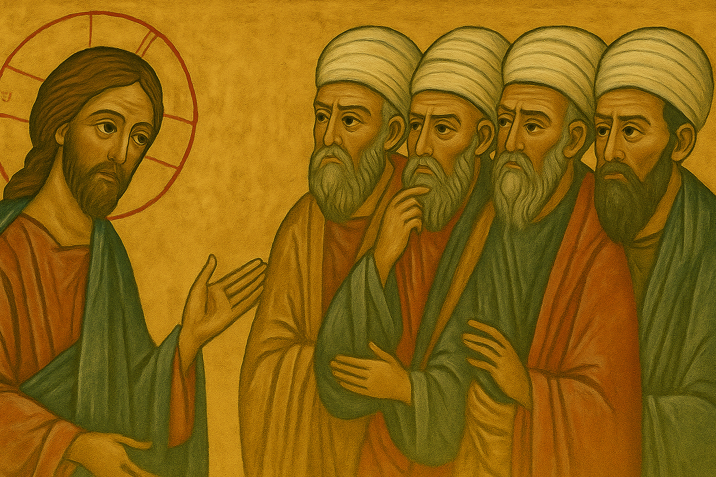
What Sins Can be Forgiven?
All sins—even the worst—can be forgiven: “Though your sins are like scarlet, they shall be white as snow.” (Isaiah 1:18) “Him who comes to Me I will never cast out.” (John 6:37) Examples: David (murder), Peter (denial), the adulterous woman (John 8).
The only sin Christ says cannot be forgiven is:
“Blasphemy against the Holy Spirit” (Matthew 12:31)
What does this mean?
It refers to hard-hearted, final rejection of God’s grace—refusing to repent at all. It's not that God won’t forgive, but that the person refuses to be forgiven. This is what makes it unforgivable.

Slide 11
What is blasphemy against the holy Spirit?
This is not a simple or extreme offense, but a deliberate, conscious, and hardened rejection of the Holy Spirit’s work, especially His work of bringing repentance and forgiveness.
Scripture Basis
“Therefore I say to you, every sin and blasphemy will be forgiven men, but the blasphemy against the Spirit will not be forgiven.” — Matthew 12:31 (also in Mark 3:28–30, Luke 12:10)
Context: Jesus had just healed a demon-possessed man, and the Pharisees accused Him of casting out demons by the power of Satan rather than by the Holy Spirit.
Why Is It Unforgivable?
Because the person refuses the very means of forgiveness.
God does not override human free will.
If someone persistently and finally resists the Spirit’s work of:
Conviction
Illumination
Repentance
Renewal
Then they cut themselves off from salvation.
The Holy Spirit convicts the heart and calls the sinner to repentance. When this call is fully and finally rejected, no other path to salvation remains
What It Is NOT
It is not a moment of doubt, fear, or spiritual struggle.
It is not ordinary sin or even serious sin.
It is not anger at God during suffering.
These can all be forgiven through confession and repentance.
St. John Chrysostom “It is not that the Spirit is greater than the Son, but that those who blaspheme the Son often do so out of ignorance. But blasphemy against the Spirit is not out of ignorance, but after full knowledge.” (Homilies on Matthew, 41:3)
St. Basil the Great “Blasphemy against the Holy Spirit is a deliberate resistance to the known truth and a refusal to accept salvation.” (On the Holy Spirit, 29.72)
St. Athanasius the Great “It is a sin against grace itself, and to sin against grace is to place oneself outside the sphere of healing.” (Letters, Ep. 40)

Slide 12
QUESTIONS?

