Slide 1
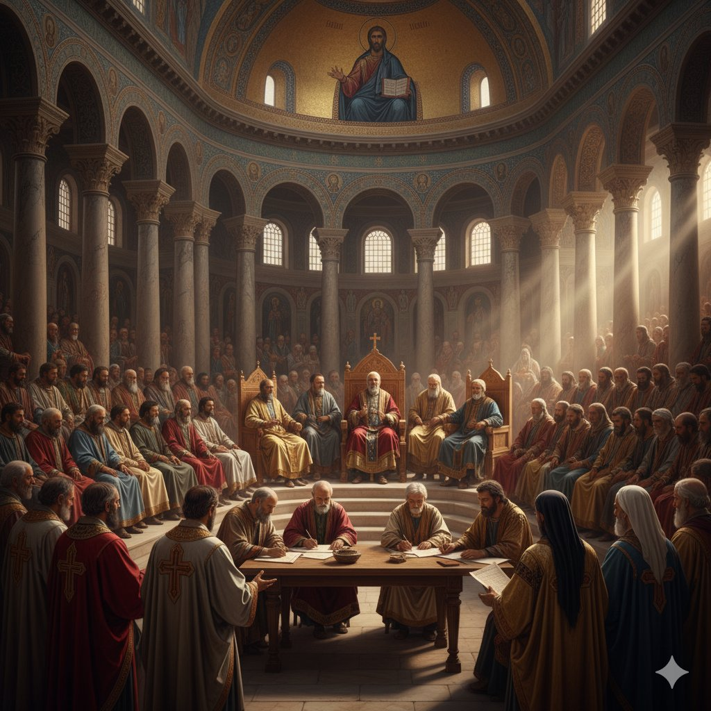
The Ancient Faith: Early Church Fathers and the Path of the Tewahedo Church
By Dn Yonnas

Slide 2

Apostolic Roots & The Pentarchy
Rome St. Peter and St. Paul
The Early Church Structure
The earliest Church was an organic network of local communities. Authority gradually consolidated around Apostolic Sees—Cities where the Apostles or their immediate disciples founded major, influential churches.
By the 4th century (Council of Nicaea, 325 AD), three Sees held primary jurisdiction across broad regions: Rome, Alexandria, and Antioch . These were the indisputable ancient powerhouses.
The Imperial Addition: The Pentarchy
The Pentarchy (rule of five) was a later imperial plan to formalize the five supreme Sees, strategically adding Constantinople and Jerusalem.
The system was based on the belief that these Patriarchs, acting collectively, safeguarded the universal faith, with authority residing in the Ecumenical Councils, not in the singular power of any one See.
Alexandria
St. Mark the Evangelist
Antioch
St. Peter
Jerusalem
St. James the Just
Constantinople
St. Andrew the Apostle

Slide 3
1,600 Years of Unity: Alexandria and the Ethiopian Episcopal Line
The Primacy of Alexandria
The Patriarchate of Alexandria (the Coptic Church) was one of the three original and most influential Apostolic Sees (along with Rome and Antioch).
It was traditionally founded by St. Mark the Evangelist, the author of the Gospel of Mark. Alexandria became the intellectual and theological capital of early Christianity, wielding immense authority over all of Africa and establishing the standards for biblical scholarship and doctrine.
Ethiopia's Indivisible Link
The First Bishop: This link began when St. Frumentius (Abune Selama) was consecrated as the first Bishop of Aksum by St. Athanasius, Pope of Alexandria, around 330 AD.
The Church in the Aksumite Kingdom (modern Ethiopia/Eritrea) was directly under Alexandria's spiritual jurisdiction for over 1,600 years.

Slide 4
The Accepted Councils (Nicaea I, Constantinople I, Ephesus I)
Council | Date | Key Heresy/Issue | Key Theological Affirmation
Nicaea I | 325 AD | Arianism (Christ was a created being) | Christ is Fully God: Jesus is of the same divine nature as God the Father.
Constantinople I | 381 AD | Macedonianism (denied the divinity of the Holy Spirit) | The Holy Spirit is Fully God: The Father, Son, and Holy Spirit are three distinct Persons who are equally divine.
Ephesus I | 431 AD | Nestorianism (divided Christ into two separate persons) | Christ is One Person: God and Man are perfectly and inseparably united in Jesus Christ. Mary is called Theotokos (God-bearer) because she gave birth to the one Person who is God.
The Shared Foundation of Faith
All major ancient Christian Churches—Oriental Orthodox, Eastern Orthodox, and Roman Catholic—share and uphold the definitions set forth by the first three Ecumenical Councils.
The Tewahedo Church uses these councils as the undisputed foundation for its doctrine on the Trinity and the Incarnation.

Slide 5
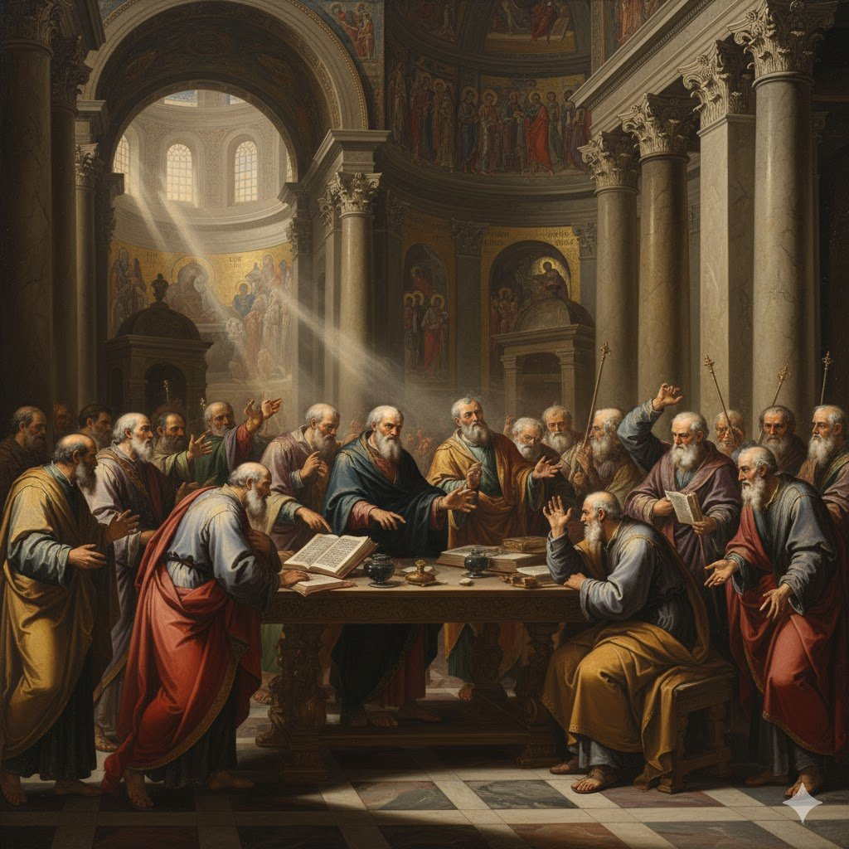
The Great Theological Conflict
The Pivotal Question
After the first three councils affirmed that Christ is fully God and fully Man (and one Person), a crucial question remained: How exactly are His Divine nature and Human nature united in that one Person?
This debate was known as the Christological Controversy. Disagreeing on the precise wording to describe this union led directly to the first major split in the ancient Church.

Slide 6
Christology Dilema
The Two Main Camps
By the mid-5th century, two main schools of thought dominated the debate:
The Alexandrian School (Tewahedo/Miaphysite)
Focus: Emphasized the complete unity of the natures after the Incarnation. They feared any language that seemed to separate Christ's divinity and humanity.
Doctrine: Argued that the natures are made "one" and work together as a single Divine-Human entity (Miaphysitism or Tewahedo).
Key Figure: St. Cyril of Alexandria (whose formula was central to the Council of Ephesus).
The Antiochian/Western School (Dyophysite)
Focus: Emphasized the need to clearly affirm that Christ's divinity and humanity remained distinct after the Incarnation. They feared language that suggested the Divine swallowed up or confused the Human nature.
Doctrine: Maintained that Christ exists "in two natures" (Dyophysitism).
Key Figure: Pope Leo I of Rome (whose Tome was central to the Council of Chalcedon).

Slide 7
The Council of Chalcedon (451 AD)
The Chalcedonian Definition (451 AD)
The Imperial Mandate
Convened by the Roman Emperor Marcian in 451 AD, the Council was called to definitively resolve the Christological conflict between Alexandria and Antioch.
The Council affirmed the doctrine that Christ is "one and the same Son... acknowledged in two natures" (in duabus naturis).
This core statement is known as Dyophysitism (Greek for "two natures").
The Definition Critical Compromise
The Chalcedonian Definition sought to be a balanced compromise by defining how the two natures exist within Christ, using four negative adverbs to guard against heresy.
The natures were united:
Without Confusion (Asynchytos): To guard against the Alexandrian extreme (which the Dyophysites called "Eutychianism").
Without Change (Atreptos): To guard against the idea that the Divine Nature was altered.
Without Division (Adiairetos): To guard against the Antiochian extreme (Nestorianism).
Without Separation (Achoristos): To guard against the final separation of the Person.

Slide 8
The Tewahedo Objection
The Alexandrian Rejection
The Alexandrian (Coptic) delegation, led by Pope Dioscorus, absolutely rejected the Chalcedonian phrase "in two natures" (en duo physeis).
Theological Fear: They argued that this wording risked a return to the heresy of Nestorianism (which divided Christ into two separate persons/subjects).
Core Doctrine: Alexandria insisted on the formula of St. Cyril: "One Incarnate Nature of God the Word," believing that after the Incarnation, the two natures became one unified reality (Tewahedo/Miaphysite).
The Schism: The Council illegally deposed and exiled Pope Dioscorus, effectively marking the permanent administrative and theological schism.
The Result
The Churches that rejected the Council of Chalcedon became known historically as the Non-Chalcedonian Churches (or the Oriental Orthodox family).
This marks the moment the ancient Apostolic Sees of Alexandria (Coptic), Antioch (Syriac), and Aksum (Tewahedo) officially separated from the Patriarchates of Rome, Constantinople, and Jerusalem.

Slide 9

The Tewahedo Christological Stance
Miaphysitism: The Doctrine of Unity
The theological position of the Tewahedo Church and the entire Oriental Orthodox family is Miaphysitism (Greek for "one nature").
This doctrine affirms that, after the Incarnation, Christ possesses one unified Divine-Human nature (physis).
The two natures are perfectly and perpetually joined, making them a single reality.
The Defining Formula
Miaphysitism is based on the formula of St. Cyril of Alexandria: "One Incarnate Nature of God the Word."
To visualize this union, the Tewahedo Fathers used the analogy of fire and iron: The fire and iron become one glowing, inseparable piece, but the iron does not cease to be iron, and the fire does not cease to be fire.

Slide 10
The Ge'ez Term: Tewahedo
What is Tewahedo?
The term Tewahedo is the Ge'ez word (the ancient liturgical language of the Ethiopian and Eritrean Churches) that translates directly to "made one" or "unity."
It is the native theological equivalent of the Greek Miaphysitism.
The term is so central to the Church's identity that it is part of its official name: The Ethiopian/Eritrean Orthodox Tewahedo Church.
The Theological Significance
Tewahedo expresses the core belief that the Divine Nature and the Human Nature of Jesus Christ are permanently and perfectly united into One Person and One Nature.
This unity is understood to be without separation, without confusion, and without change—both natures remain distinct in their properties but are inseparable in their existence within Christ.

Slide 11
The Nine Saints & Monasticism
Exiles of Faith and Missionaries
Period: The late 5th and early 6th centuries, right after the theological turmoil of the Council of Chalcedon (451 AD).
Identity: A revered group of missionaries, traditionally numbering Nine Saints, who arrived in the Aksumite Kingdom.
The Context: Many were believed to be Byzantine monks or clerics who fled the Roman Empire due to their rejection of the Chalcedonian Dyophysite doctrine. They sought refuge and a fertile ground for their Miaphysite faith.
Securing the Tewahedo Identity
Their arrival was critical in solidly establishing the Alexandrian theological position in the Ethiopian Highlands. They were missionaries of the Tewahedo faith.
Monasticism: They introduced and formalized the structures of intensive monasticism, creating spiritual centers that became essential for preserving the faith during later centuries of isolation.
Scripture: The saints were instrumental in finalizing and standardizing the translation of the Bible and key liturgical texts into the classical Ethiopian language, Ge'ez.

Slide 12
Monasteries and the Nine Founding Fathers
Centers of Faith and Learning
Each saint is associated with establishing a key monastery that served as a center for theology, education, and cultural preservation, primarily located in the regions of Tigray (Ethiopia) and Eritrea. These monasteries became the strongholds of the Miaphysite faith:
Debre Damo: Founded by Abba Aragawi, this is one of Ethiopia's oldest monasteries, famously located on a flat-topped mountain accessible only by a rope.
Abba Garima Monastery: Founded by Abba Garima, this monastery is the custodian of the Garima Gospels, some of the oldest illuminated Christian manuscripts in the world, dated to the 5th–7th centuries.
Debre Zewayt/Qorqor: Associated with figures like Abba Aftse.
The Tewahedo tradition venerates these specific figures as the fathers of Ethiopian monasticism. They are traditionally named:
Abba Aftse
Abba Alef
Abba Aragawi (or Za-Mika’el)
Abba Garima
Abba Guba
Abba Liqanos
Abba Pantelewon
Abba Sehma
Abba Yem'ata

Slide 13
Foundational Fathers
Church Father | Life (Approx.) | Key Work / Contribution | Relevance to Tewahedo Faith
St. Ignatius of Antioch | c. 35 – c. 108 AD | Seven Epistles: Early defender of the reality of Christ's flesh. | His fierce defense of the undivided unity of Christ's person laid the groundwork for Miaphysite theology.
St. Athanasius of Alexandria | c. 296 – 373 AD | On the Incarnation of the Word | Consecrated the first Bishop of Aksum (St. Frumentius), establishing the Alexandrian authority over the Tewahedo Church.
St. Cyril of Alexandria | c. 376 – 444 AD | Twelve Anathemas (against Nestorius) | His formula, "One Incarnate Nature of God the Word," is the canonical basis for the Tewahedo doctrine.
Pope Dioscorus I of Alexandria | d. 454 AD | Defense at Chalcedon | The primary figure who rejected the Chalcedonian Creed and was deposed, causing the official schism between the Oriental Orthodox and the rest of the Church.
The Nine Saints | Late 5th Century | Founding Monastic Orders | Solidified the Miaphysite position in the Ethiopian Highlands and finalized the translation of the Ge'ez Bible.

Slide 14
QUESTIONS?

