Slide 1
The Holy Cross: History, Significance, and Christian Doctrine
A Lesson on the Importance of the Cross in Christianity
By Dn Yonnas

Slide 2

From Execution to Emblem
Historical Context:
The cross was originally a brutal instrument of Roman execution—designed for degrading, despising, and torturing criminals.
Transformation:
Despite its grim origins, the cross became a symbol of dignity, pride, and salvation.
It is now raised high over churches, featured on church towers, domes, and temple veils.
Symbolic Meaning:
Today, the cross stands as the emblem of Christianity and a declaration of faith.

Slide 3
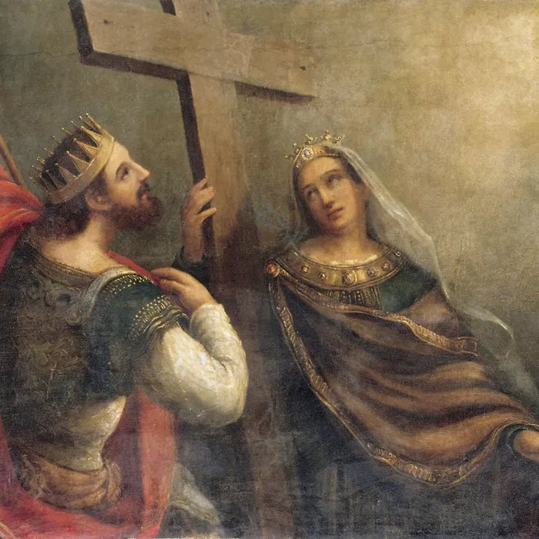
The Holy Cross in History – Queen Helena’s Journey
Queen Helena’s Journey:
An elderly woman (over 80 years old) set out for Jerusalem after her son’s death.
Motivated by a divine vision (or dream), she traveled to the Holy Land to find solace.
Discovery at the Holy Tomb:
Upon arrival, she found the site in ruins—overrun by a pagan temple to Venus.
Queen Helena ordered the demolition of the temple and removal of the debris.
The Revelation:
Among three discovered crosses, one bore Pontius Pilate’s inscription, identifying it as the Lord’s Cross.
She also found the nails used to crucify Christ.
One nail was sent to Emperor Constantine, who fixed it to his royal helmet—an act that later influenced the tradition of adorning kings’ crowns with a nail.
Church Foundations:
Queen Helena built a large church over the Holy Tomb, calling it the “New Jerusalem.”
Another church was built at the Cave of Nativity in Bethlehem, marking the humble birthplace of Christ.

Slide 4
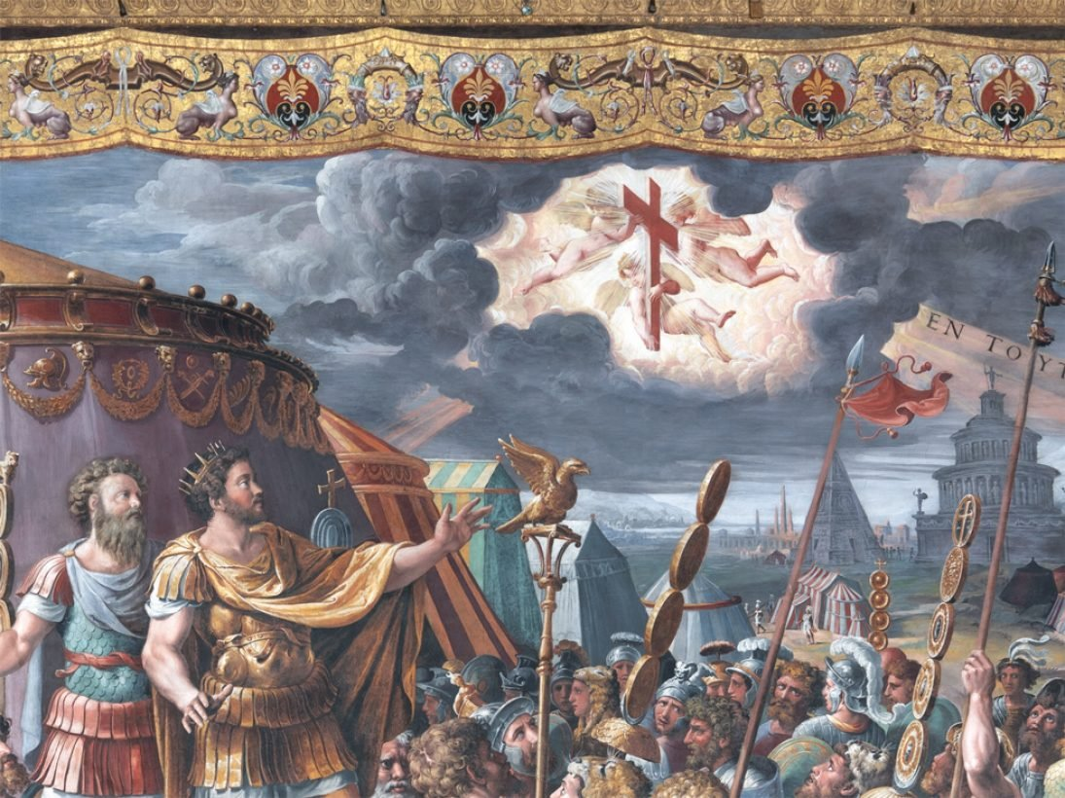
Miraculous Appearances of the Cross
Constantine’s Vision:
Emperor Constantine and his army witnessed a radiant cross in the sky late in the afternoon.
Inscribed upon the cross were the words: “By this sign you will conquer.”
This vision spurred Constantine’s conversion to Christianity and his victory over the tyrant Maxentius.
The 351 AD Miracle in Jerusalem:
A pillar of light—more brilliant than the sun—appeared in the sky over Jerusalem.
It remained visible for several hours, inspiring both awe and a mixture of fear and hope among the citizens.
“By the end of times when the sign of the cross covers the whole sky, east, west, north, and south. At that time, all the kingdoms of the earth will submit themselves to the Lord Christ” - Kesis Solomon
“That at the name of Jesus every knee should bow, of things in heaven, and things in earth, and things under the earth; And that every tongue should confess that Jesus Christ is Lord, to the glory of God the Father.” - Philippians 2:10-11

Slide 5
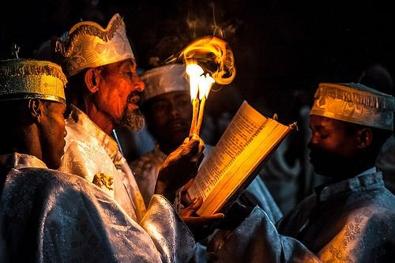
The Cross in Orthodox Dogma
Incarnation & Redemption:
Incarnation:
The cross testifies that Christ “tasted death on it,” proving He became human and possessed real flesh like ours.
This confirms The Creed—the belief that God became man.
Redemption:
His death on the cross was propitiatory, meaning it served as an atoning sacrifice for our sins, fulfilling the The creed.
Trinitarian Faith:
Making the sign of the Cross is a public declaration of faith in the Triune God: the Father, the Son, and the Holy Spirit.
This affirms the foundational Christian belief in “One God in three hypostases (persons) but of one essence (substance).”
Reconciliation:
Christ’s sacrifice on the Cross reconciles humanity to God by canceling our debts (our sins) and defeating sin.
He was hung between the sky and the earth to be the bridge back to God, stretching out His hands to receive us.
He even descended into Hades (the realm of the dead) to bring back Adam and his children, restoring Paradise.
Debt Cancellation – Scriptural Support:
Colossians 2:13–14 (King James Version):
Colossians 2:13: “And you, being dead in your sins and the uncircumcision of your flesh, hath he quickened together with him, having forgiven you all trespasses;”
Colossians 2:14: “Blotting out the handwriting of ordinances that was against us, which was contrary to us, and taking it out of the way, nailing it to his Cross.”

Slide 6
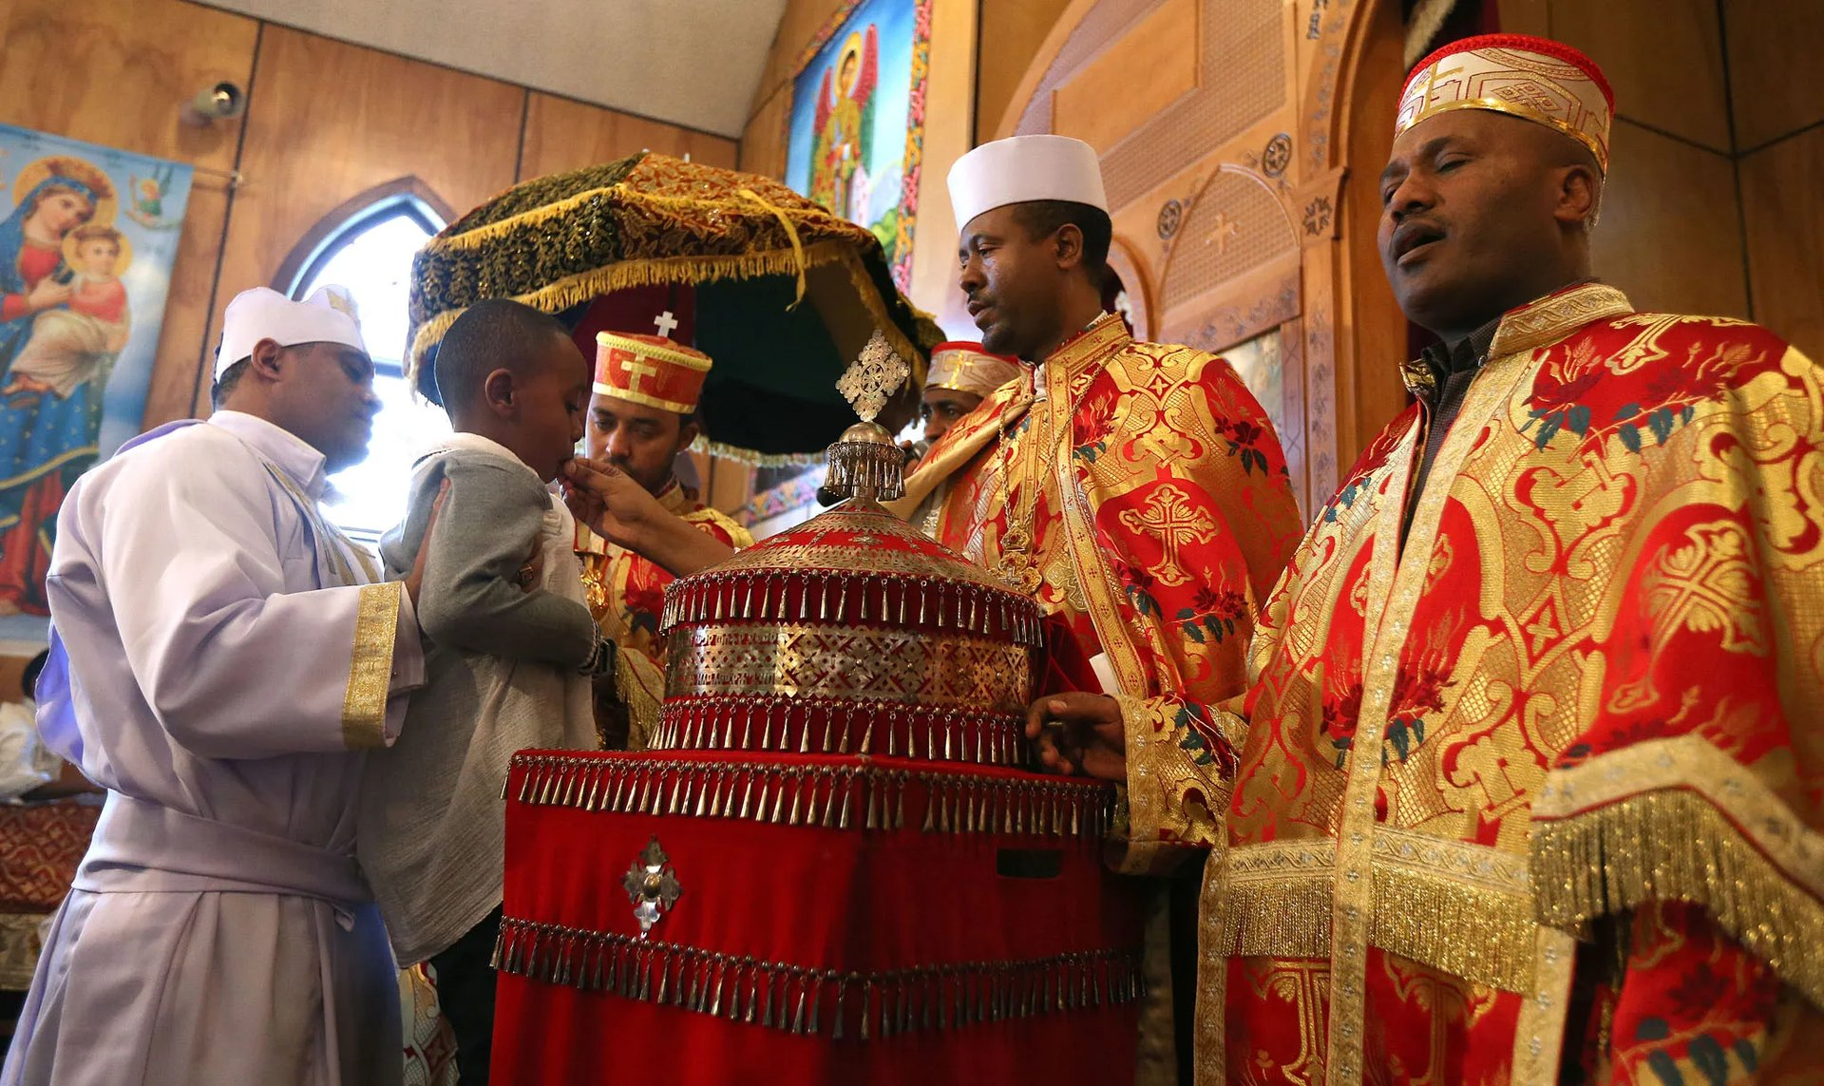
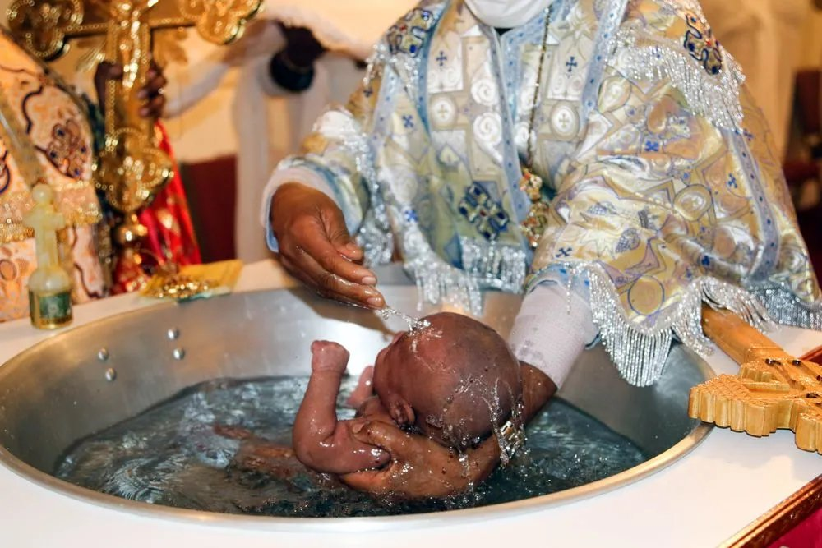
The Cross in Orthodox Sacraments
Baptism: • Water sanctified with the Cross (“Baptism is the Cross” – St. John Chrysostom) • Symbolizes dying to sin & rebirth in Christ
Chrismation: • Our bodies are anointed with 36 crosses by the priest, using holy oil.
Confession
• Cross on the head signals forgiveness
Holy Communion: • Communion presents the living body and blood of Christ
Unction of the Sick: • Oil is crossed 7 times (with 7 Gospel readings & 7 lit wicks) • Emphasizes divine perfection
Holy Orders: • through the power of the cross a male is ordained into the Holy Order of the church. Marriage: • Cross placed on the bride and groom • Marks a life of sacrificial love leading to the “Crown of Victory”

Slide 7
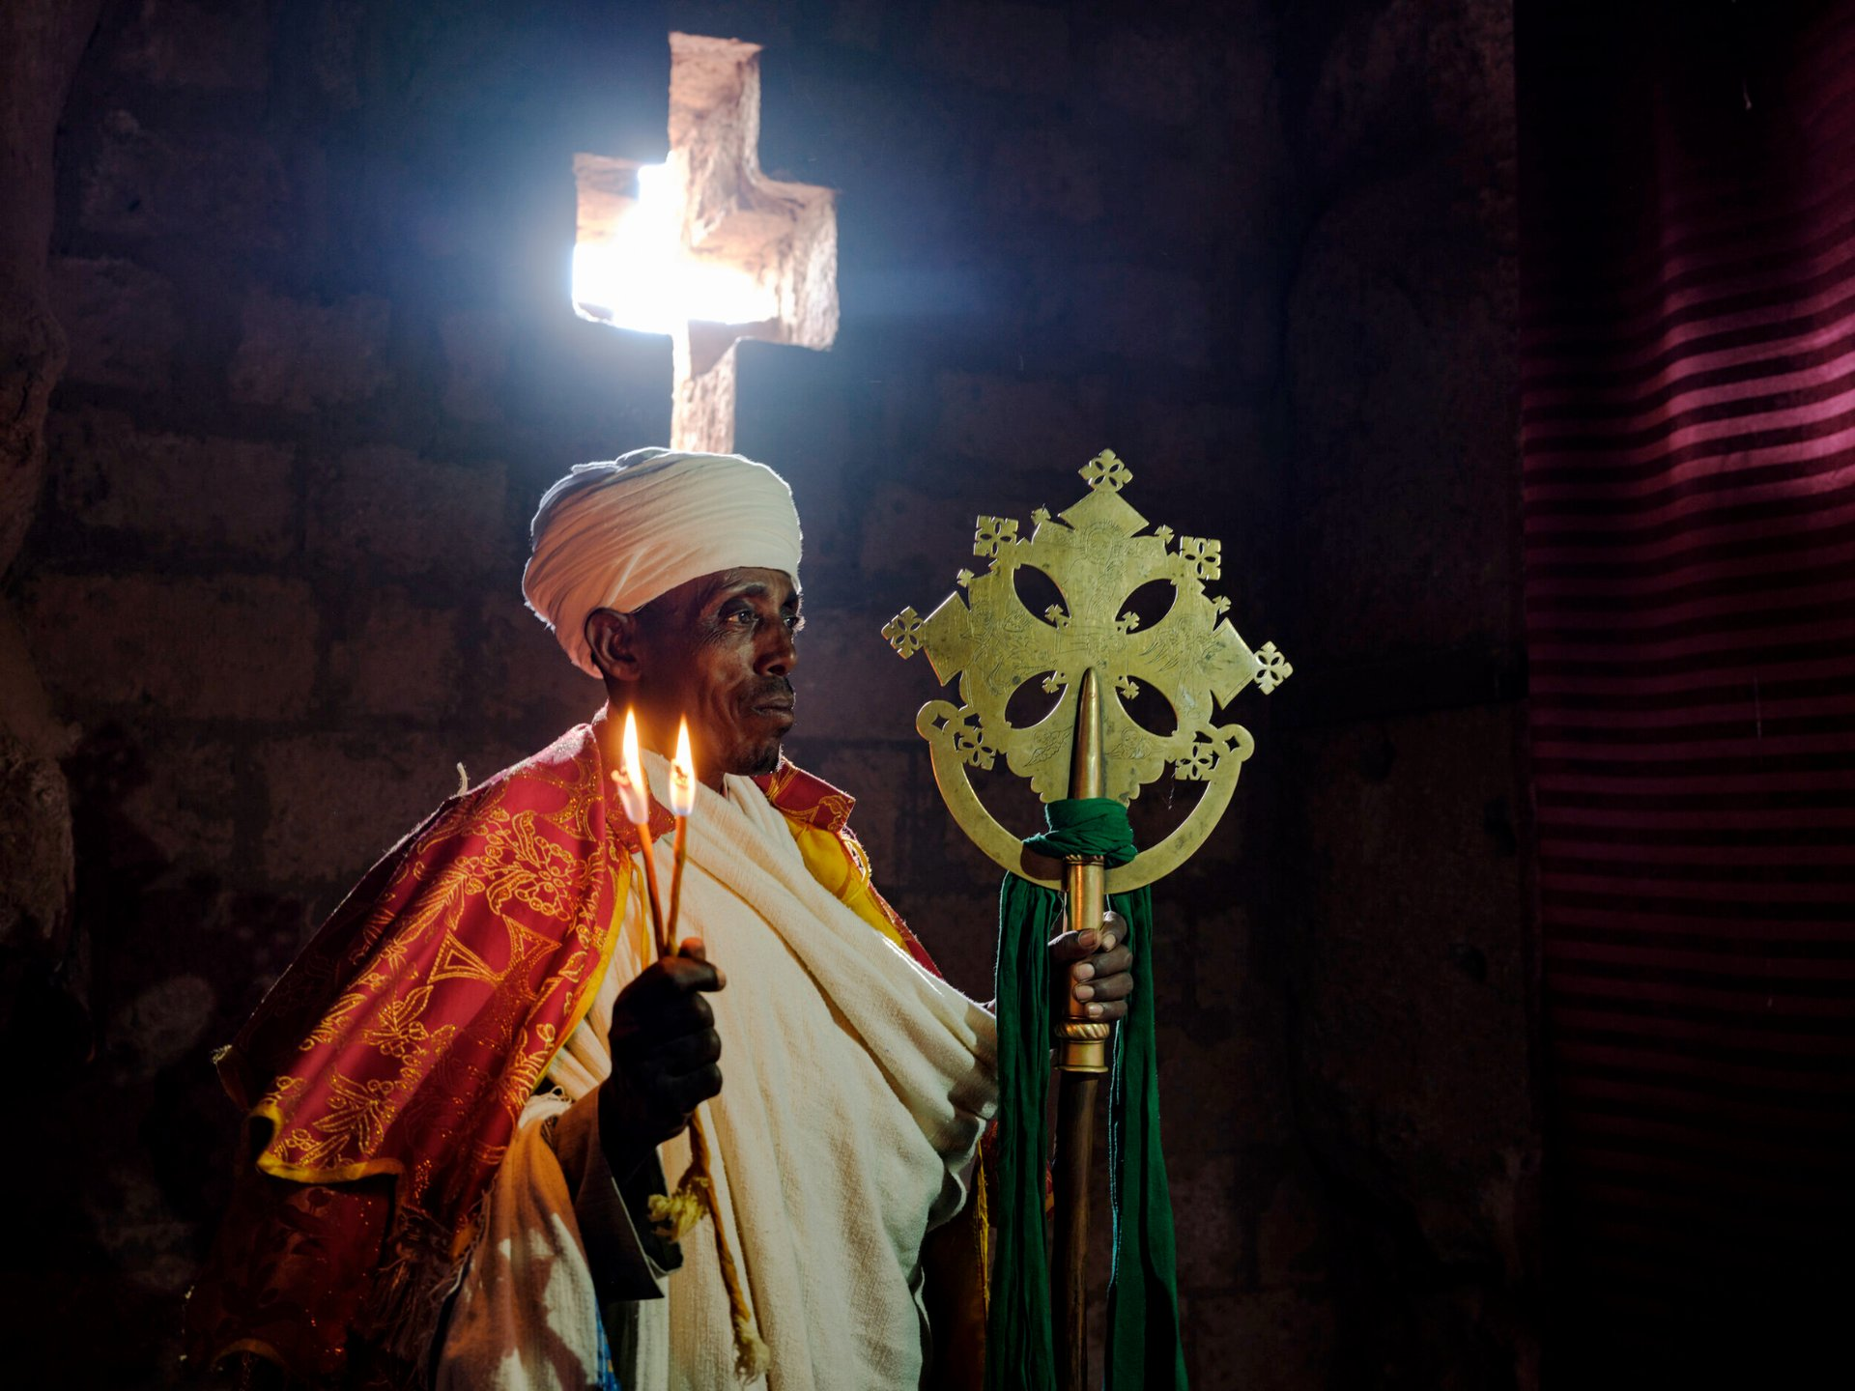
The Cross in Daily Life
Spiritual Protection:
Making the sign of the Cross is believed to drive away demons, reminding them of the Devil’s defeat at Golgotha.
Overcoming Sin:
It acts as a remedy for defiled lust and quenches the “flames” of sin, symbolically extinguishing its power.
Empowerment Through Prayer:
When we cross our foreheads, chests, or stretch our hands in the shape of the Cross, we symbolically free ourselves from the authority of death.
This gesture represents a journey deep into our soul through prayer, much like a bird spreading its wings to soar.
Triumph Over Temptation:
The Cross is also a sign of salvation and a tool for overcoming temptation.
Even the martyrs would “cross the cup” offered to them as a mark of their unyielding faith.
Symbol of Victory:
The Cross remains our pride, beauty, crown, weapon, and declaration of faith—a tangible reminder of the irresistible power of God.

Slide 8
Concluding Reflections
Key Points & Quotations:
“Through the Cross man can drive away all the deceits of the demons.”
Attributed to Athanasius the Apostolic.
“The martyr did not drink the cup before furrowing it with the sign of the Cross which is the sign of salvation.”
Attributed to Theodore (the Historian).
“Our salvation is confirmed when we partake in the sacraments and their symbols. One of these symbols is the sign of the Cross.”
Attributed to St. Gregory of Nyssa.
Message:
These reflections underscore that the Cross is not just an external symbol but the very means of our salvation.
It is integral to our spiritual journey—driving away evil, affirming our faith, and assuring us of God’s everlasting grace.

