Slide 1
Love and Forgiveness: The Transforming Cycle of Grace
By Dn Yonnas

Slide 2
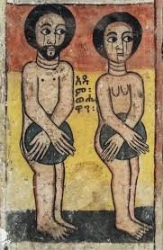
The Original Sin and God's Profound Hurt
When Adam and Eve sinned, God was not just upset—He was hurt.
Adam and Eve are His children (created in His image).
He desired companionship and union with them.
The Fall of Adam and Eve was a spiritual separation, grieving the heart of a loving Father who desired companionship.
In Genesis 3, notice the shame:
They hide.
They blame.
Genesis 3:9:
“Then the LORD God called to Adam and said to him, ‘Where are you?’”

Slide 3
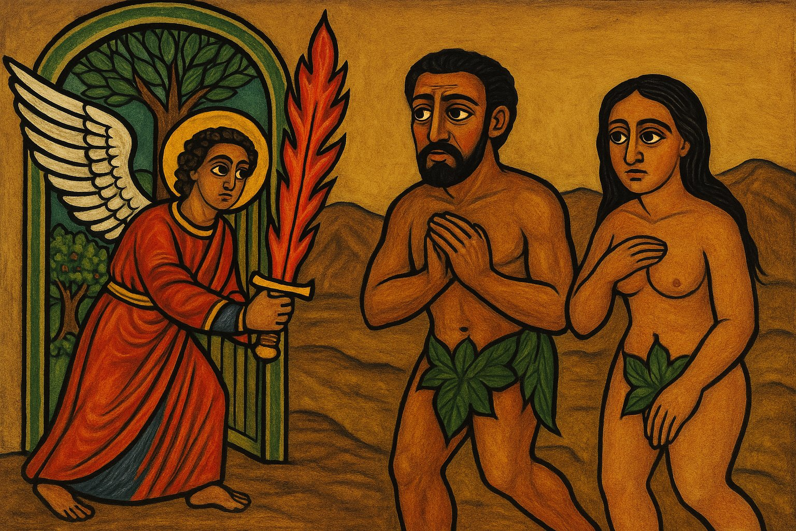
The dilemma: How can the unholy live with God?
A profound dilemma was formed:
God is perfectly Holy Humanity became unholy.
The Question: How can the unholy live in God's presence ?
Genesis 3:23–24
“Therefore the LORD God sent him out of the garden of Eden… So He drove out the man; and He placed cherubim… and a flaming sword… to guard the way to the tree of life.”

Slide 4
A Plan From The Beginning
Punishment was justly handed down. Communion was broken, and Adam and Eve were exiled from the Garden.
But in the same moment of judgment, God’s profound love provided a path to salvation.
He did not abandon His children. He did not want to throw us away. He had a plan for us to come back to Him.
The 5,500-Year Prophecy (The Deferral of Life)
"O Adam, as to the fruit on the Tree of Life that you have asked for, I will not give it to you now, but only when the 5500 years are fulfilled. At that time I will give you fruit from the Tree of Life, and you will eat, and live forever, you, and Eve, and your righteous descendants.”- The First Book of Adam and Eve 38:2
Foreshadowing In Genesis:
"And I will put enmity between you and the woman, and between your seed and her Seed; He shall bruise your head, and you shall bruise His heel." - Genesis 3:15

Slide 5
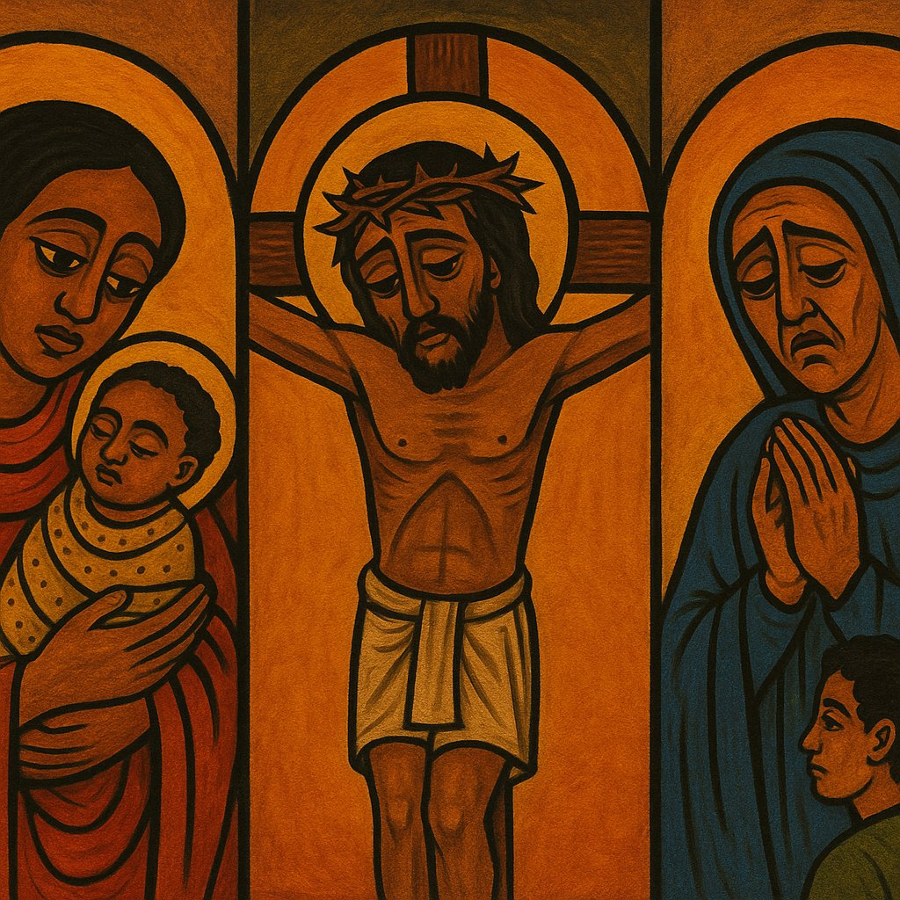
Love x Suffering
Love is constant, not conditional. Therefore love inevitably carries pain.
The Mother Analogy: Does a mother not suffer in childbirth, raising, and worrying over her child? She does not see this as suffering, but as love.
Love is not just a feeling - Love is a choice, a decision, a way of doing and living for ourselves, but also for others.
Verse:
"Greater love has no one than this, than to lay down one’s life for his friends." - John 15:13
The greatest Form of Love is Sacrificial.

Slide 6
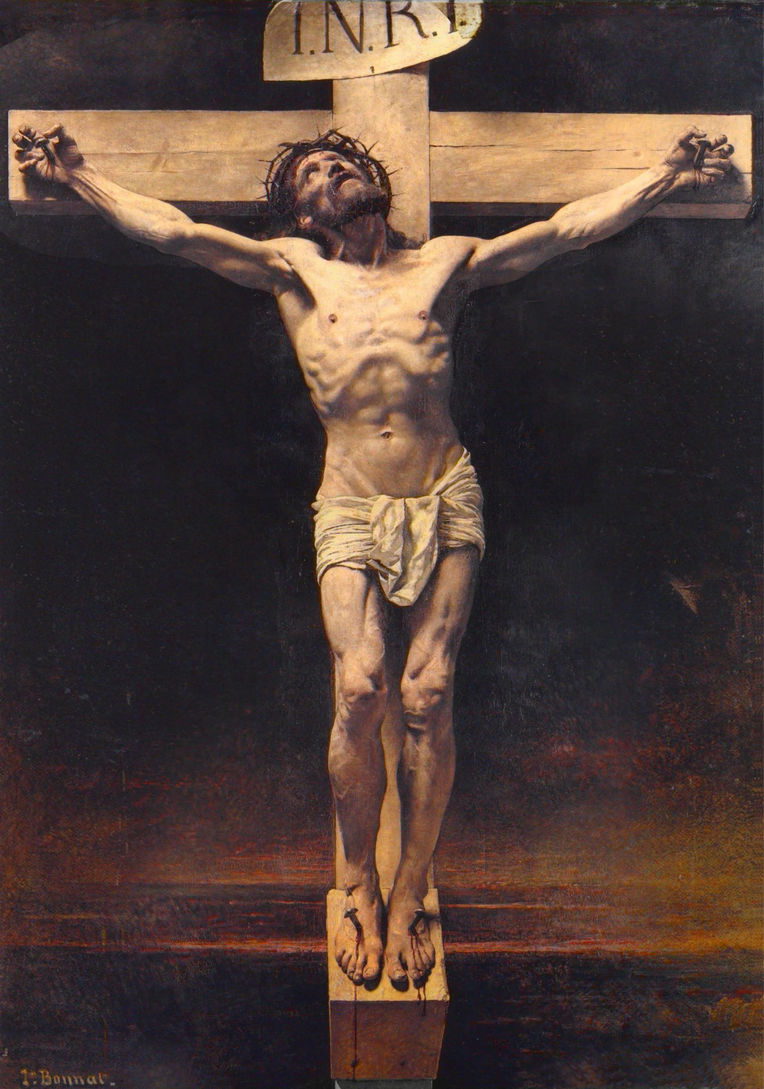
The Ultimate Expression of Love
God's Great Sacrifice
God's love is so immense that He gave His only begotten Son.
This was His solution to the Dilemma.
He did this for us "even when we were in the wrong, even when we did not deserve it."
Verse:
"For God so loved the world that He gave His only begotten Son, that whoever believes in Him should not perish but have everlasting life." - John 3:16

Slide 7
The Cost of Our Forgiveness
This was not a simple act. The cost of our sin was paid by Christ in every conceivable way—spiritually, psychologically, and physically—to redeem humanity.
1. The Spiritual Agony (Gethsemane)
The suffering began before the physical torture. Christ took upon Himself the full weight, horror, and filth of every sin committed.
Anguish: The anguish was so profound that His body reacted with Hematidrosis—sweating "great drops of blood." - 2 Corinthians 5:21
2. The Physical Torture (The Praetorium)
The goal of the Roman scourging was to bring the victim to the point of death.
The Scourging: He was beaten with the Roman flagrum (a whip with bone and metal).
Beatings and Slaps: He endured countless slaps and beatings from the temple guards and Roman soldiers, often focused on His face and head.
The Public Humiliation (Golgotha)
The Crowning: A thick "crown" of sharp thorns was pressed into His scalp, mocking His Kingship and inflicting continuous pain.
Humiliation: He was stripped naked, mocked, and forced to carry the cross. Crucifixion was the ultimate death of shame, reserved for traitors and the worst criminals. The Death: He was pierced with nails, suffering hours of agonizing asphyxiation, having to push up on the nails just to breathe.
Verse:
"But He was wounded for our transgressions, He was bruised for our iniquities; the chastisement for our peace was upon Him, and by His stripes we are healed." - Isaiah 53:5

Slide 8
Too Much To Ask?
God asks us to love Him and love others. This dual love is the central requirement of the Christian life.
Question for Reflection: Having seen the depths of His love, is love too much to ask?
Verse:
"Jesus said to him, ‘You shall love the Lord your God with all your heart, and with all your soul, and with all your mind.’ This is the first and great commandment. And the second is like it: ‘You shall love your neighbor as yourself.’" - Matthew 22:37-39
Our "suffering" is the daily, necessary process of dying to self—crucifying the flesh and resisting the desires that keep us separated from God.
Question for Reflection: Can the suffering of trying to abstain from sin be equated to His suffering?
Denying our pride, our anger, and our worldly desires.
Fasting, Prayer, Early Liturgy
This struggle is our necessary participation in the principle of His great love. It is the cost of becoming God-like (Theosis).
Verse:
"I have been crucified with Christ; it is no longer I who live, but Christ lives in me..."- Galatians 2:20

Slide 9
Forgiveness
The Prerequisite for Grace
Before you ask God to forgive you, make sure you have forgiven your neighbor.
How can you ask God for forgiveness and not forgive others?
Our ability to receive God's mercy is directly tied to our willingness to give mercy.
Verse:
"For if you forgive men their trespasses, your heavenly Father will also forgive you. But if you do not forgive men their trespasses, neither will your Father forgive your trespasses." - Matthew 6:14-15

Slide 10
The Goal: A Transformed Life
Theosis: Becoming God-like
The goal is not just to be forgiven, but to be transformed.
We must Learn God's nature, Experience it, and Emulate it.
This is how His love has a profound impact on our lives.
Love Embodies:
Sympathy
Forgiveness
Understanding
Patience
Fair Judgement
Verse:
"Beloved, let us love one another, for love is of God; and everyone who loves is born of God and knows God." - 1 John 4:7
"Love suffers long and is kind; love does not envy; love does not parade itself, is not puffed up; does not behave rudely, does not seek its own, is not provoked, thinks no evil; does not rejoice in iniquity, but rejoices in the truth; bears all things, believes all things, hopes all things, endures all things. Love never fails." - 1 Corinthians 13:4-8

