Slide 1
The Life Of Saint Tekle Haimanot
By Dn Yonnas

Slide 2
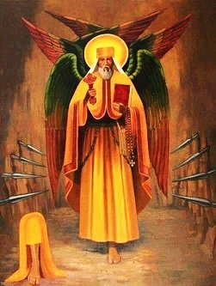
Saint Teklehaimanot: The Six-Winged Pillar of Faith
Name & Meaning: Tekle Haymanot ("Plant of Faith"). His Gädlä (life story) elaborates this as "Plant of the Father, the Son, and the Holy Spirit."
Identity: Monk, Hermit, Missionary, and Founder of Debre Libanos Monastery (Shewa).
Origin: Born in Zorare (Bulga, Shewa) to the priest Tsega Ze’ab ("Grace of God") and Egzi’e Haraya ("Choice of God," also called Sarah).
Veneration: Feast day is August 30 (Gregorian) / Nehase 24 (Ethiopian). Veneration is official in Rome and Egypt (Coptic Church).
Iconography: Depicted with six wings (Seraphic grace) and standing on one leg (a sign of unceasing, sacrificial prayer).

Slide 3
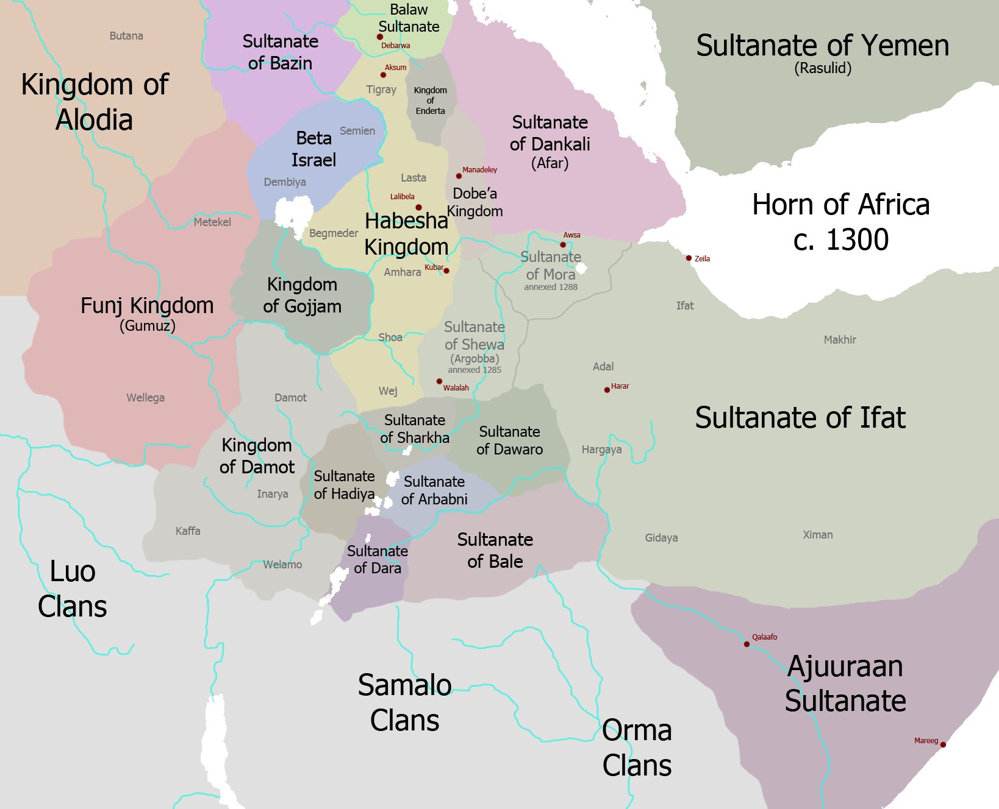
The State of Ethiopia in the 13th Century
The Land: Ethiopia's central and southern provinces (like Shewa, where he was born).
The Political Climate: A period of instability following the Zagwe Dynasty.
The Spiritual Climate:
Christianity, while strong in the North, had weakened in the South.
Syncretism: Many people mixed Christian beliefs with local pagan rituals and spirit worship.
Isolation: Priests were few, and monastic centers of learning were far away.
A need for re-evangelization from within.

Slide 4
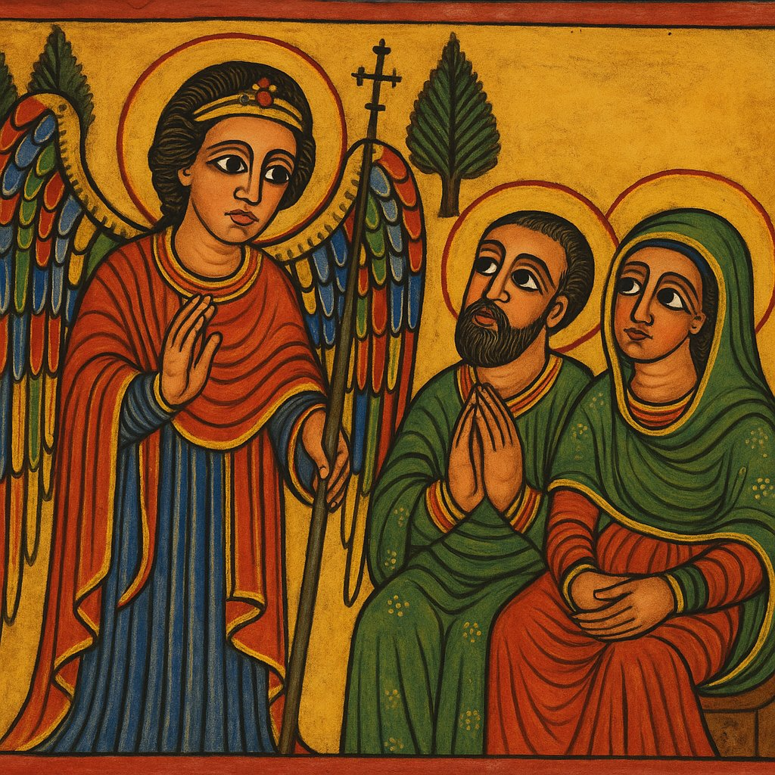
Childhood: A Child of Prophecy and Early Grace
Father: Priest Tsega Ze’ab ("Grace of God").
Mother: Egzi’e Haraya ("Choice of God," also known as Sarah).
The Trial: A righteous, wealthy, and devout couple who were barren (childless) for many years.
The Vow: They prayed constantly, fasted, and gave alms, pledging their firstborn child to the service of God.
The Promise: The Archangel Michael appeared to them, announcing they would bear a son who would "renew the faith of Ethiopia" and be a light to the nation.

Slide 5
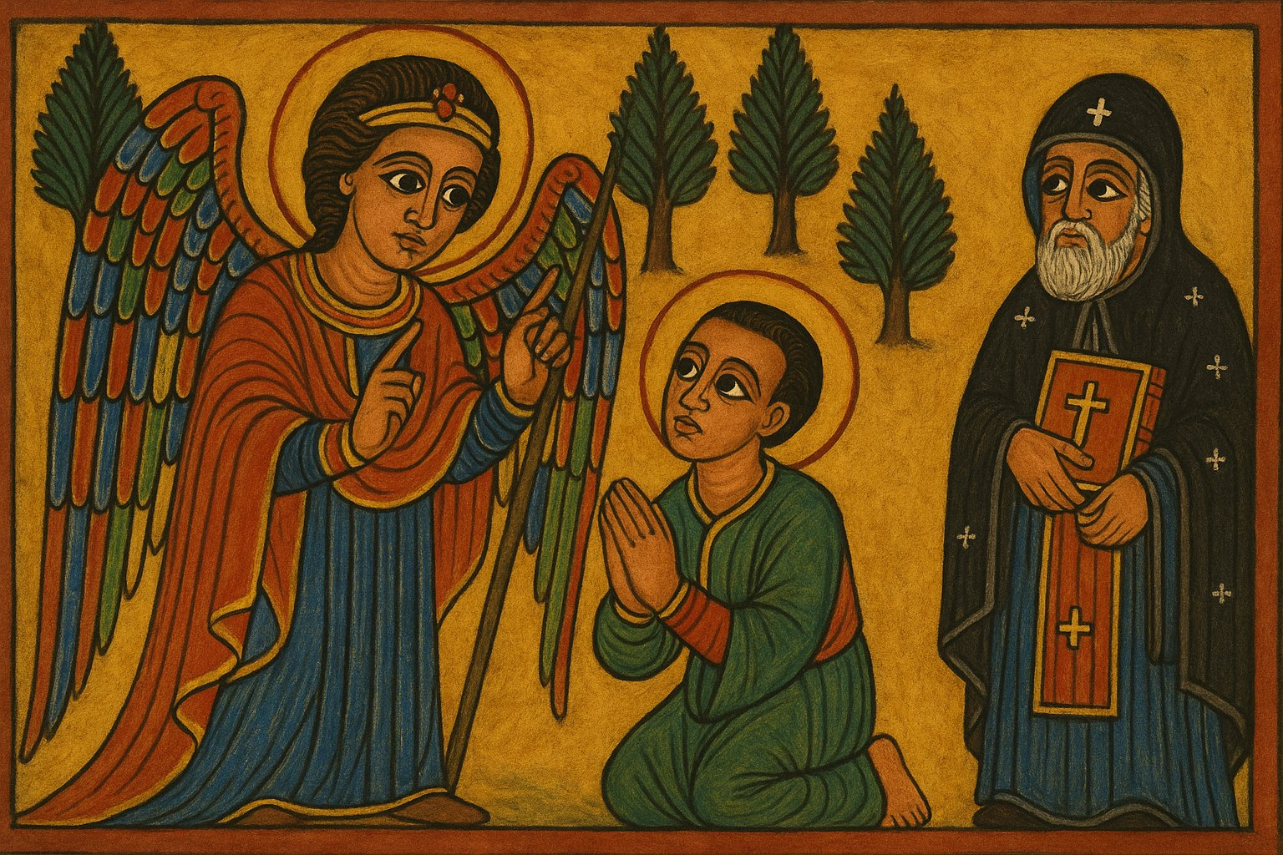
Formation & Monastic Training
The Divine Call: While he was a young deacon, the Archangel Michael appeared to him in the forest.
The Command (The "What"): The angel gave him a direct and specific command:
He was to renounce the world entirely.
He must give up the marriage his parents had arranged for him.
He was to dedicate his entire life to "saving souls" and preaching the Gospel.
The New Name: It was at this moment that the angel gave him his new, prophetic name: Tekle Haymanot ("Plant of Faith").
Ordination: Following this call, the Archangel directed him to go to the Coptic Bishop, Abuna Kirollos (Cyril) of Alexandria, who was visiting the region. Recognizing the divine grace in him, the bishop ordained him as a priest.
Monastic Training (The Two Streams):
Lake Hayq (Istefanos Monastery): Studied under Abba Iyasus Mo’a, learning the communal (cenobitic) life, theology, and chant.
Debre Damo: Traveled to the legendary clifftop monastery of Abba Aragawi to learn the severe, solitary (hermit) life of asceticism.

Slide 6
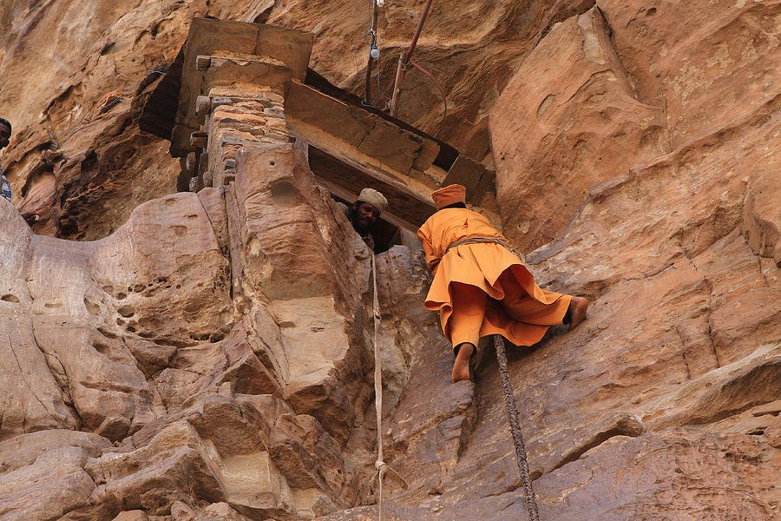
The Miracle of the Six Wings
The Command: After nine years at Debre Damo, an angel commanded him to descend and begin his mission to the South.
The Descent: The monks began to lower him by rope from the sheer cliff (the only way down).
The Miracle: Halfway down, the rope snapped. (His Gädlä says Satan, enraged at his obedience, cut the rope).
As he fell, six brilliant wings burst from his back, and he flew safely to the ground.
The Meaning: This was his "ordination by heaven." It was the divine seal of approval, confirming his apostolic mission and identifying him with the Seraphim.
Symbol of divine grace and angelic zeal; each wing represents Faith, Hope, Charity, Obedience, Purity, Humility

Slide 7
The Great Mission: Evangelizing Damot
The Mission Field & Initial Contact: Guided by the Holy Spirit, St. Teklehaimanot entered the pagan kingdom of Damot. He first made contact with the Prince (the chief noble/heir).
The First Miracle: The saint demonstrated the power of Christ by casting out a demon and healing the Prince from a grave affliction, leading to the Prince's immediate conversion and baptism.
The King's Fury: The King, Motolomi, was furious that his heir and court had converted, seeing it as a collapse of his religious and political authority, which relied on the worship of a great serpent idol (zedo).
Confrontation & Divine Protection: Motolomi escalated the conflict, sending an army to kill both the saint and the converted Prince.
The soldiers' spears, thrown at the saint, stopped in mid-air.
Motolomi threw his own spear, which reversed direction and killed his horse (a symbol of his earthly power), mercifully sparing his life.
The Final Signs: The saint cursed the serpent idol, which died, and then prayed, causing rain to immediately fall during the severe drought.
Total Conversion: Humbled by these acts of judgment and mercy, King Motolomi, the Prince, and the entire populace repented, were baptized, and consecrated their land to Christ.

Slide 8
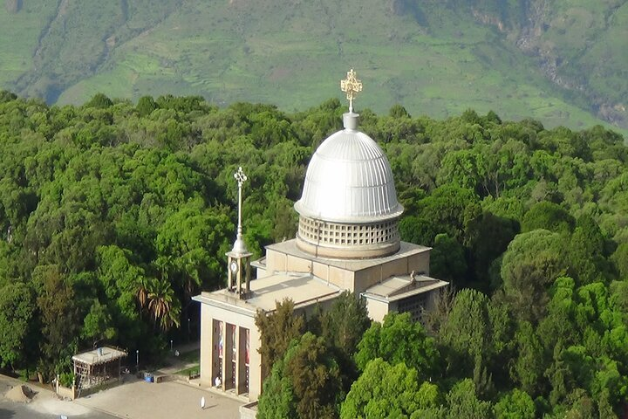
Founding Debre Libanos (1284)
The Foundation (c. 1284): After his mission, he founded the monastery of Debre Libanos ("Mount of Lebanon") in Shewa.
The Spiritual Capital: This monastery grew to become the single most important spiritual center in all of Ethiopia.
The Ichege: He established the office of the Ichege, the Abbot of Debre Libanos.
National Importance:
The Ichege became the highest-ranking native-born Church official in Ethiopia (second only to the Coptic Abuna).
This gave the Ethiopian Church administrative stability and a unified, internal leadership for the first time.
Debre Libanos became the "mother monastery" for hundreds of other monasteries across the nation.

Slide 9
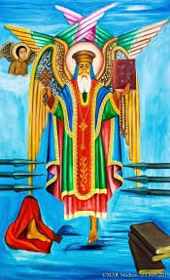
Seven Years on One Leg: The Triumph of Spirit Over Flesh
The Final Vow: In his old age, he devoted himself to unceasing prayer, vowing to stand for the rest of his life.
The Vigil: He stood in prayer day and night, without sitting or lying down, for seven years.
The Cost: From this unceasing vigil, his leg decayed from fatigue and broke off.
The Final Act: He continued his prayer, standing on the one remaining leg for the rest of his life.
Theological Meaning: The ultimate symbol of endurance, sacrificing his body as a "living sacrifice" (Romans 12:1).

Slide 10
Summary: The Apostle, The Founder, The Pillar
Why is he important to the Orthodox Church?
He is a model of both apostolic mission (the six wings) and ascetic devotion (the one leg).
He connects the scholarly life (Hayq) with the ascetic life (Damo) and the official Church (Alexandria).
Why is he a special saint for Ethiopia?
The Apostle of the South: He re-Christianized half the nation.
The Great Unifier: He founded Debre Libanos and the office of the Ichege, giving the Ethiopian Church its own national leadership.
The National Icon: He is the ultimate model of Ethiopian piety, endurance, and sacrificial faith.
Final Lesson: He shows us that true faith is a "plant"—it must be nurtured (formation), spread (mission), and rooted in total sacrifice (endurance). Embodiment Of Theosis.

Slide 11
QUESTIONS

Slide 12
Cited Sources
ia803401.us.archive.org/25/items/bookofsaintsofet0001unse/bookofsaintsofet0001unse.pdf
https://archive.org/details/bookofsaintsofet0001unse/page/256/mode/2up
https://copticcrew.com/pages/st-takla-haymanot
www.teklehaimanot.org/saint-teklehaimanot/
https://en.wikipedia.org/wiki/Tekle_Haymanot

